Slide 1
Massmine for the Masses
Joshua Moore, Logan Hornbuckle, Patricia Tanzer, Morgan McIntyre
Notes:
Patti will present this slide.

Slide 2
What is MassMine?
MassMine is a command line tool designed for researchers to simplify the collection and use of data from online sources such as social media networks.
www.massmine.org
Notes:
Josh will present this slide.

Slide 3
What is MassMine for the Masses?
A web application that…
Facilitates using the MassMine tool for researchers
Provides an analysis feature without user having to interact with command line
Saves prior studies and analyses
Allows studies of big data
Notes:
Mention how MassMine is not user friendly for non-tech savvy researchers.
Josh will present this slide.

Slide 4
Domain and Intended Users
MassMine for the masses will be used by…
Researchers interested in gathering data from Twitter
Universities that want to host and implement their own version of the application
Notes:
Mention that we wanted to implement this project in a way that other universities could host this application with ease.
Morgan will present this slide

Slide 5
Implementation
MassMine for the Masses will be implemented via…
Django interface
Mongo DB databases
A host linux server via the UNCG library
Notes:
Mention our design choices and why we chose them
Morgan will present this slide.

Slide 6
Security
MassMine for the masses will implement the following security measures…
At-rest encryption of user authorization keys, usernames, and Twitter data
Passwords will be salted and hashed
The site will be be accessed via an https page
Built-in security features within the Django framework used to prevent
Cross site scripting
Cross site request forgery
Additional measures to prevent:
Injection attacks (input validation)
Notes:
Patti will present this slide.

Slide 7
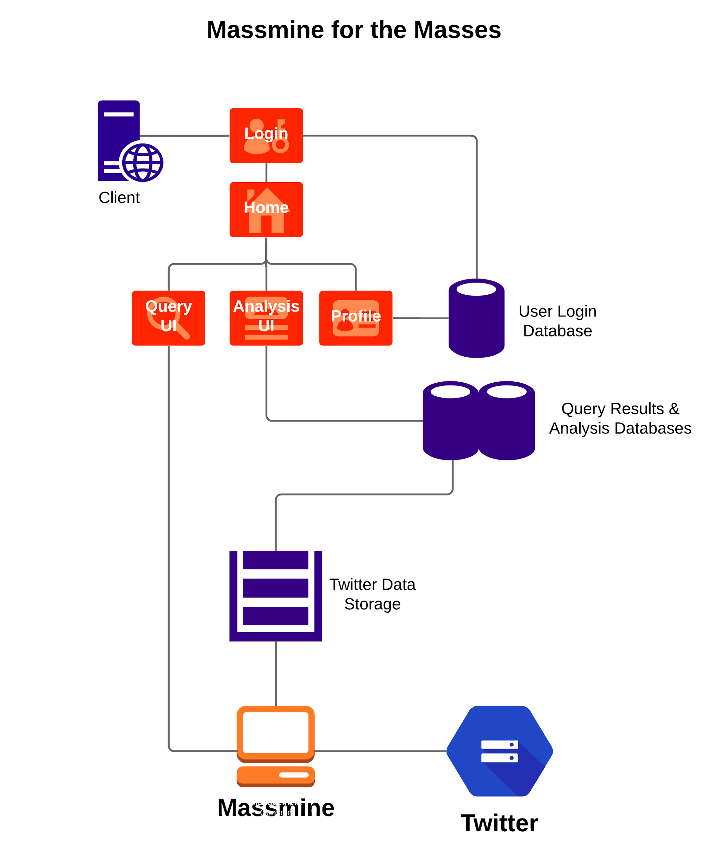
Overview
4 user interfaces:
Login
User profile
Query
Analysis
3 databases:
User information
Analysis formulas
Tweets
Host server
Multiple instances of Massmine
Notes:
Logan will present this slide.

Slide 8
Tools used
Github: https://github.com/JoshCMoore/Massmine-for-the-Masses
Massmine: https://www.massmine.org/
MongoDB: https://www.mongodb.com/
Django: https://www.djangoproject.com/
Notes:
Logan will present this slide.

