Slide 1
Massmine for the Masses
Joshua Moore, Logan Hornbuckle, Patricia Tanzer, Morgan McIntyre

Slide 2
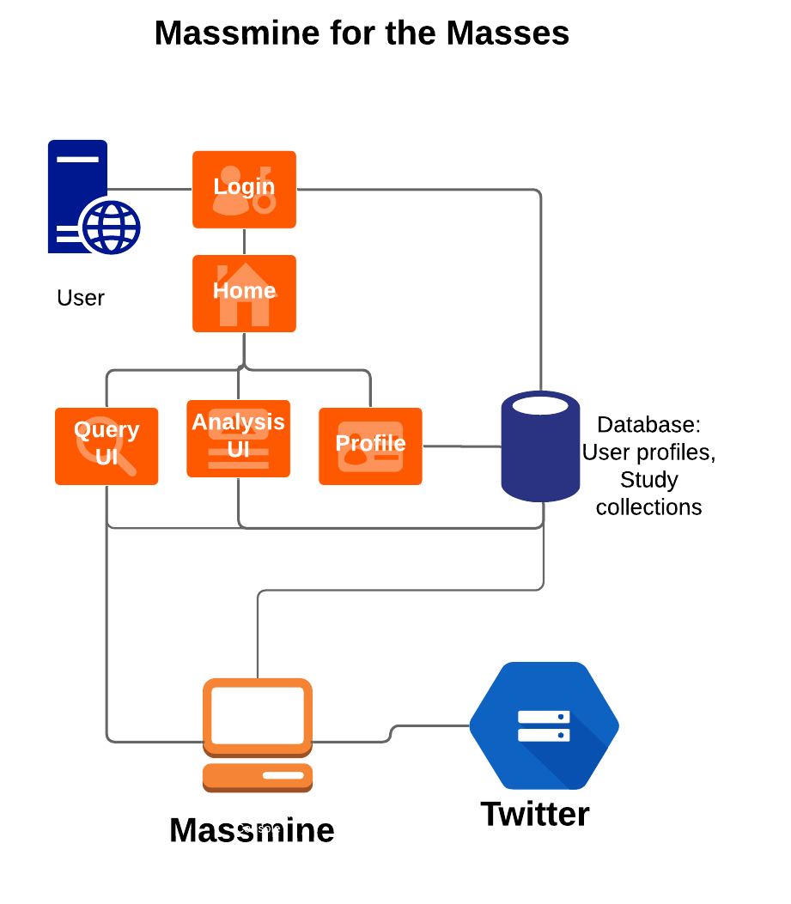
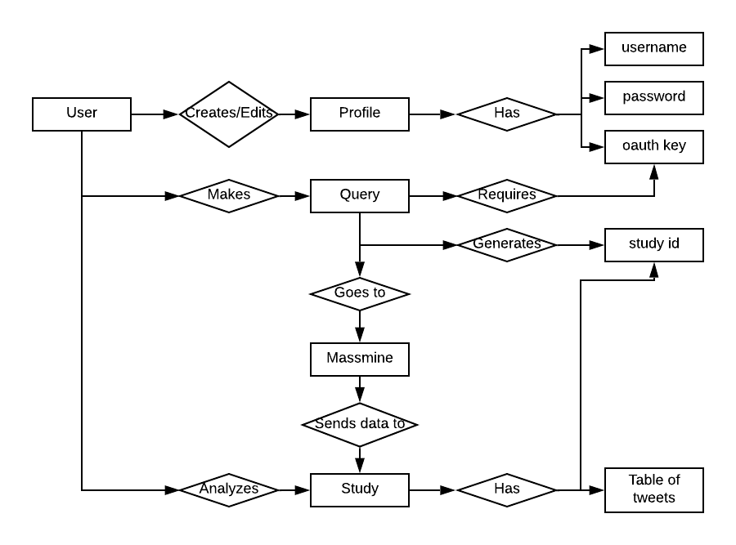
Updating old documentation models
System ERM System Overview

Slide 3

Encryption...
Trying to avoid having encryption key on github & docker image
Workaround may be possible, but key sits right next to database...

Slide 4
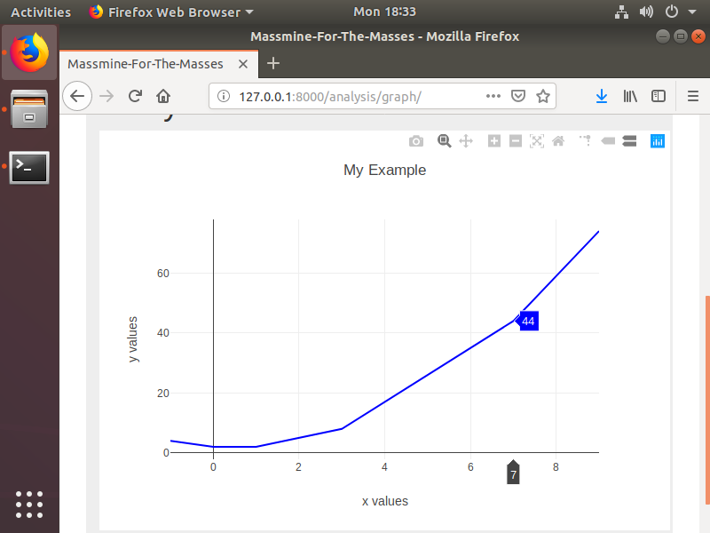
Learning to play with plotly
What is ‘cufflinks’ and why is it necessary?

Slide 5
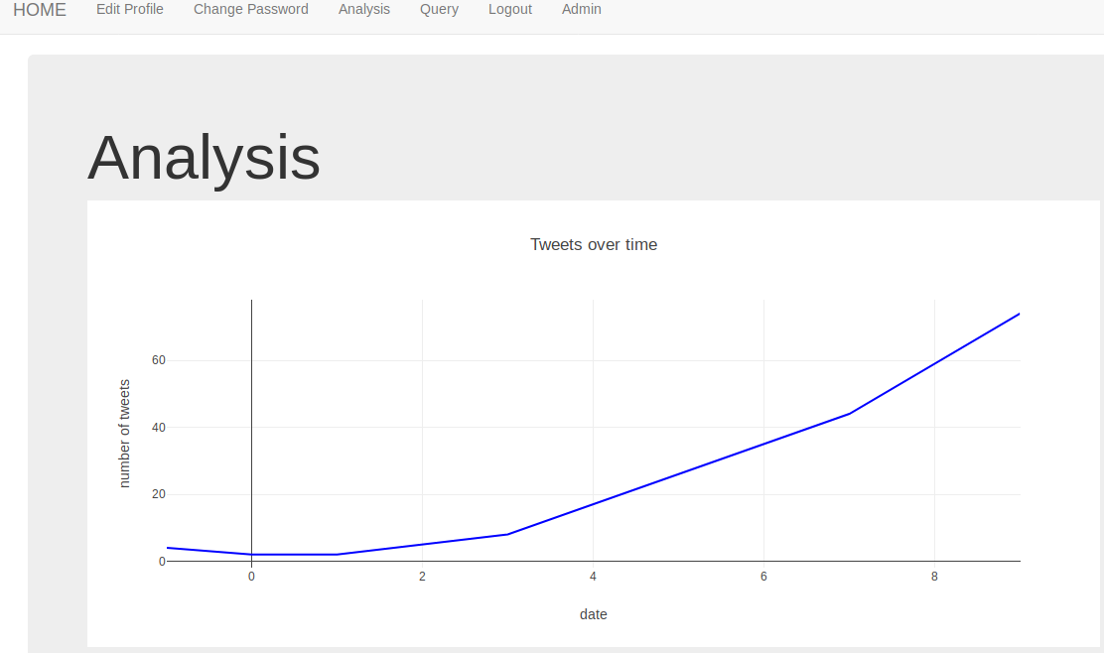
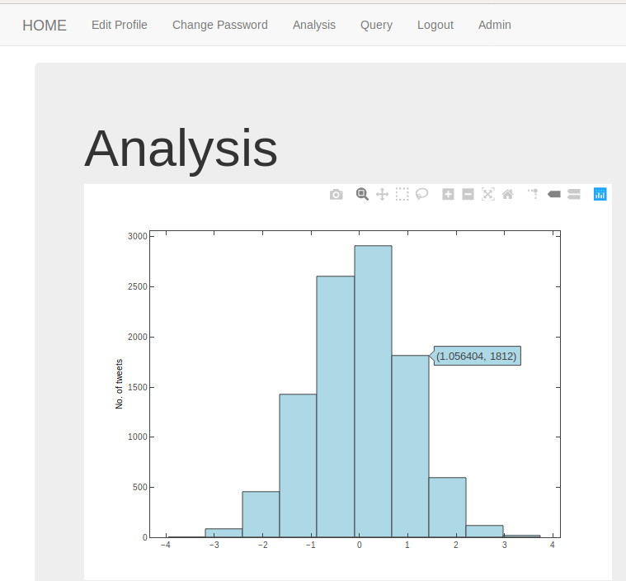
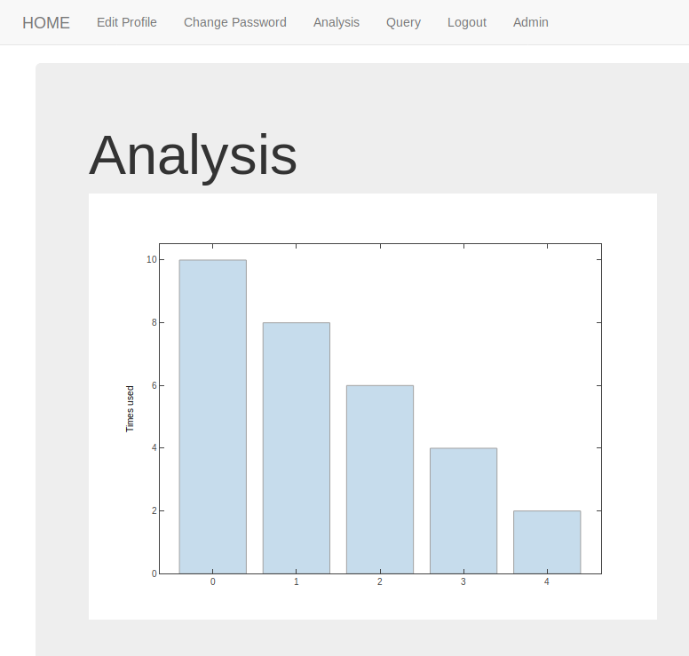
New Analysis graphs!

Slide 6

Query updates

Slide 7
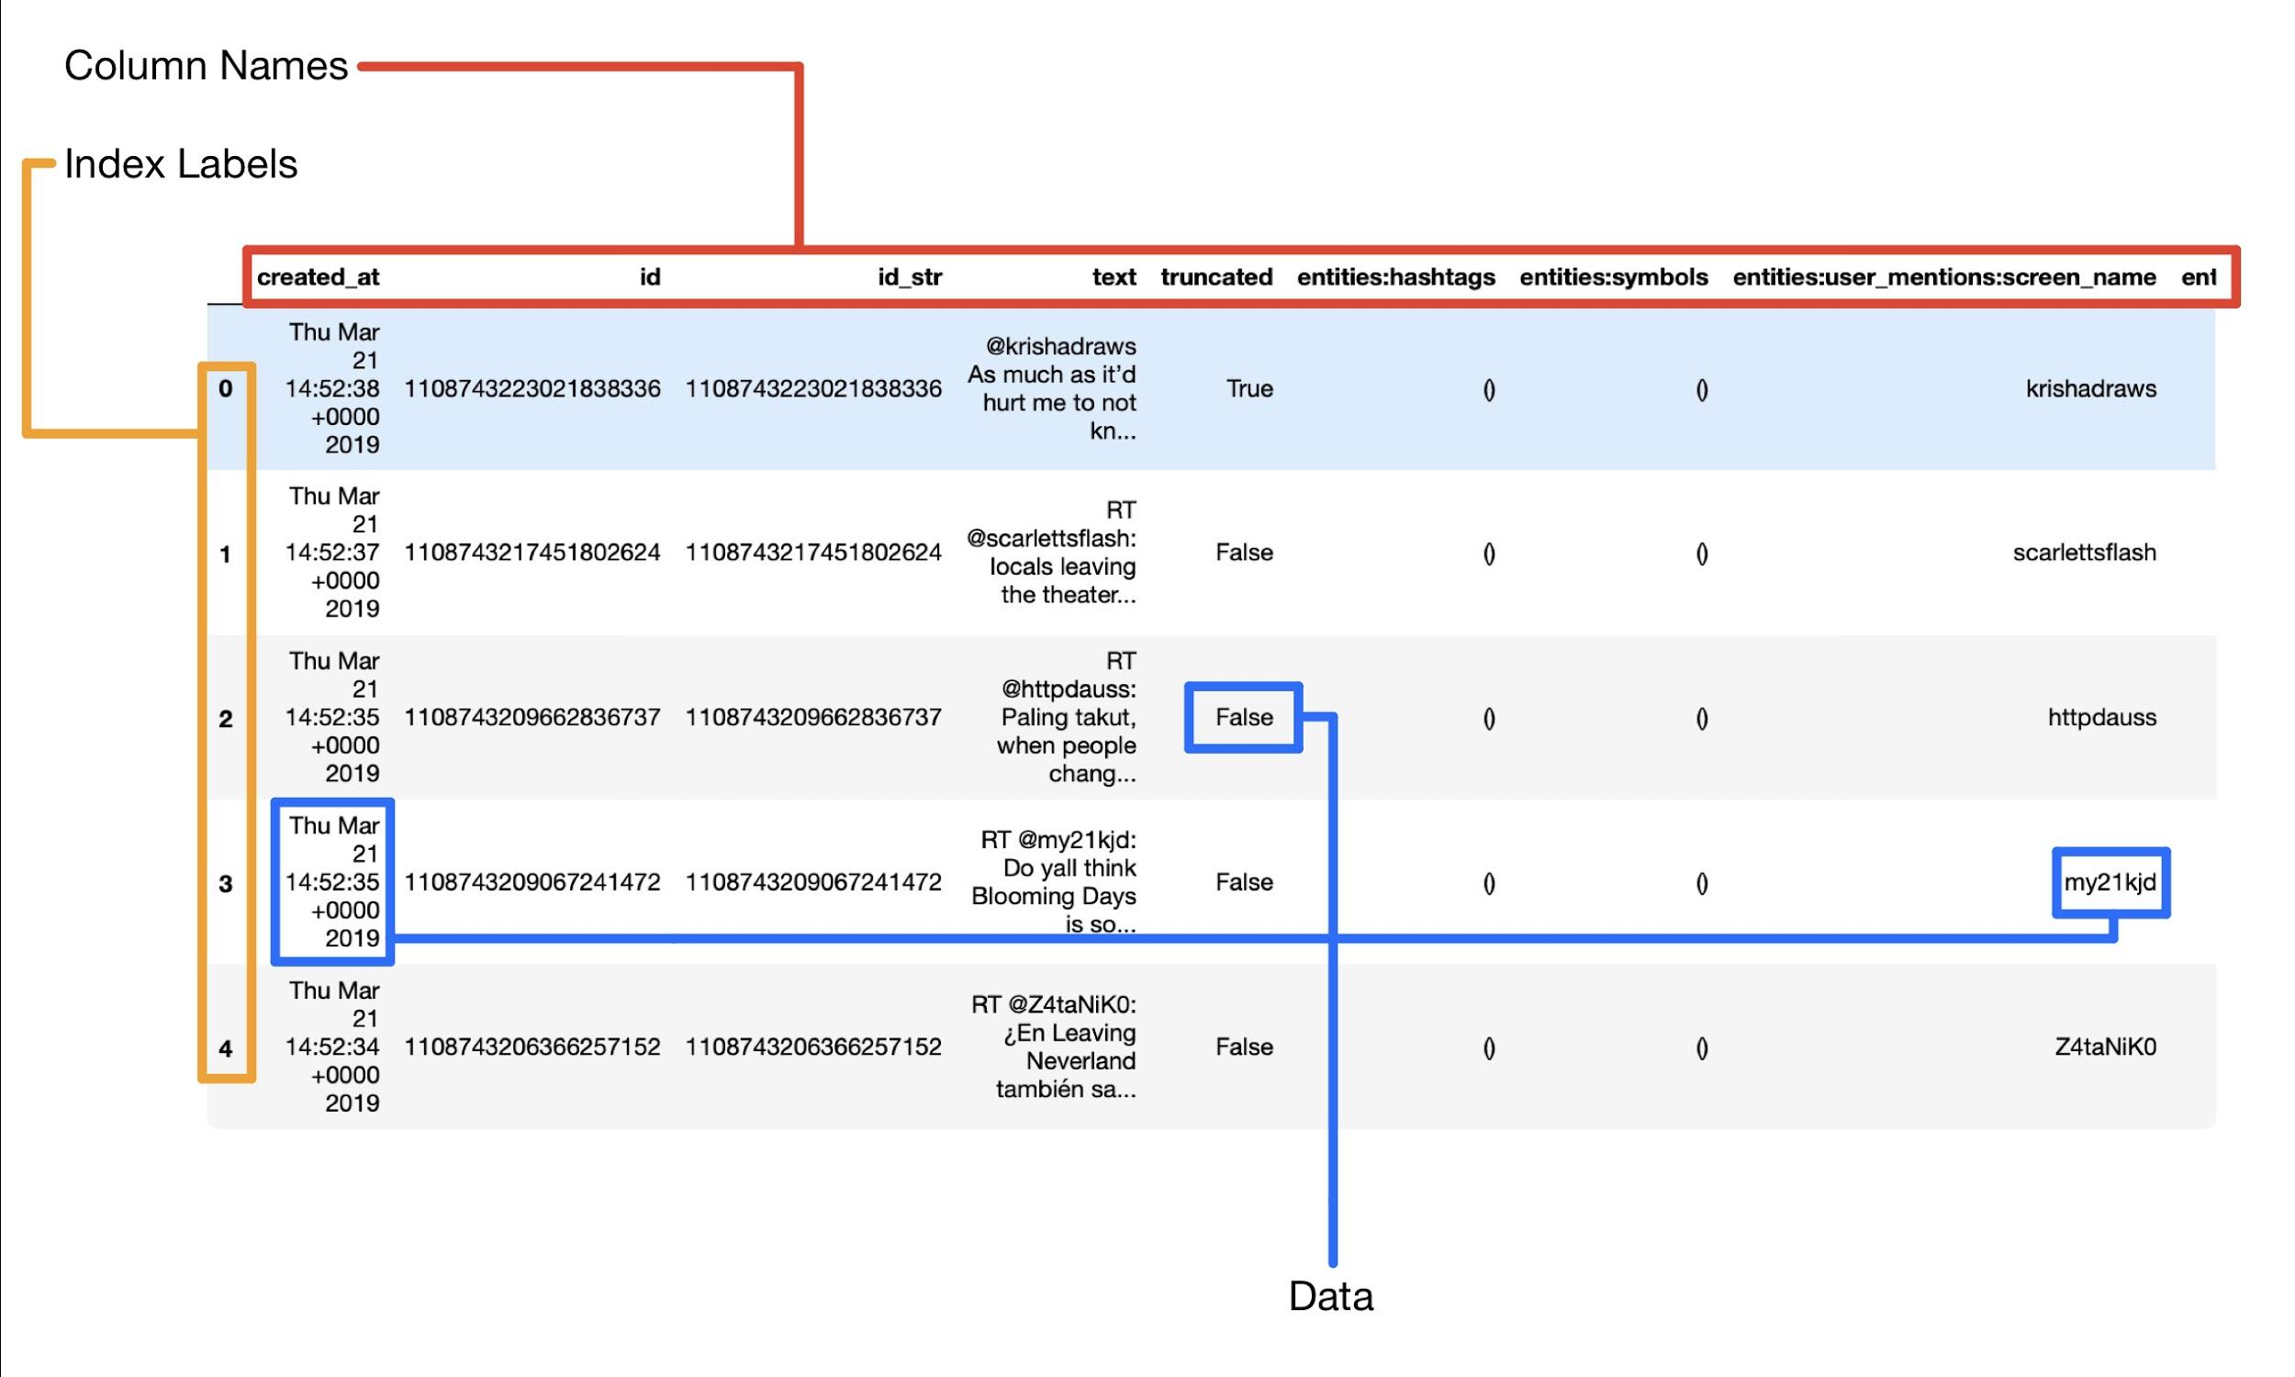
Using Pandas DataFrame

Slide 8
Query Page Progress Update:
Working:
SQLite DB connected to Query Page
New Query -> Table Creation
Not Working:
Difficulties Storing Tweet Data

Slide 9
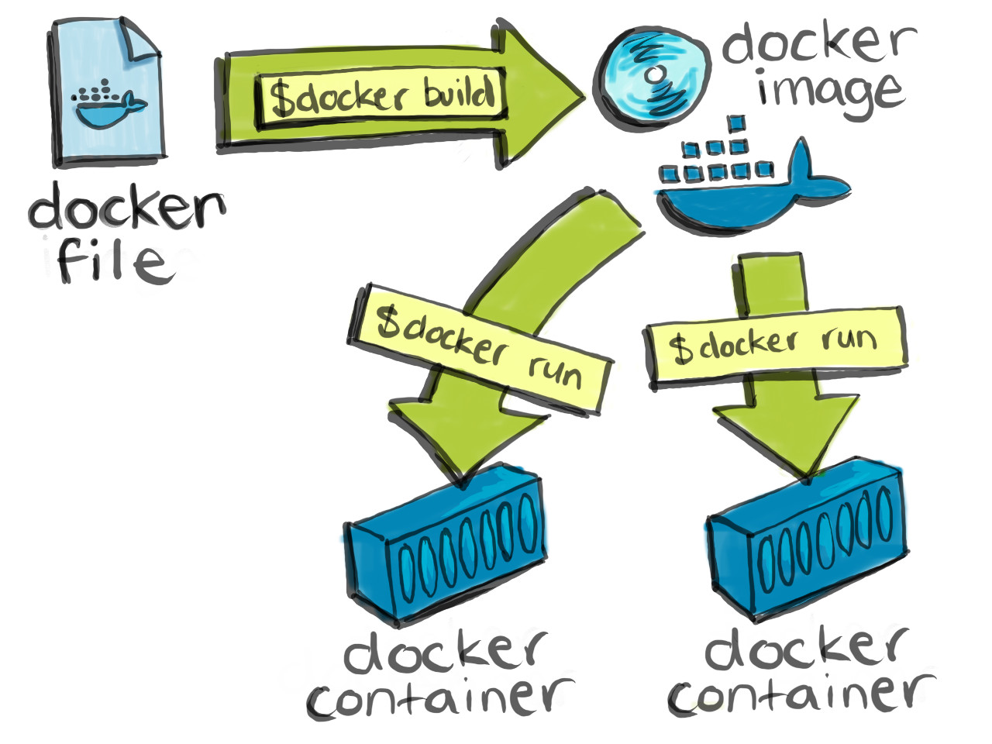
We’ve gone public!
https://github.com/JoshCMoore/Massmine-for-the-Masses/tree/master
Docker is live!
Challenges without paying for Windows 10 Pro;
Using Docker CE for linux (command line only)

Slide 10
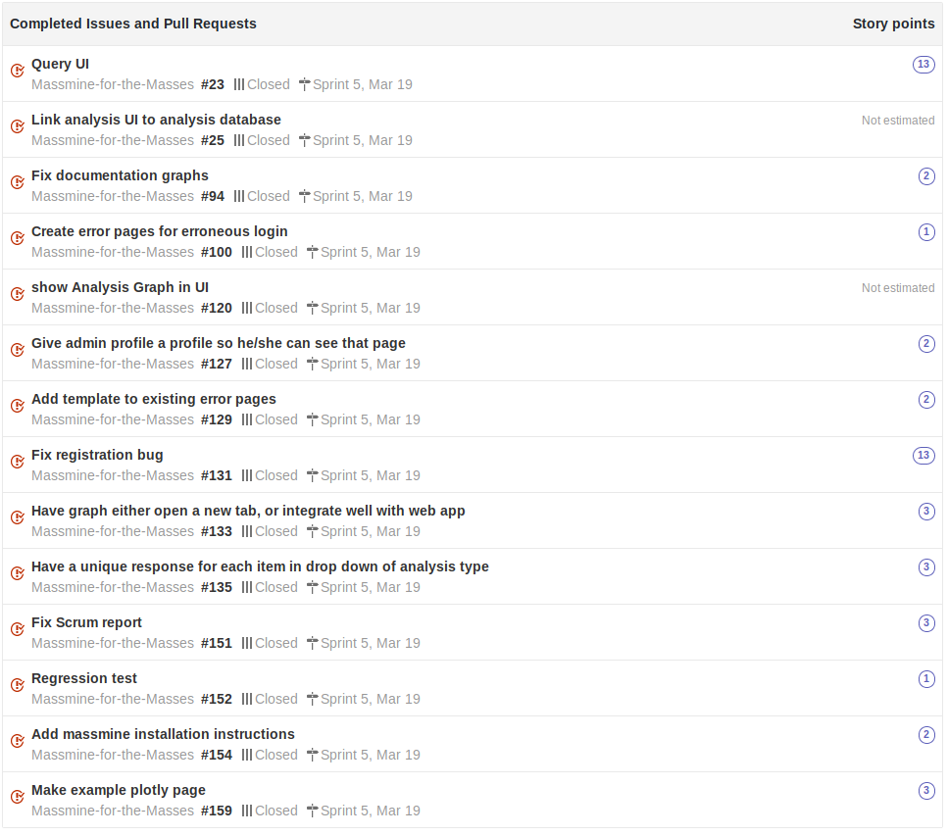
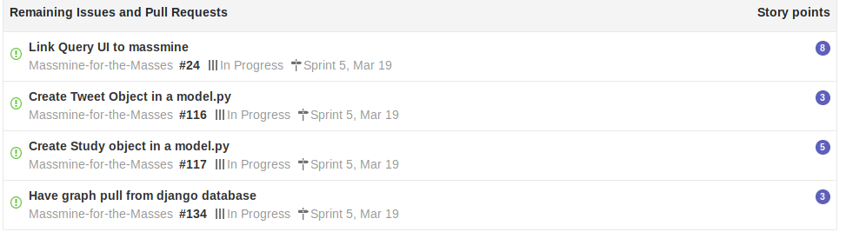
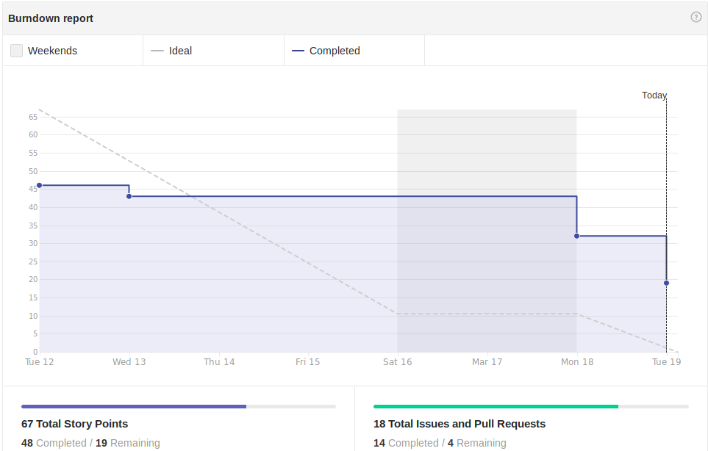
Scrum Update: March 19
Still missing key parts
Notes:
Patti

Slide 11
Goals for Mar. 26
Priorities:
Tweet model - Logan
Study Model - Josh
Install JSAN - Patti
Parse data - Logan
Insert data into database -Logan
Graphs drawing from some database - Morgan
Secondary goals:
Solve encryption of oauth key
Installation script
Celery
Test Docker image

