Slide 1
Massmine for the Masses
Joshua Moore, Logan Hornbuckle, Patricia Tanzer, Morgan McIntyre

Slide 2
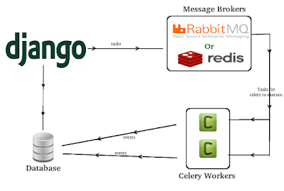
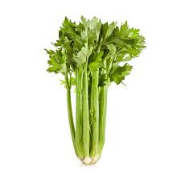
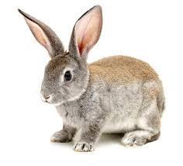
What is Celery?
Brokers and workers

Slide 3

Encryption...
Trying to avoid having encryption key on github & docker image
Workaround may be possible, but key sits right next to database, and our users have physical access...

Slide 4
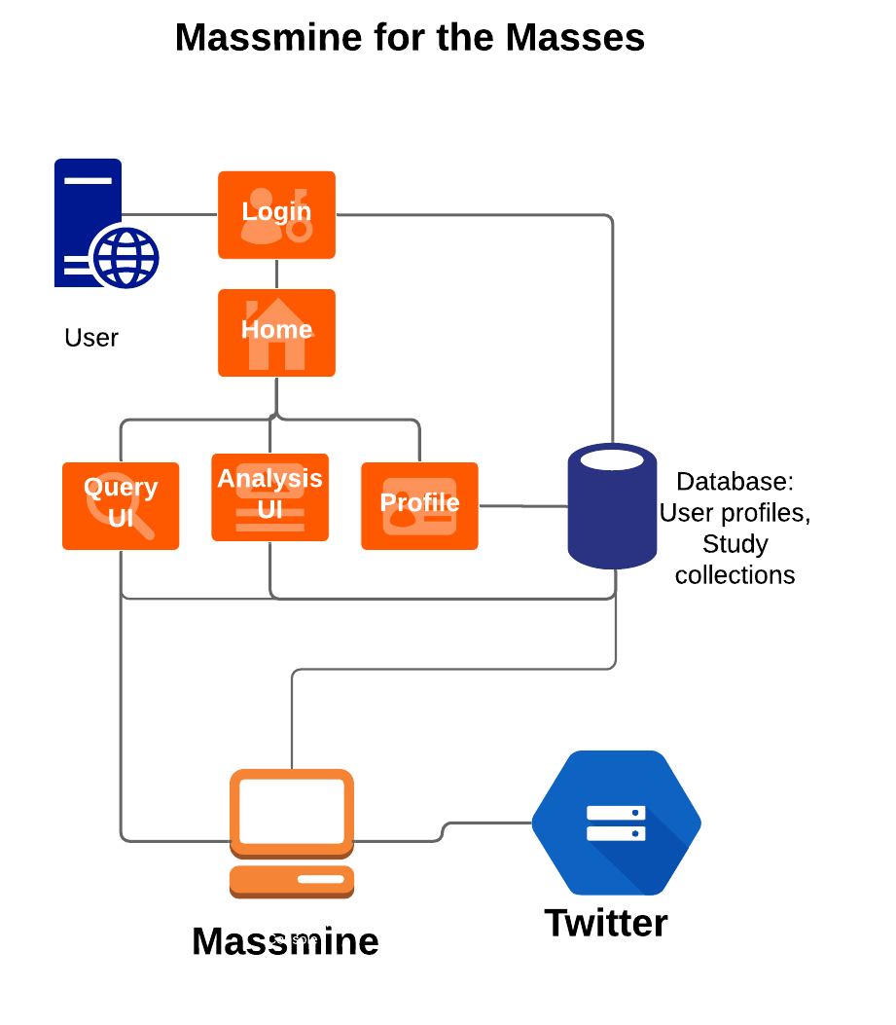
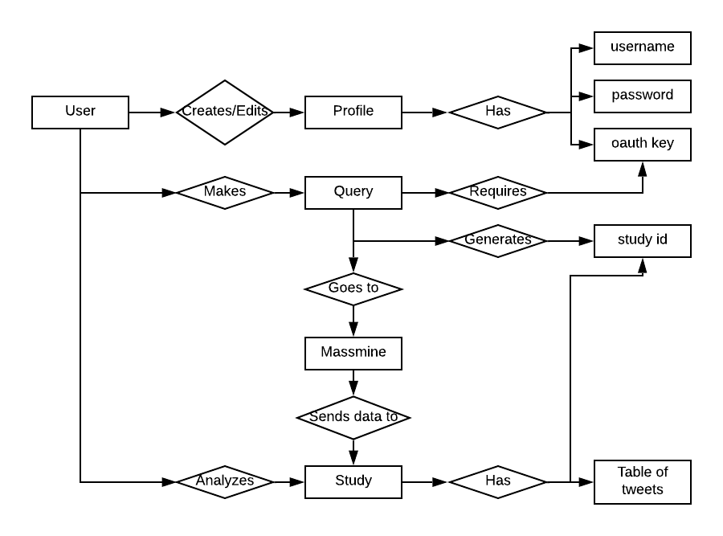
Updating old documentation models
System ERM System Overview

Slide 5
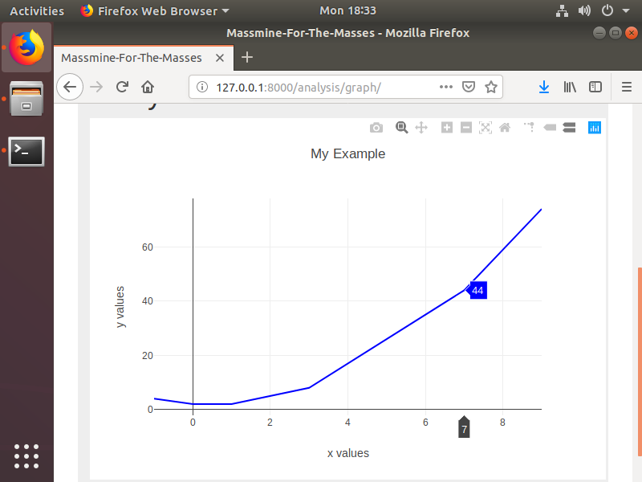
Learning to play with plotly
What is ‘cufflinks’ and why is it necessary?

Slide 6
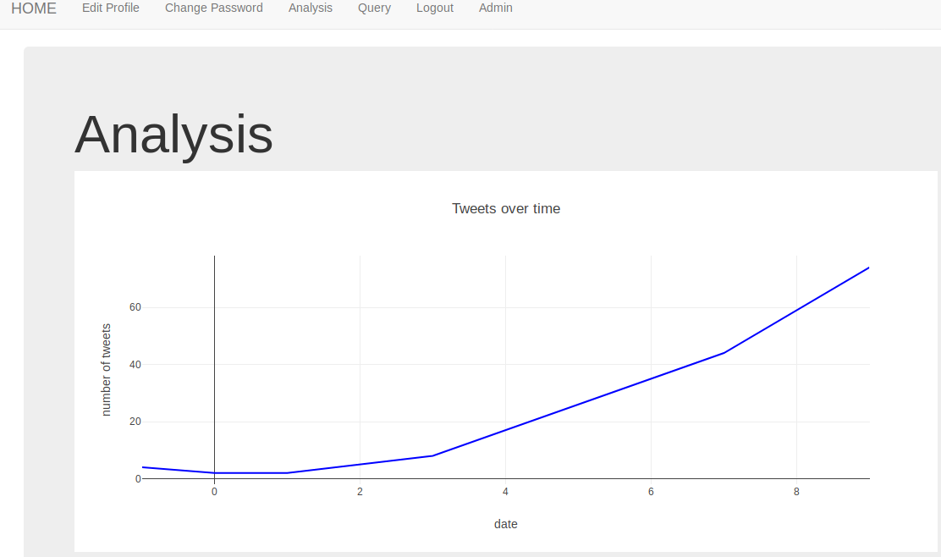
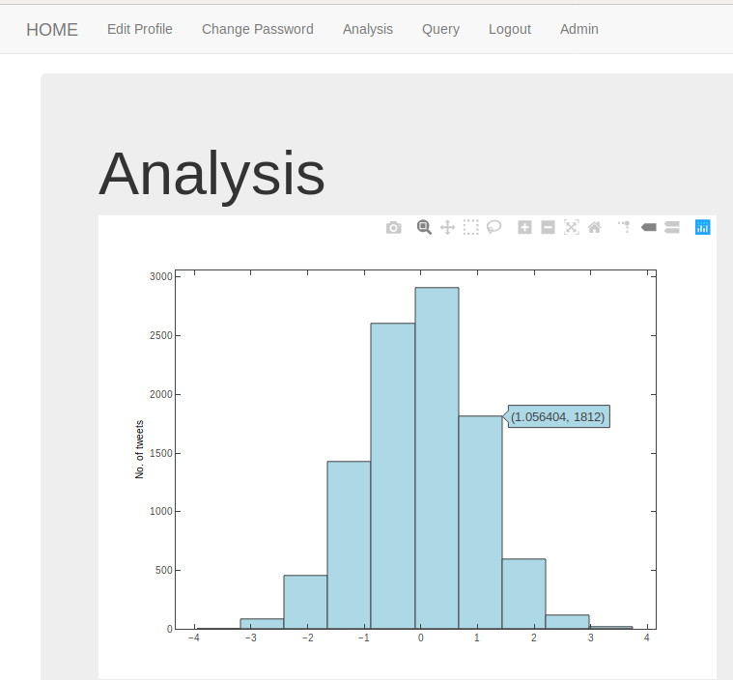
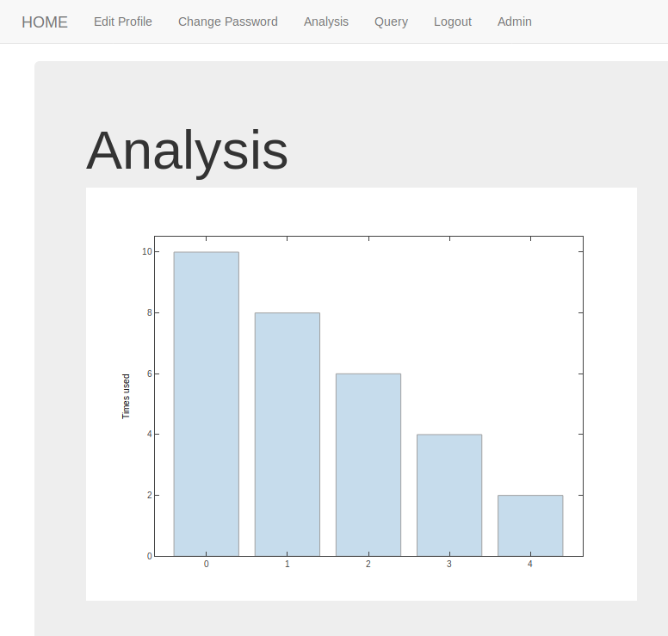
New Analysis graphs!

Slide 7
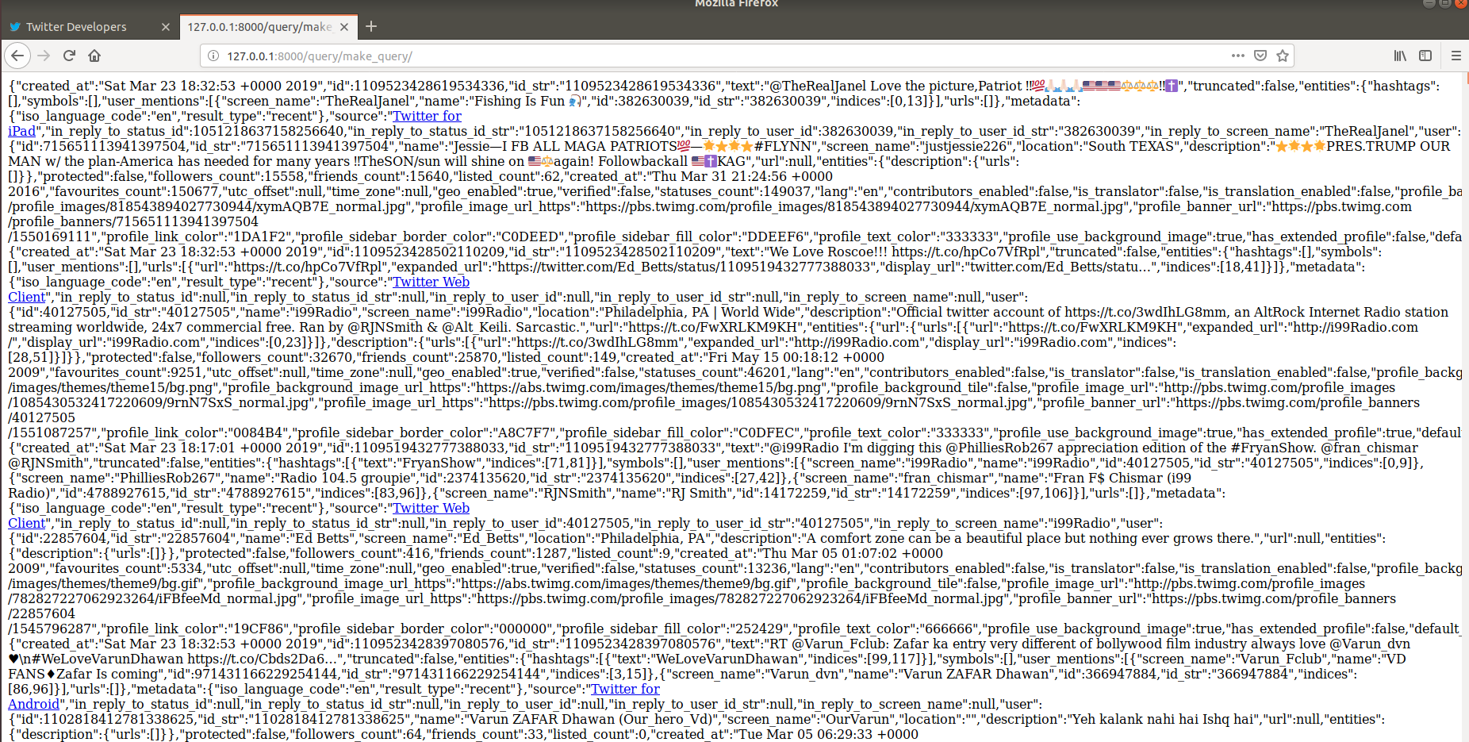
Massmine is talking to Django!
No more CSV
No more JSON

Slide 8

Query Page Progress Update:
SQLite DB connected to Query Page
New Query -> Table Creation
Connected MassMine output to Query page

Slide 9
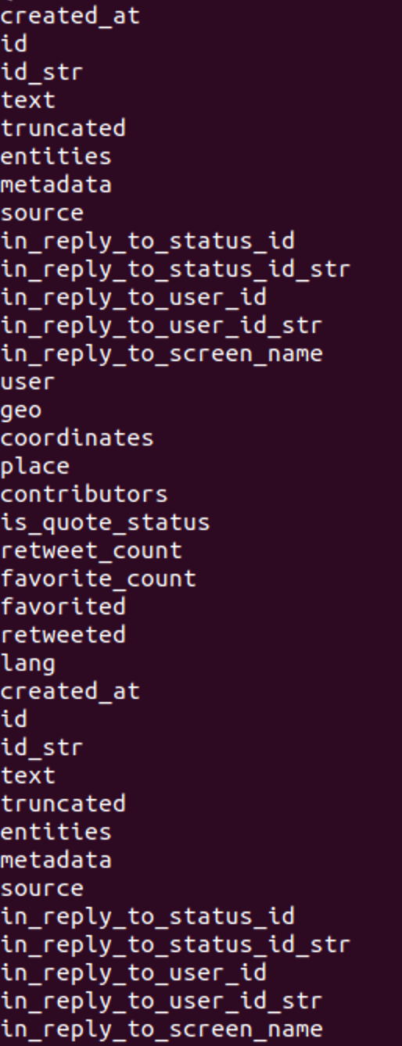
Getting Data from MassMine to DB
COMPLETED:
Convert terminal output to string
Using json.loads() convert each tweet to Dictionary Format
TO DO:
Implement bulk-store algorithm as an asynchronous task
Connect to Study Model
Notes:
Logan

Slide 10
Study Database
Now stores tweets that are directly associated with the user and study that they belong to
Users can view their previous studies TODO
Add more fields
Allow users to interact with previous studies and perform new analysis on them

Slide 11
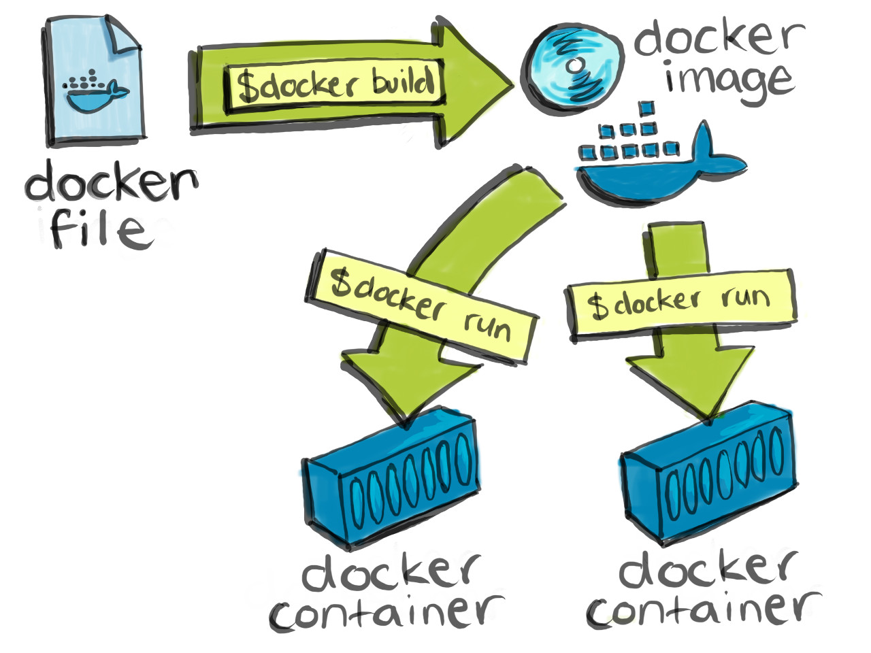
We’ve gone public!
https://github.com/JoshCMoore/Massmine-for-the-Masses/tree/master
Docker is live!
Challenges without paying for Windows 10 Pro;
Using Docker CE for linux (command line only)

Slide 12
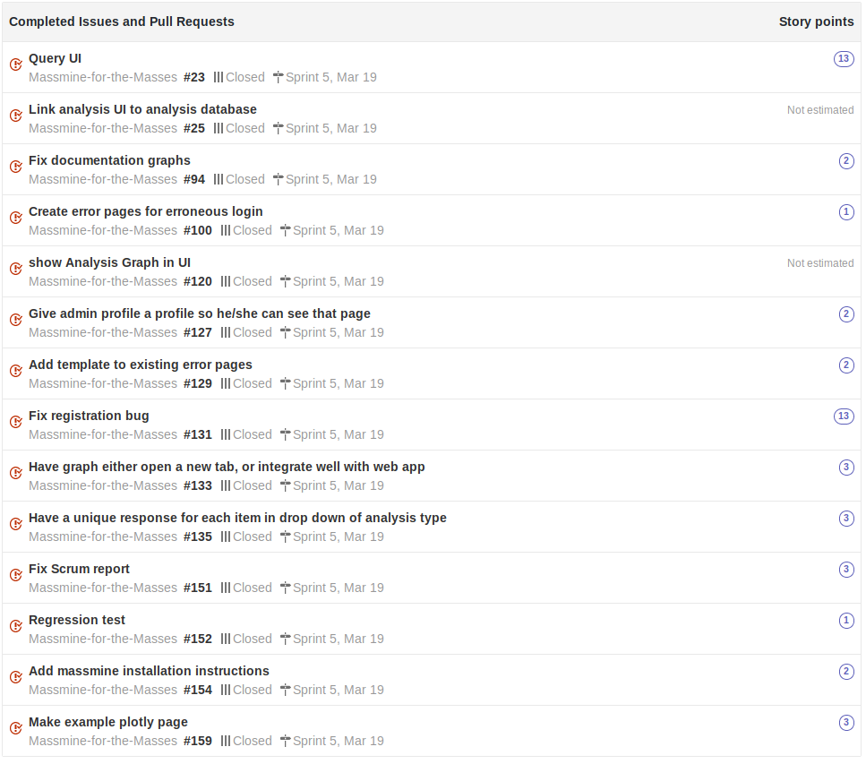
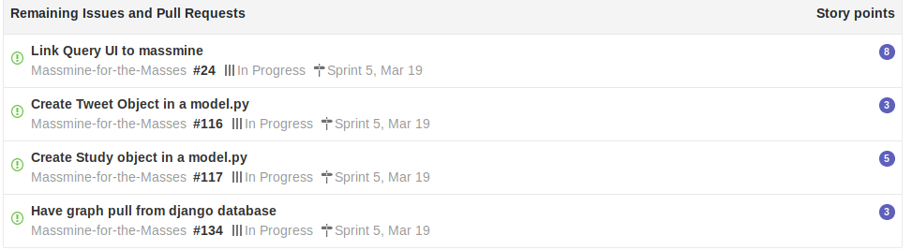
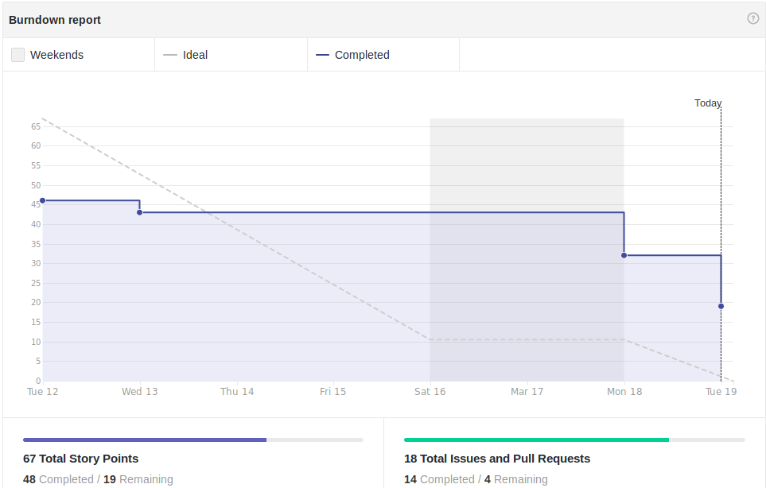
Scrum Update: March 19
Still missing key parts
Notes:
Patti

Slide 13
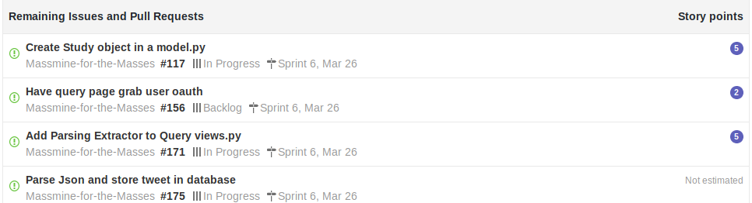
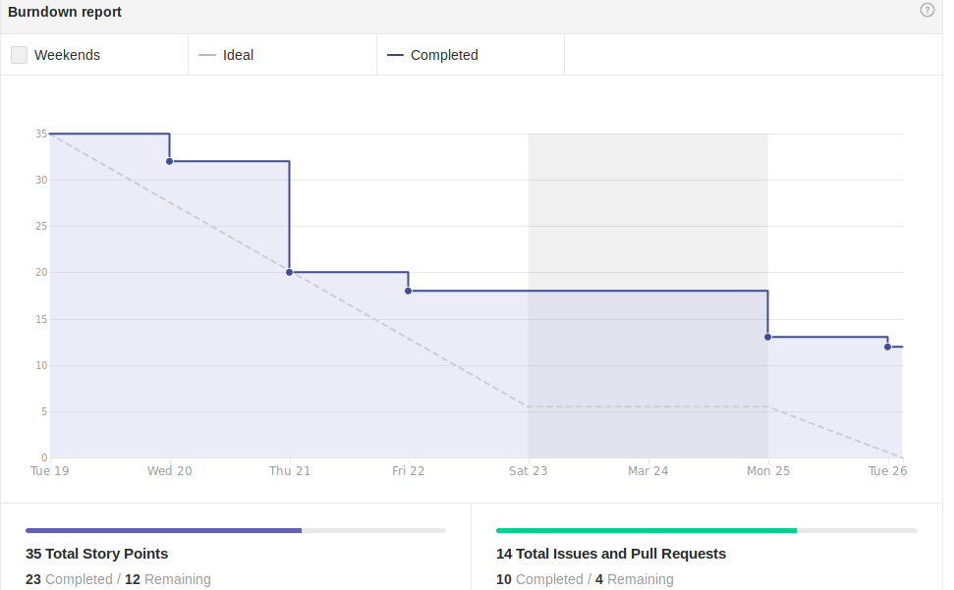
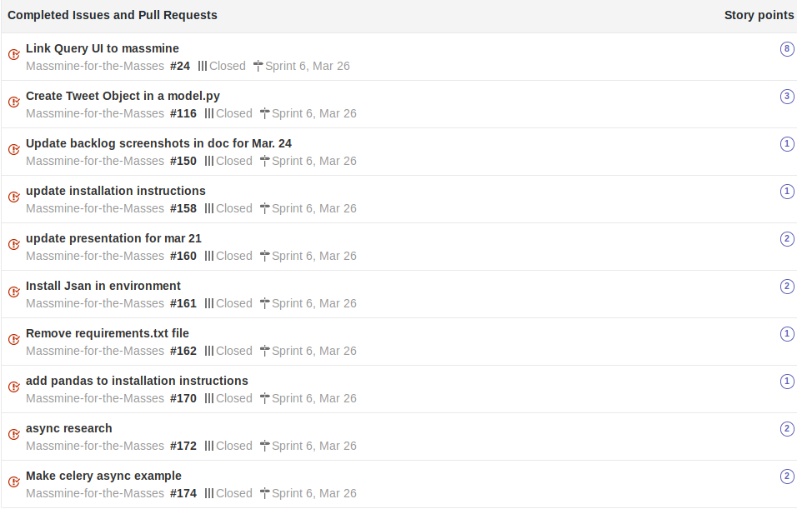
Scrum Update: March 26
Waiting on some of the same pieces, additional dependent backlogs

Slide 14
Goals for Mar. 26
Priorities:
Tweet model & parsing data - Logan
Study Model - Josh
Asynchronous django views - Patti
Stream system output to django - Morgan
Secondary goals:
Solve encryption of oauth key
Installation script for source building
Test Docker image
Graphs drawing from some database - Morgan

