Slide 1
Massmine for the Masses
Joshua Moore, Logan Hornbuckle, Patricia Tanzer, Morgan McIntyre
Notes:
Josh

Slide 2
Functional Requirements
The following are features MassMine doesn’t implement, but creates a better user experience.
Create and update new users
Store user information
Allow multiple users to simultaneously gather Twitter data. The mass of data collected by a query is a ‘study’
Store collected Twitter data
Allow users to perform basic analysis on this Twitter data
We chose a web application as the best way to complete these goals.
Notes:
Morgan

Slide 3
Create and Update New User
Implementation: Django framework
Challenges:
Verifying user identity
Preventing injects
Notes:
We need a mail server or something to email the user if they forget a password (Patti)

Slide 4
Store User Information
Implementation: MongoDB
Challenges:
Security of sensitive information
Notes:
Oauth key, password (Patti)

Slide 5
Creating a ‘study’
Implementation: Django, MassMine
Challenges:
MassMine socket
Getting a valid query from the user
Notes:
Preventing injects when getting query (Josh)

Slide 6
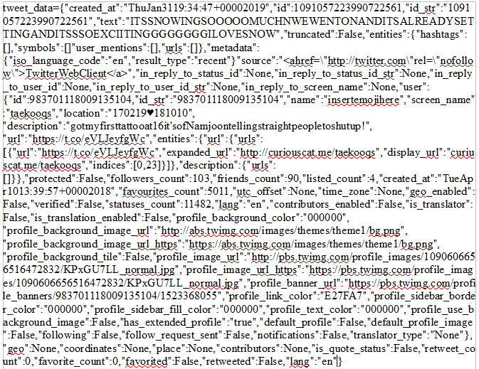
Store Collected Twitter Data
Implementation: MongoDB
Challenges:
Parsing MassMine Results
Nested Data
Notes:
Logan
Massmine results are raw JSON file, using JSAN to convert massmine results.
Retrieving nested data fields within JSON file.

Slide 7
Creating an ‘analysis’
Implementation: MongoDB, Django
Challenges:
Graphical displays
Time to complete analysis
Generating pre-made useful analyses
Notes:
Morgan

Slide 8
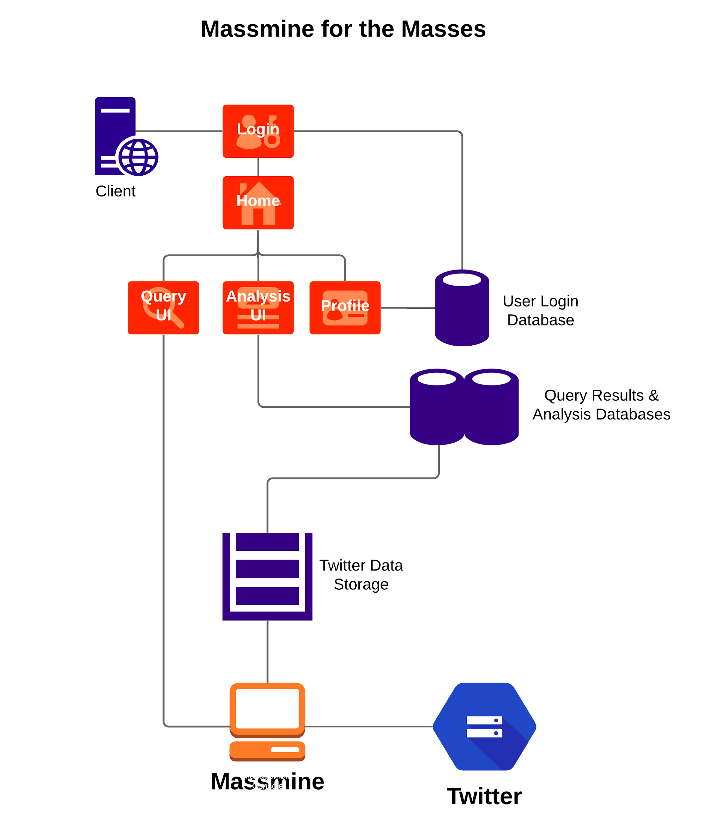
Overview
4 user interfaces:
Login
User profile
Query
Analysis
3 databases:
User information
Analysis formulas
Tweets
Host server
Multiple instances of Massmine
Notes:
Logan will present this slide.

Slide 9
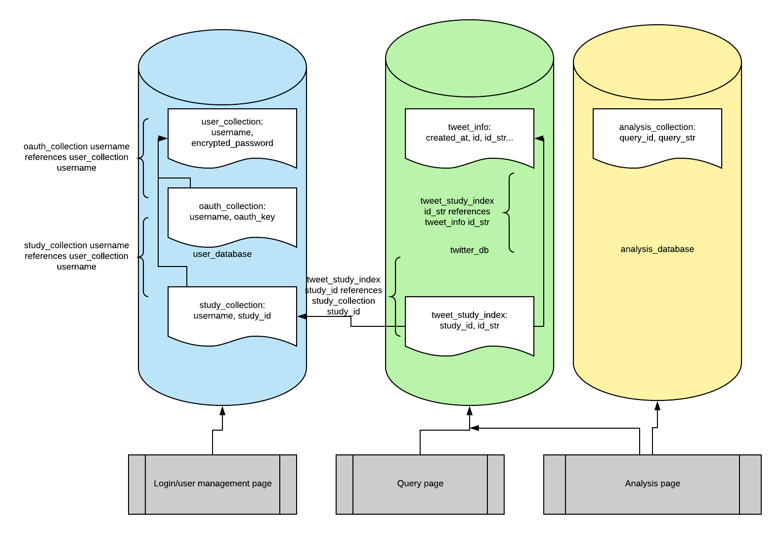
Database usage
Notes:
Logan

Slide 10
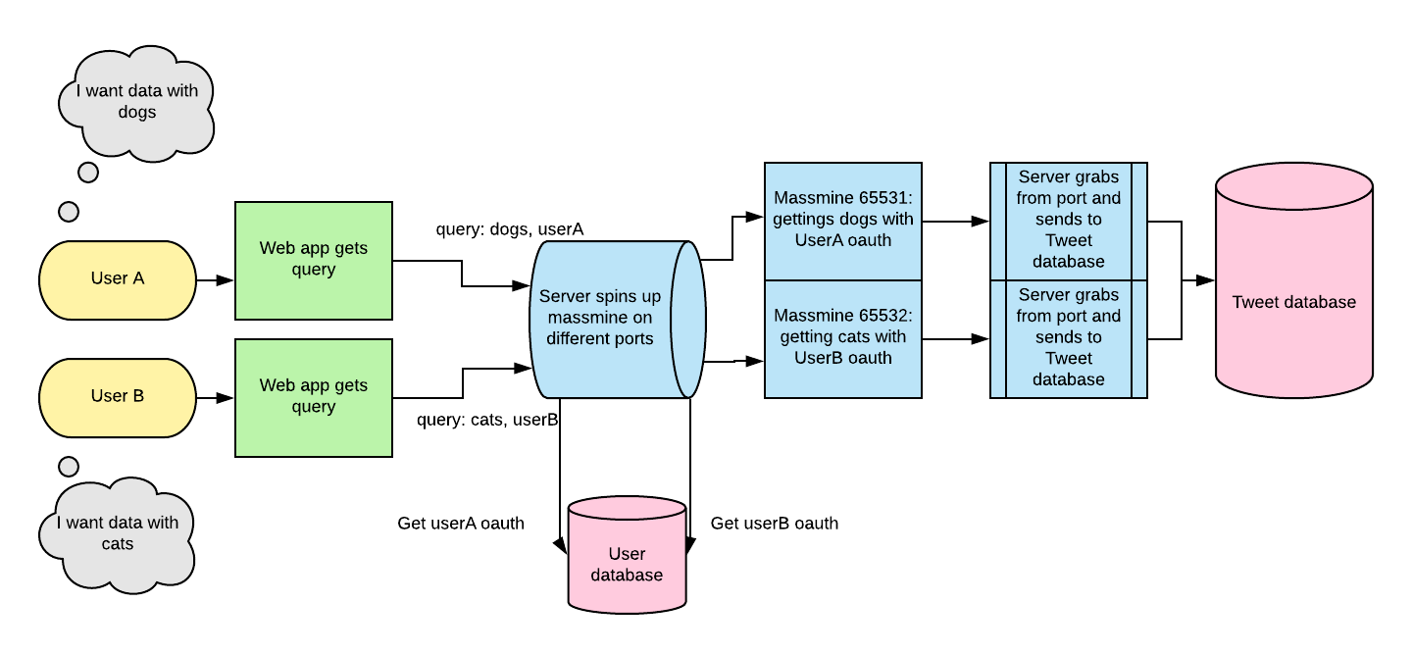
Massmine connection
Notes:
Morgan. Dataflow. We will have multiple instances of massmine running, and ports to separate them.

Slide 11
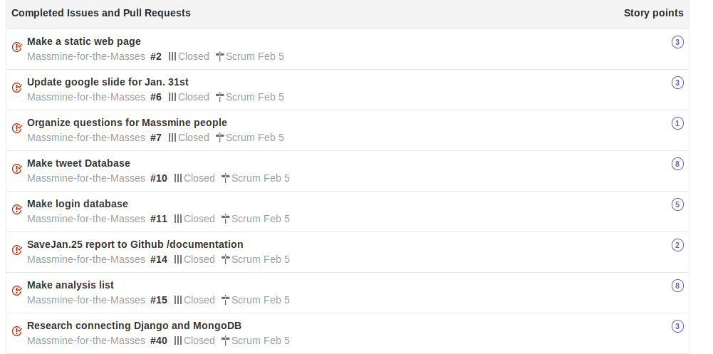
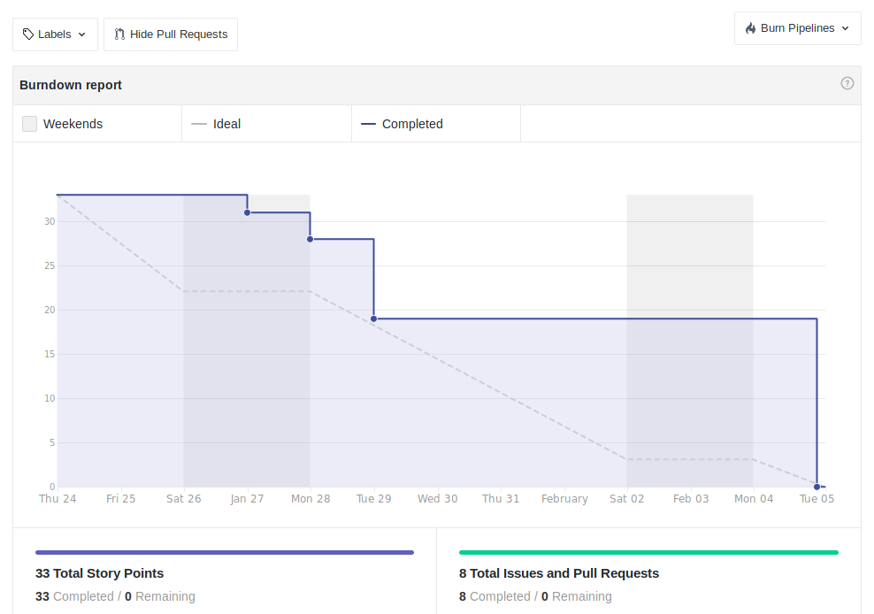
Scrum Update: Feb 5
Sprint past week: On target!

Slide 12
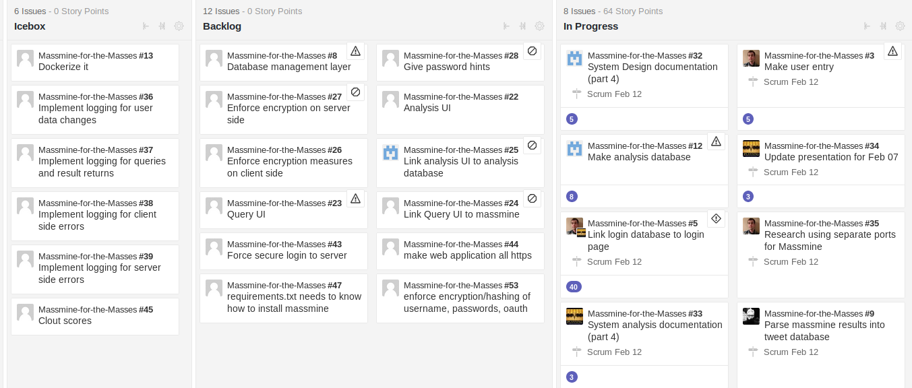
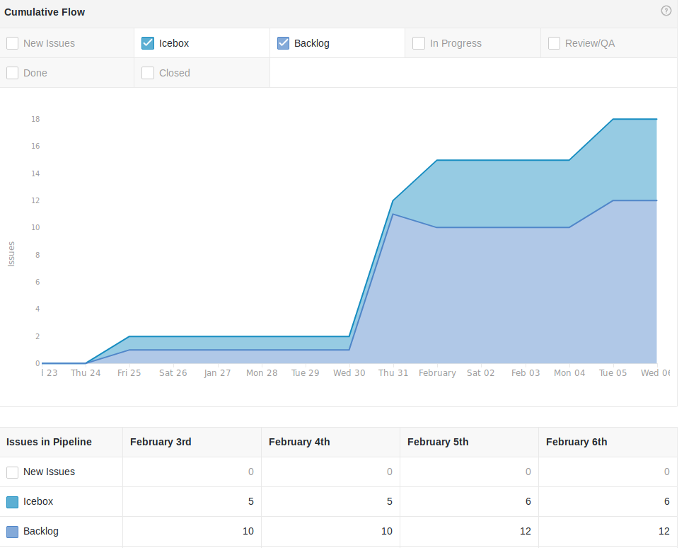
Backlog: Feb. 05
We have a lot to do...

Slide 13
Here’s what we’ve done...
Patti: database template and login database
Josh: login page and work on massmine socket
Logan: tweet database and code review
Morgan: analysis database and code review

Slide 14
Tools used
Github: https://github.com/JoshCMoore/Massmine-for-the-Masses
Massmine: https://www.massmine.org/
MongoDB: https://www.mongodb.com/
Django: https://www.djangoproject.com/
Notes:
Logan will present this slide.

