Slide 1
Massmine for the Masses
Joshua Moore, Logan Hornbuckle, Patricia Tanzer, Morgan McIntyre

Slide 2
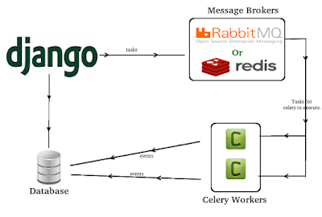
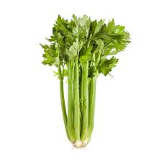
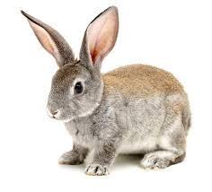
What is Celery?
Brokers and workers

Slide 3

Encryption...
Trying to avoid having encryption key on github & docker image
Workaround may be possible, but key sits right next to database, and our users have physical access...

Slide 4
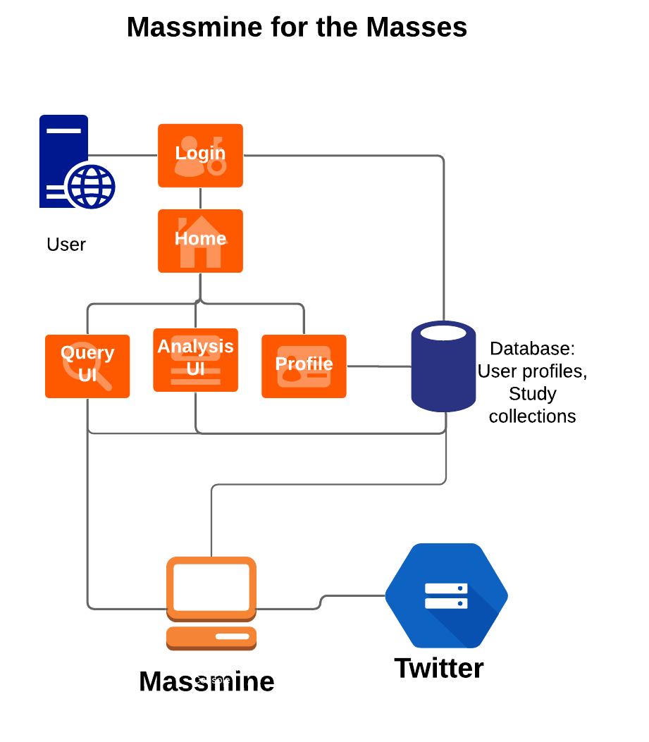
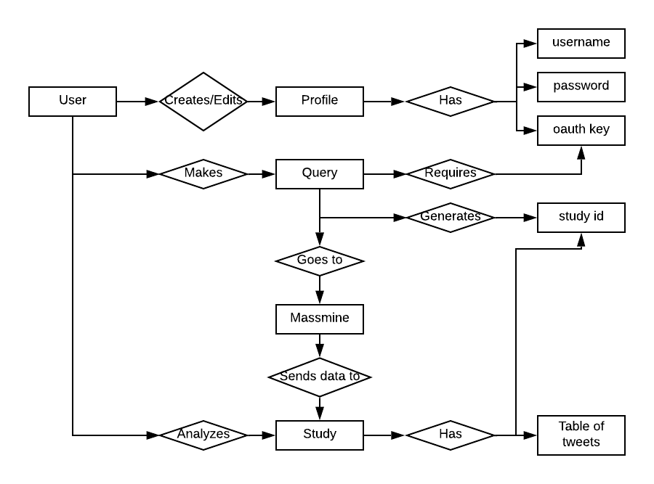
Updating old documentation models
System ERM System Overview

Slide 5
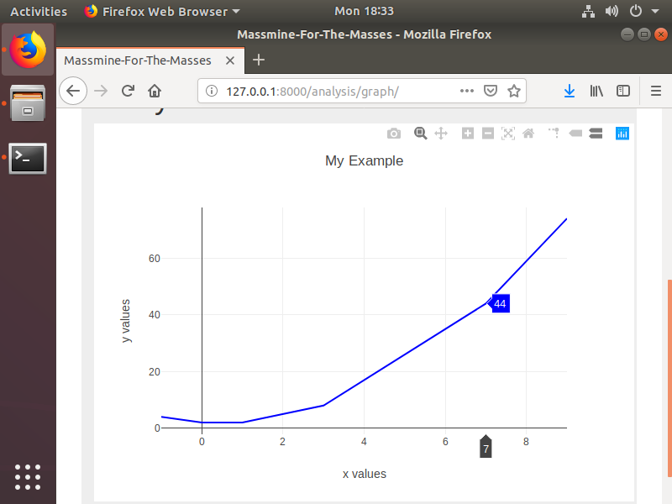
Learning to play with plotly
What is ‘cufflinks’ and why is it necessary?

Slide 6
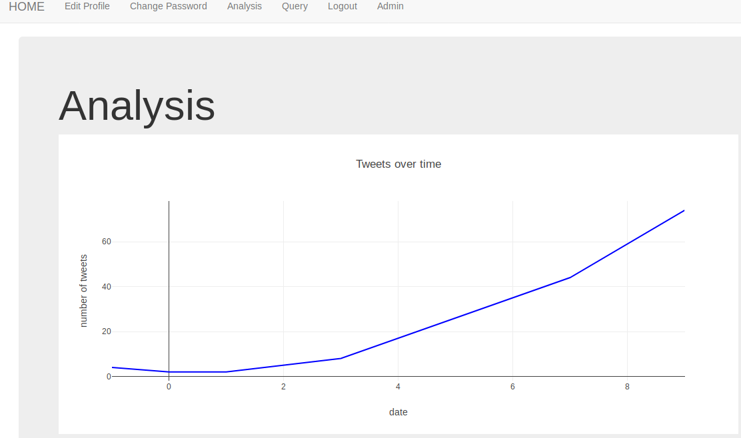
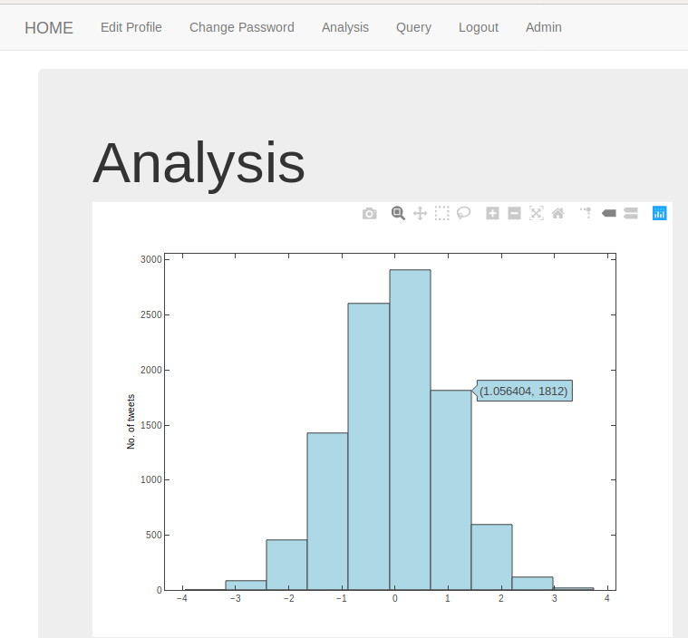
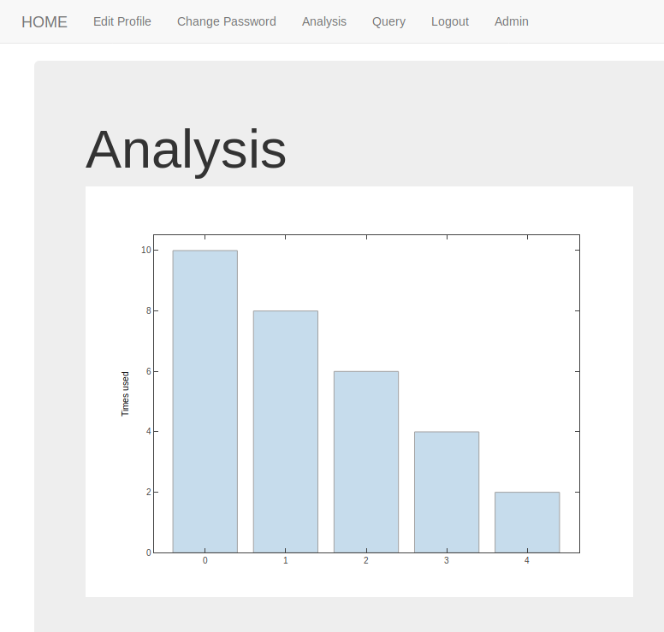
New Analysis graphs!

Slide 7
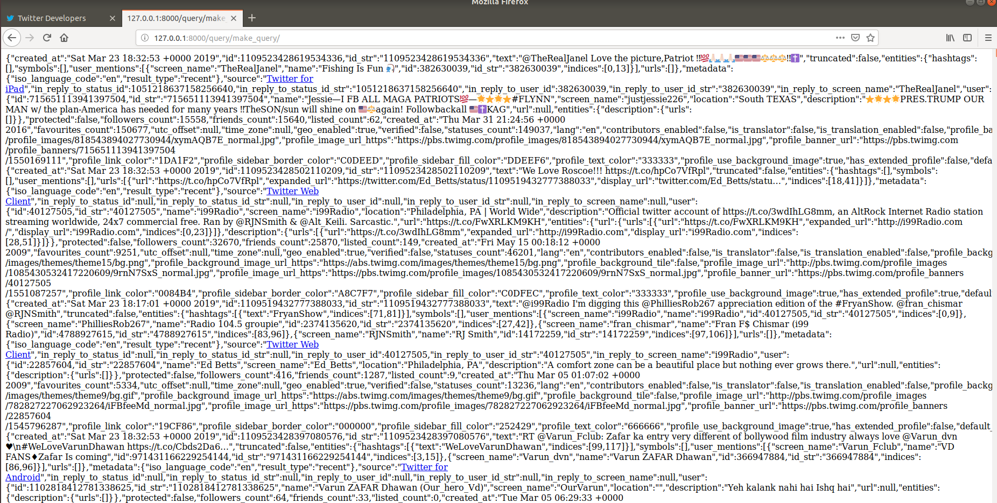
Massmine is talking to Django!
No more CSV
No more JSON

Slide 8

Query Page Progress Update:
Working:
SQLite DB connected to Query Page
New Query -> Table Creation
Not Working:
Difficulties Storing Tweet Data

Slide 9
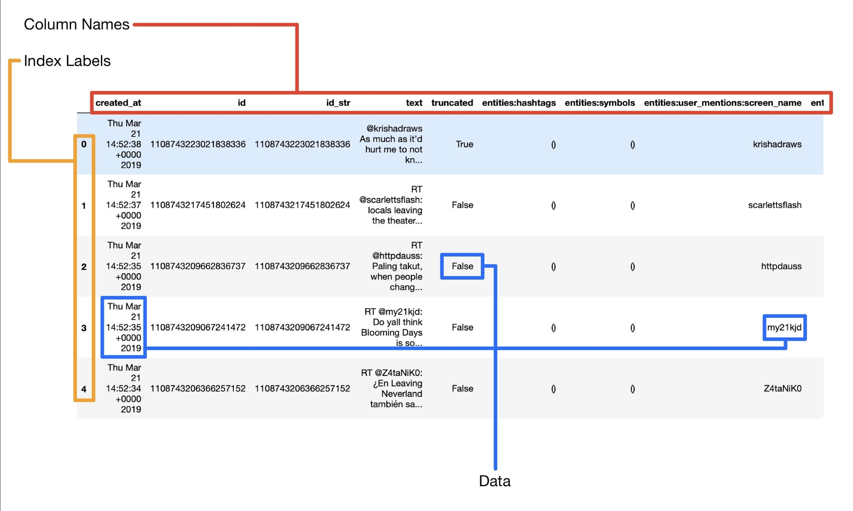
Using Pandas DataFrame

Slide 10
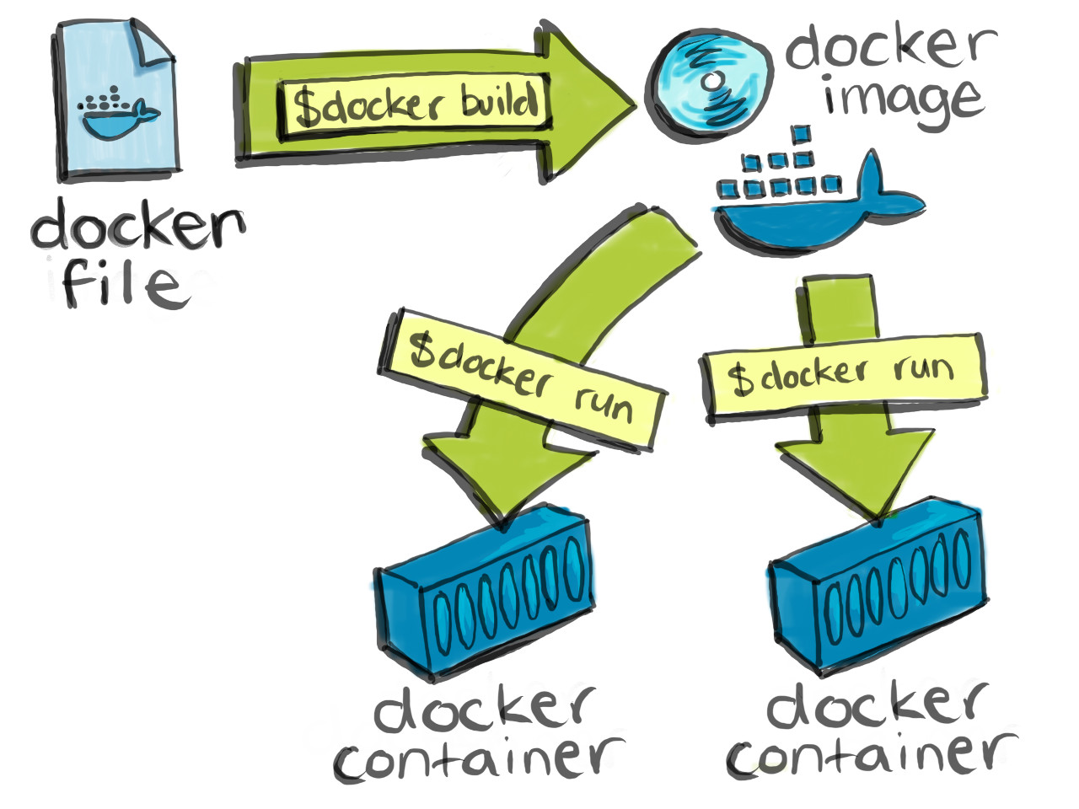
We’ve gone public!
https://github.com/JoshCMoore/Massmine-for-the-Masses/tree/master
Docker is live!
Challenges without paying for Windows 10 Pro;
Using Docker CE for linux (command line only)

Slide 11
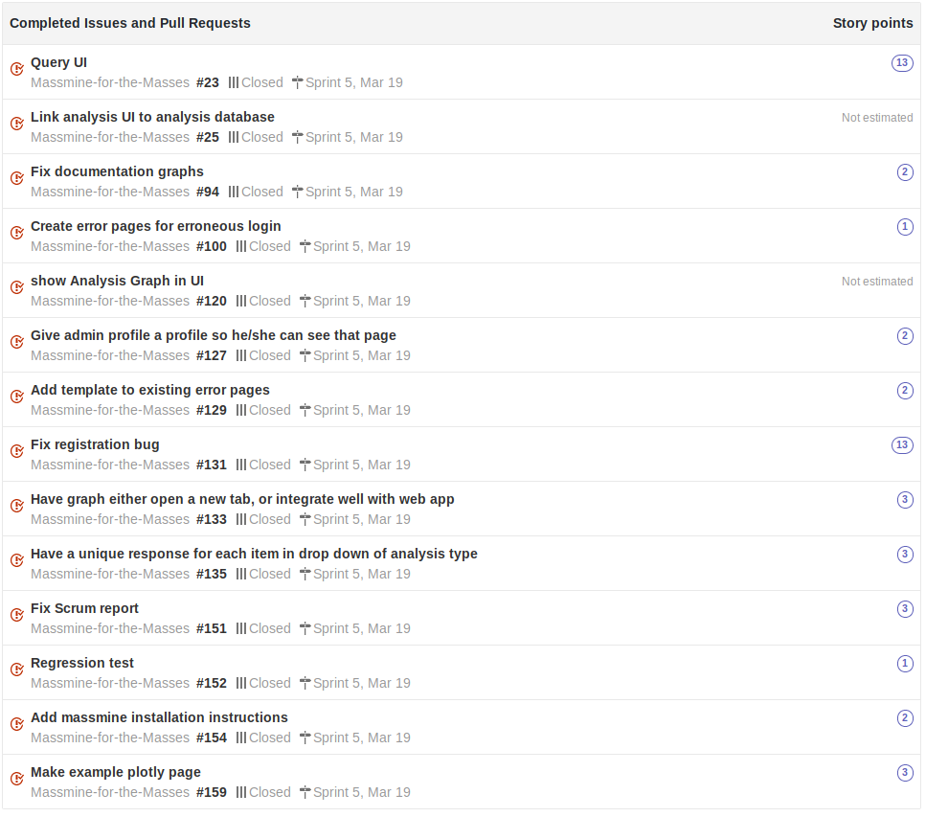
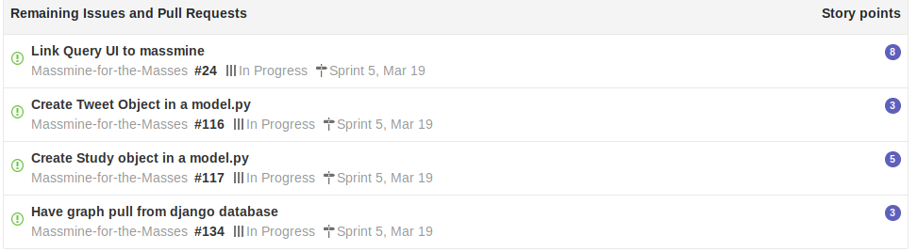
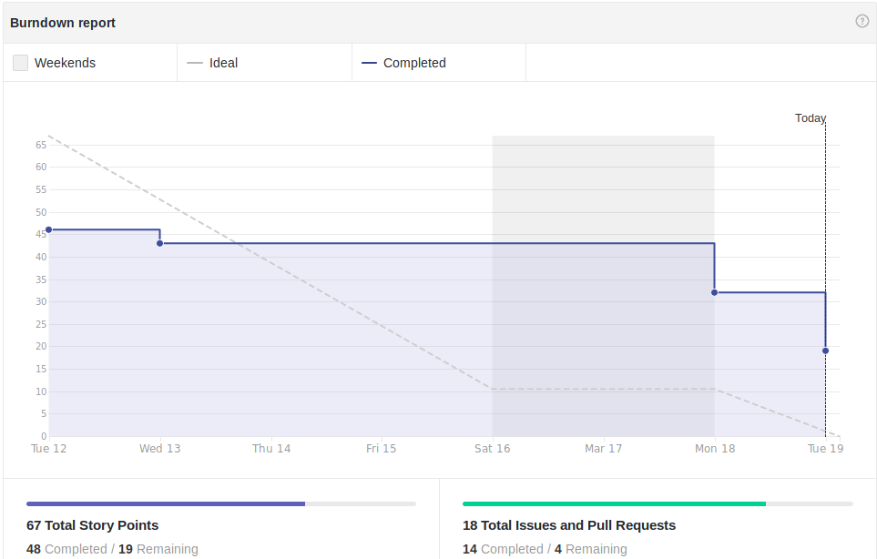
Scrum Update: March 19
Still missing key parts
Notes:
Patti

Slide 12
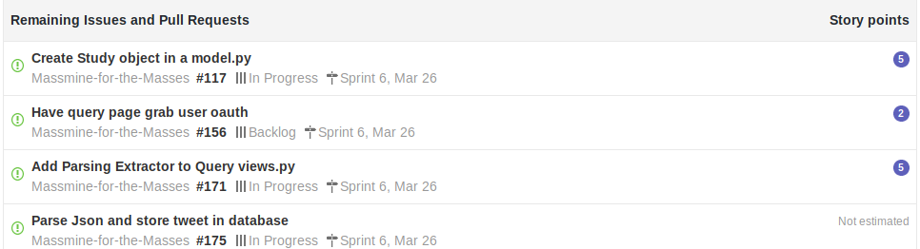
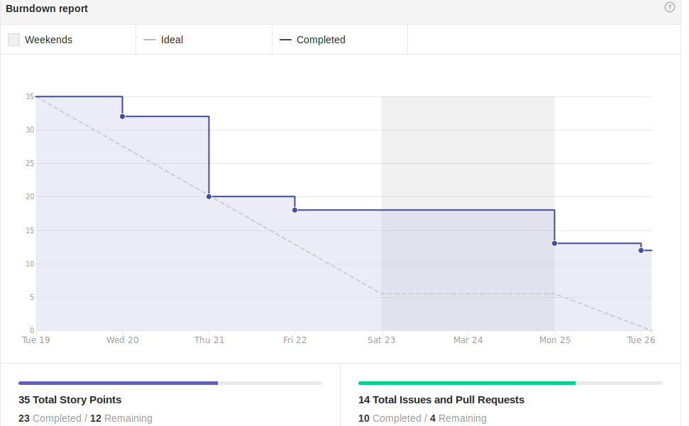
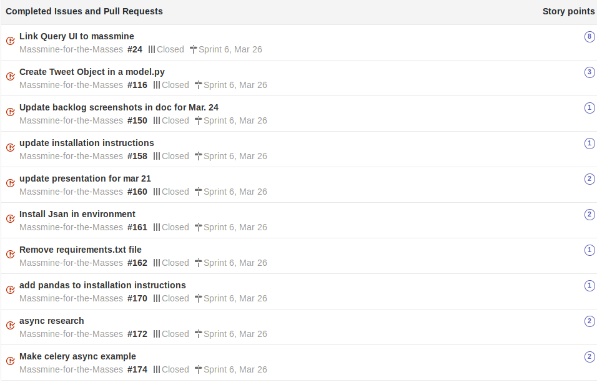
Scrum Update: March 26
Waiting on some of the same pieces, additional dependent backlogs

Slide 13
Goals for Mar. 26
Priorities:
Tweet model & parsing data - Logan
Study Model - Josh
Asynchronous django views - Patti
Stream system output to django - Morgan
Secondary goals:
Solve encryption of oauth key
Installation script for source building
Test Docker image
Graphs drawing from some database - Morgan

