Slide 1
Massmine for the Masses
Joshua Moore, Logan Hornbuckle, Patricia Tanzer, Morgan McIntyre

Slide 2

Major changes last week!
Smaller!
Faster!
Lighter!
Better! Making it local, making it Docker
Notes:
Morgan

Slide 3
Subsystems of Massmine for the masses
Query models
Analysis models
User models
MassMine Integration
Notes:
Everybody

Slide 4
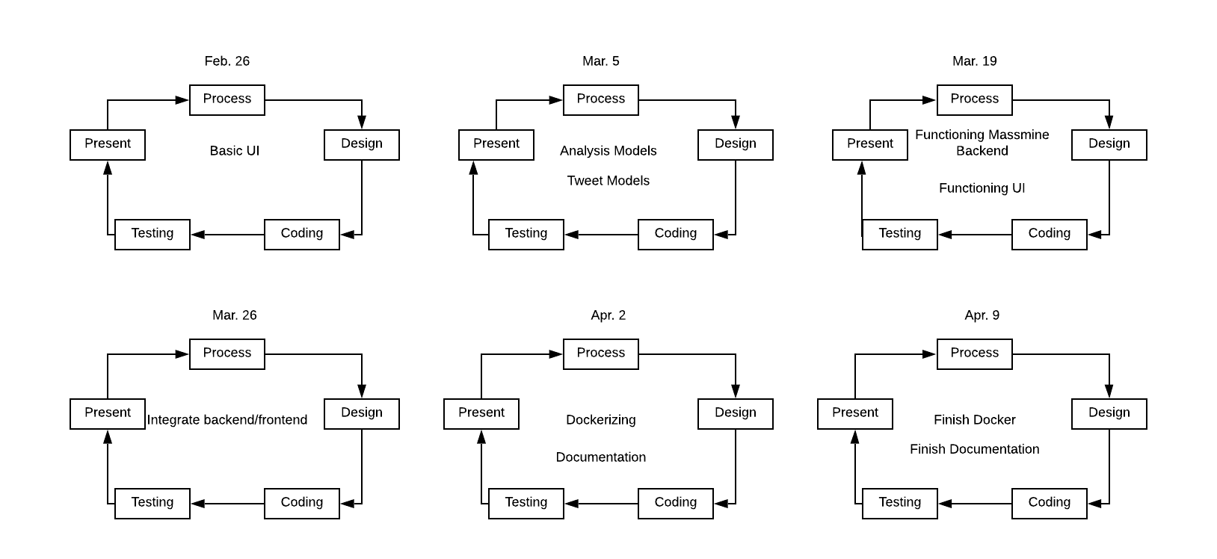
New Process Model
Notes:
Logan

Slide 5
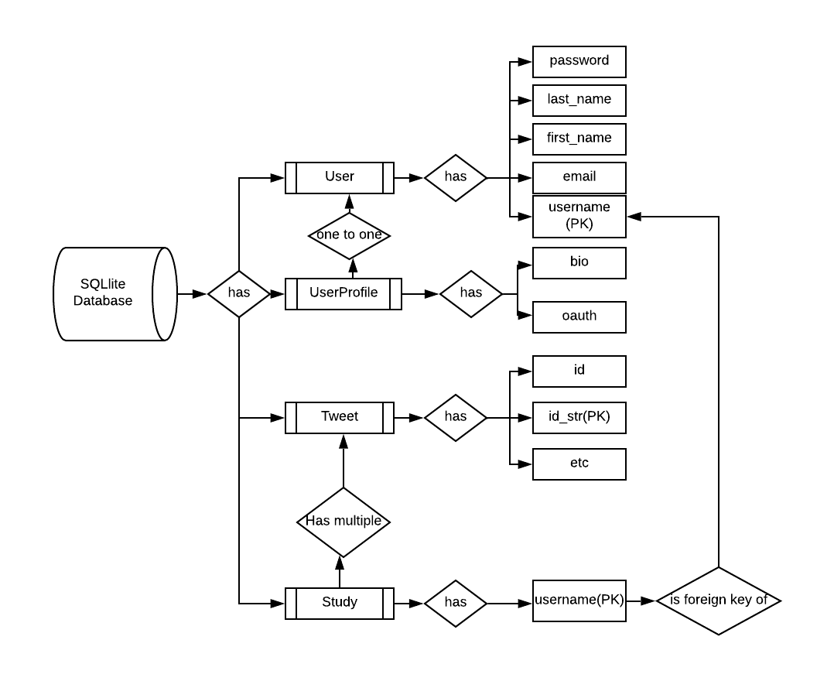
Similar database model
Notes:
Josh

Slide 6
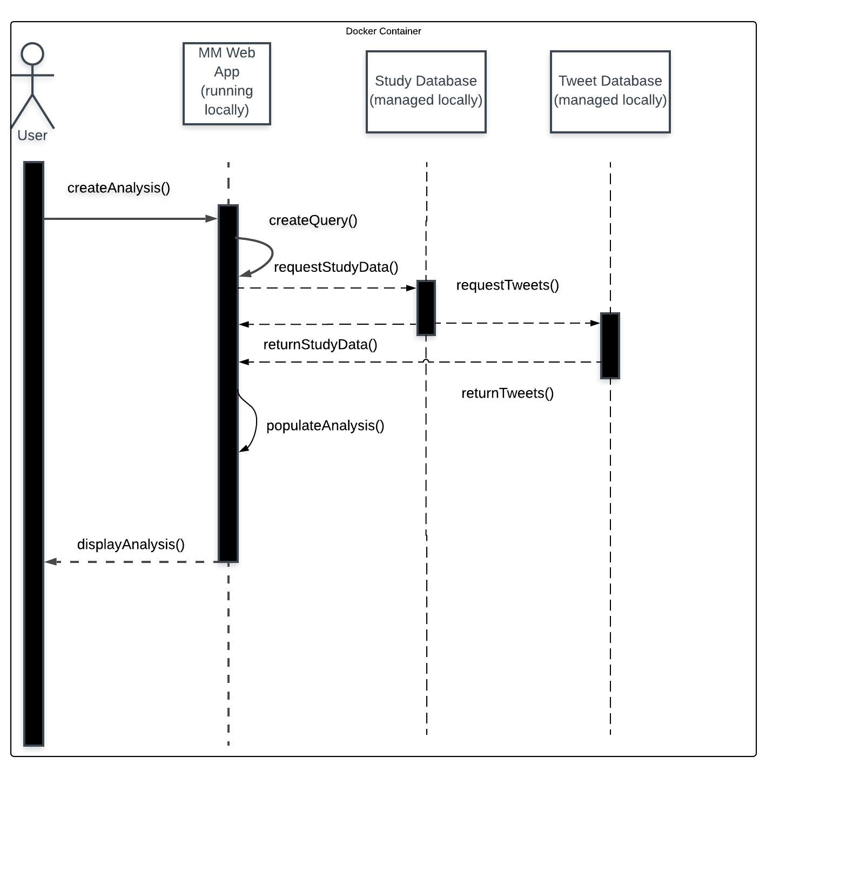
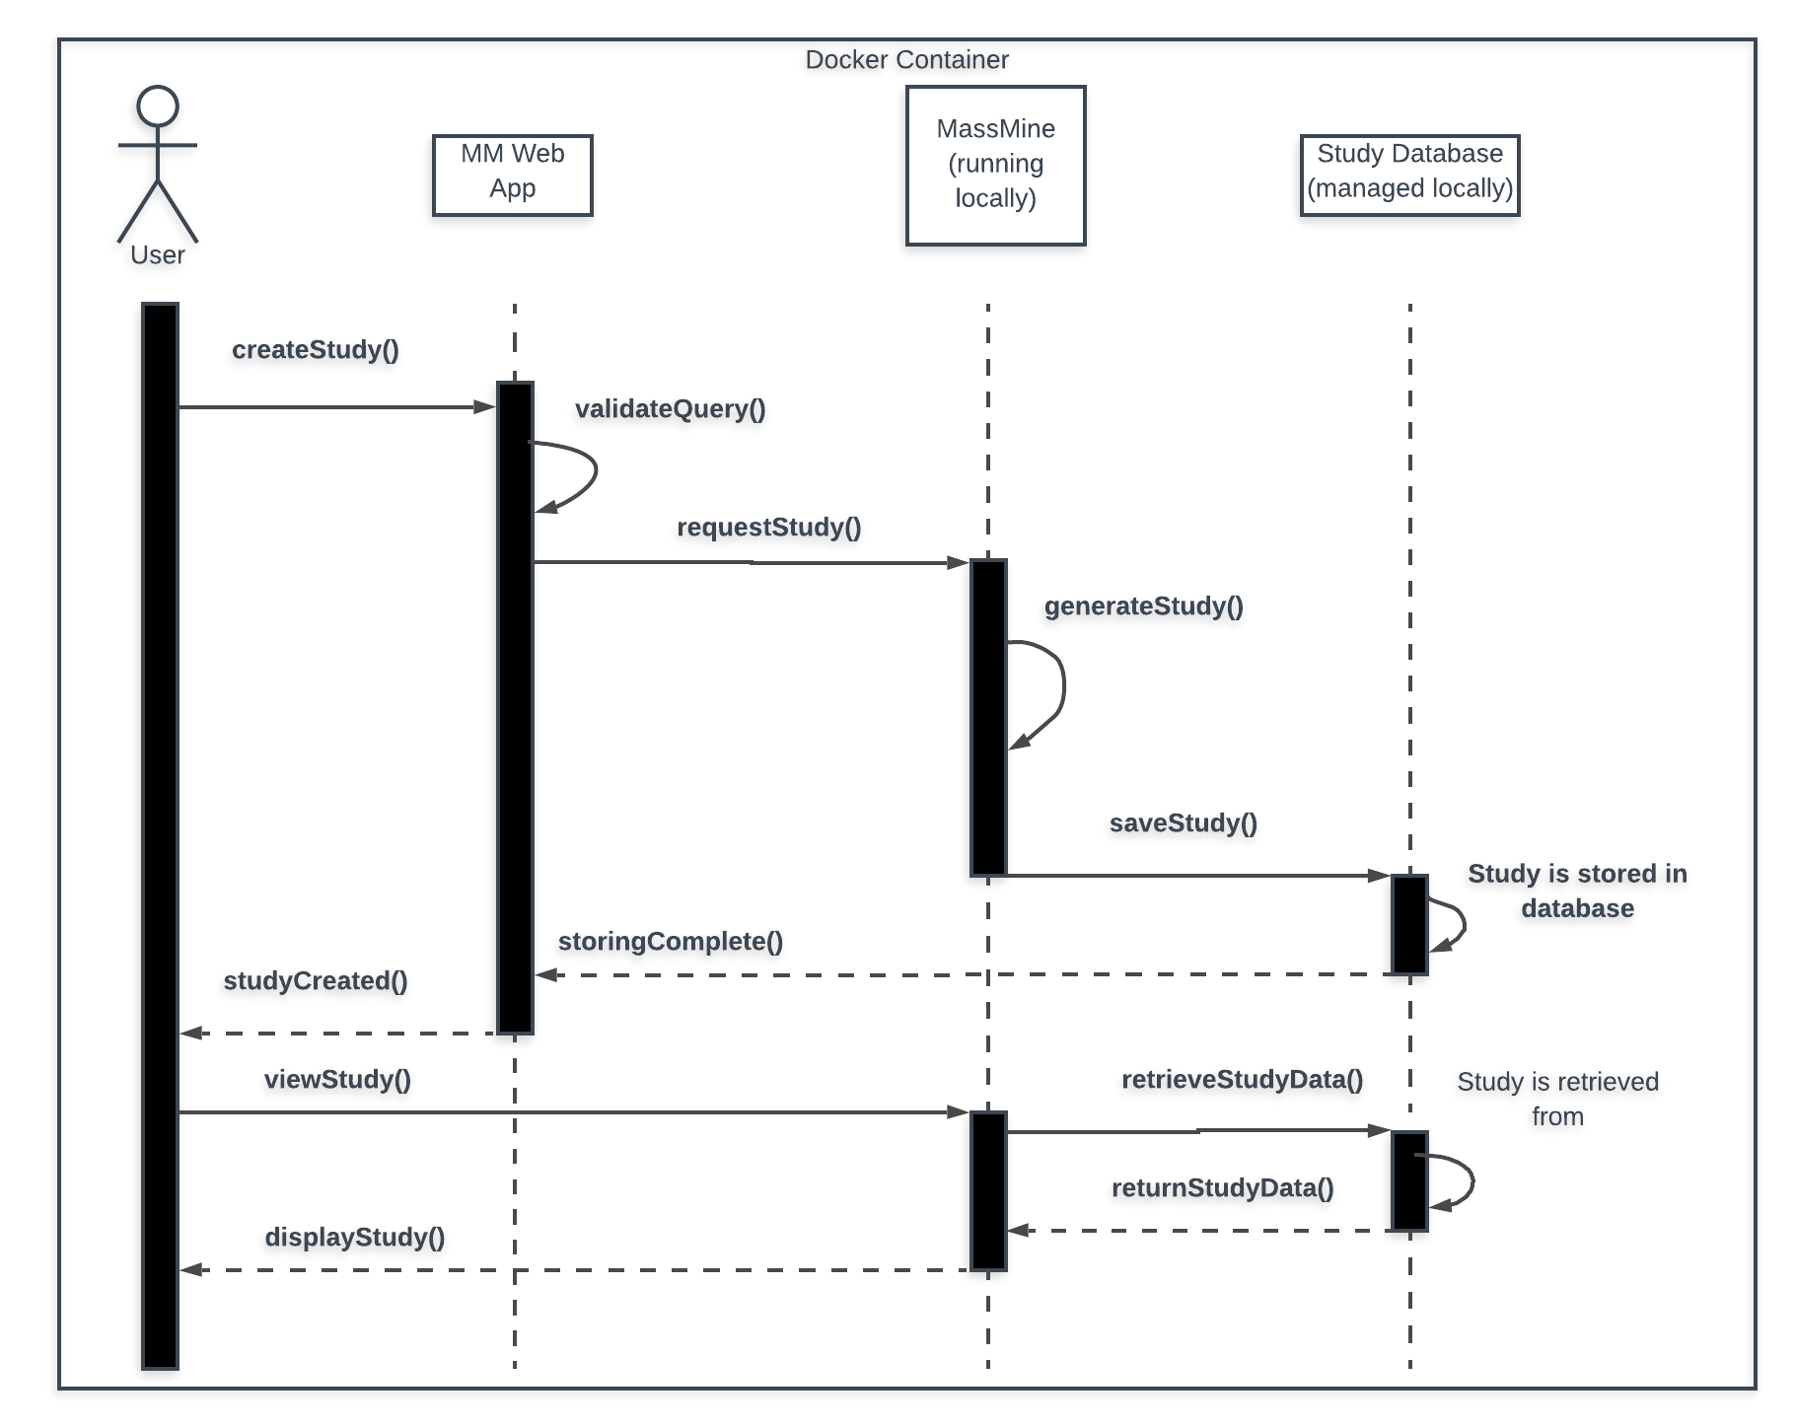
Analysis: Similar flow, just local!

Slide 7
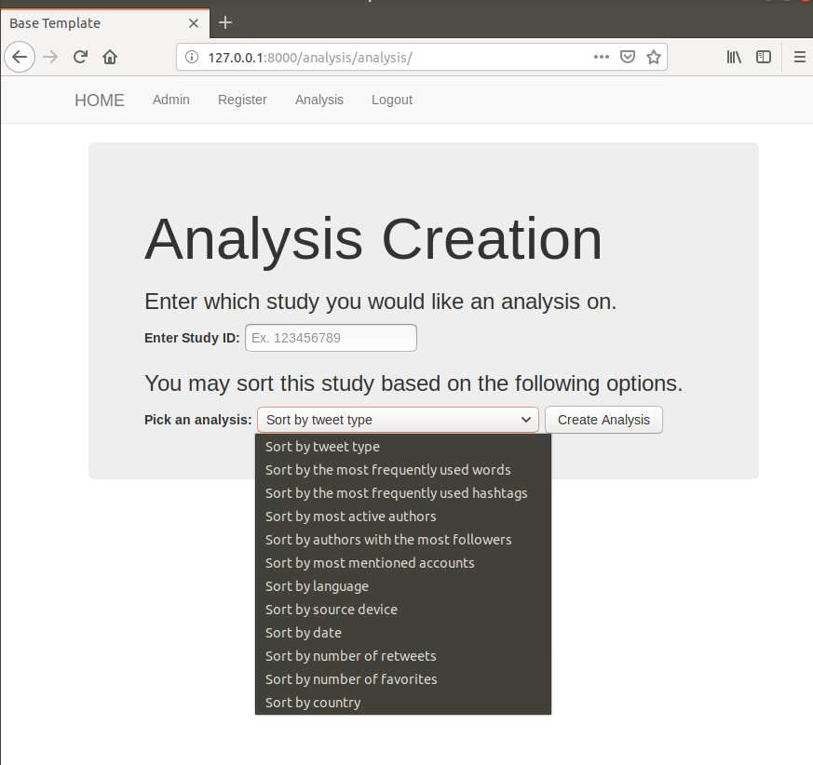
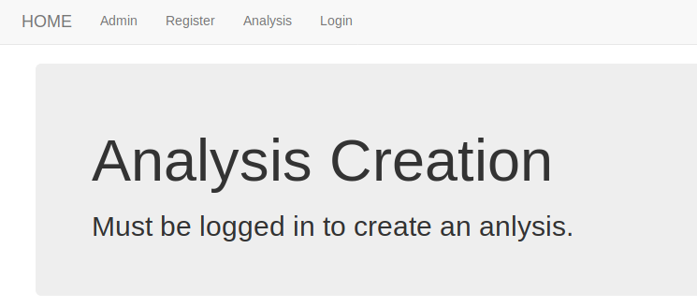
Analysis UI
Changes on backend?
Notes:
No more database, just pulls from study database.

Slide 8
Query UI
Tasks:
Using Django 2.1.7 to create Query Interface
Communicating with Massmine
Query Interface will build Massmine Query
Determine best format / parsing method
Example Massmine Query:
# Fetch some data first massmine --task=twitter-search --count=200 --query=love --output=mydata.json # Convert the JSON from above into .csv, keeping the # "text" and "user:screen_name" fields jsan --input=mydata.json --output=mydata.csv --keep text user:screen_name

Slide 9
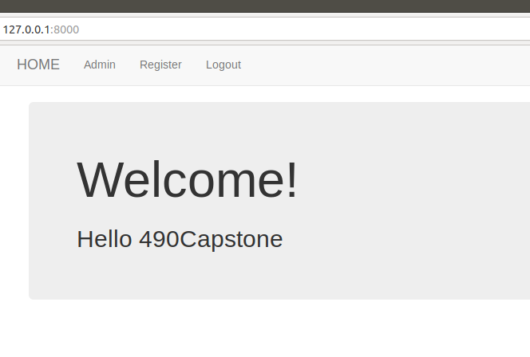
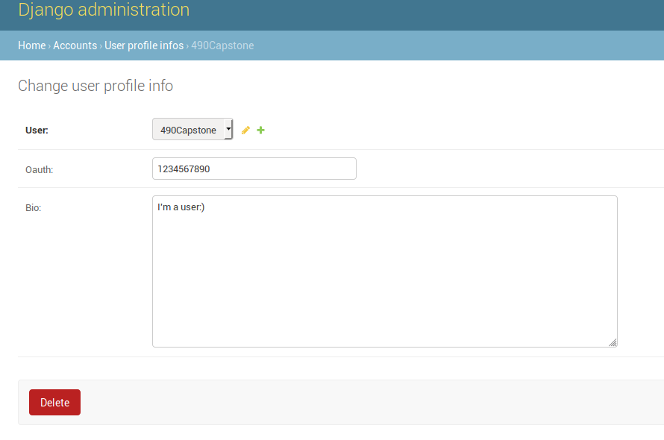
User UI - to Feb. 19
Creating the user object!

Slide 10
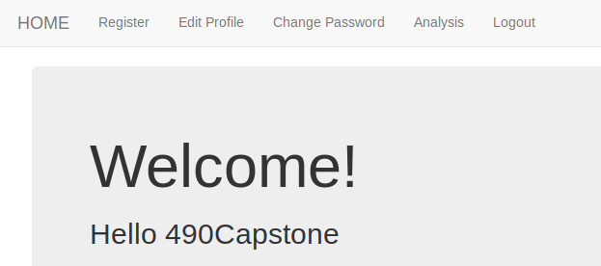
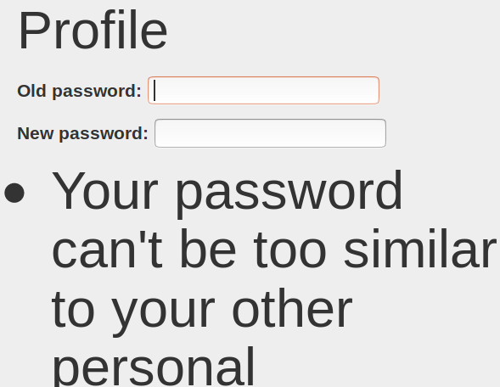
User UI - to Feb. 26
Hiding pages a user shouldn’t see, editing profile. Need to fix font size...

Slide 11

Massmine Integration
Chicken cluck is a pain.
Backup plan: Parsing a json on the local host. Forces us to manage our own cache when massmine dumps large files.
Notes:
Insert Josh here.

Slide 12
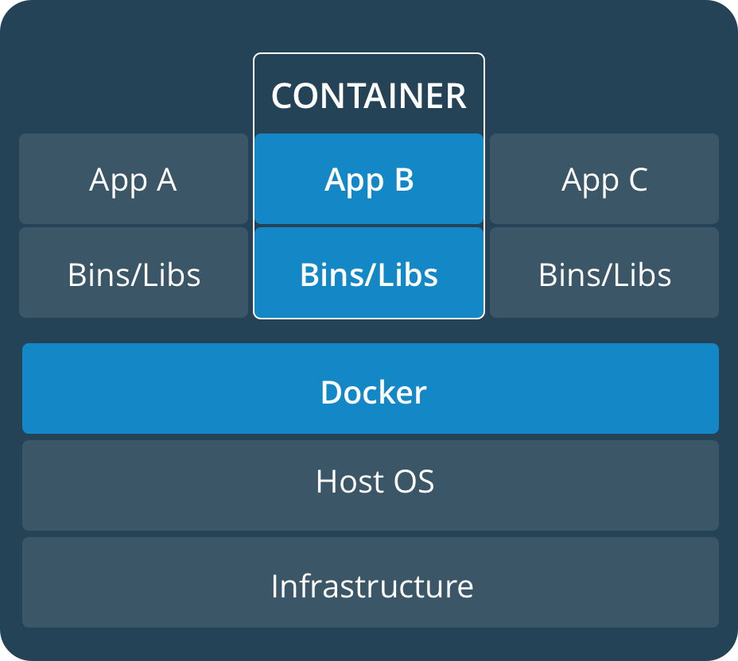
Docker implementation so far:
Notes:
Josh

Slide 13
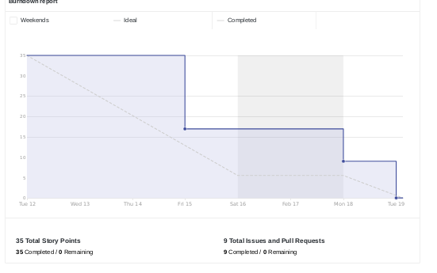
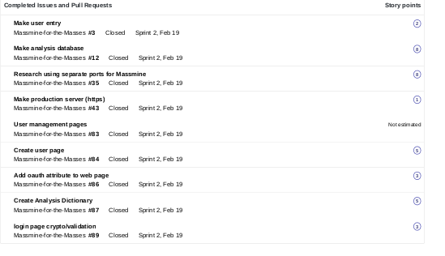
Scrum Update: Feb 19
Made pretty good time!
Notes:
Patti

Slide 14
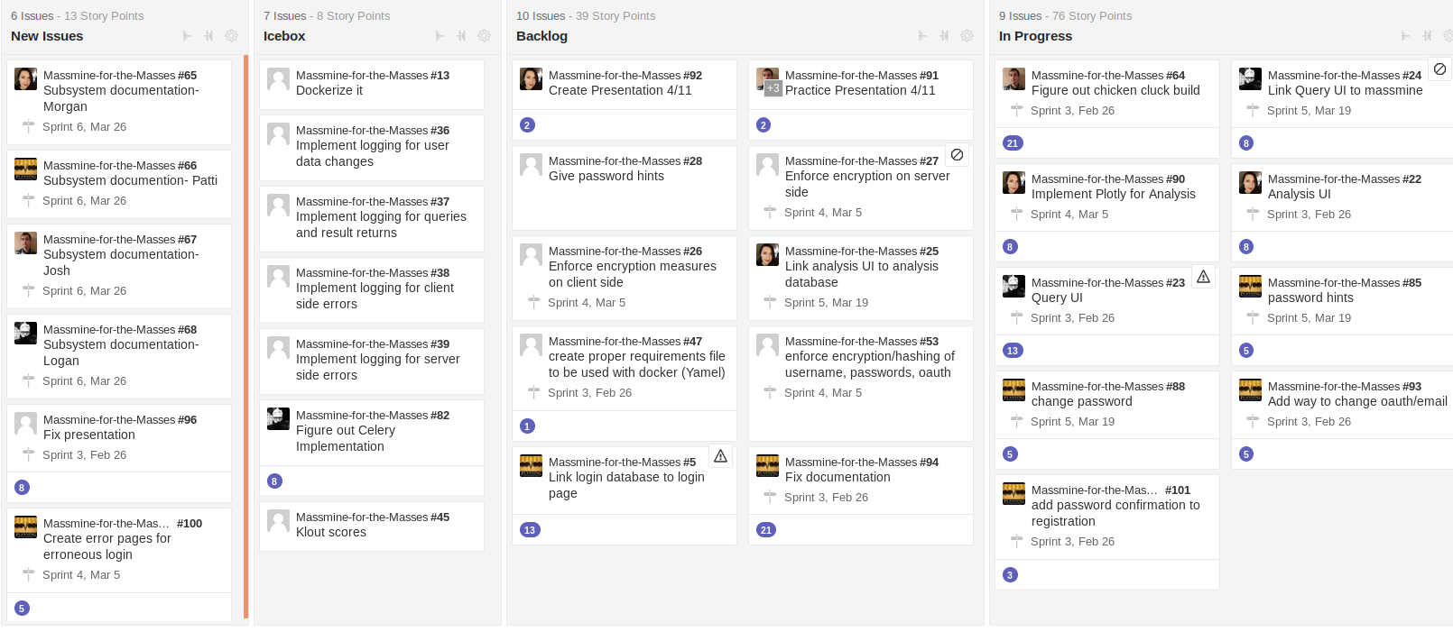
Backlog: Feb. 19
Still a good bit to do, but broken down further and has further breaking down to go
Notes:
Patti

Slide 15
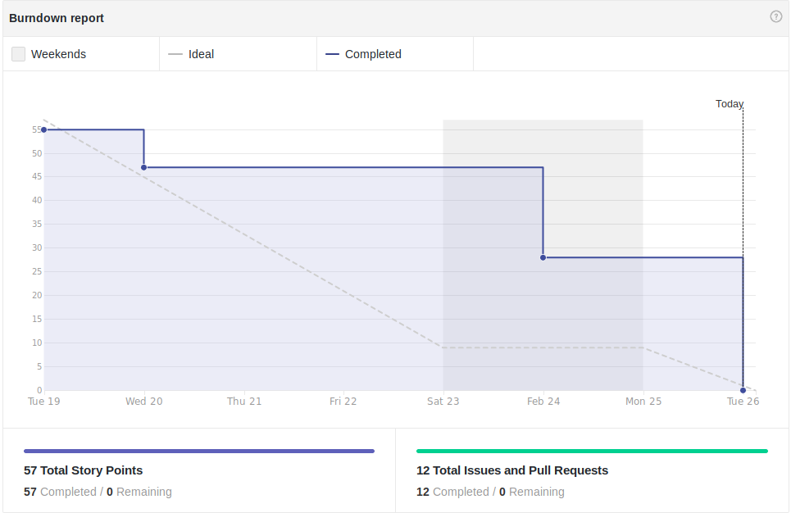
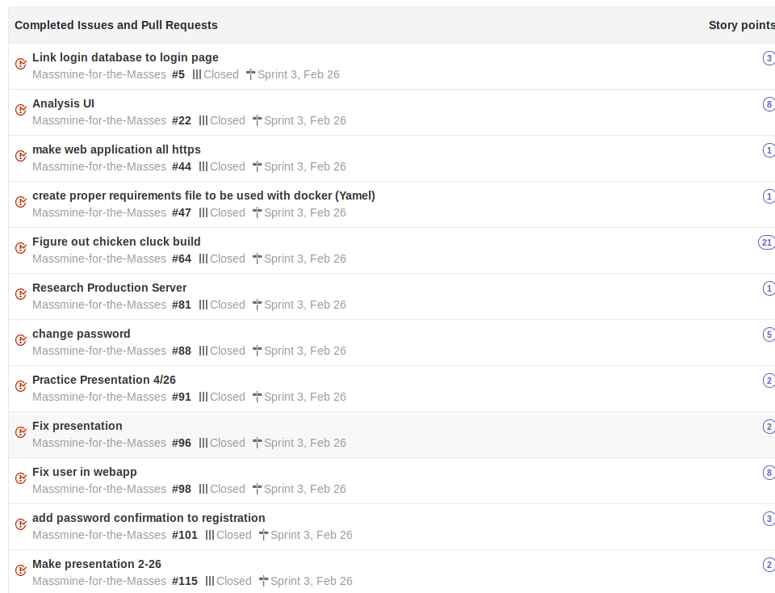
Scrum Update: Feb 26
On track
Notes:
Patti

Slide 16
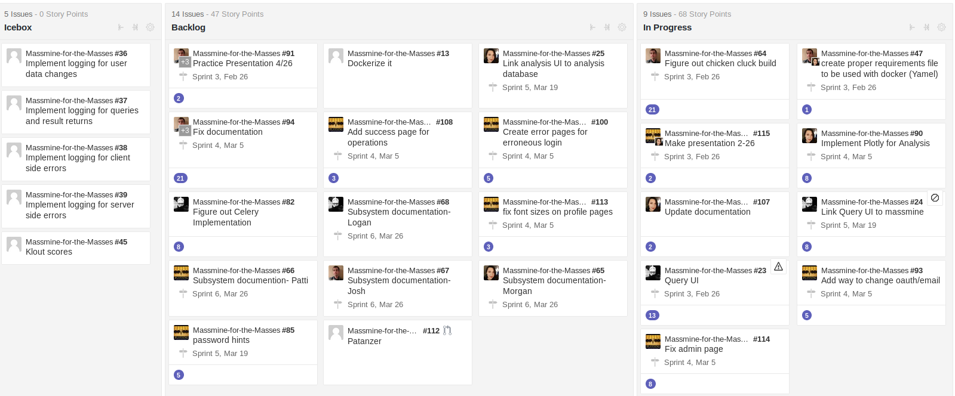
Backlog: Feb. 26
Some subsystems are broken down into component pieces. Others still exist as large blocks.
Notes:
Patti

Slide 17
What’s to come?
Models!
Socket? Who needs it?
More usability for the user! (and the admin page back)
Graphs for data
Notes:
Mention the backend work we’re going to get done, maybe include database diagram?

