Slide 1
Massmine for the Masses
Joshua Moore, Logan Hornbuckle, Patricia Tanzer, Morgan McIntyre

Slide 2
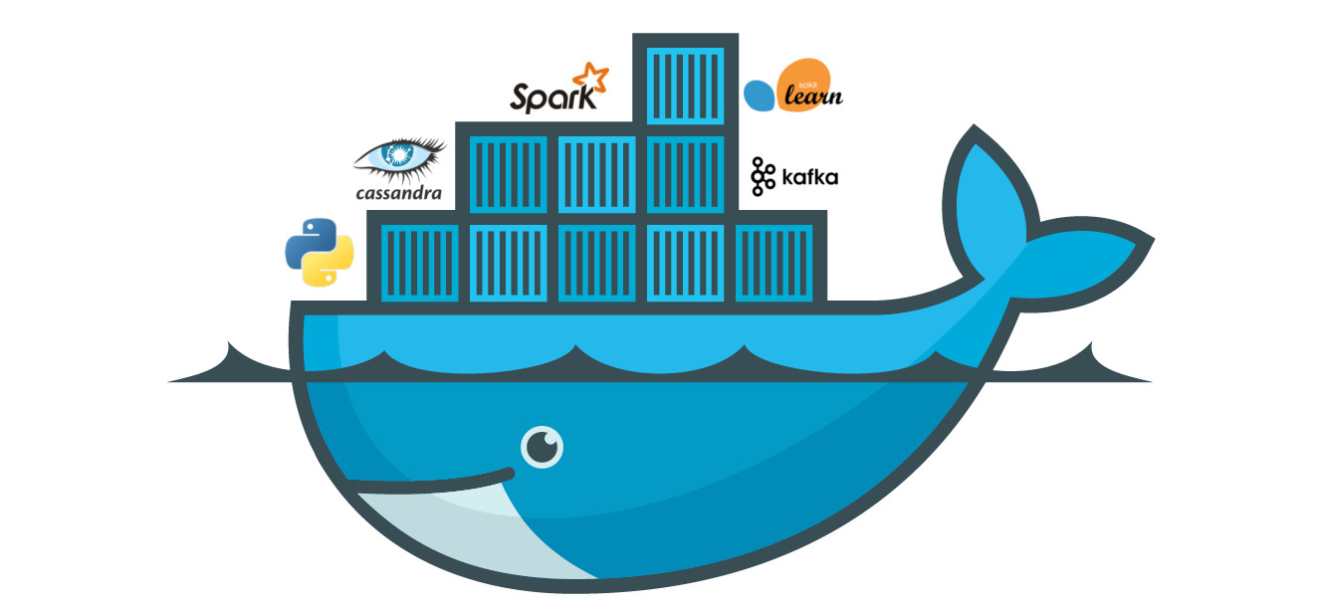
Major changes!
Smaller!
Faster!
Lighter!
Better! Making it local, making it Docker

Slide 3
Subsystems of Massmine for the masses
Query models
Analysis models
User models
MassMine Integration
Notes:
Morgan

Slide 4
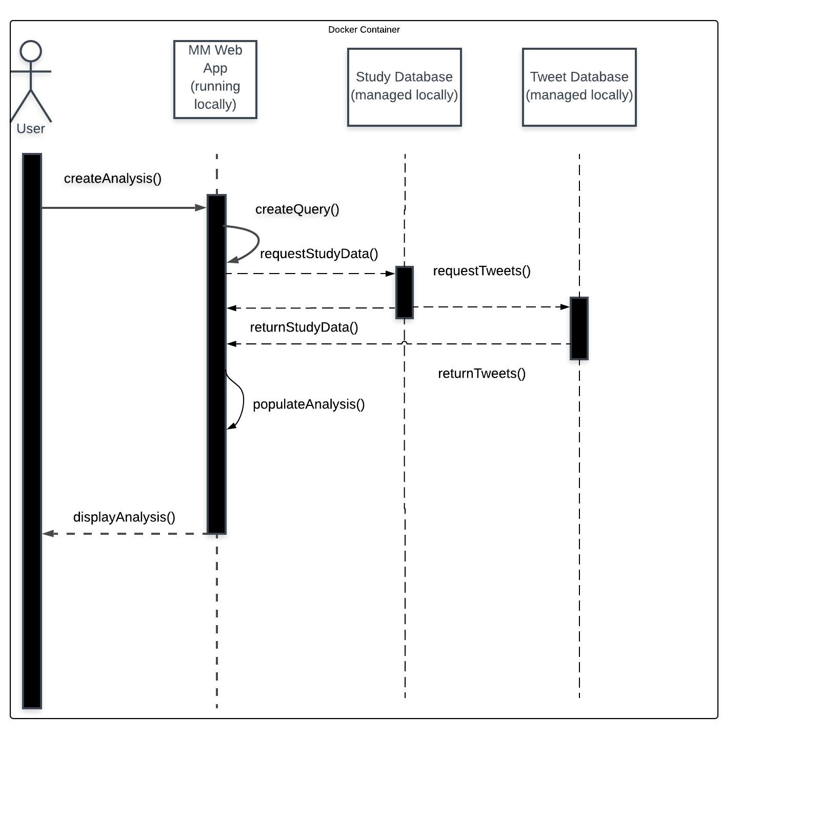
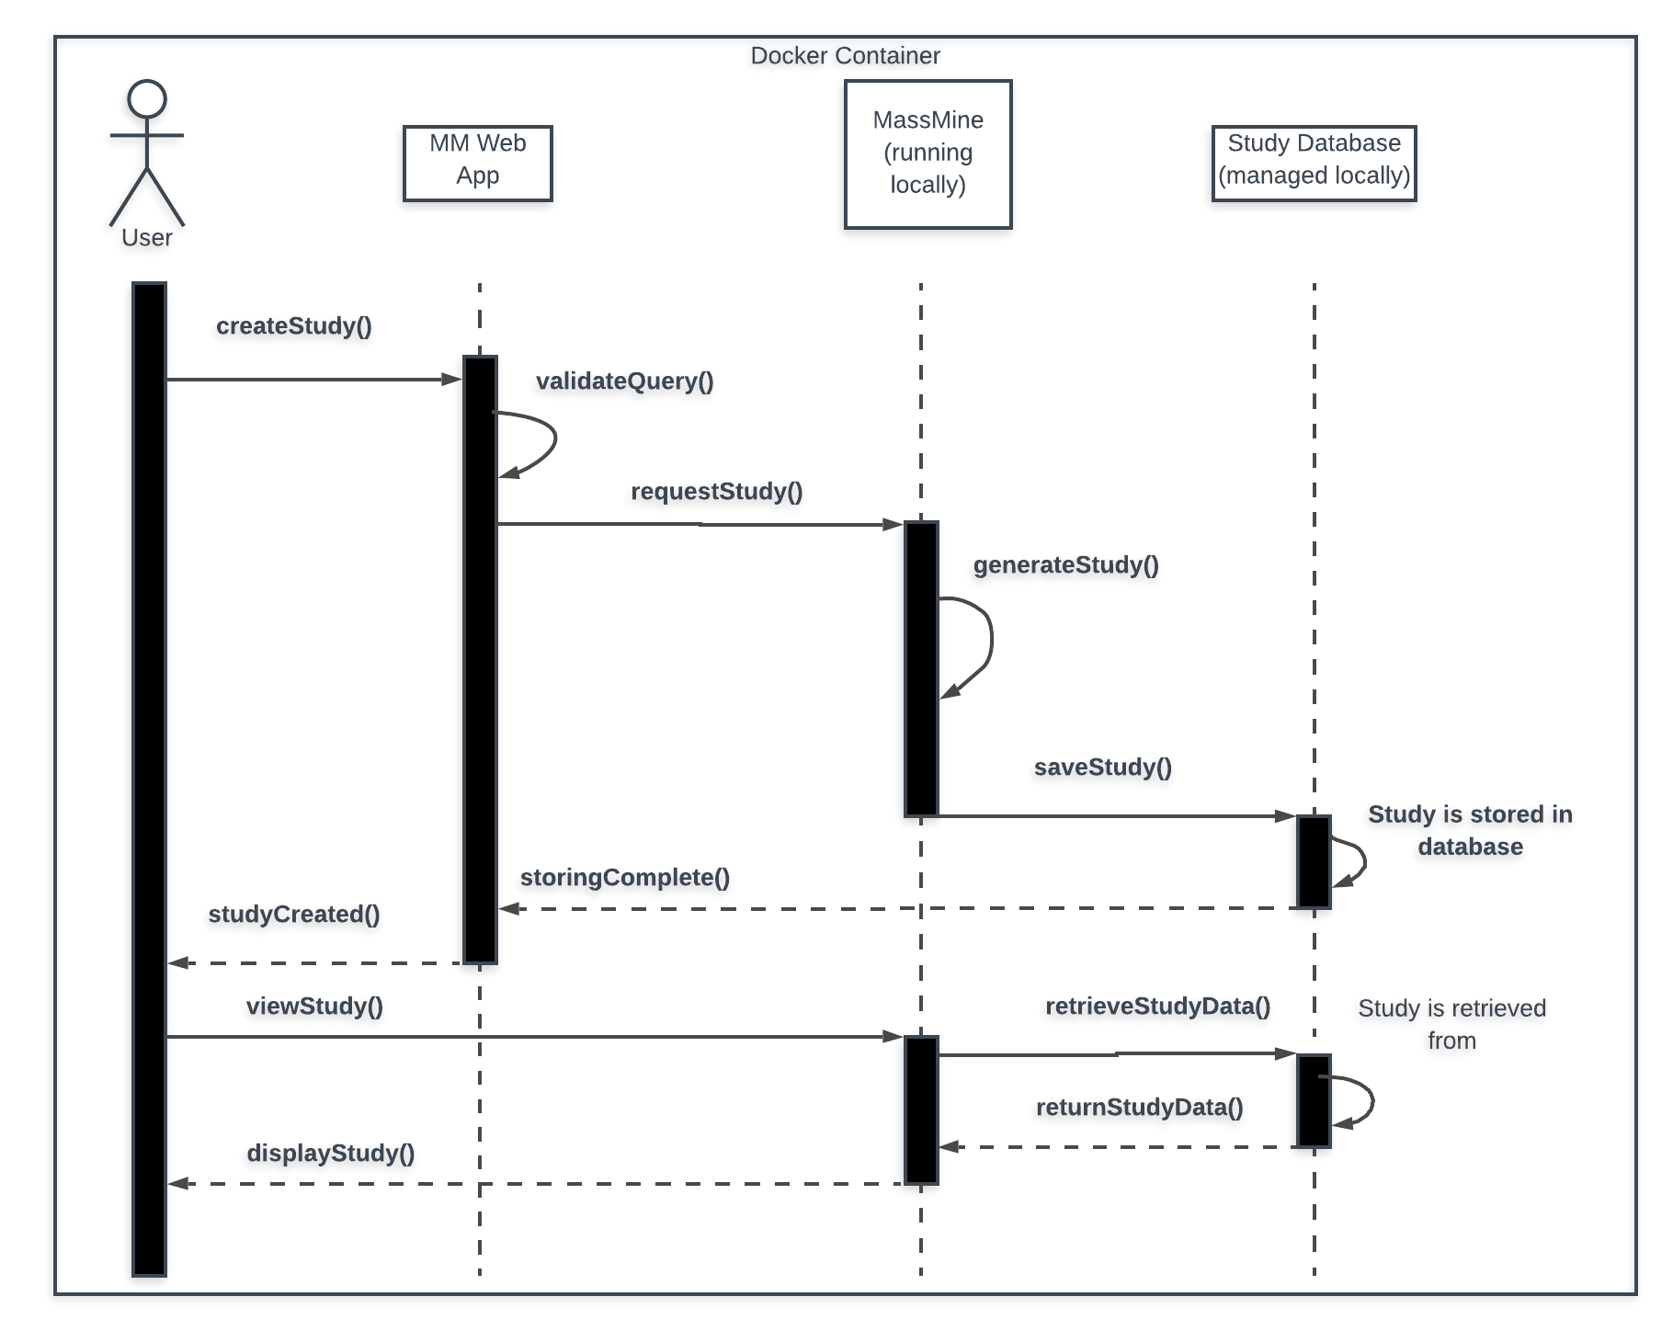
Similar flow, just local!

Slide 5
Query UI
Tasks:
Using Django 2.1.7 to create Query Interface
Communicating with Massmine socket
Query Interface will build Massmine Query
Determine best format / parsing method
Example Massmine Query:
# Fetch some data first massmine --task=twitter-search --count=200 --query=love --output=mydata.json # Convert the JSON from above into .csv, keeping the # "text" and "user:screen_name" fields jsan --input=mydata.json --output=mydata.csv --keep text user:screen_name

Slide 6
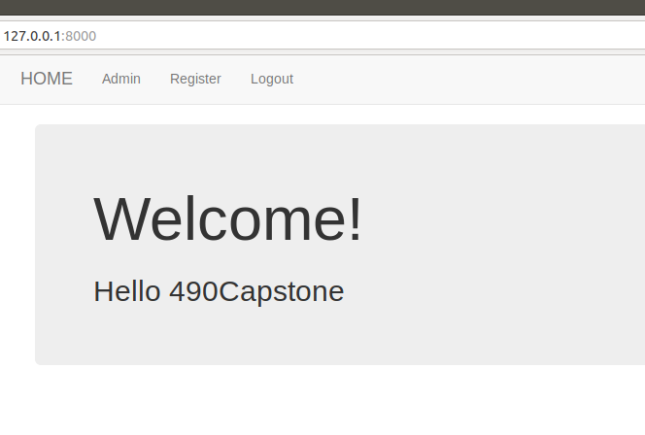
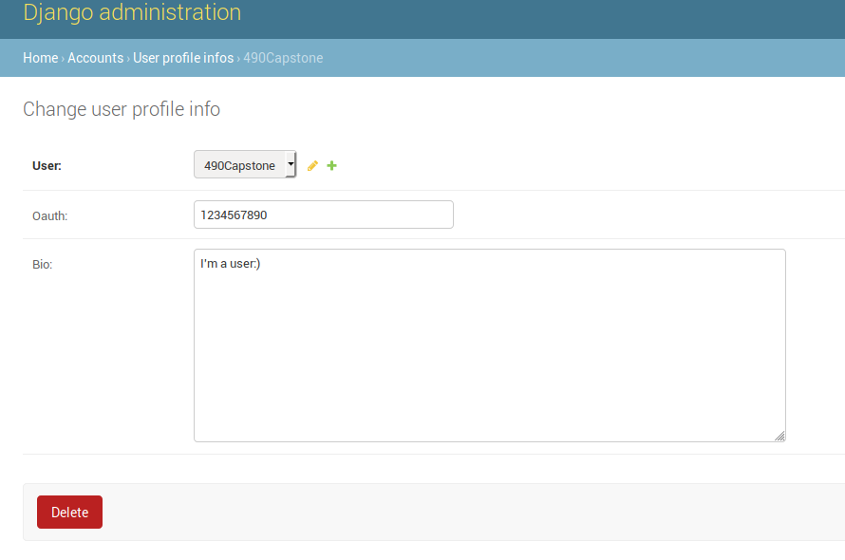
User UI
Working on password hints, non-admin changes to profile

Slide 7
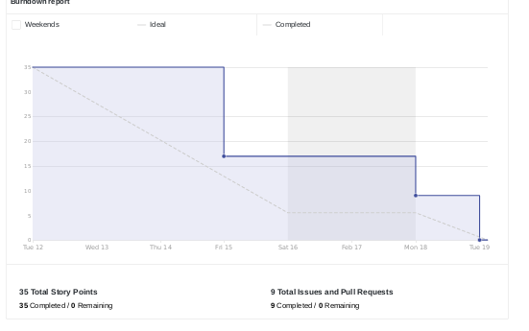
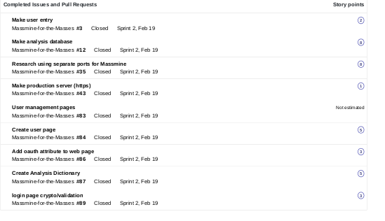
Scrum Update: Feb 19
Making better time this week
Notes:
Patti

Slide 8
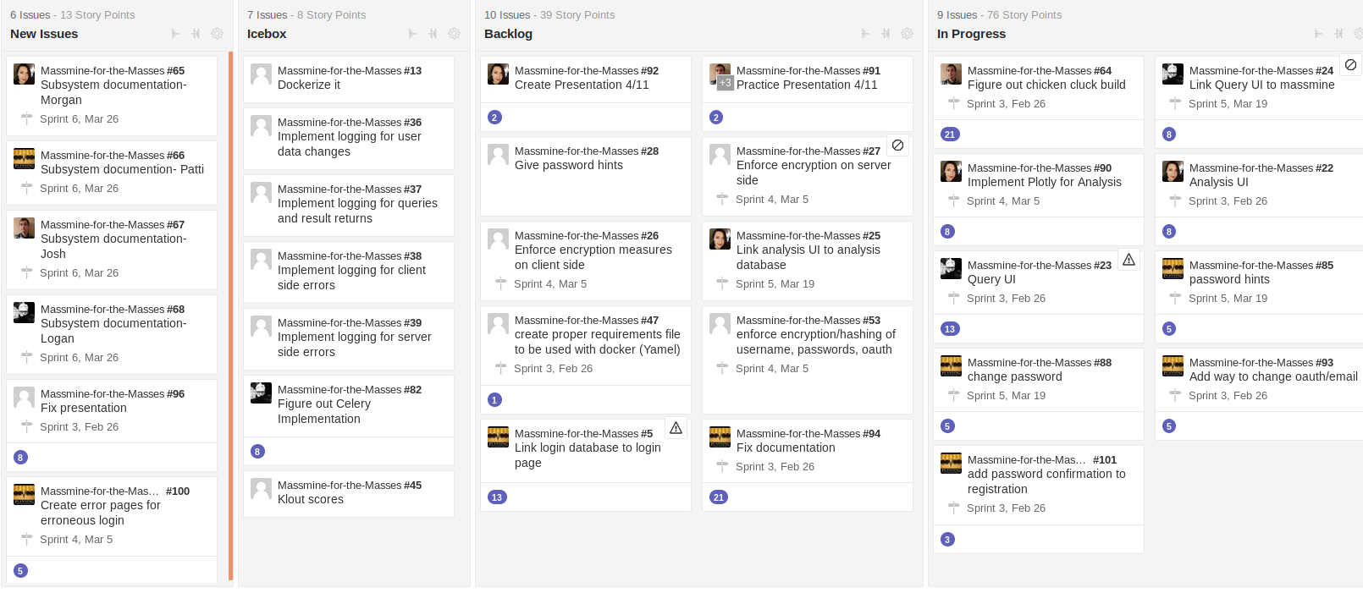
Backlog: Feb. 19
Still a good bit todo, but broken down further and has further breaking down to go
Notes:
Patti

