Slide 1
Massmine for the Masses
Joshua Moore, Logan Hornbuckle, Patricia Tanzer, Morgan McIntyre

Slide 2


Slide 3
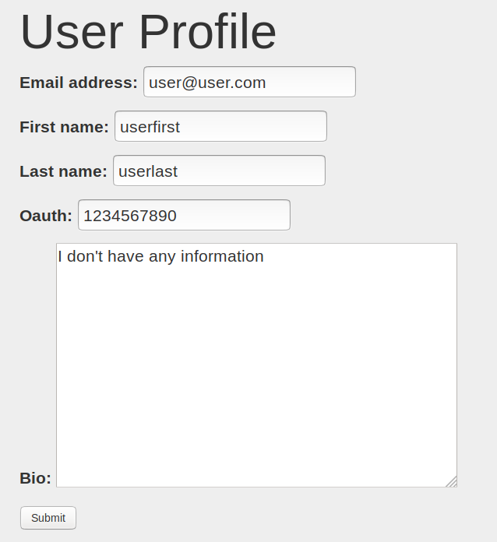
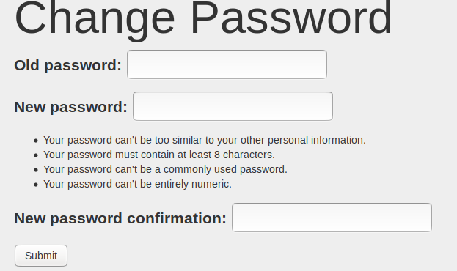
User Updates:
Edit all fields except username
Can change password without being admin!

Slide 4
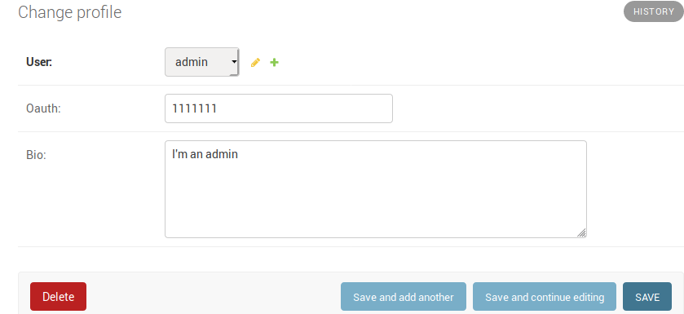
Admin Updates
Admin page linked on navbar
Admin no longer breaks when accessing own profile
Created by command line or existing admin

Slide 5
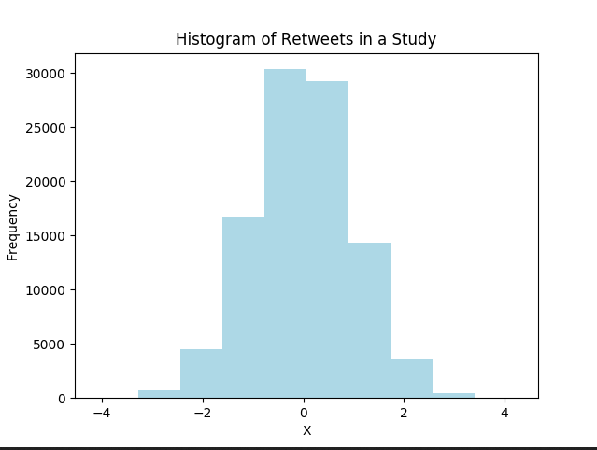
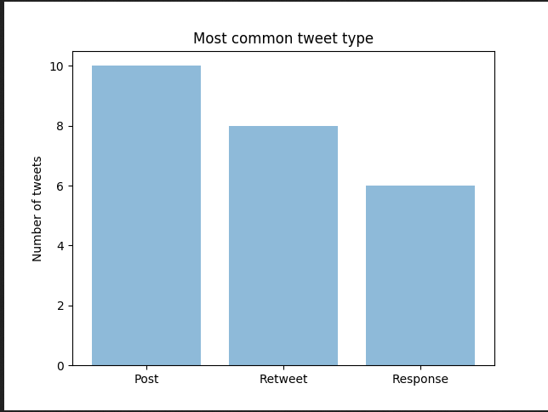
Analysis Update
Done:
Functioning plotly graphs
Unique display based on dropdown bar
To be done:
Graphs pull from sqlite database and tweet/study model
Integrate better with app as a whole

Slide 6
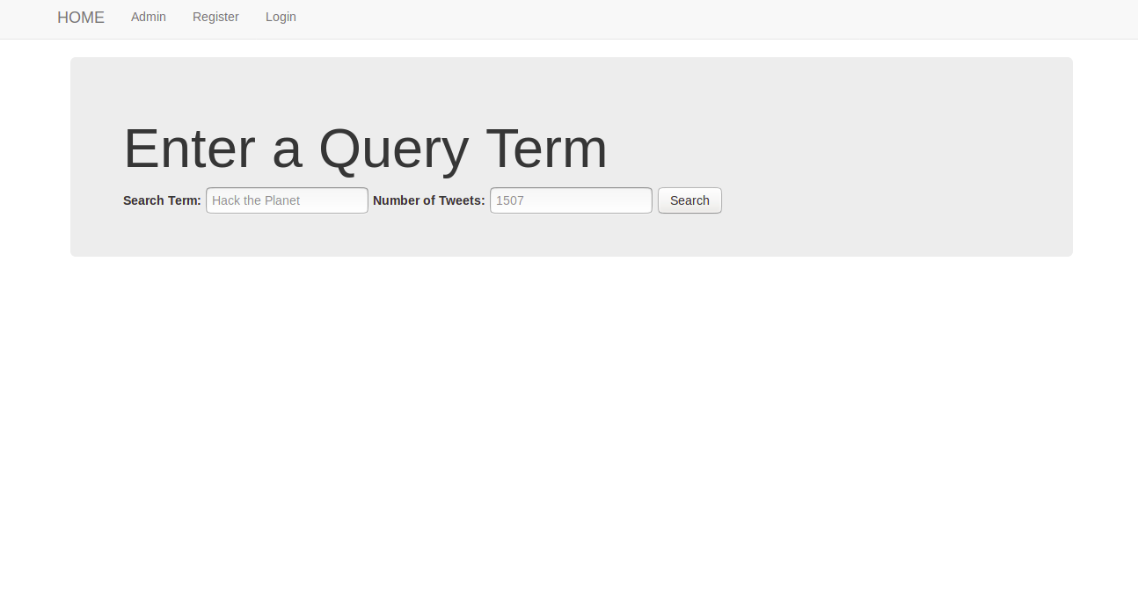
Massmine/Query Stuff

Slide 7
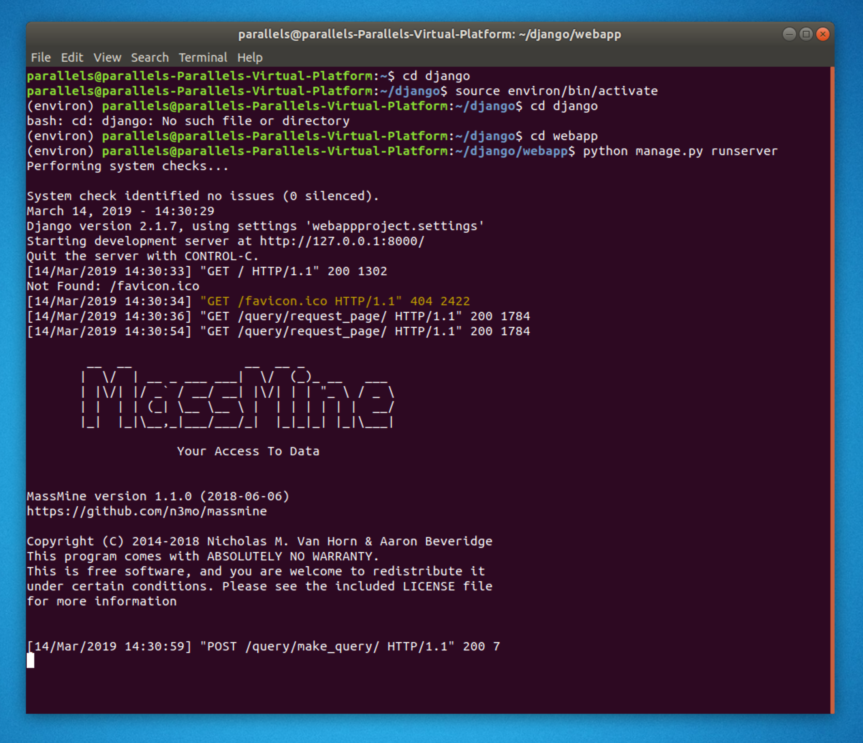
Massmine Integration
Current:
Able to create Massmine query from webpage
Still in prototype stage
TO DO:
Optimize with Celery
Integrate with DB
Notes:
Logan

Slide 8
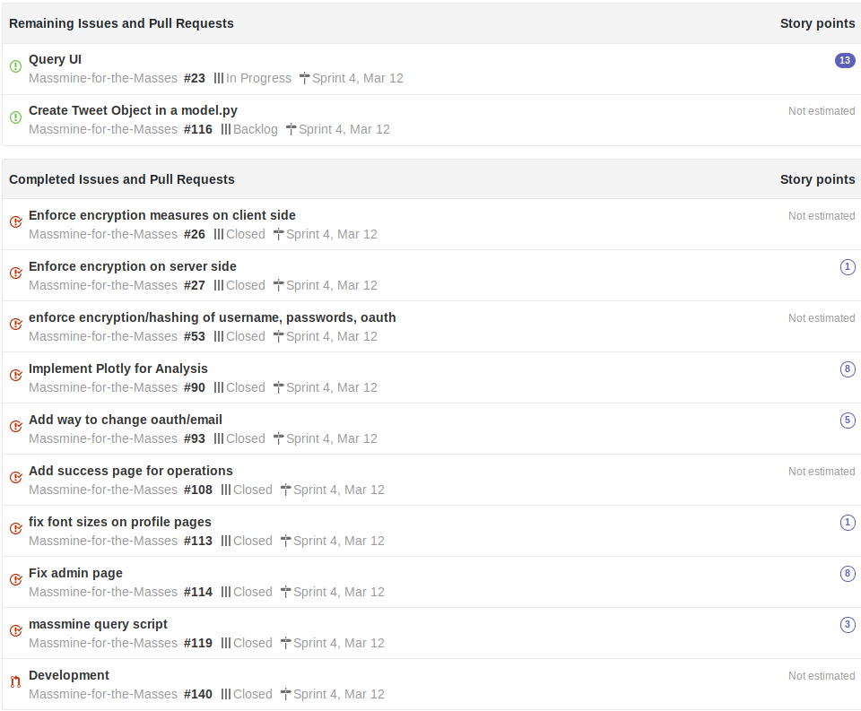
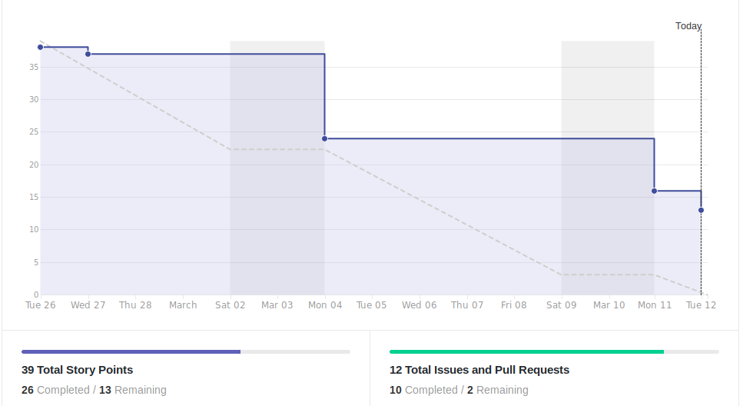
Scrum Update: March 12 (two week sprint)
Lack of communication putting us behind schedule
Notes:
Patti

Slide 9
Goals for Mar. 19
Priorities:
Query page
Presentation docs
Tweet model
Study Model
Insertion of values to database
Side goals:
Graphs in documentation
Analysis in new tabs or integrated

