Slide 1
Processing framework & Hit Finder algorithm

Slide 2
Reminder
10 fibres per APA @9.6 Gbps
12-bit ADC samples @2MSamples/s
Effectively 10 independent data streams
Each fibre corresponds to 256 wires
Induction & collection wires on the same fibre
10 “Hit Finder” processors operating in parallel (1 per fibre) @250MHz
Each Hit Finder produces hits also by processing ADC values in parallel

Slide 3
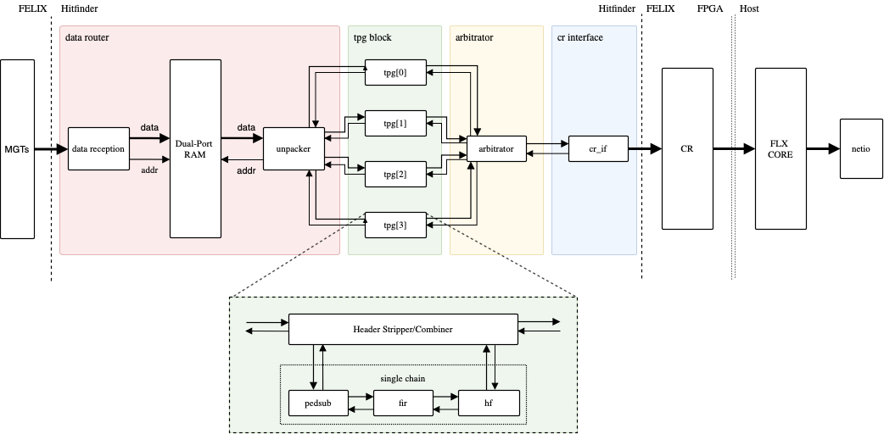
Hit Finder Firmware Architecture

Slide 4
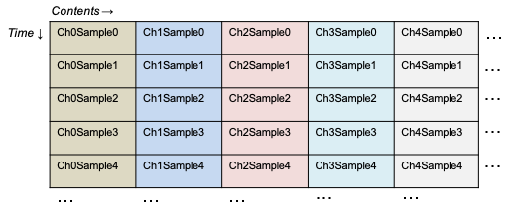
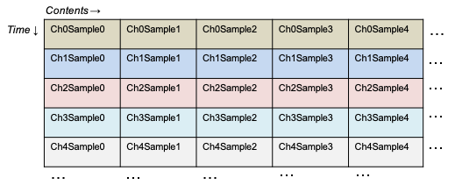
Data Router
Consists of 3 major blocks: Data Reception, Data Storage and Unpacker
Data Router turns WIB packets (multiple channels, single time-tick) to processing packets (single channel, multiple time-ticks)
Data arrives in packets containing all channels for a single time-tick
Rearrange into packets with multiple time ticks for a single channel

Slide 5
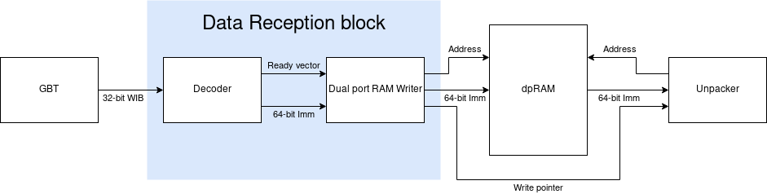
Data Router
Data Reception block receives data from the GBTs and converts incoming packets from 32-bit WIB to Nx16-bit (N=4) format
Converted packet written to a circular buffer (Data Storage - dpRAM block implementation)
Recognizes & exploits repeating patterns in incoming data, allowing smarter buffering of smaller parts of the frame
Unpacker: unpacks channel data from Data Storage (64-bit dpRAM), repacks them N=4 channels at a time, and sends the packets to the TPG blocks over axi4s bus
Data Storage

Slide 6
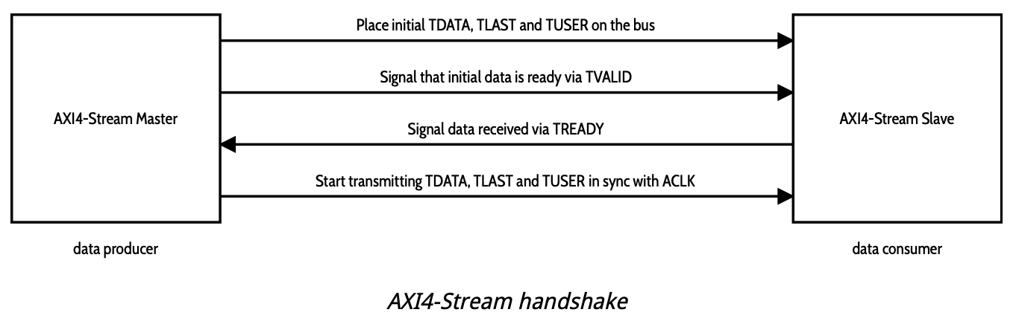
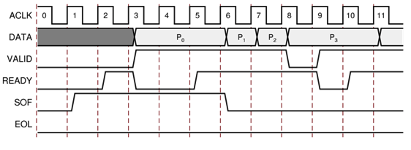
Data Format used in TPG blocks
ADC samples are processed in packets
Each packet consists of 64 ADC samples (data frame) and a Header that contains a time-stamp, channel no. and flags (Header frame)
AXI4-Stream protocol after unpacking & reordering of data
AXI4-Stream: AMBA protocol designed to transport arbitrary unidirectional data streams
tvalid denotes valid data on the bus
tuser flag denotes end of each frame,
tlast denotes end of packet
tready used to apply backpressure

Slide 7
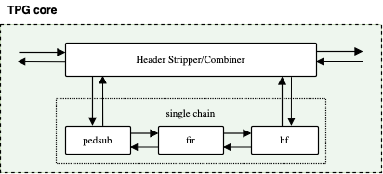
TPG block - Header Stripper/Combiner
Receives packets from Data Router
Upon arrival of a packet signal DR to hold transmission
Strips Header and sends it to the output
Sends the 64 ADC values to the processing chain (PedSub, FIR, HF)
Receive hits from Hit Finder and forwards them to the output
Signals Data Router to send next packet

Slide 8
TPG block - Pedestal Subtraction
Firmware implementation based on Phil’s algorithm for Pedestal Subtraction
Algorithm:
Start with accumulator=0 and an estimate of the pedestal
If ADCvalue >(<)pedestal => accumulator +(-) 1
If accumulator = +(-) 10 => pedestal +(-) 1 and reset accumulator to 0
State Save/Restore mechanism
At the end of each packet store the pedestal & accumulator values and retrieve them when it’s time to process a packet from that same channel again.
Use of distributed RAM to save BRAM resources
For validation purposes we currently also send to the output the pedestal and accumulator values at the beginning of each data packet, if that packet produces a hit.

Slide 9
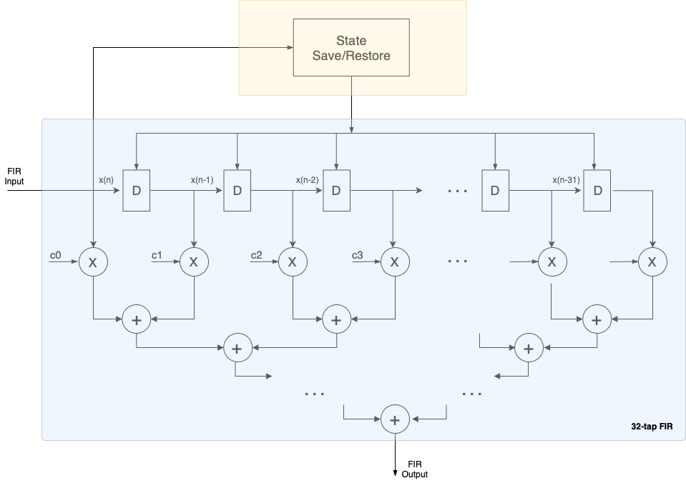
TPG block – Filtering
Simple low-pass, 32-tap FIR filter
Custom FIR implementation
State Save/Restore mechanism
Store the last 32 ADC values of an incoming packet for each channel
Retrieve the values and preload them into the FIR when it’s time to process a new packet from that same channel
Coefficient set currently hardwired
Can easily be changed to accept different sets of coefficients

Slide 10
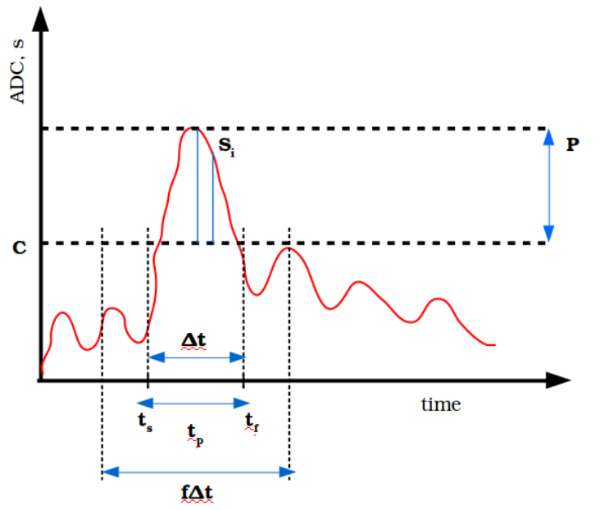
TPG block - Hit Finder
Processes pedestal-subtracted & filtered ADC values
A hit starts when 2 consecutive ADC values (si) are above threshold and lasts until the values drop below threshold
Quantities output by Hit Finder:
Start/End time of a hit
Peak time, peak amplitude
Sum of all ADC values above threshold
Detects if a hit expands over end of packet and raises a Hit Continue flag
Hit Finder is memory-less (no State S/R)
Threshold can be changed via IPBus

Slide 11
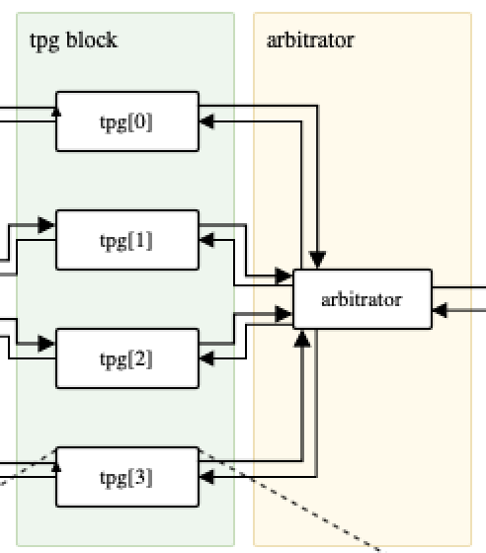
Arbitrator & CR-interface
Arbitrator: multiplexes the 4 TPG blocks into a single output
FIFOs used to buffer inputs in case of multiple incoming packets
Waits for end-of-packet signal to output data
CR-interface: used as interface between Hit Finder and Central Router
Consists of 3 main blocks:
FIFO wrapper: prevents backpressure events
Hit Packet Filter: filters out hit empty packets, detects & removes corrupted hit packets
CRIF Packer: is the CR-if core and translates each hit packet into a CR packet format

