Slide 1
Firmware Implementation for the Proto-DUNE II Hit Finding Architecture with the Xilinx HLS Tool

Slide 2
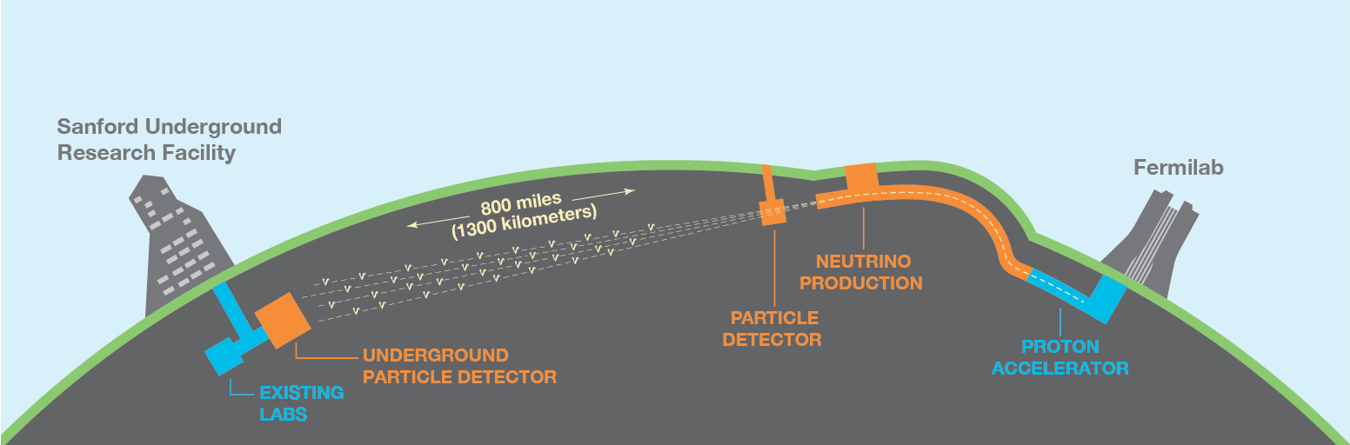
Deep Underground Neutrino Experiment
DUNE is a long baseline neutrino beam experiment based in North America. It consists of:
  A neutrino source generated from a 1.2 MW proton accelerator at Fermilab
  A large-scale far detector 1300 km from the beam source, and 1500 m underground at SURF
  A composite near detector 574 metres from the beam source

Slide 3
Neutrinos and the SM
Rates of CP violation in the quark sector does not account for the relative abundance of baryonic matter seen in the universe
Perhaps leptonic CP violation is the answer?
To record the rate of leptonic CP violation, one must search for differences in the behaviour between neutrinos and antineutrinos
Achievable via precision measurements of oscillations from muon (anti)neutrinos into electron (anti)neutrinos at both DUNE detectors

Slide 4
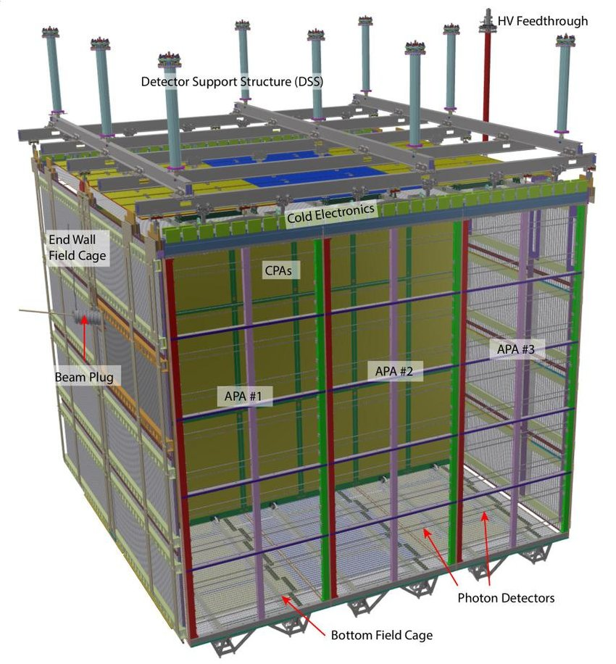
ProtoDUNE DAQ
Each LAr TPC module in the ProtoDUNE II design contains 150 APAs. Each APA contains 10 fibres, with each fibre accommodating 256 wires.
The APAs collect charges produced by neutrino interactions. Photo-multiplier tubes collect scintillation photons.
The FELIX interface receives data from the APAs and processes it with an FPGA that hosts the data reception, processing and transmission firmware

Slide 5
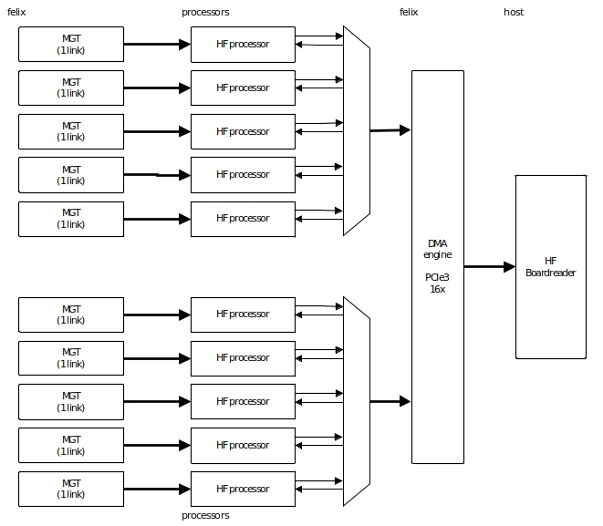
FELIX HF Architecture

Slide 6
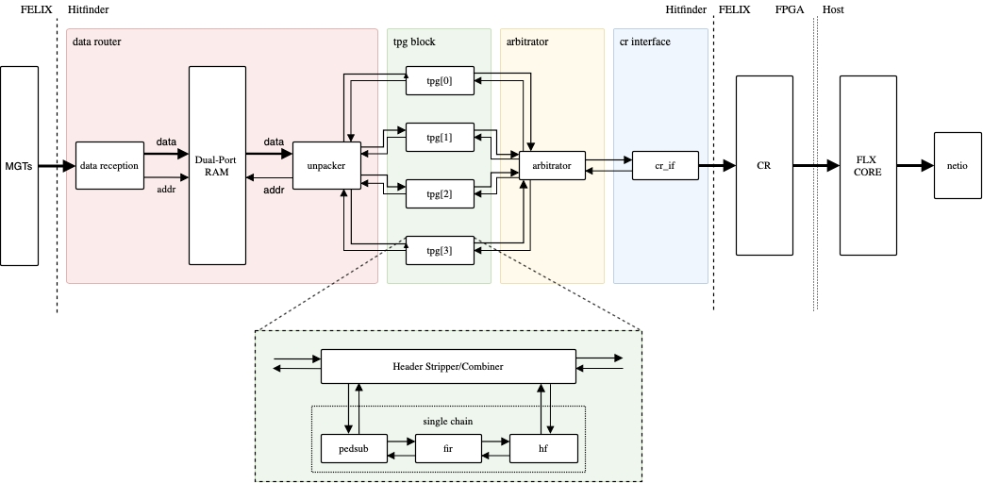
FELIX HF Architecture

Slide 7
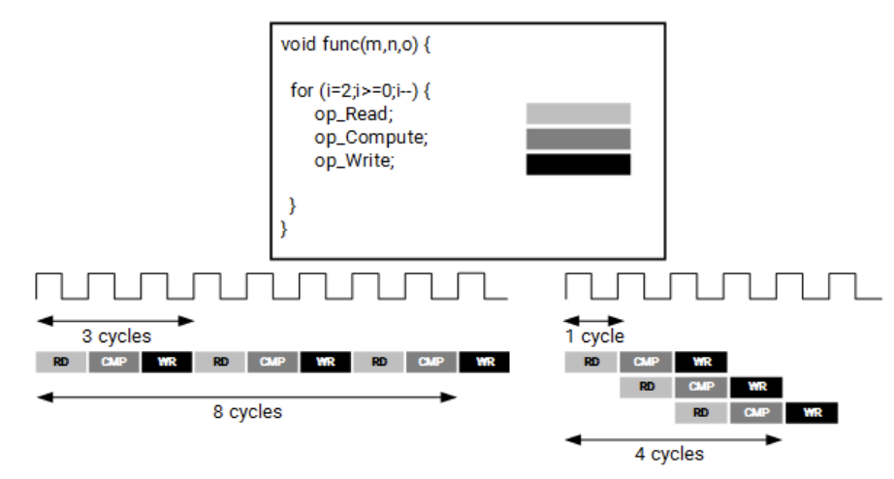
HLS
HLS software interprets a high abstraction language with a desired behaviour and generates digital hardware the implements that behaviour
A C algorithm is synthesized into an RTL, with the option of providing instructions on the implementation. These are called directives.
Operations are implemented via signal communication between BRAMs, LUTRAMs, LUTs, FFs and DSPs on the FPGA board

Slide 8
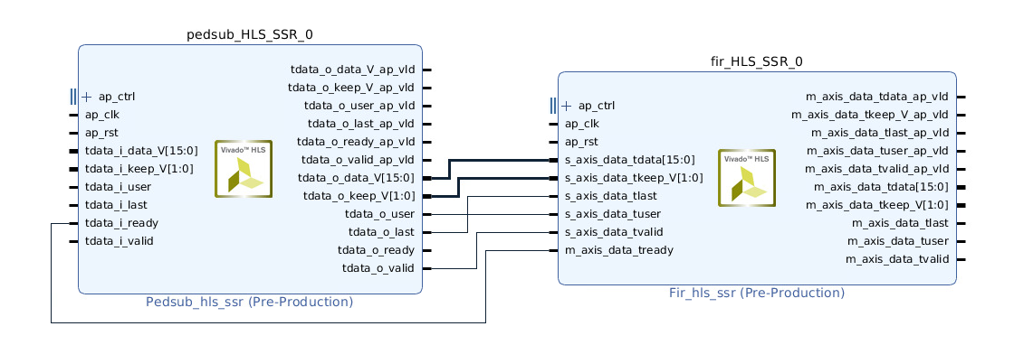
Aims of the Project
Redesign the TPG core firmware
Use the Xilinx Vivado HLS software to do so
Compare the resource utilization and performance of the new designs to those written manually in HDL

Slide 9
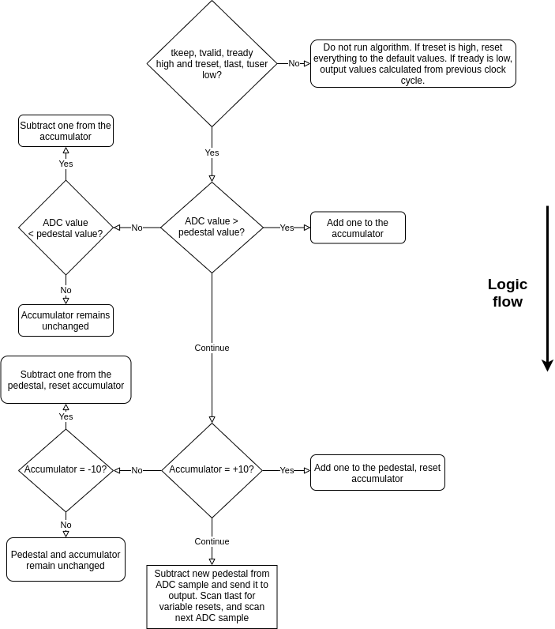
Pedestal Subtraction Algorithm

Slide 10
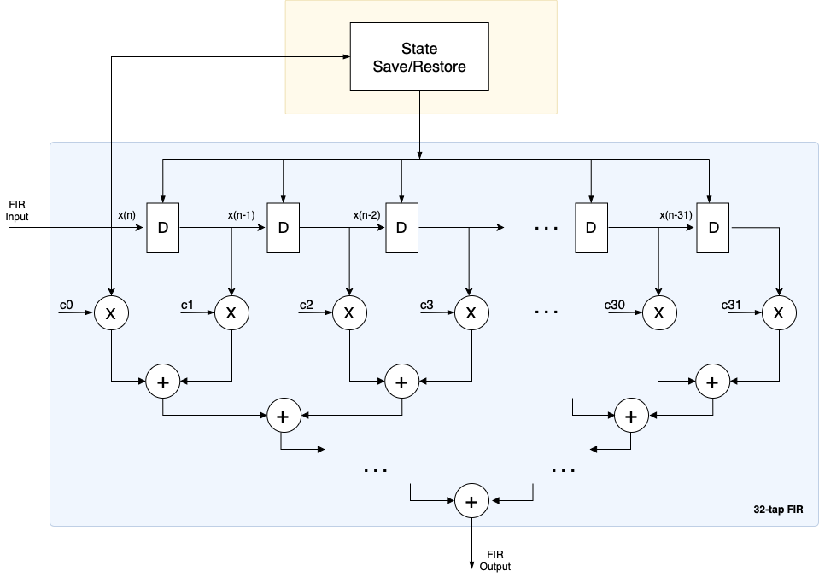
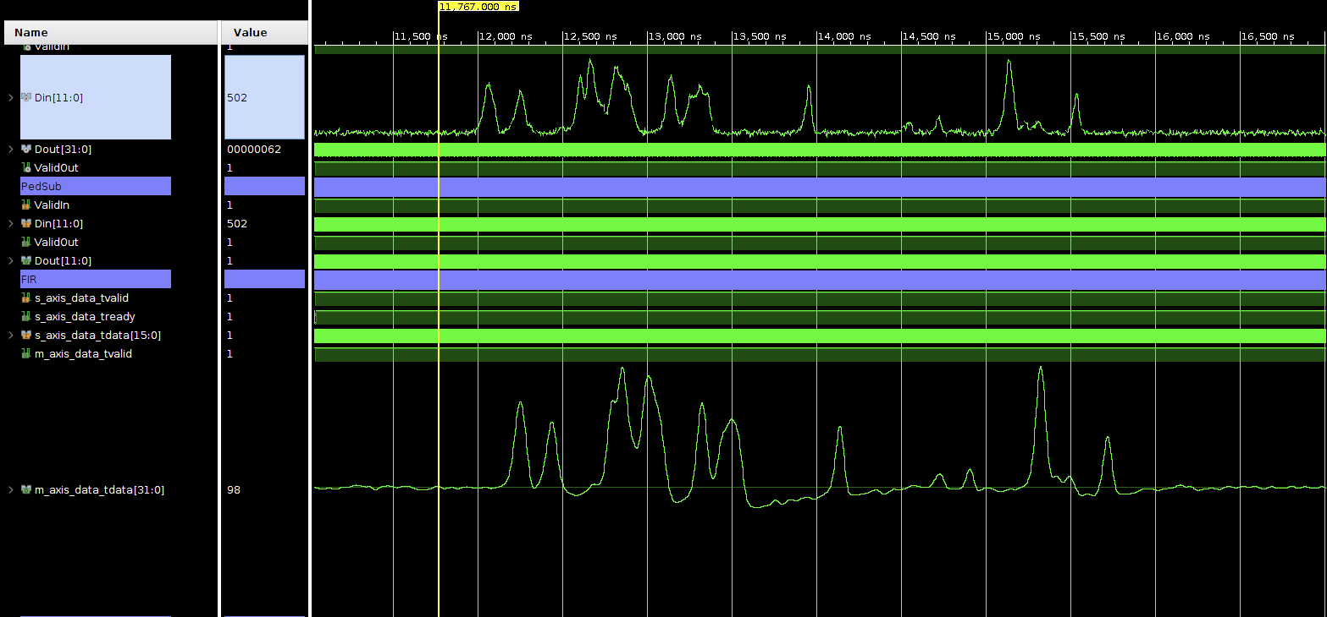
FIR Filter

Slide 11
Required Behaviour and Solutions
SSR mechanism
Fully pipelined input and output
‘Instantaneous’ response to back pressure

Slide 12
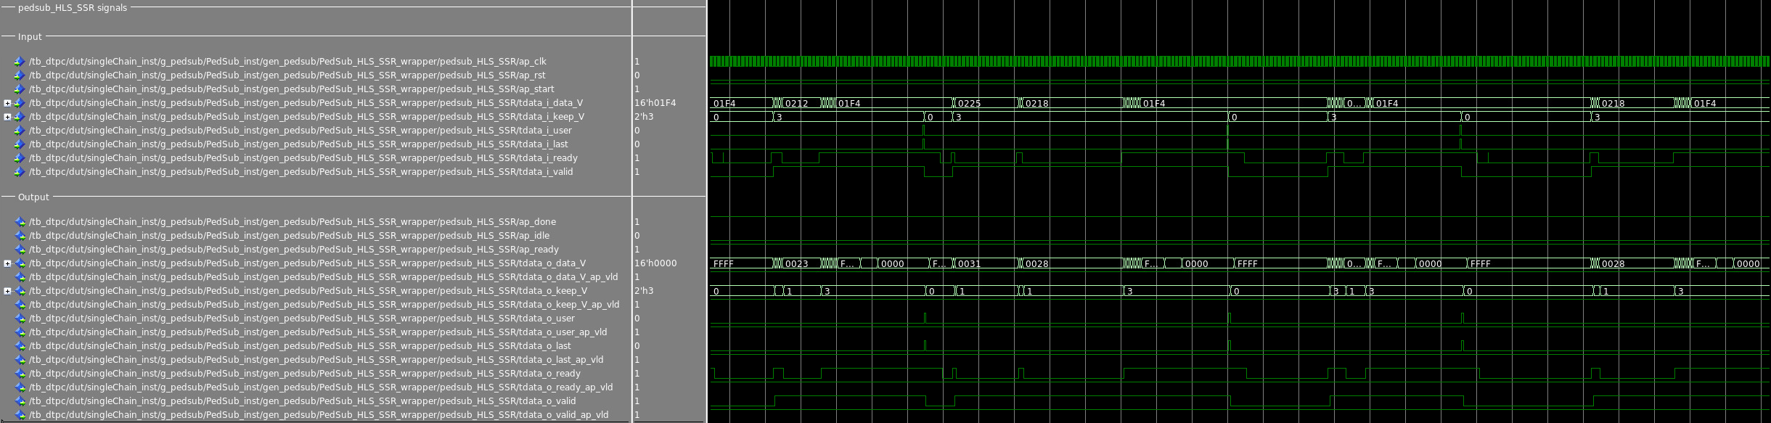
Testing the Output

Slide 13
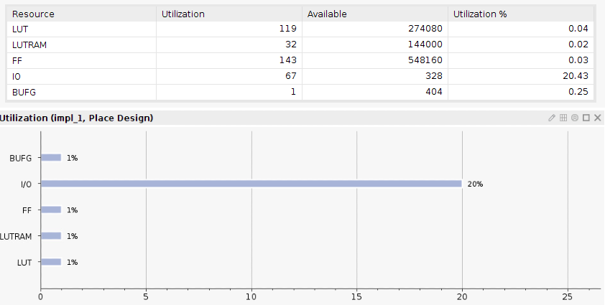
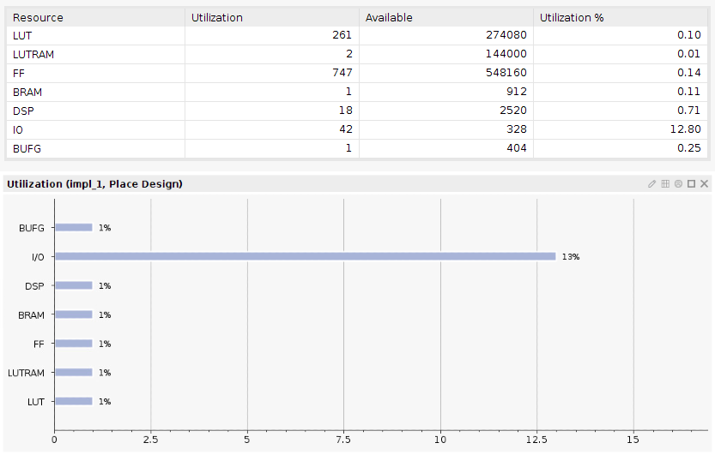
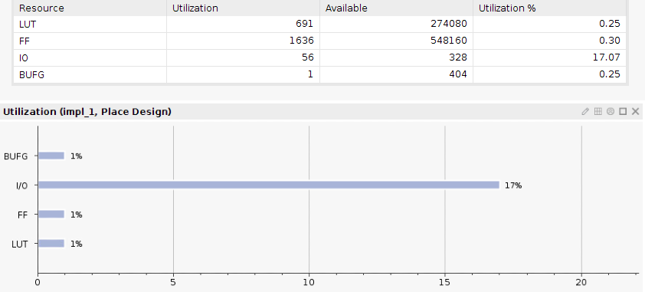
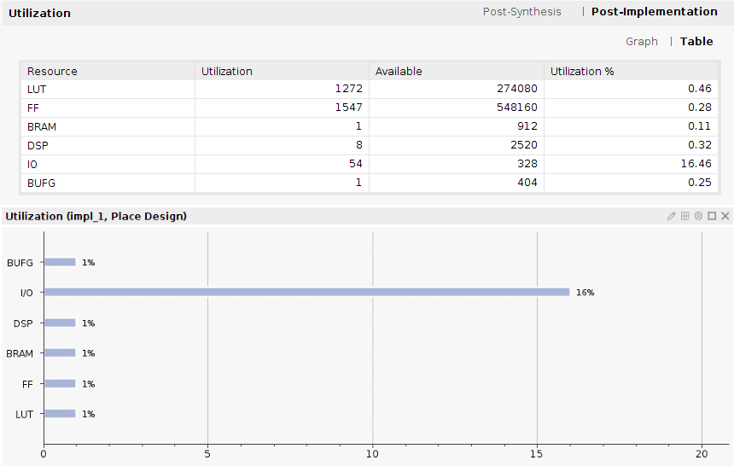
Design Comparison
Pedestal Subtraction with SSR
FIR filter with SSR
Manual HDL
Manual HDL
HLS
HLS

Slide 14
Conclusions
C++ coding style was vastly different to normal software development.
Required a trial and error approach to debugging. Less transparency than direct HDL development
In general, HLS implementations are less resource efficient
HLS provides better design productivity and more accessibility to FPGA development

