Slide 1
Windows Active Directory &
Systems Administration Lab
Hands-on project walkthrough
Ubuntu Server • Samba AD • Windows 11 • DNS • Group Policy
1

Slide 2
What I built
2
Project overview
I built a small company-style environment where Ubuntu Server acted as the Active Directory domain controller and Windows 11 acted as the employee computer. I created users, groups, and Organizational Units, joined Windows to the domain, created a Group Policy, linked it to the Computers OU, and then troubleshot and verified the policy application.

Slide 3
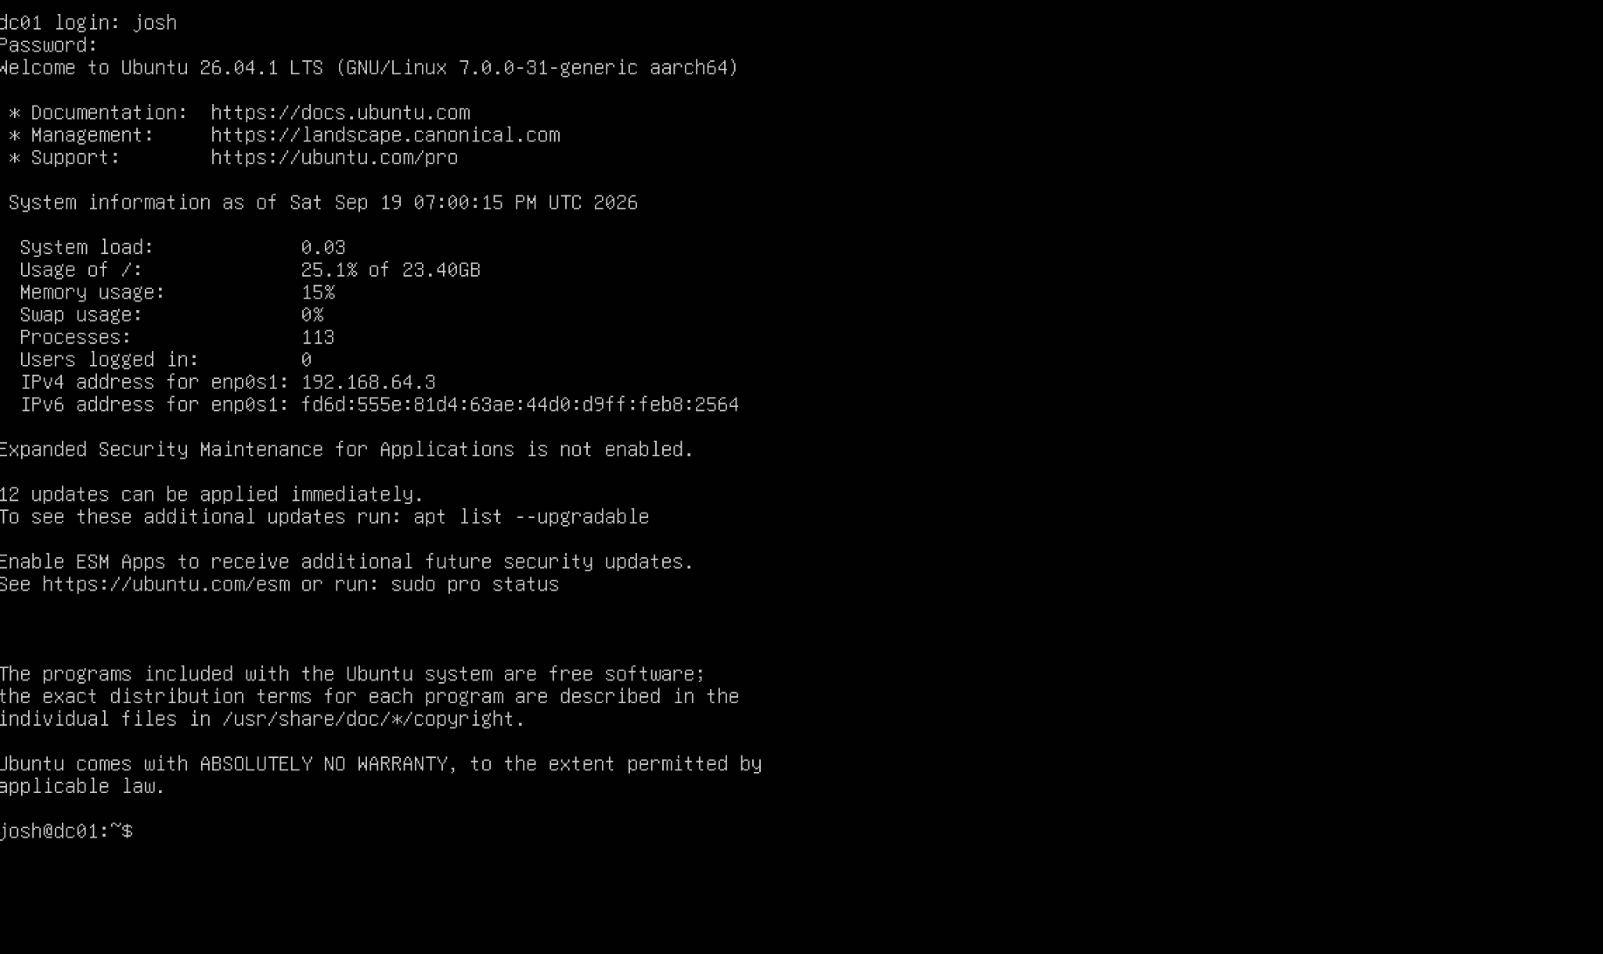
3. Set up Ubuntu Server / DC01
3
What I did
I set up an Ubuntu Server VM and configured it as DC01, the server that would act as the center of my Active Directory lab.
Why it matters
The domain controller is the central server that provides the Active Directory services the Windows computer connects to.

Slide 4
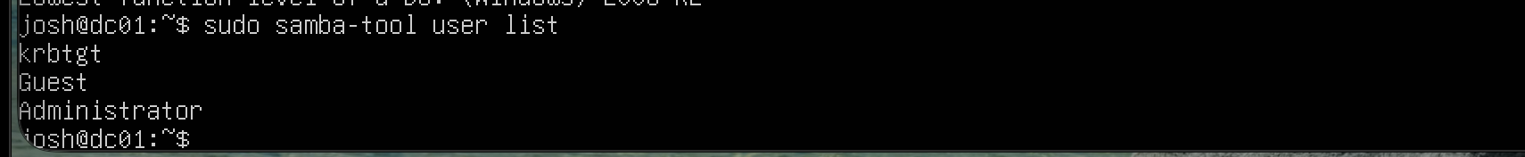
4. Verify the Active Directory domain
4
What I did
After provisioning the Samba Active Directory domain, I verified that the default domain accounts such as Administrator, Guest, and krbtgt were present.
Why it matters
This confirmed that the basic Active Directory domain environment had been created successfully.

Slide 5
5. Create the IT-Admins group
5
What I did
I created the IT-Admins group and added TestUser to it, then verified the membership.
Why it matters
Groups make it easier to manage users and permissions without handling every user individually.

Slide 6
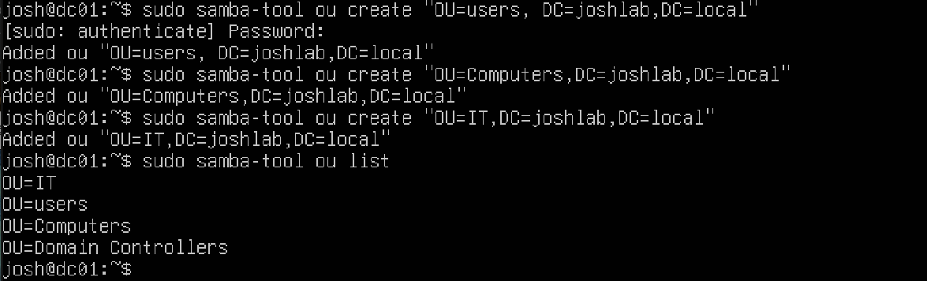
6. Create Organizational Units
6
What I did
I created the Users, Computers, and IT Organizational Units to organize the objects in my domain.
Why it matters
OUs give me a way to organize users and computers and provide a place where policies can be targeted.

Slide 7
7. Move TestUser into the Users OU
7
What I did
I moved TestUser into the Users OU and verified the user's location in the directory.
Why it matters
Keeping users organized in the correct OU makes the directory easier to manage and lets policies be targeted appropriately.

Slide 8
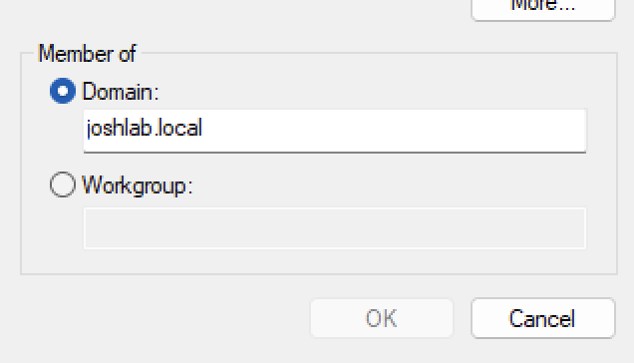
8. Join Windows to JOSHLAB.LOCAL
8
What I did
I configured the Windows machine to connect to the Ubuntu server and joined it to the JOSHLAB.LOCAL domain.
Why it matters
A domain-joined computer can use the centralized services and policies provided by the domain controller.

Slide 9
9. Move the Windows computer into the Computers OU
9
What I did
I moved the Windows computer account into the Computers OU so it could be managed through that OU.
Why it matters
This lets policies linked to the Computers OU apply to the Windows computer.

Slide 10
10. Verify the AD service
10
What I did
I verified that the Samba Active Directory Domain Controller service was active.
Why it matters
The AD service needs to be running for the domain environment and its services to work.

Slide 11
11. Create the Windows Security Baseline GPO
11
What I did
I created a Group Policy Object named Windows Security Baseline.
Why it matters
The GPO gives me one place to define Windows settings that can be applied to managed computers.

Slide 12
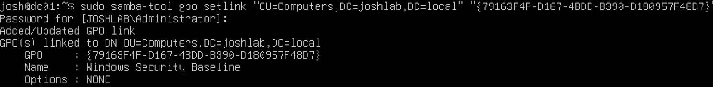
12. Link the GPO to the Computers OU
12
What I did
I linked the Windows Security Baseline GPO to the Computers OU.
Why it matters
Linking the GPO tells Active Directory which OU should receive the policy.

Slide 13
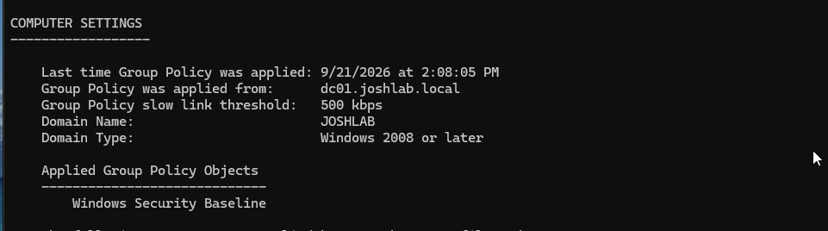
13. Verify the GPO was applied
13
What I did
I used gpresult to verify that Windows Security Baseline appeared under the Applied Group Policy Objects.
Why it matters
This proves the GPO was successfully processed by the Windows computer.

Slide 14
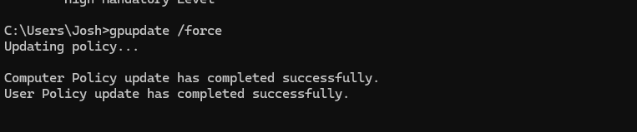
14. Confirm Group Policy update succeeded
14
What I did
I reran gpupdate /force and confirmed that both Computer Policy and User Policy completed successfully.
Why it matters
This confirmed that the troubleshooting was resolved and the Windows machine could successfully process Group Policy.

Slide 15
15
Troubleshooting & Challenges
Wrong Ubuntu ISO — Initially used the AMD64 Ubuntu ISO on my Apple Silicon Mac. I replaced it with the ARM64 version.
Samba Provisioning — My first Samba AD provisioning didn't work correctly, so I rebuilt the Samba configuration and provisioned the domain again.
IPv6 DNS Issue — Windows was also trying IPv6 for DNS, which caused normal lookups to fail even though IPv4 DNS worked.
Biggest takeaway: I learned how AD, DNS, SMB, SYSVOL, and Group Policy depend on each other.
Learning the Commands — I used Samba documentation and AI to learn unfamiliar commands, troubleshoot errors, and understand what each command was doing. I then ran and verified the commands in my lab.

Slide 16
Project Result
15
Final result
The final lab included a working Active Directory-compatible domain, users and groups, organized OUs, a Windows 11 domain-joined computer, a Group Policy security baseline, and successful Group Policy processing.

