Slide 1
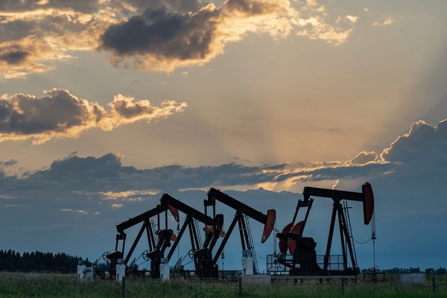
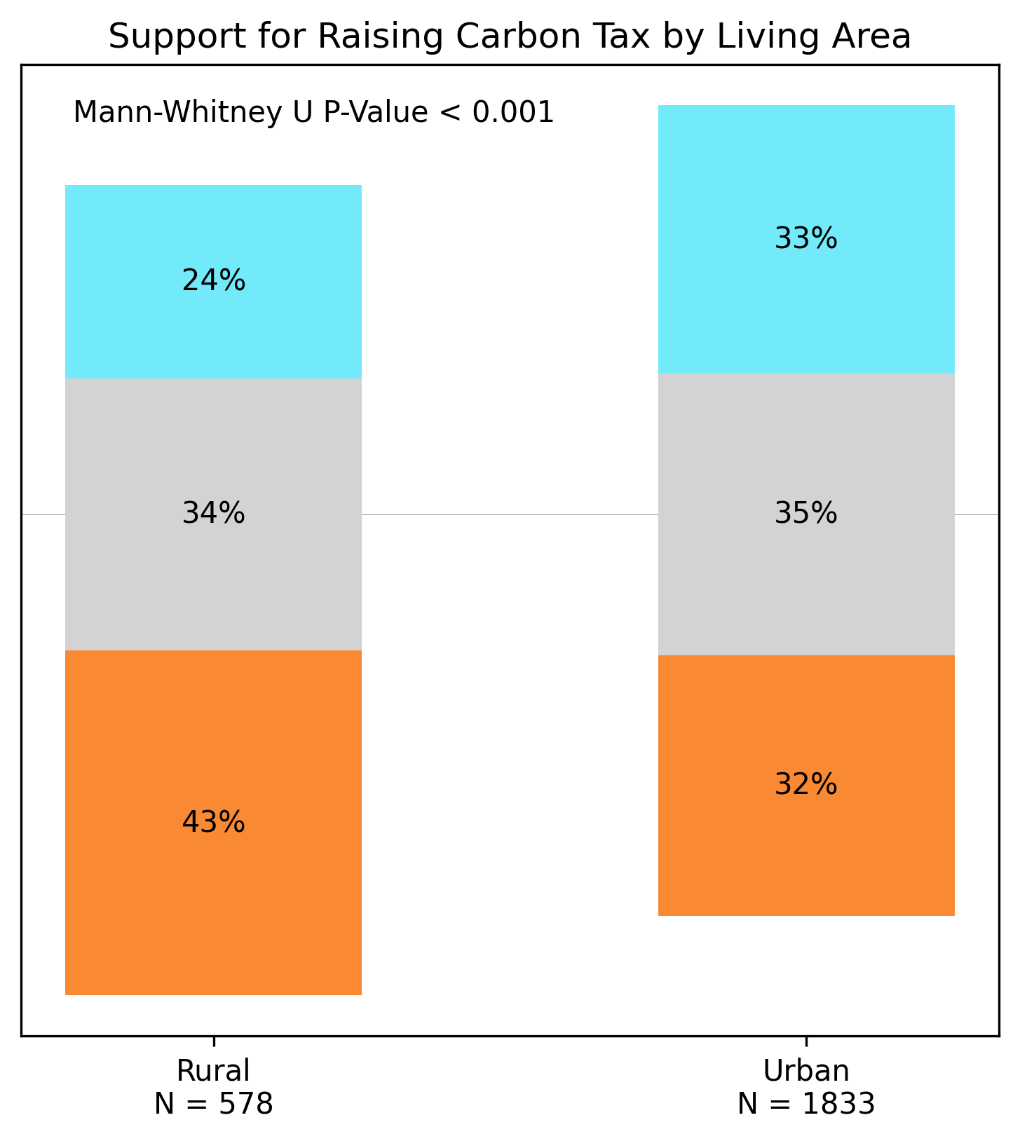
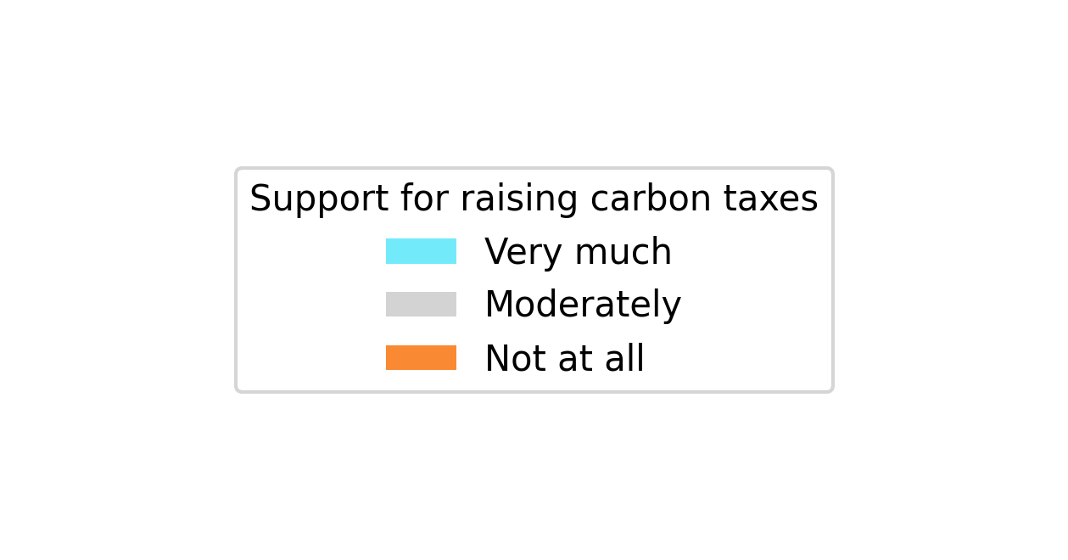
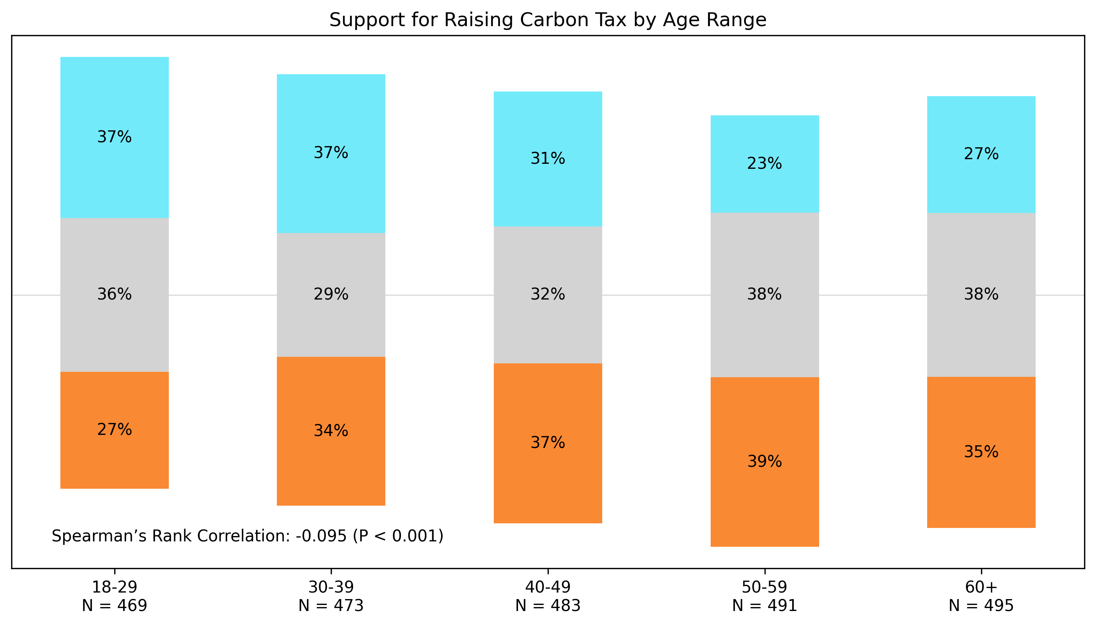
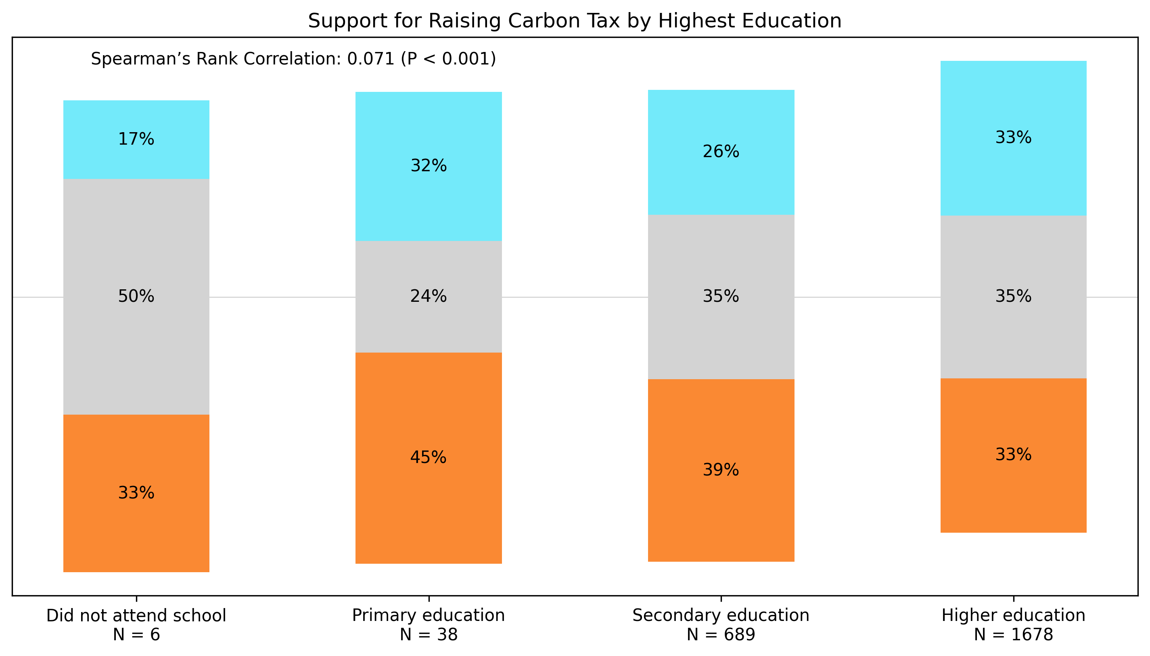
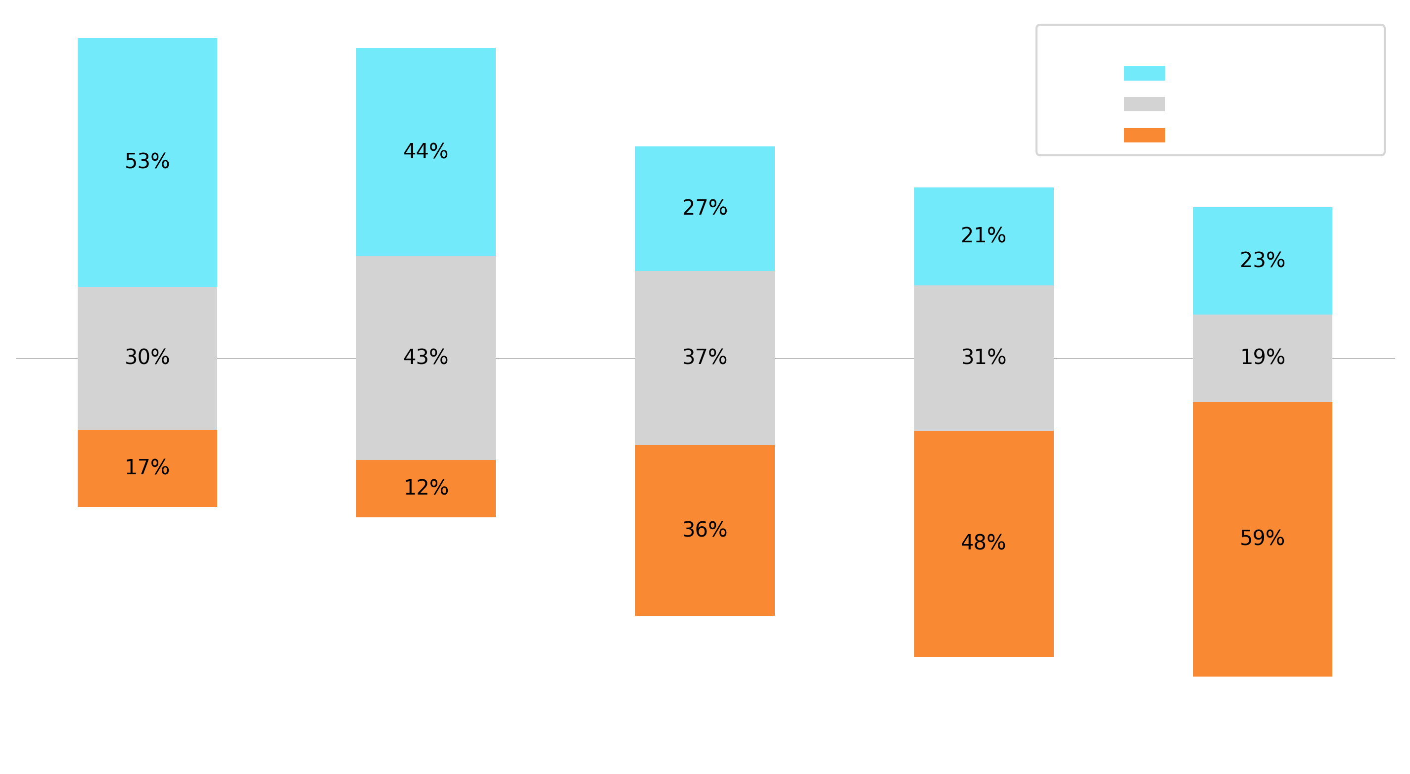

Rural residence, conservative ideology, higher age and lower levels of education correlate with higher opposition to raising carbon taxes on gas and fossil fuel.
What individual factors correlate with Canadians’ opposition to raising carbon taxes on gas and fossil fuels or coal?
A secondary analysis of the TISP dataset
Non-Cognitive Predictors of Student Success: A Predictive Validity Comparison Between Domestic and International Students
RESULTS:
There was no significant relationship between sex, religiosity or income and support for raising carbon taxes.
DISCUSSION:
While statistically significant, it should be noted that the magnitudes of correlation that age and level of education have with support for increased carbon tax are small. Furthermore, the distribution of responses for level of education is overwhelmingly skewed towards higher education.
Overall, this analysis is helpful for understanding public support for raising carbon taxes in Canada, which can inform policy decisions aimed at addressing climate change.
REFERENCES:
Josh Dyce
BACKGROUND:
Carbon taxes are a key policy tool used to reduce greenhouse gas emissions by placing a financial cost on fossil fuel consumption. Advocates argue that such taxes encourage cleaner energy use and help combat climate change [1], while opponents criticize them for increasing living costs, particularly for lower-income households [2]. In Canada, carbon pricing has been a highly debated issue, with campaigns like "Axe the Tax" reflecting strong opposition in certain regions [3].
The TISP dataset is a 2022 collection of questionnaire responses from 71 922 participants in 68 countries, offering insight on public attitudes towards science and climate change [4].
OBJECTIVES:
Determine which, if any, of the following factors correlate with Canadian’s self-reported support for raising carbon taxes on gas and fossil fuels:
METHODS:
Data analysis and visualization was performed in Python using the Scipy and Matplotlib libraries.
The Mann-Whitney U Test was used to compare two independent groups (e.g., Sex, Rural vs Urban)
Spearman’s Rank Correlation was used to assess relationships between ordinal variables (e.g., Education, Political Ideology)
Age and Income were grouped in intervals to turn them into ordinal variables
Conservative ideology has the strongest correlation:
Age Rural residence Political orientation Level of education | Sex Religiosity Income
Notes:
Notes:
In Powerpoint, click View > Guides
Keep text within gutter guides.
Author list: Don’t split names onto two lines (e.g., “Jimmy [break] Smith”). If that happens, use a new line, unless you need the space. Bold the first names of anybody who’s presenting in person.
Intro/methods/result: Do not drop below font size 28, but if you have extra space, jack up the font size until the space is full.
Do not use color in the sidebars except in graphs/figures. It’ll pull attention from the center and slow interpretation for passersby.

