Slide 1
SCRUM AGILE

Slide 2
Key Facts about Scrum-Agile Approach
Individuals and interaction is more important over process and tools
Everything starts and ends with SCRUM BOARD
Customer collaboration is there in every step
Scrum-Agile is very fast-paced
Scrum master is not the manager
Scrum master guides the team to resolve issues

Slide 3
Roles in Scrum-Agile Approach
01
02
03
PRODUCT OWNER
SCRUM MASTER
Responsible for ensuring scrum methodology is being followed
Responsible for managing scrum backlog, release management and stakeholder management.
DEVELOPER TEAM
It comprises of writer, designer, programmer and tester.

Slide 4
Phases in SCRUM-AGILE
4. Production
Product is deployed and used by end-users
Closely monitored for early stages bugs
2. Planning
Requirement gathering
Building of backlog
Analysis of risk factors
5. Retirement
GOAL 5
Referred as end of life for product
Product is removed from production
Migration to new release
1. Project Initiation
3. Development
Referred as inception or envision phase
Project vision and economic feasibility is discussed
Selection of team, resources and setting up duration of project.
Working on products in incremental phases.
Releasing products for review

Slide 5
Events in Scrum-Agile

Slide 6
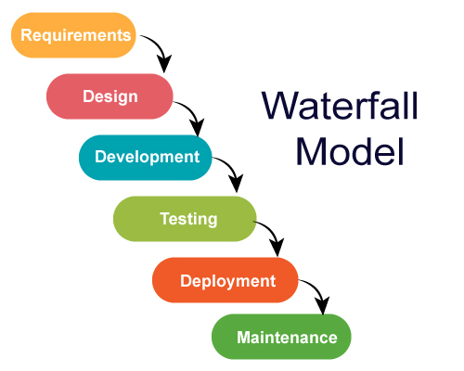
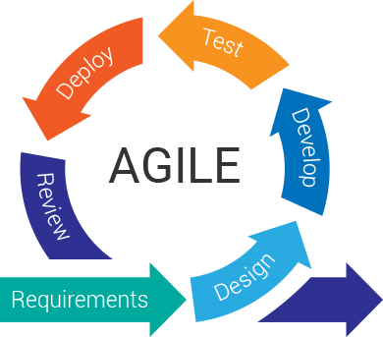
Difference between Waterfall and Agile Model
Waterfall Model
Agile Model

Slide 7
Factors to Consider When Choosing an approach
Time of the project delivery
Budget
Complexity of the project
Agile is preferred over waterfall to deliver the project within a short span of time
The waterfall model requires more budget due to risks
For low complexity projects, waterfall is better. Otherwise, agile model should be preferred

Slide 8
THANKS!

