Slide 1
Boosting
Josh Feldman
**You have permission to use these slides

Slide 2
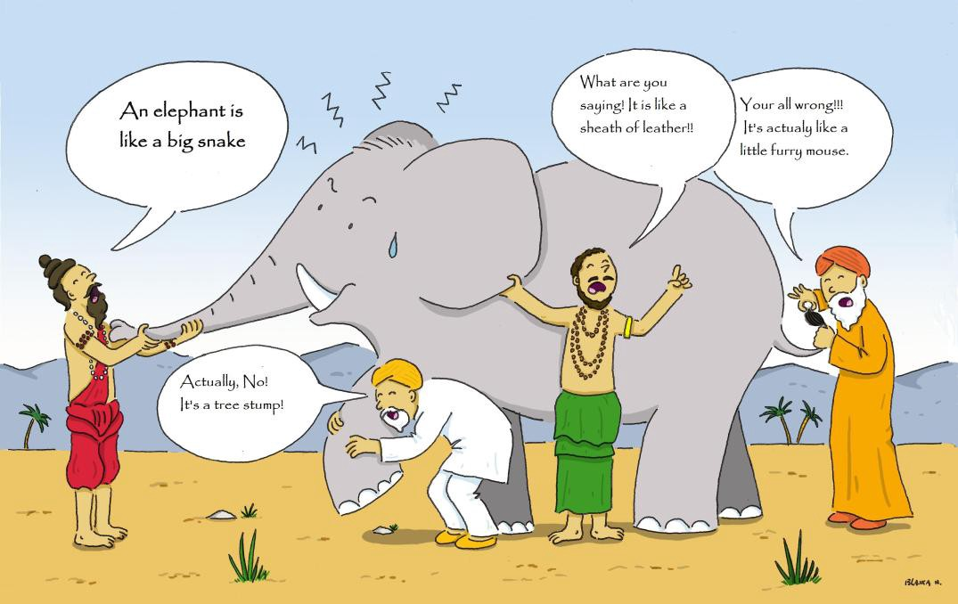
Intuition
Often a group of experts is smarter than a single genius, even if the each individual expert isn’t as smart as the genius
In boosting we train our experts sequentially, with each one learning from the mistakes of the previous attempts
We actually don’t want each individual expert to be too “smart”, because otherwise our experts will just memorize our examples and not learn any general truths

Slide 3
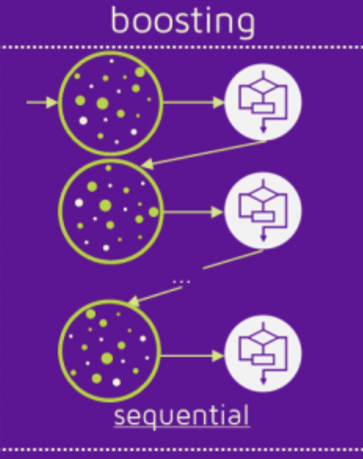
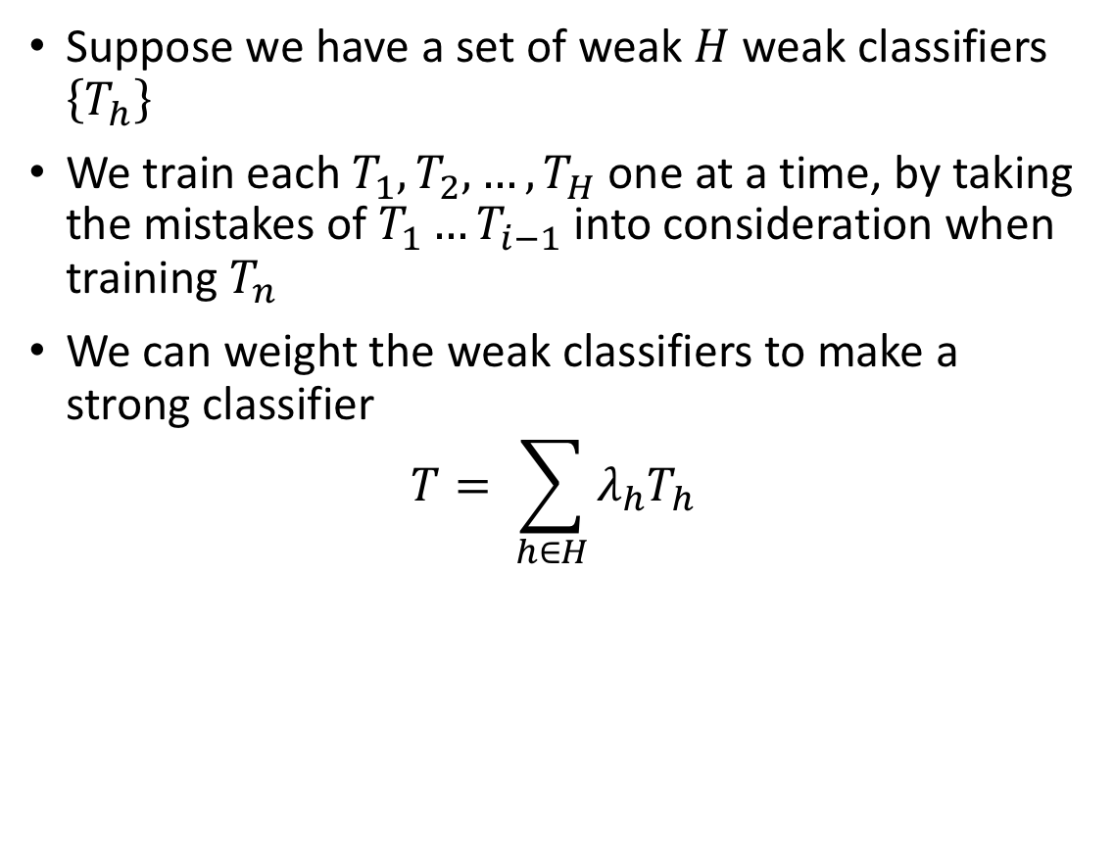
More Formal Definition
Suppose we have a set of weak $H$ weak classifiers $\left\{T_{h}\right\}$
We train each $T_{1},T_{2},…,T_{H}$ one at a time, by taking the mistakes of ${T_{1}…T}_{i−1}$ into consideration when training $T_{n}$
We can weight the weak classifiers to make a strong classifier
$$T= \sum_{h∈H}{λ_{h}T_{h}}$$

Slide 4
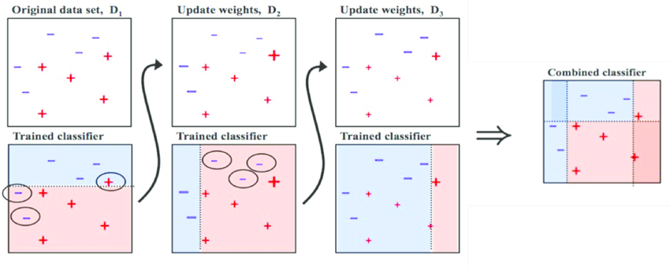
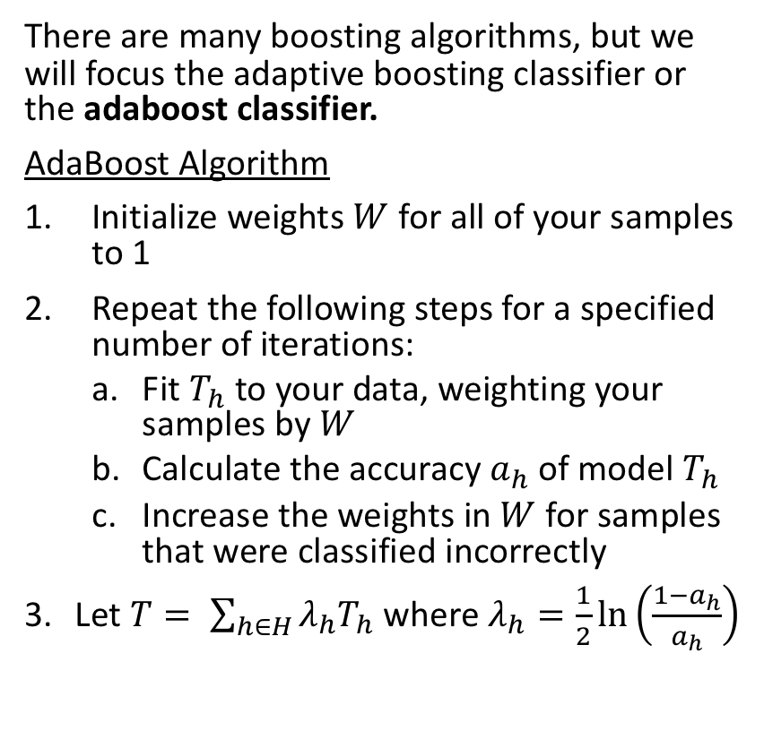
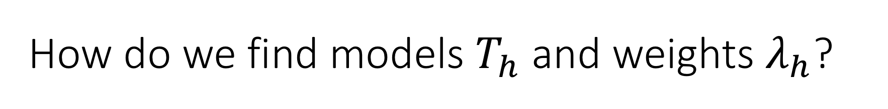
How do we find models $T_{h}$ and weights $λ_{h}$?
There are many boosting algorithms, but we will focus the adaptive boosting classifier or the adaboost classifier.
AdaBoost Algorithm
Initialize weights $W$ for all of your samples to 1
Repeat the following steps for a specified number of iterations:
Fit $T_{h}$ to your data, weighting your samples by $W$
Calculate the accuracy $a_{h}$ of model $T_{h}$
Increase the weights in $W$ for samples that were classified incorrectly
Let $T= \sum_{h∈H}{λ_{h}T_{h}}$ where $λ_{h}=\frac{1}{2}\ln\left(\frac{1−a_{h}}{a_{h}}\right)$

