Slide 1
Voting System - PPS Mini Project – CLAP - 4
Koushik C R (RA2111003010087)
Josh G George (RA2111003010092)

Slide 2
Introduction
This project is a simple voting system that can be used to count the votes and declare winners.
It can also detect illegal voters and ban them.
It has a basic Admin portal for some control over the application.
It is done with the help of arrays, pointers, structures, functions and file management(text file).
The program will save everything into a text file and will also print out the necessary data when required from the text file.
The application’s directory will have two files. ‘main.c’ and ‘election.h’
‘election.h’ is a module that is user-made and has to be imported into the ‘main.c’ file.

Slide 3
System Requirements
Any computer that has a C compiler like GCC or Turbo C or Turbo C++, etc.
Online Compilers that supports file management.
Any IDE like VS Code and gedit can also be used to compile and run the program provided that a compiler with the necessary extensions are installed.
An application that can open text files like notepad.

Slide 4
How it works?
First, when the program is executed, it will give the user three options – Student panel, Admin Panel and Exit, out of which anything can be chosen.
Admin panel will give the user a few options to choose if the enter the correct username(Admin) and password(admiN).
It can be used to create and continue elections, delete illegal votes, ban voters and view the results.
Depending on the number of candidates, different text files will be created to save data.
Next, to use the student portal, the user has to enter the user ID which is “yearbranchrollnum”. For example, 2022btech00064 and maximum roll number is assumed to be 100 but still it must be entered with 5 digits.

Slide 5
How it works?
Then, the student can vote for any of the given candidates with the help of the given menu and the confirmation message will be shown on screen.
To ban a voter, the user must use the admin panel and enter their roll number.
Illegal votes can also be deleted from the admin panel by entering the student user ID.
Again, by using the admin panel, results can be viewed along with the voting percentage.
If the program is terminated in between due to some reason, it can be continued with the help of the admin panel.

Slide 6
What parts of the C language are used?
Header files used are stdio.h, conio.h, string.h, stdlib.h
Different datatypes along with structures, scanf and printf statements, if else statements, for and while loops, arrays, pointers, and text files have been handled by using arrays and pointers.
Arrays have been declared which are also considered as pointers in file management because of easier accessibility.
The file election.h has been imported to main.c using the #include statement.
Switch Case statements have also been used to choose the options and display the appropriate functions required for the voting process.

Slide 7
Source Code
Source code for the project can be accessed at the link given below.
Link: https://github.com/JoshGeorge2553/PPS_CLAP4_092

Slide 8
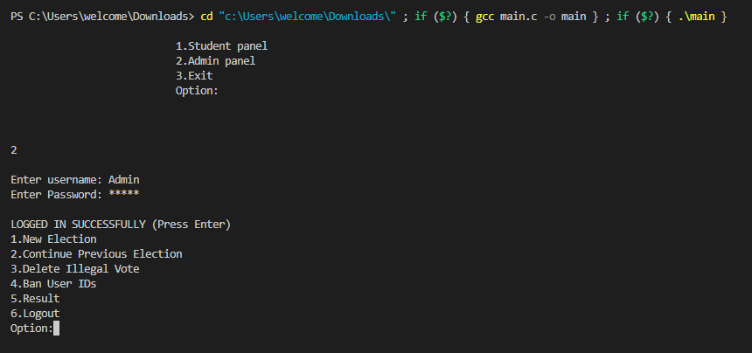
Output

Slide 9
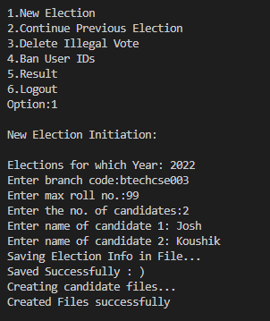
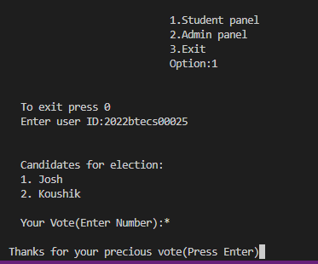

Output

Slide 10
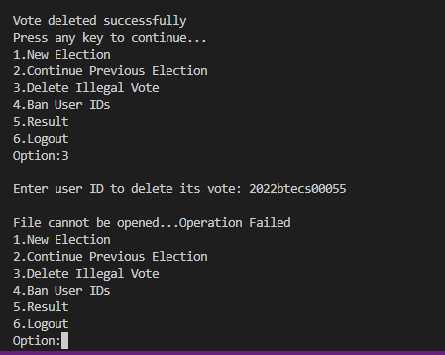
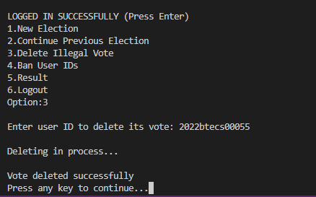
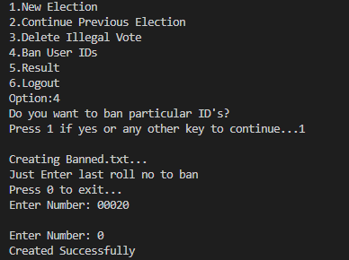
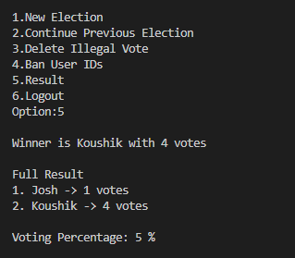
Output

Slide 11


