Slide 1
BioNetFit
Design Review I
Team U.I. Fit
Charles Chatwin, Matthew Burns, Joshua Gutman, Tanner Brelje
Mentor & Client: Dr. Abolfazl Razi
Notes:
Tanner’s notes: Slide 2 - Give credit to Dr. P and the Los Alamos team
Slide 3 - more visualizations. More overal
NEED PAGE NUMBERS ON THE SLIDES, who is speaking during the slide
Thank god, he likes the new feasibility report
More info on BioNetFit, as it is not clear, more pictures
Point out specifics of the config file to highlight how long the process is
Add to the visualization slide, in order to make the process more understandable.
Add points from what Josh talked about to the slide
Speed up the security risks
ADD A LOOOOOOT OF VISUALIZATIONS

Slide 2
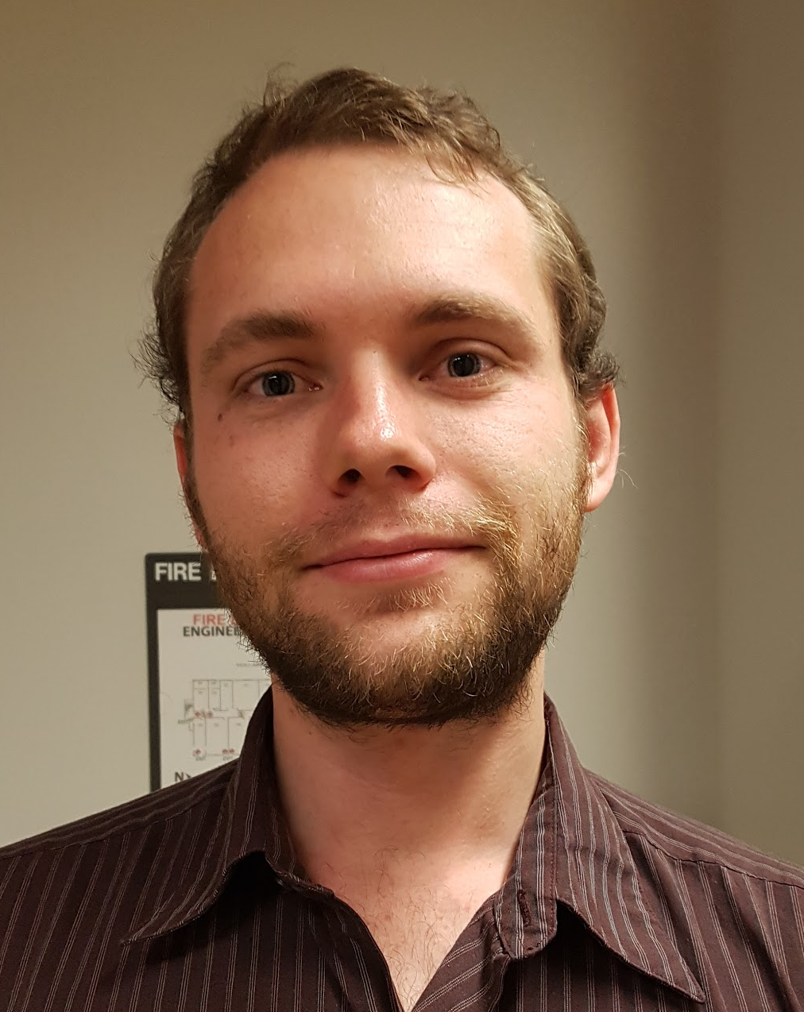
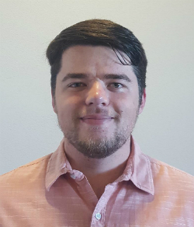

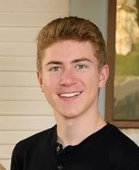
Team U.I. Fit
Charles Chatwin
Team Leader
Tanner Brelje
Coordinator
Matthew Burns
Web Designer
Joshua Gutman
Release Manager
Notes:
Slide 1&2 should take 30 seconds max.

Slide 3
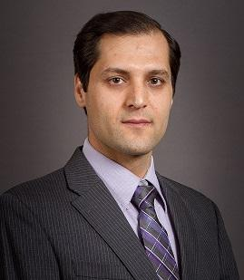
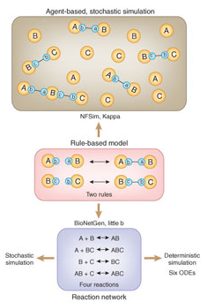
Mentor and Client:
Dr. Abolfazl Razi
Assistant Professor of Electrical Engineering in the School of Informatics, Computing and Cyber Security (SICCS) at Northern Arizona University.
B.Sc., M.Sc., and Ph.D. in Electrical Engineering.
Accomplished work to quantify the biological process along with researchers at Los Alamos and Dr. Posner.
Notes:
Slide 1&2 should take 30 seconds max.

Slide 4
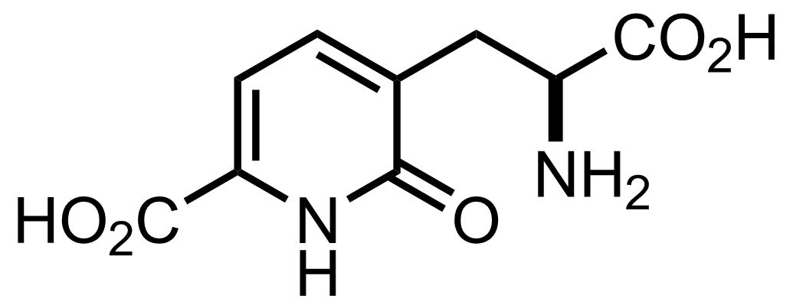
Molecular Biology
Molecular Biology is an ever-advancing scientific field that finds a main focus in the experimentation and testing of molecular combinations.
These experiments consume a heavy amount of time and resources, and may not even yield palpable results.
Enter BioNetFit, a software created to simulate large scale molecular interactions.
Notes:
30 - 45 seconds to introduce the problem in a grand scope Posner and his group created BioNetFit
Molecular Biology is used in medical fields and other important research

Slide 5

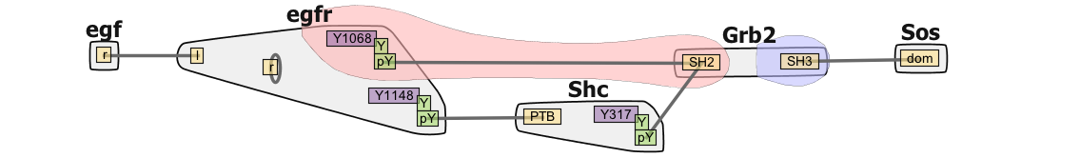
BioNetFit
Simulates large scale experiments; Runs similar experiments multiple times with configurable parameters.
Implements BioNetGen and NFSim to simulate reactions.
User uploads a experimental-results file, which is used by BioNetFit to measure how close it is to reality and choose the next set of parameters.
Uses genetic algorithms, simulated annealing, and others methods to choose the best parameters, and the next set of parameters.
Notes:
About 45 sec to talk about the current uses of BioNetFit

Slide 6
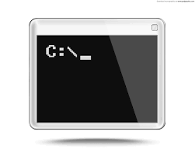

The Problem
BioNetFit suffers from poor usability.
Only exists as a command-line tool.
Requires the user to create a complicated and long configuration file.
Results are not easily interpreted.
Output data complicated and messy.
No visual representation of the data.
Cannot run large experiments in a reasonable timeframe.
BioNetFit uses MPI to parallelize its simulations.
Works accurately, but very slowly on a single machine.
Not optimized for clusters.
Notes:
~1 minute to address the problems with the software as a whole

Slide 7
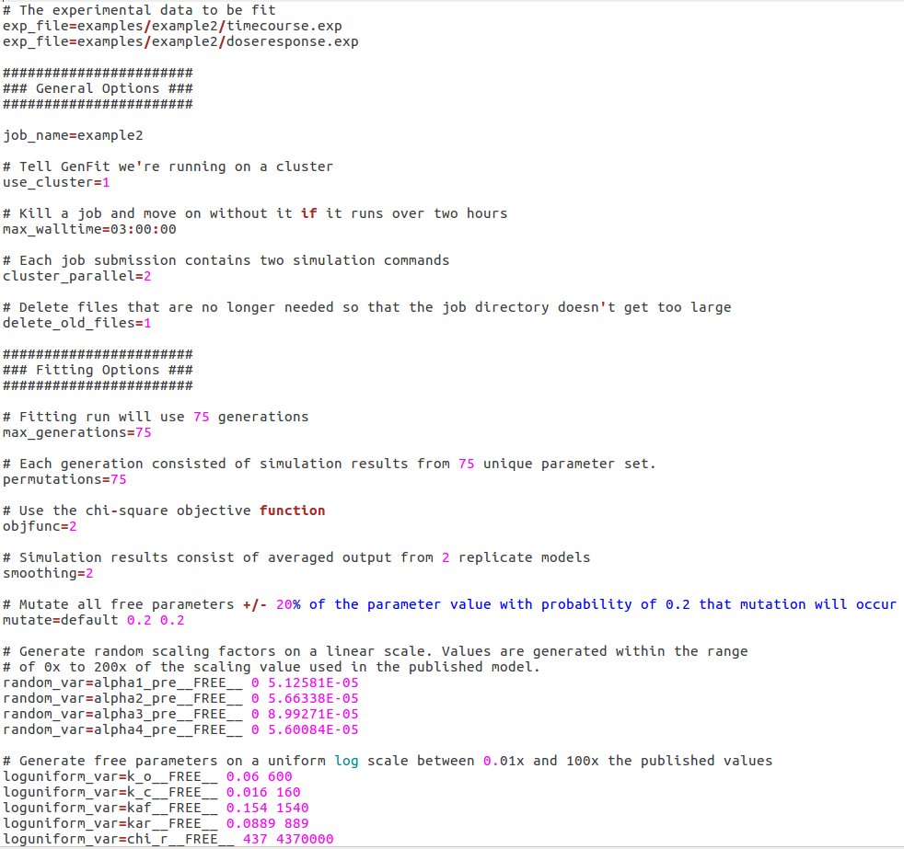
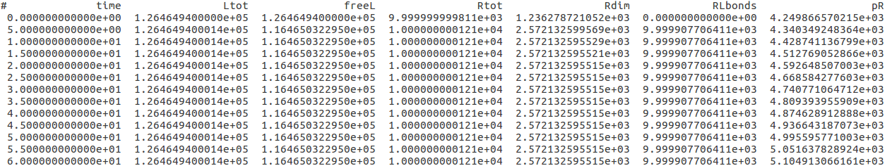
(no title needed, format later)
Image of bionetfit on cmd line
Example output
Example config file
Notes:
Take a few moments to show examples of the program in its current state.

Slide 8
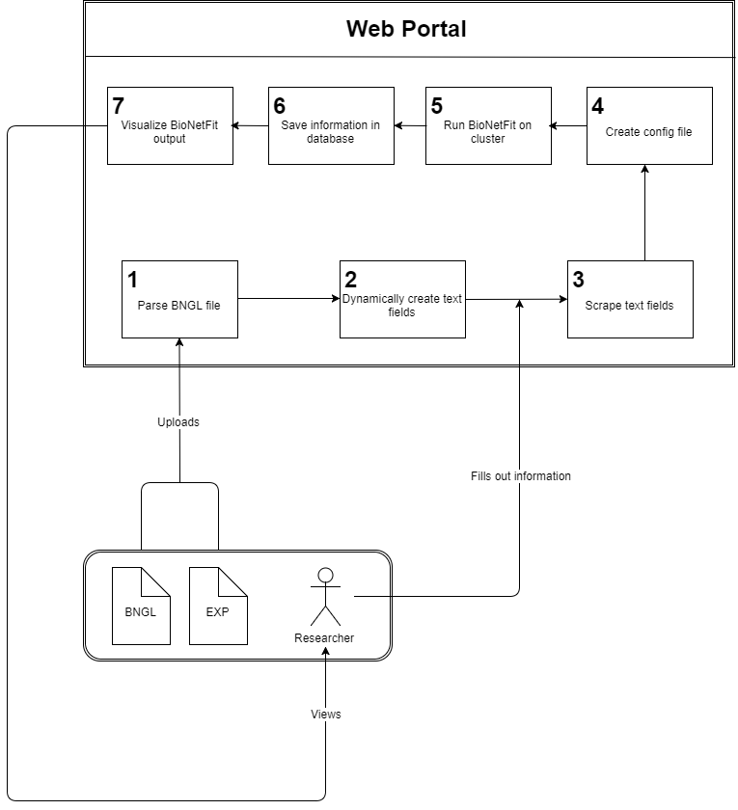
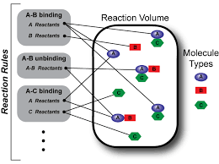
Our Solution
Our solution is a Web 2.0 Graphical User Interface that will drastically increase the usability of BioNetFit.
Automatically generate necessary files.
Visualize results to increase ease-of-interpretation for users.
Implement parallelization via NAU Monsoon cluster in order to increase processing speed.
Notes:
Talk for 1-2 minutes on this, going into details (but not too much) on each.

Slide 9
Key User Requirements
The user must be able to:
Generate configuration files.
Run BioNetFit on a cluster.
Visualize the results of BioNetFit
Save all information related to BioNetFit in a database.
Repeat past experiments with small alterations.
Download any and all files related to BioNetFit.
Notes:
Need to take about 4 minutes on this. Talk about 3 main requirements and some others here, and then delve into the main 3 in the following slides.

Slide 10

Key Technical Requirements
Dynamic HTML generation
Text fields are created from user-uploaded file
Scraping text fields
Text fields are scraped to get user-inputted information
Creating files from user-inputted information
A configuration file is created from user-inputted information

Slide 11

Key Technical Requirements (cont.)
SSH from server to server
All relevant information is sent to a cluster to run BioNetFit
Storing information in a database
All input and output files are stored in a database for each user
Visualizing data
Plot BioNetFit output

Slide 12

Python Framework
Requirement | Fulfilled by | Python?
Dynamic HTML generation | Django | Yes
Scraping Text fields | Django | Yes
Creating files | Vanilla Python | Yes
SSH from server to server | Paramiko | Yes
Database | MongoDB | Partial
Visualizing Data | MatPlotLib | Yes

Slide 13
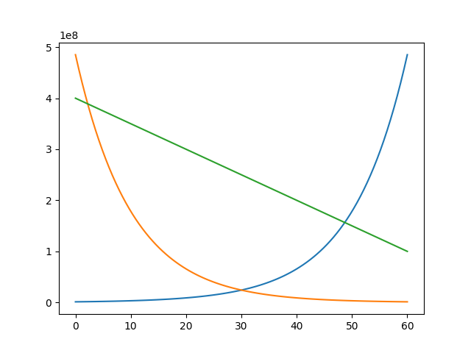
Visualizing Data
MatPlotLib
Read output of BioNetFit
Put each variable into an array
Create plot using MatPlotLib and arrays
Other methods of visualization could be added

Slide 14
Risks and Feasibility
Possible Risks | Importance | Steps Towards Mitigation
Unable to access NAU Monsoon Cluster. | High | Currently in contact with Monsoon coordinator; access will be granted for a secure system.
Insecure storage and usage of Monsoon login details. | High | Looking into methods to securely store and use login information on unix systems.
Securing a Domain to host the BioNetFit GUI. | Medium | Host using NAU web services; use Amazon web services for backup/testing.
Database leaks personal data of the user. | Low | Assure that no privately held data will be stored within the user database; Name, Password, Files.

Slide 15
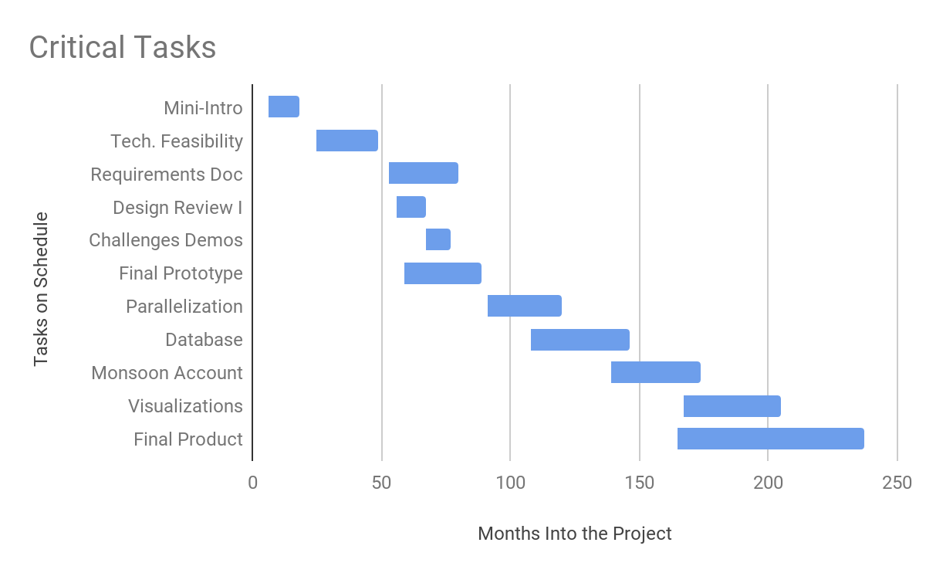
Schedule
Currently Here
Aug. Sep. Oct. Nov. Dec. Jan. Feb. Mar. Apr. May.

Slide 16
Conclusion
The Problem: BioNetFit is not easy to use, requires a lot of time to process huge experiments, and gives outputs that are hard for researchers to digest.
Our Solution: A Web 2.0 GUI that will increase ease-of-use, implemented with parallelization on the Monsoon cluster, and clear visualizations of outputs.
Implementation via Python Framwork
Django, Paramiko, vanilla Python, etc.
Risks to design can be overcome via feasible options.

