Slide 1

Web220_A2
Esports Tracker

Slide 2
Executive Summary
Based around Esports.
Application to track statistics.
Statistics for games, leagues players or matches.
Notes:
The application I propose is an esports tracking website called ‘the esports centre’ based around the modern sporting genre esports. Esports being the online matchmaking sport centered around video games. With the application itself allowing users to view various statistics from games, leagues, players and matches from a database search. Teams being able to register their own data (once approved) to see these categories for their own local teams.

Slide 3
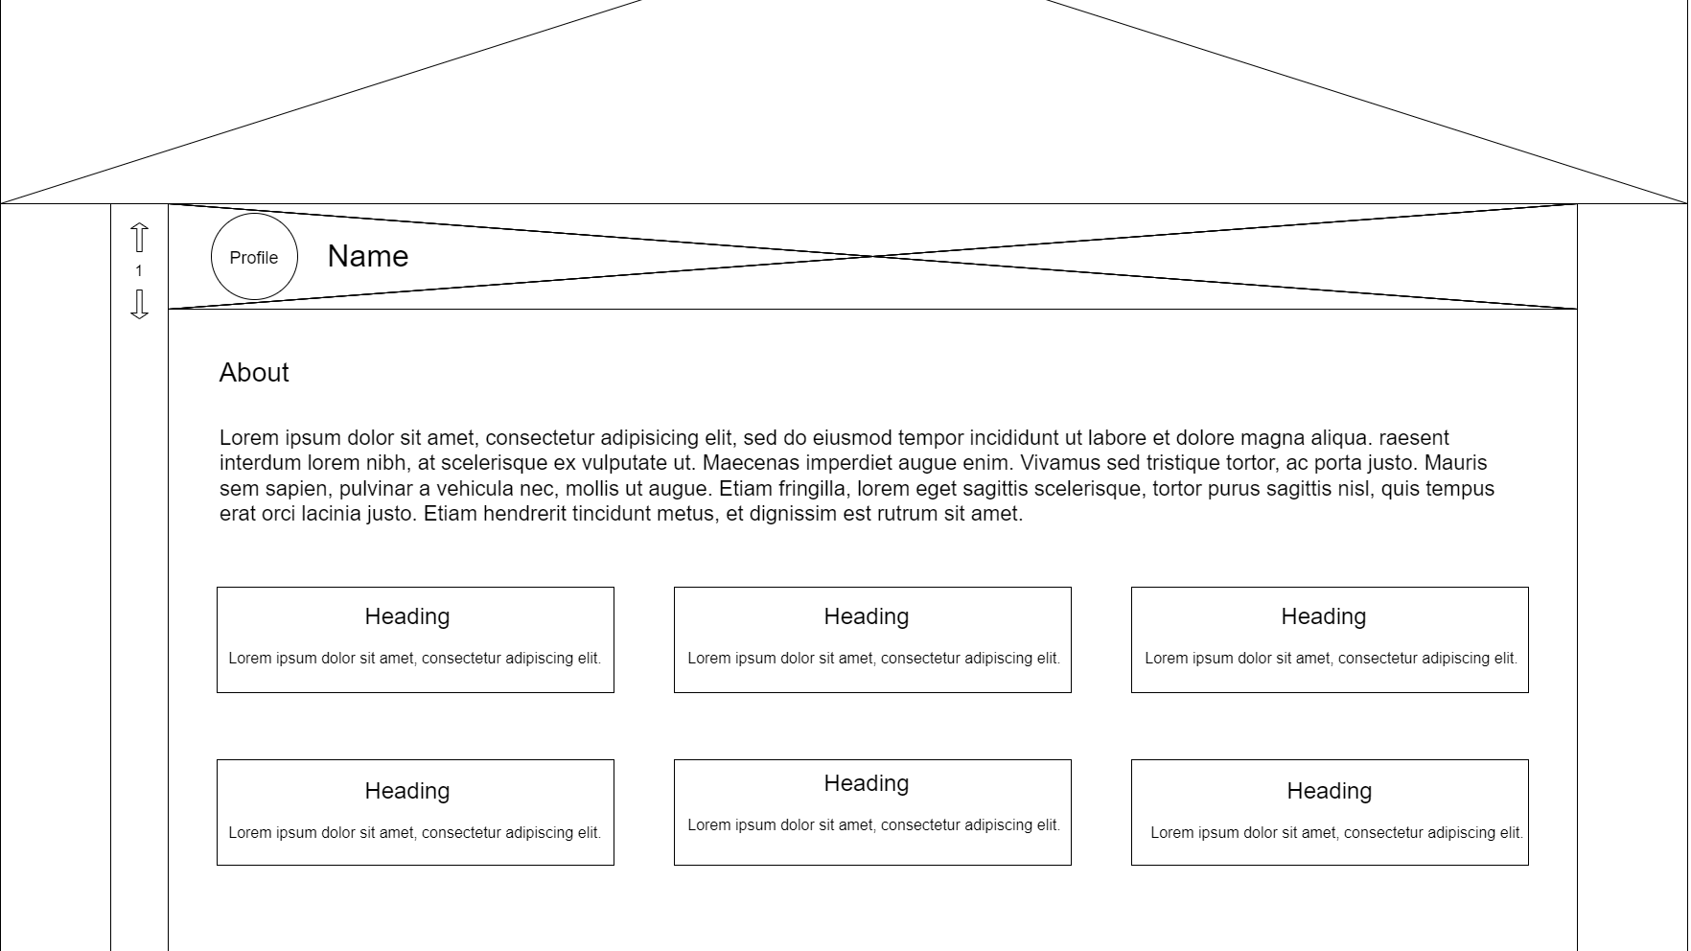
Features
Publishing Feed
Voting system
Search and filtering
Team registry
Notes:
There are four main features to this application. Firstly a publishing feed where the previously mentioned categories will appear in the form of articles, similarly to a blog or forum site. This would be customisable through a voting system where users can upvote or downvote a article to alternate the order of results or not shown some results at all. Search and filtering functionality through the database for precise results is another. With the registering system as mentioned being the final feature. A form would allow local teams to add their own statistics into our database and be featured in the site.

Slide 4

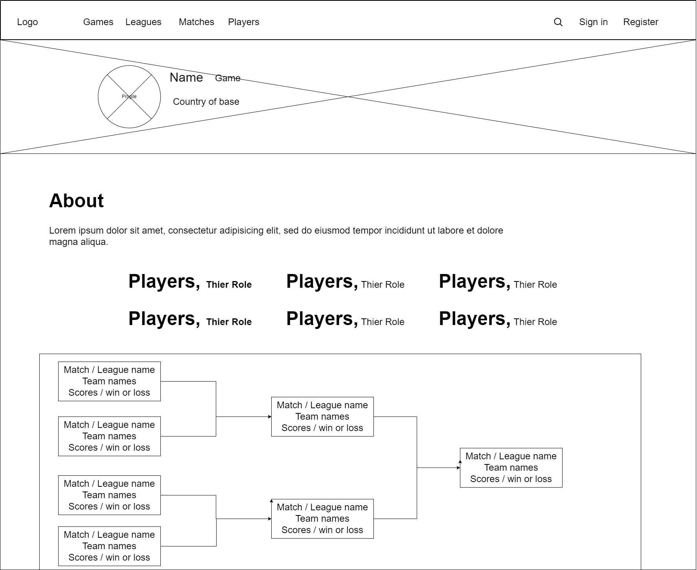
Unique selling point
Engaging and dynamic content
Interactive customisable feed
Notes:
This project contains two unique selling points the first being the ability to engage a local audience through the registry system. This registry system and the dynamic nature of the site ,meaning new data is always being updated, encouraging consistency and time investment with users. The exclusivity of these local teams also adds to this engagement with no rival application having access to this content. Secondly the voting system creates an individually tailored experience for each user, allowing them to choose the content that they view based on what interest them improving their experience with the service.

Slide 5
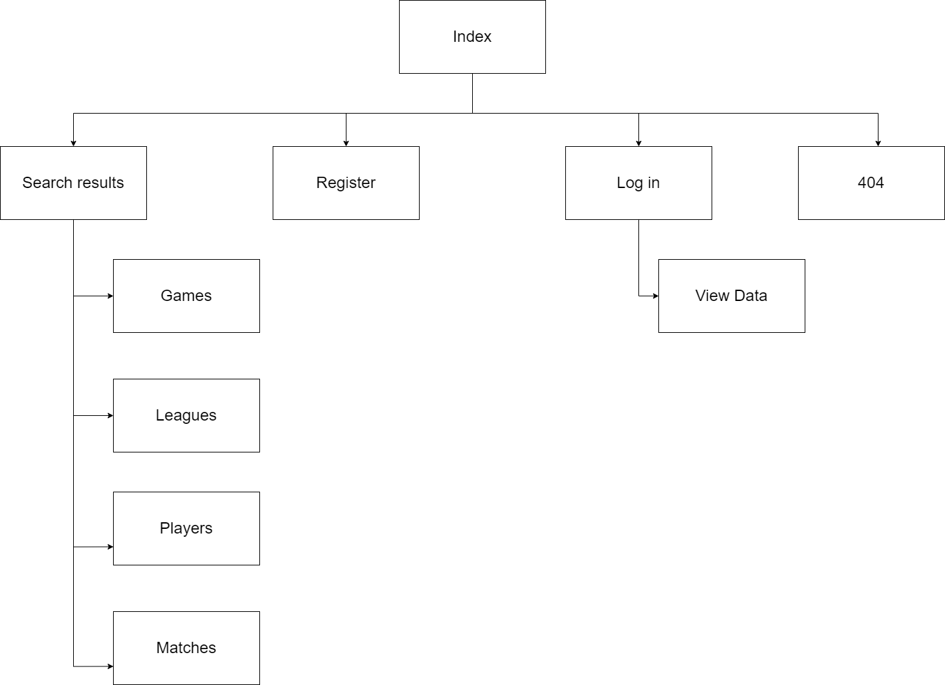
Structure
Front-end
HTML (React.js)
CSS
Material UI
JSX
Back-end
SQL database
Minimum viable product
Landing page
Search results page
Individual categories
Registering page
Notes:
The front-end would use HTML with React as the team has the most experience with this library and components are beneficial to a large project such as this. Along with standard CSS
An SQL database would be used for the data management system as data is unlikely to be unique.
The minimum viable product will require: A landing page containing the search function, the resulting search page, pages for each statistics and the registering page for local teams.

Slide 6
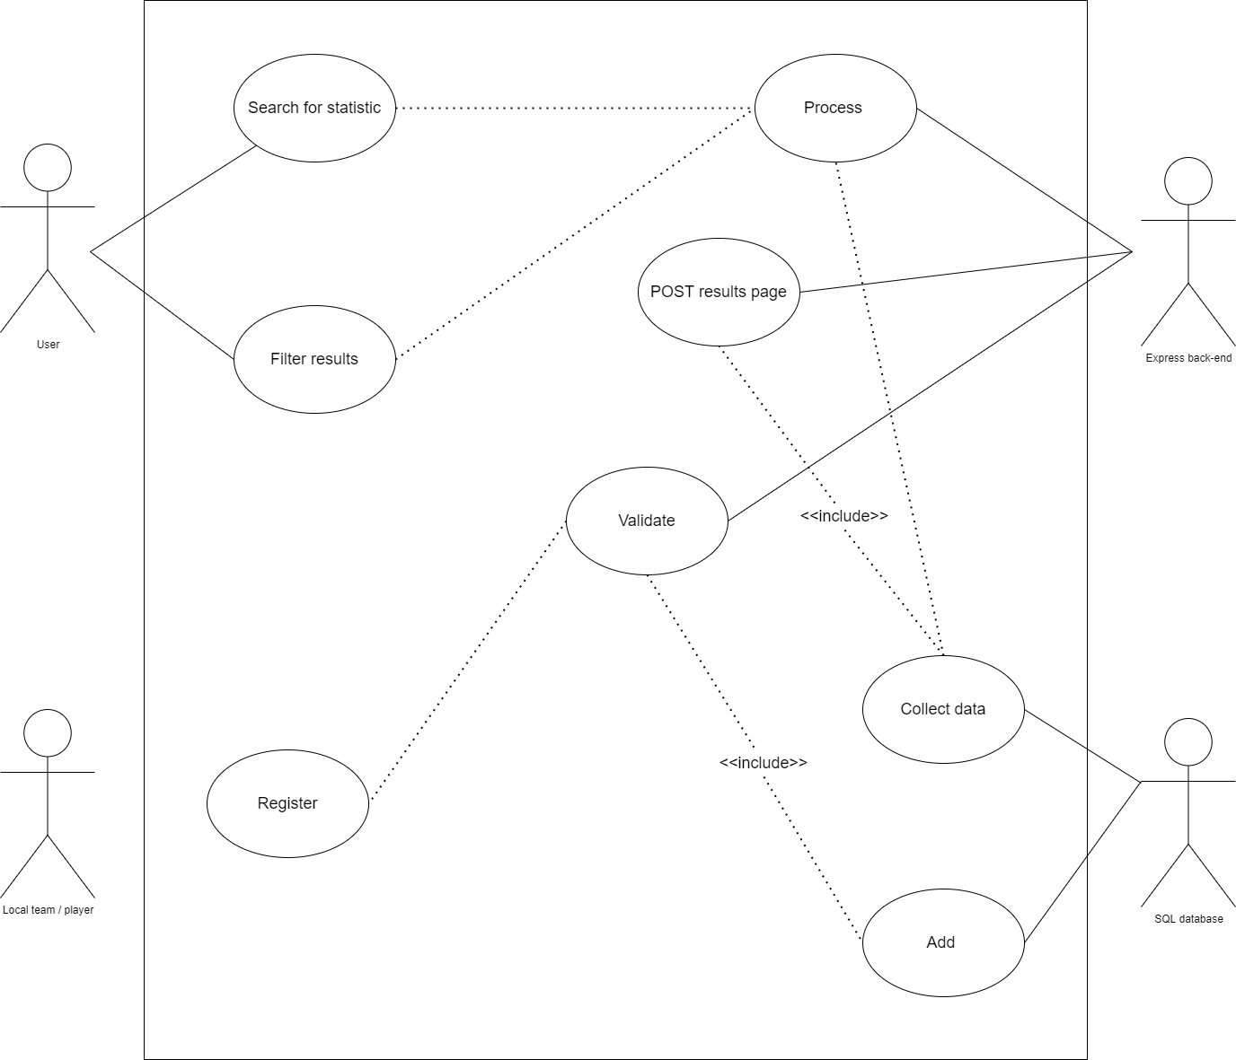
UML
User search for statistic
Processed through database
Returns results

Slide 7

Operations

Slide 8
Original Roles
Full stack data management
Security and registry back-end developer
Front-end
Front-end UI, Documentation
Notes:
The teams roles as follows: A full stack developer focuses around data management and front-end designing, security and registry systems back-end developer and two front-end developers with one specifically focuses on user interfaces.
This roles are largely maintained by the same members as in the Student Survival Box project. With Louis being made a full stack developer due to his knowledge of both back-end system and design skills. Yordan retaining his role as back-end developer due to the high standard and efficiency or work previously produced. Danny has been moved to a front-end developer due to their already being two back-end developer but not do the discredit of previous work and he has shown he can work to the same high standard in both front and back-end.
I will also be front-end however I will be focusing on user interfaces mainly as I have the clearest idea of what the interface of the project should look like. Im also covering most of the documentation for the project as I did this previously and made effort to conform to industry standards.

Slide 9
Actual Roles
Yordan- Back-end data management and validation
Danny – Full stack component creation, styling and front-end functionality
Louis - Front-end component creation and styling
Josh – Front-end component creation and styling

Slide 10
Projected Timeline
Milestone one
Complete documentation up too time of
Establish basic level front-end UI and index
Searching and registering
Milestone two
Voting system
User study's for UI and back-end functionality
Apply user study
Milestone three
Refine front-end design and accessibility
Back-end security, validation and database maintainability
Milestone four
Release first build
Gather performance metrics
User study for all site features
Apply metrics and user study
Finishing all documentation
Notes:
The project timeline is as follows: The first milestone will be completing documentation up to that current time, creating a basic front end and UI so that the back-end developers can start work on searching and registering. The second milestone will be create the front-end and back-end for the voting system. At this point the first user study's will be released and applied. The third milestone will be refine the front-end and made it accessible for as many platforms as possible whilst the back-end focuses on system security, form validation and database maintainability. The final milestone is releasing or deploying the build depending on the assignment requirements, gather performance metrics, issuing a second user study and applying both. Lastly finishing all documentation.

Slide 11
Timeline
Milestone one
Documentation and front-end as expected. Search and registering pushed back.
Milestone two
Voting system’s replaced with search and registering. User study sent in later milestones
Milestone three
Front end styling and component refactoring was applied. With additional tables and back end refactoring.
USP page
Milestone four
User study carried out but not for finished build.
Addressing user study feedback
Documentation (presentation, standups)

Slide 12
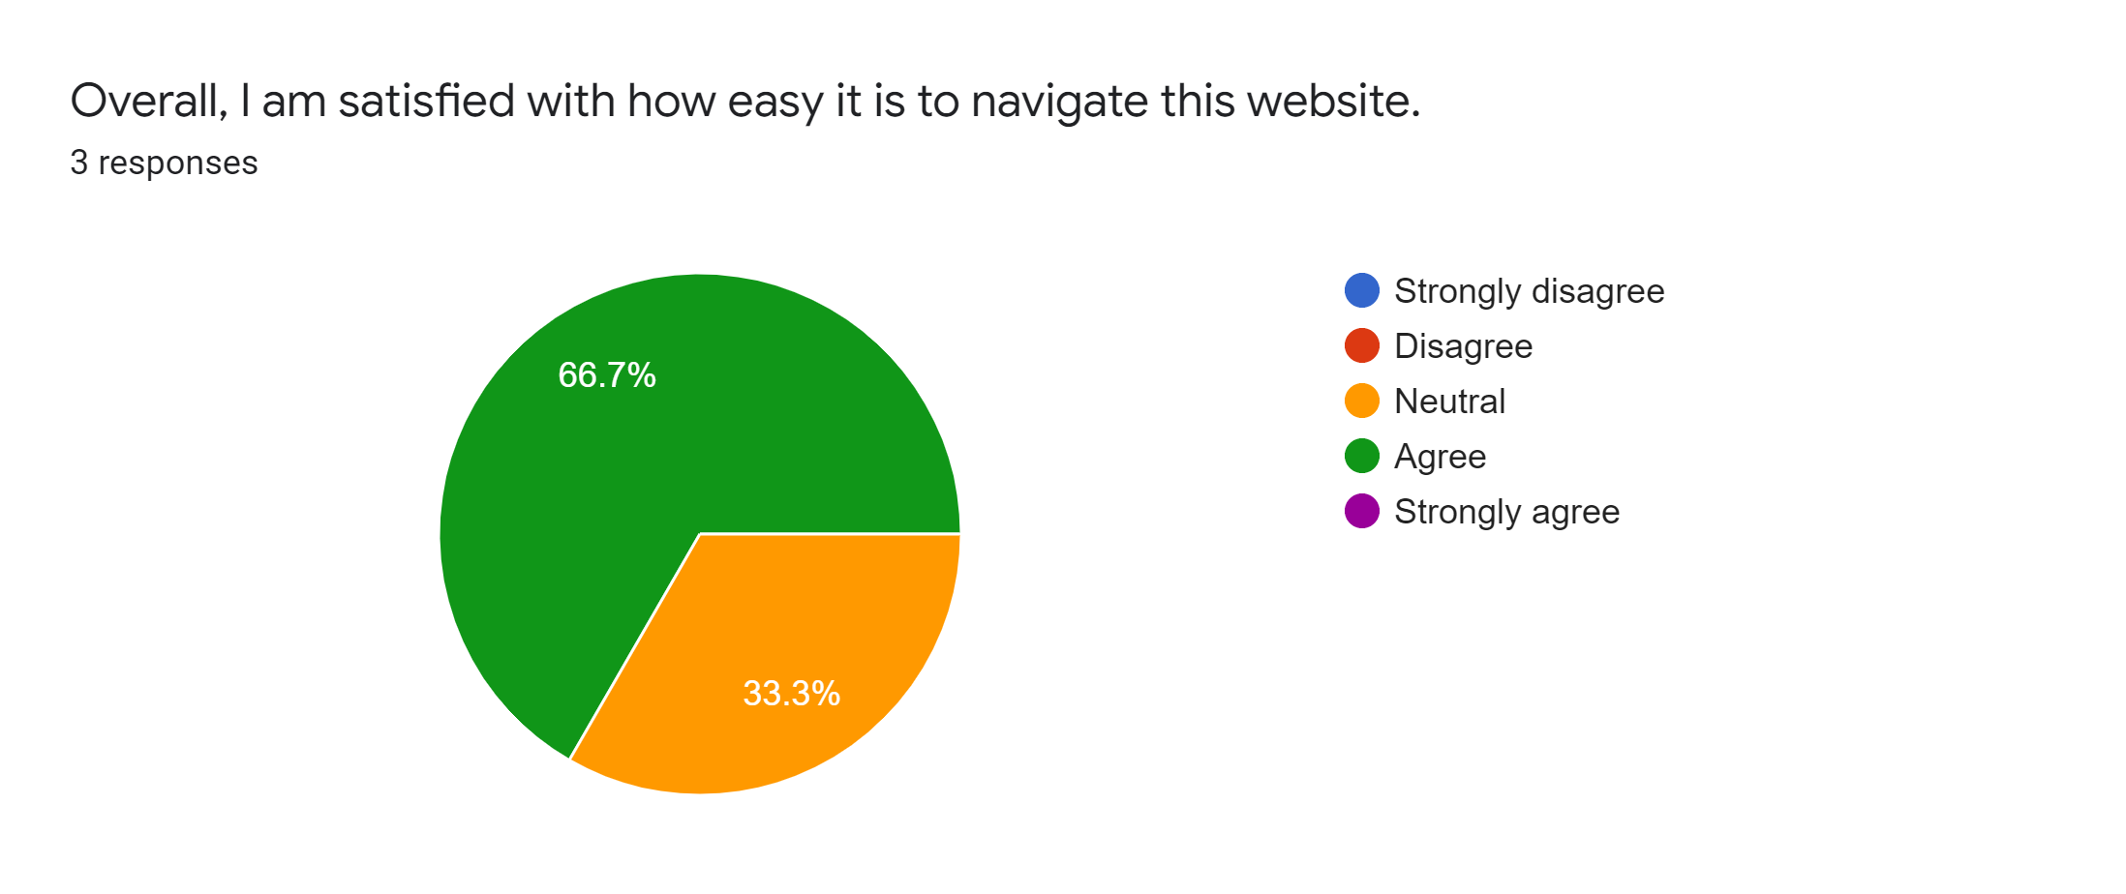
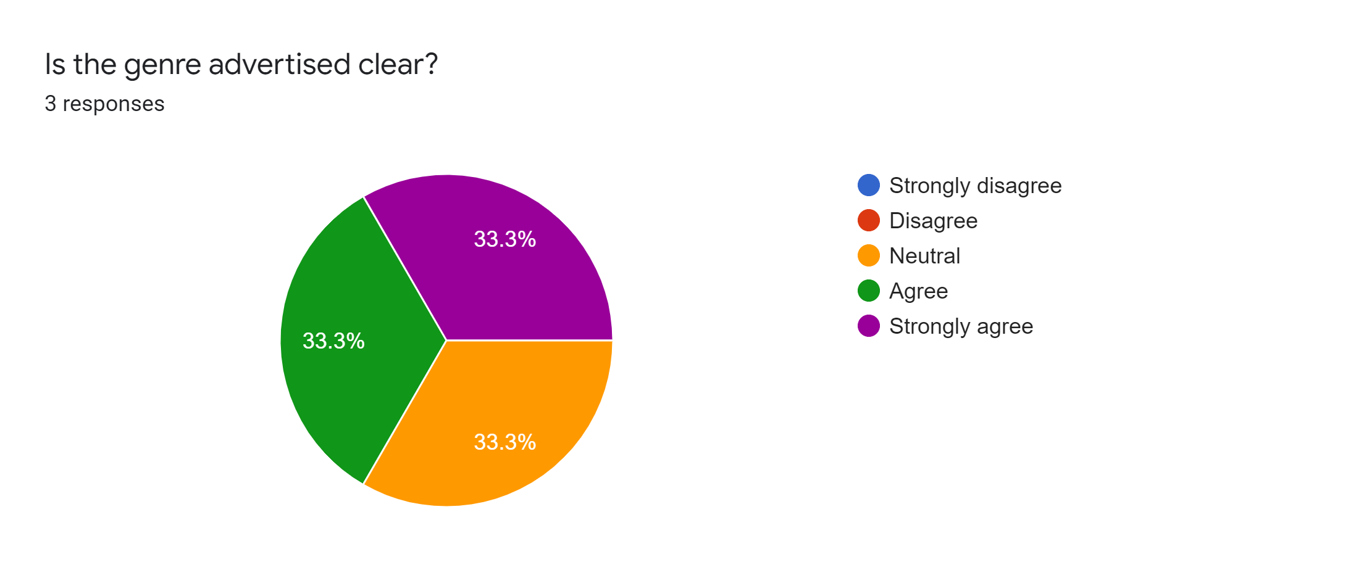
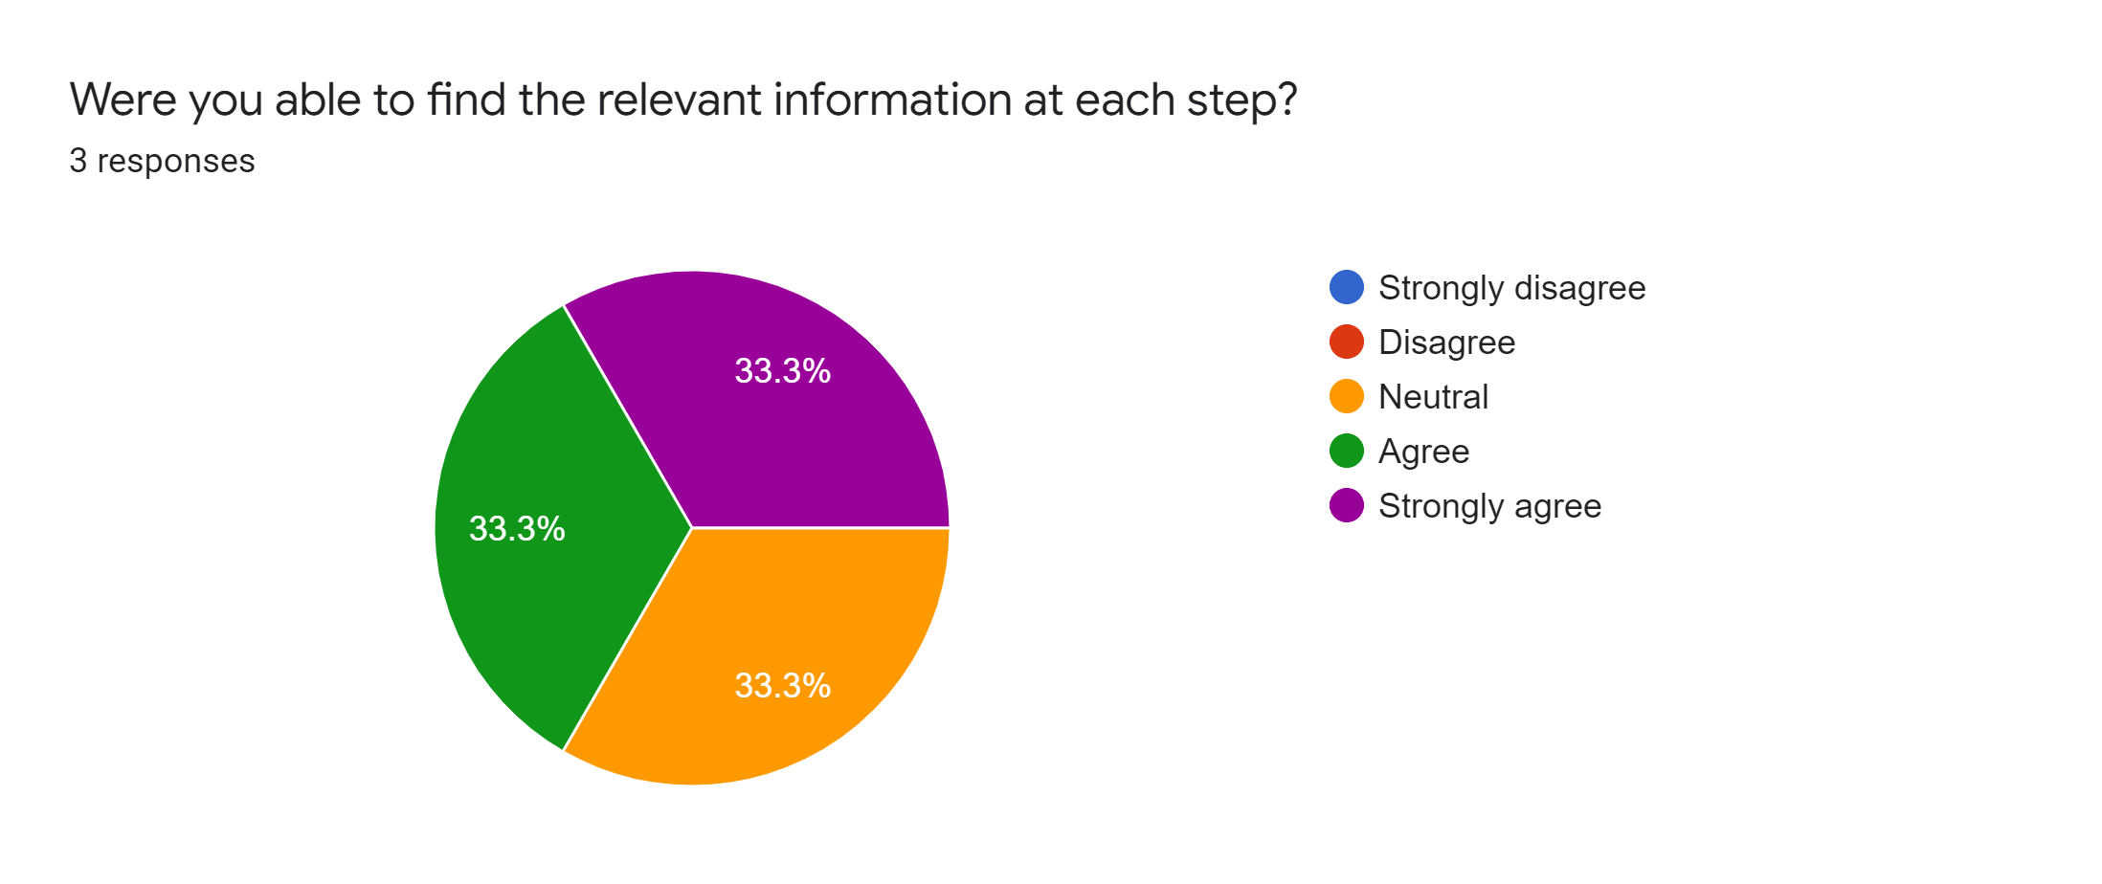
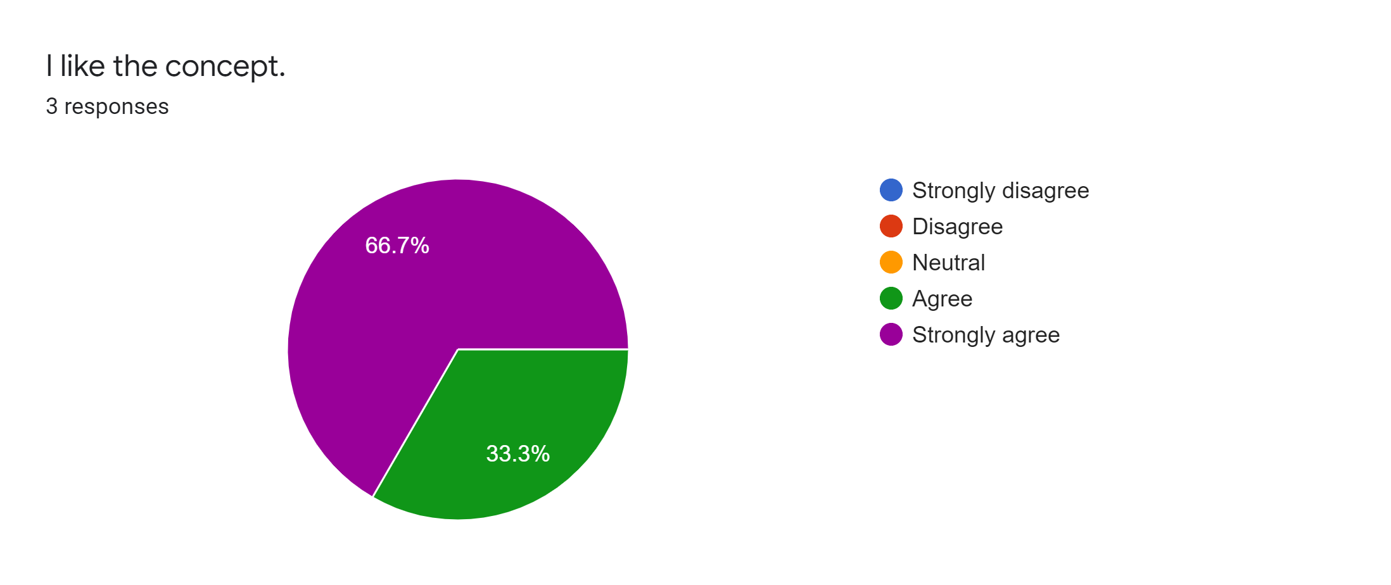
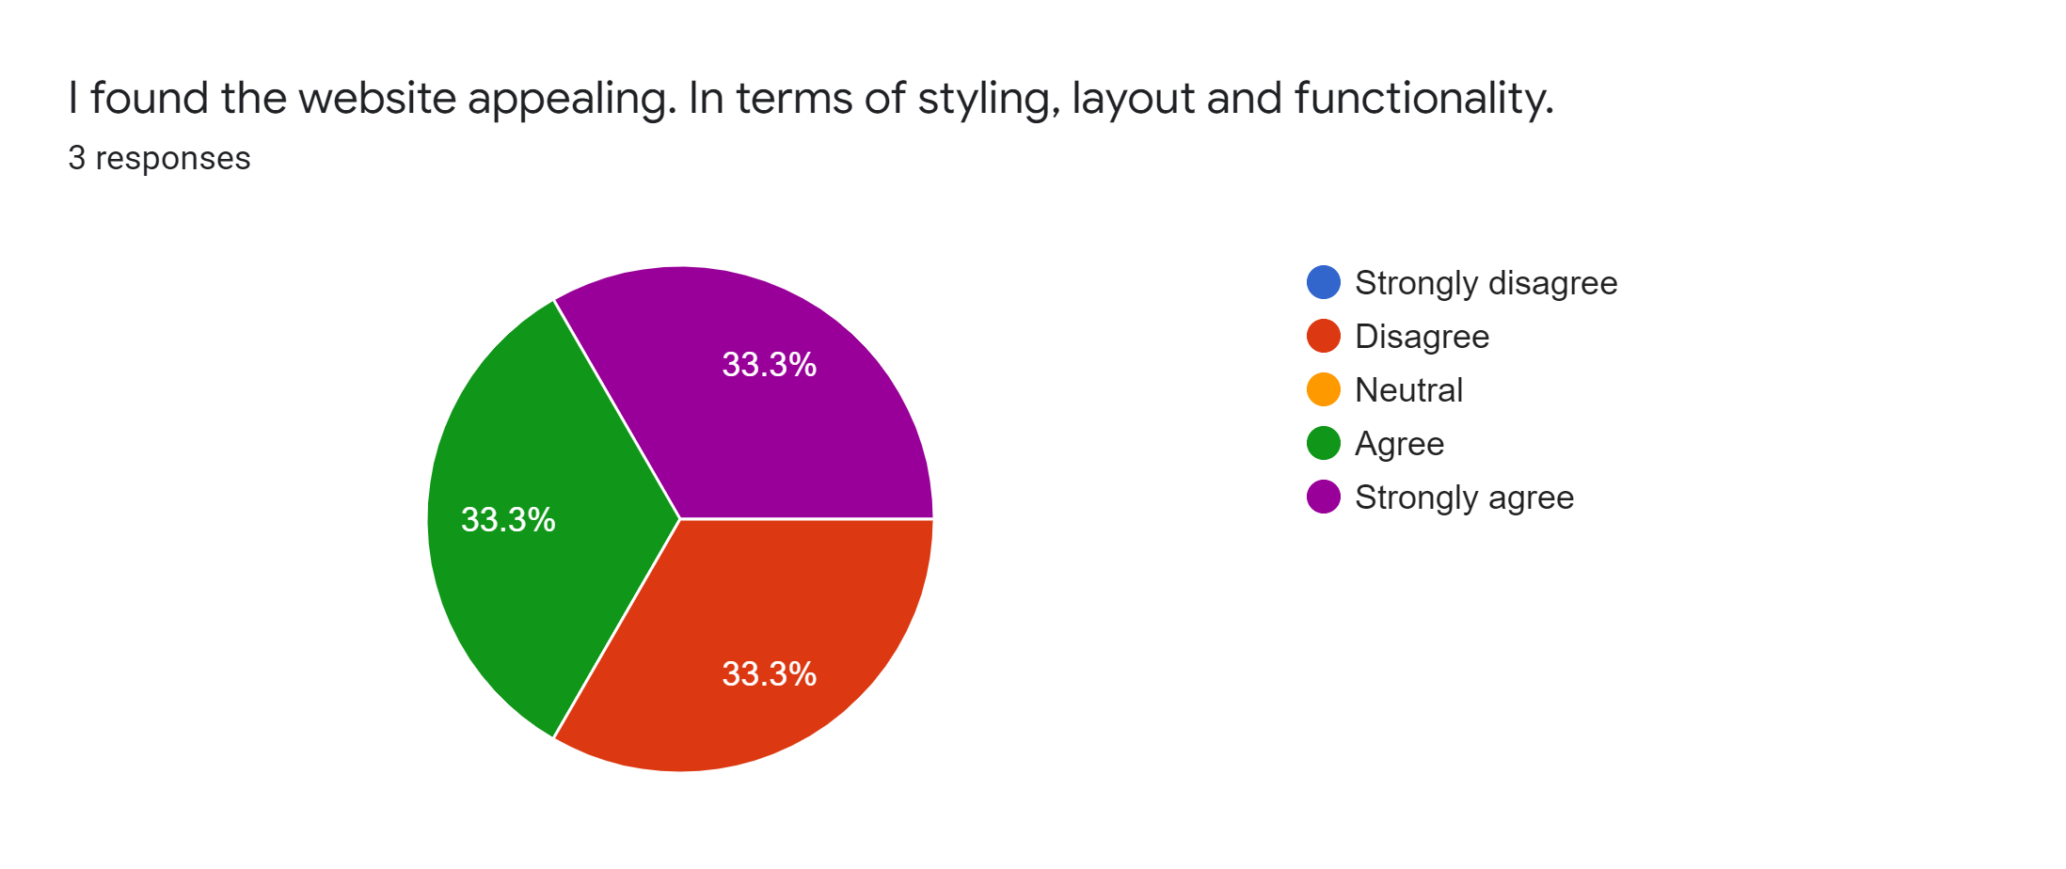
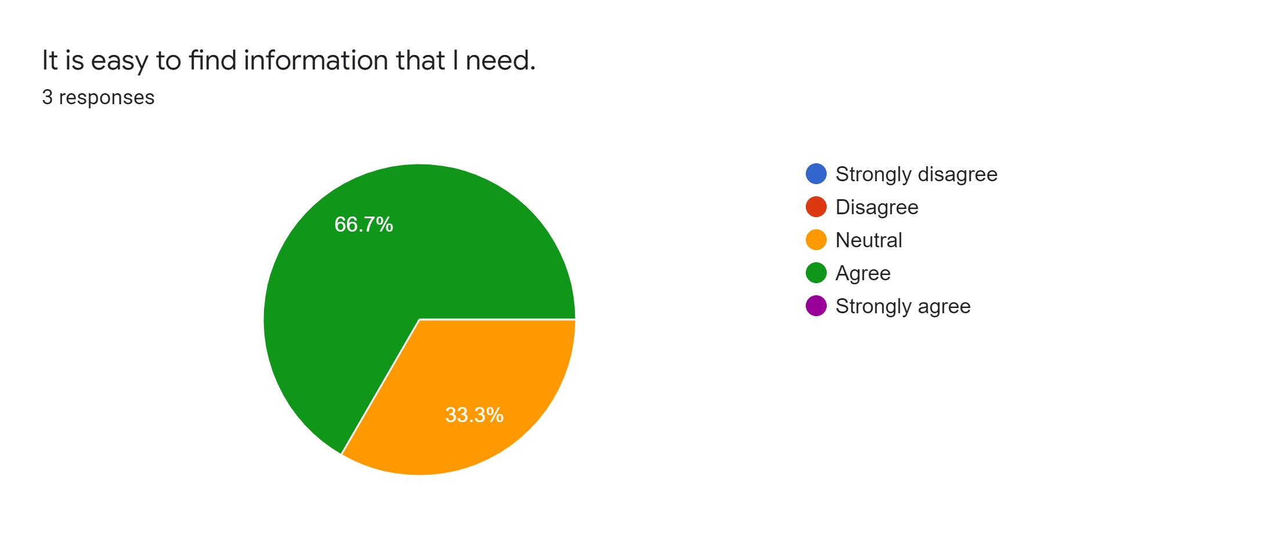

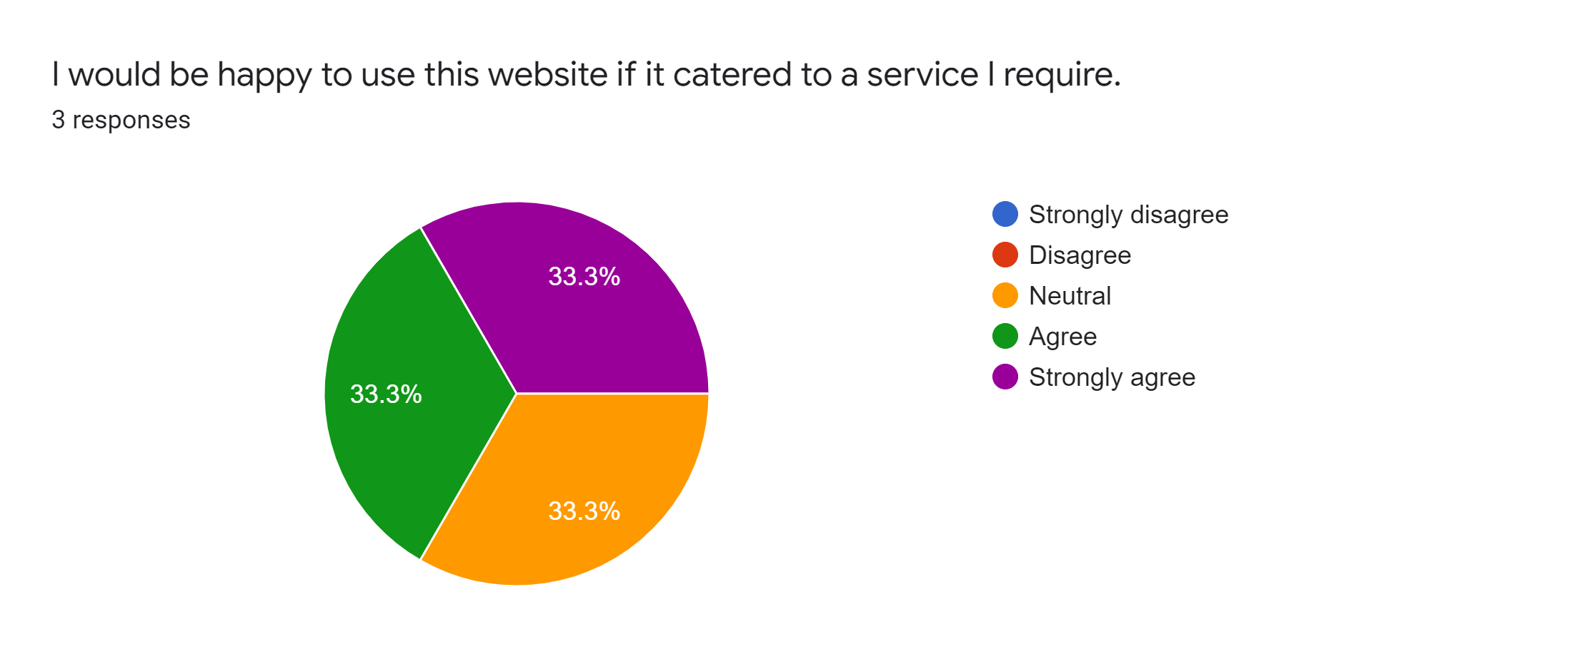
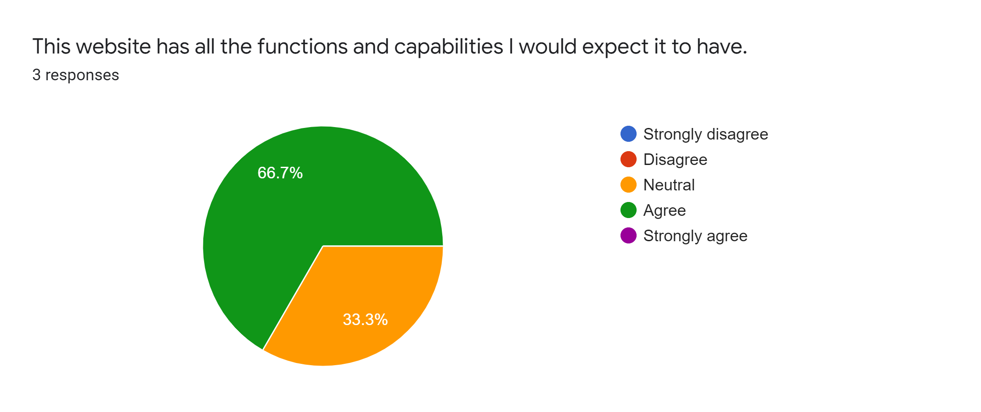
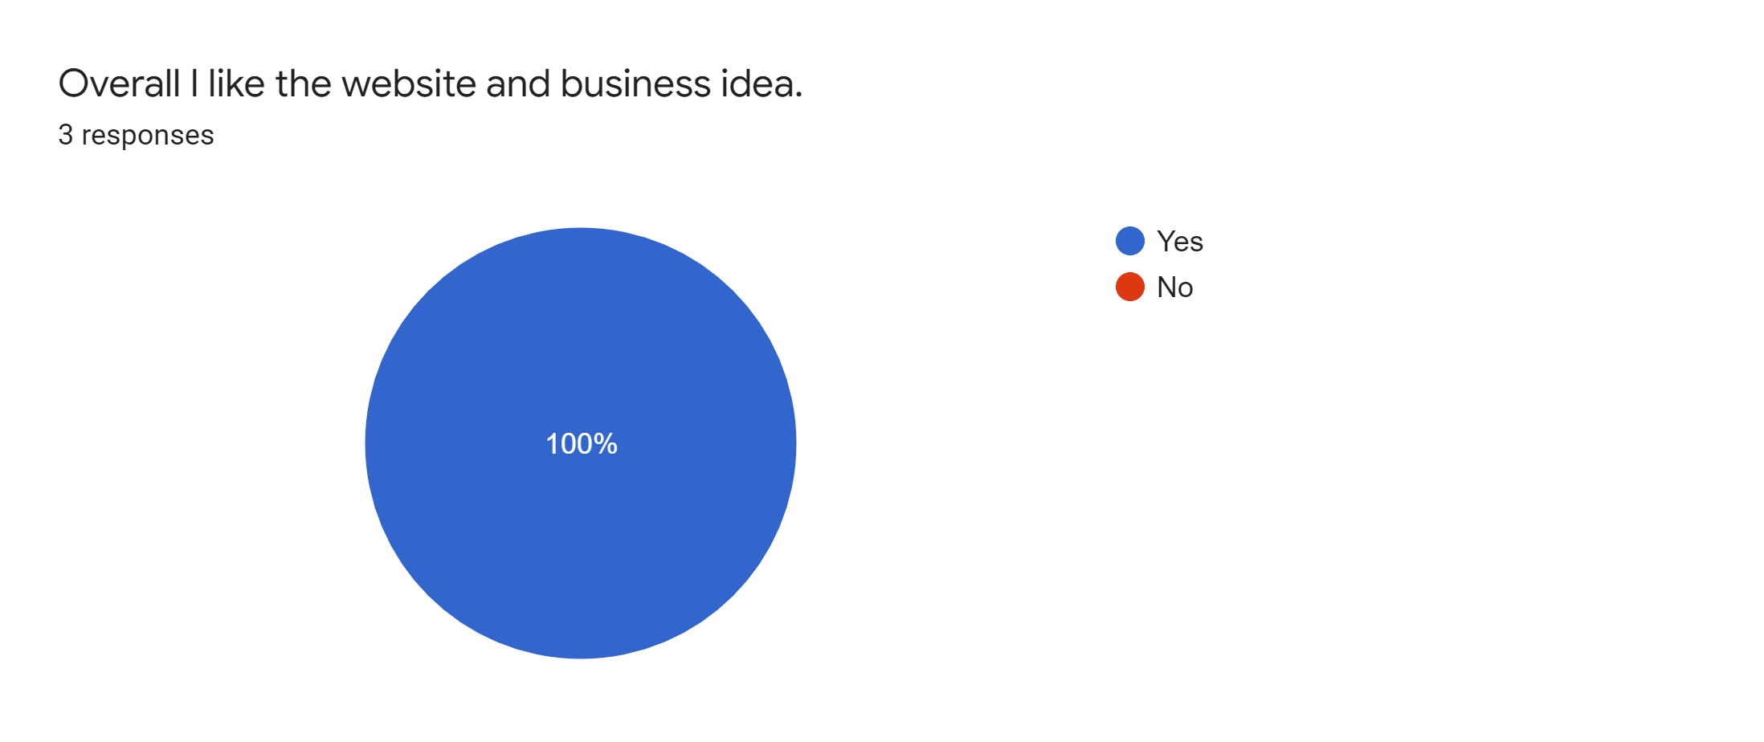
User studies
User study results go here

Slide 13
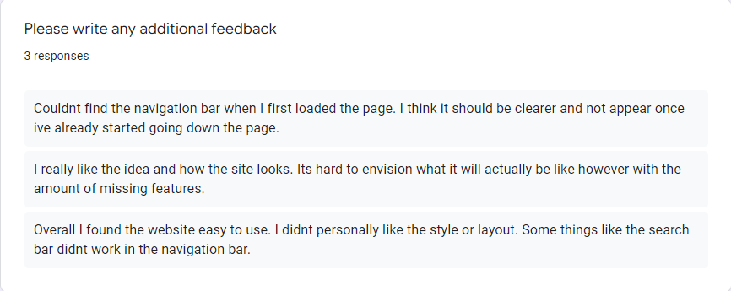
User study
Navbar bug
Missing features
Potential layout and styling refactor

Slide 14
Future direction
Features:
Linking back-end and front-end functionality
Results and voting to link to database
Front-end styling improvements
Additional user studies
Deployment

