Slide 1


Consumer Goods
Ad_Hoc Insights
by Josh Jebastine

Slide 2
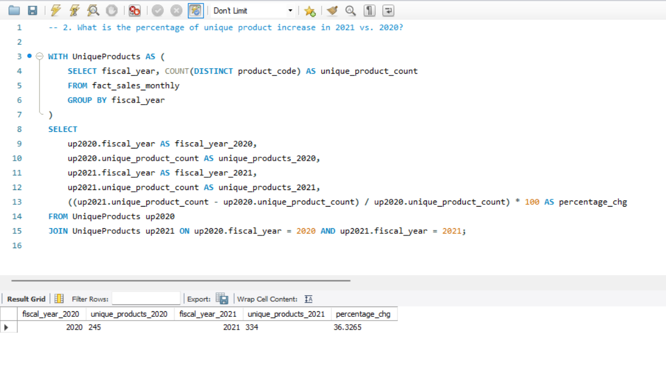
Unique Product Increase Rate 2020 VS 2021
In 2021 36% Unique Products growth is noted.

Slide 3
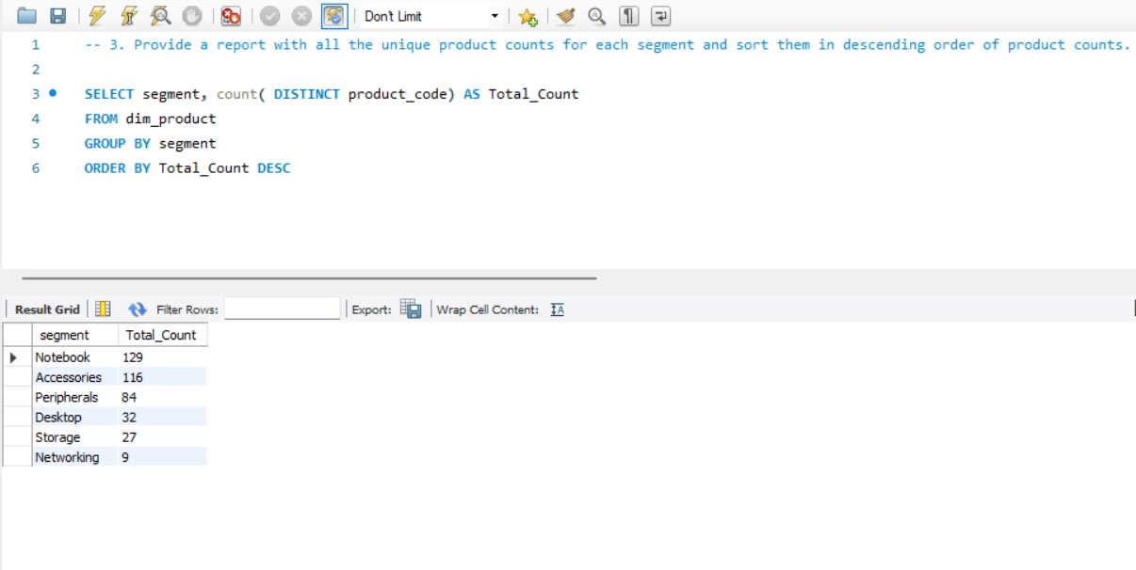
Segment Wise Contribution
Notebook contributes majority - 33% in Overall segment.

Slide 4
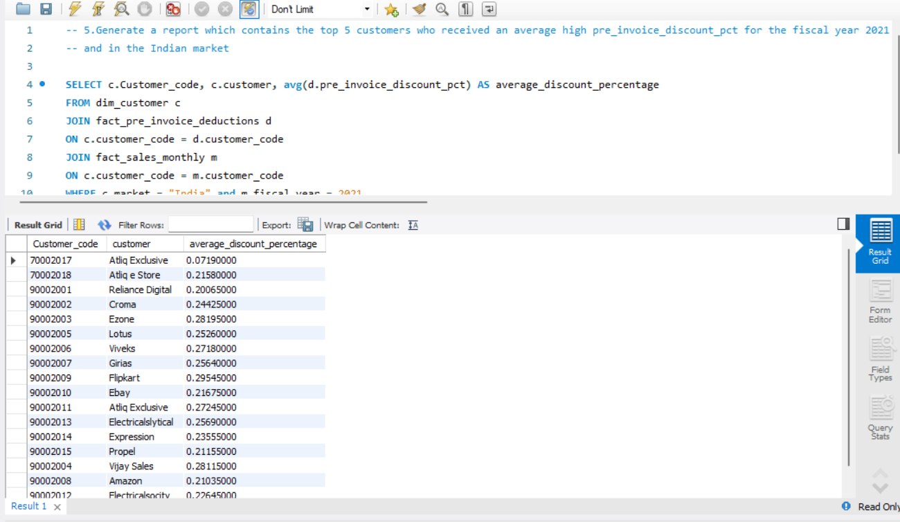
Average Discount to Customers
Flipkart has highest discount percentage.

Slide 5
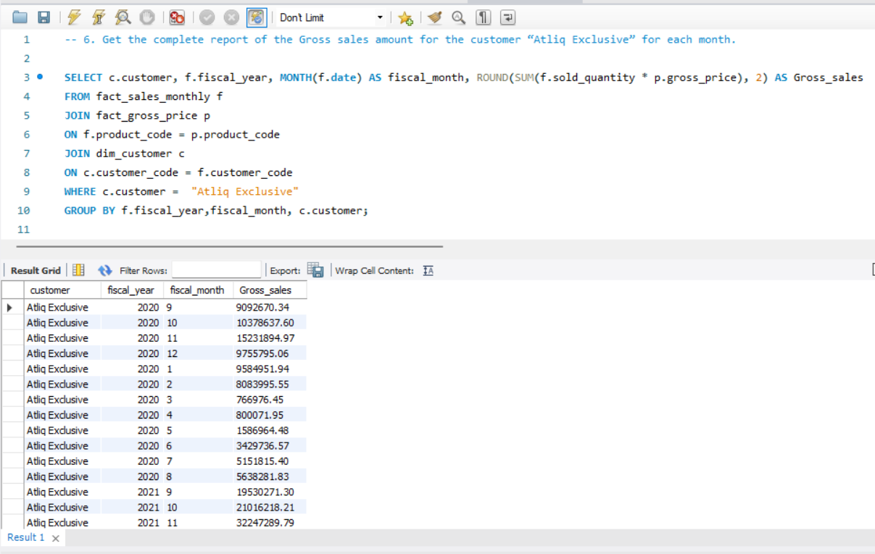
Atliq Hardwares 2020 VS 2021 Gross Sales
2021 has the largest amount of sales.

Slide 6
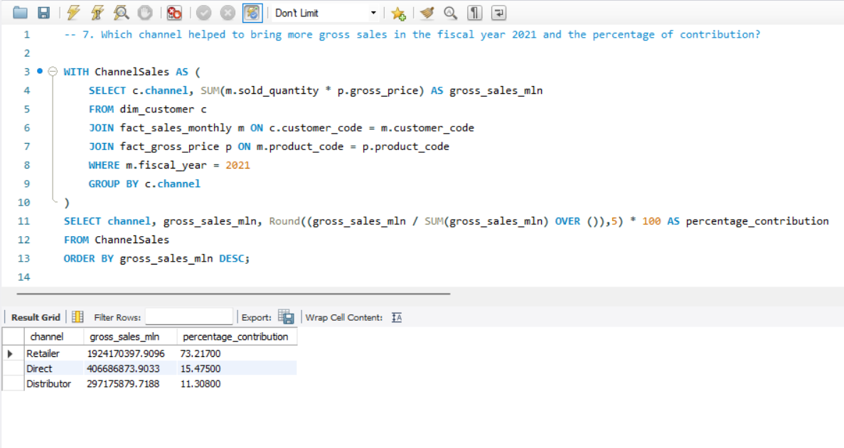
Channels Contribution
Retailers has 73% of contribution

