Slide 1



High-Throughput Computing in Python, Powered by HTCondor
Josh Karpel | karpel@wisc.edu
Notes:
Computer in duplicate screen mode
Powerpoint in duplicate screen mode
Fullscreen jupyter lab

Slide 2
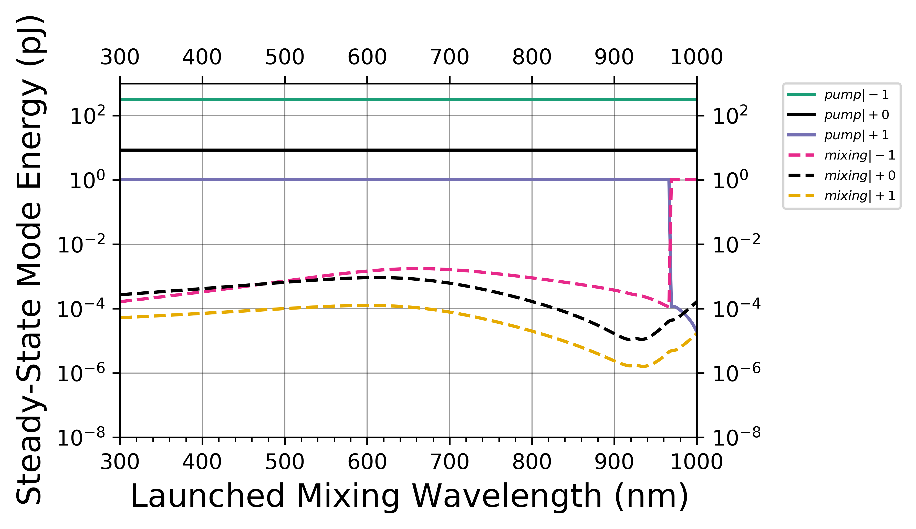
Common Problems in Scientific Computing
What happens to Y as we change X?
500 Simulations
1 Hour Each

Slide 3
What happens to Y as we change X?
Setup
X1
Simulation
Y1
Analysis
X2
Simulation
Y2
X3
Simulation
Y3

Slide 4
X = [0, 1, 2, …]
Y = map(simulation, X)
make_plot(X, Y)

Slide 5
HTMap is a
Pure-Python,
Seamless,
Lightweight,
Focused
HTCondor
Job Submitter & Manager

Slide 6
Who is HTMap for?
Has a working computation written in Python
Knows Scientific Python, but not necessarily anything else
Wants to use high-throughput computing… but is very busy
Users
“Well, it works on my laptop…”
Users have similar workflows, but dissimilar skills
Facilitators

Slide 7
Who is HTMap NOT for?
“The output of my analysis is a file”
“My function takes a millisecond to run”
“But I don’t use Python…”

Slide 8
Independent Execution
multiprocessing
htmap
condor_submit
concurrent.futures
Short-Running
Long-Running
dask
condor_submit_dag
Interdependent Execution

Slide 9
HTMap
https://github.com/htcondor/htmap
Slides and Code
https://github.com/JoshKarpel/htcondor-week-htmap-talk

