Slide 1


Neural Architectures in Financial News sentiment Analysis
Student No – 720017170
Notes:
- Have you ever wondered if news headlines can affect market dynamics?
- It can be possible.
- Today, I will show that with the right dataset and models, we could analyse this
relationship.
- Let's dive in!

Slide 2
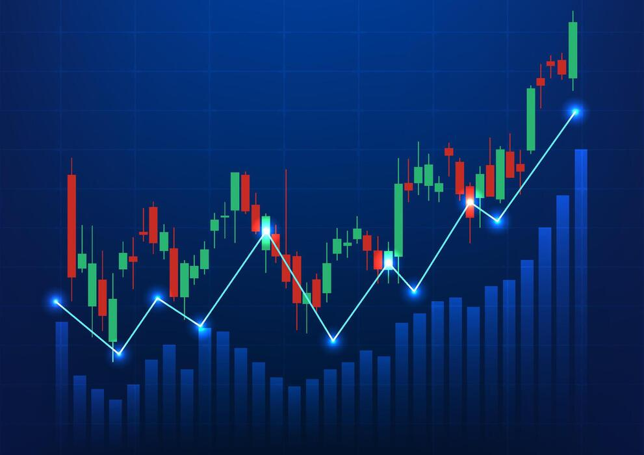

Background
[1]
Traditional Stock Market Analysis – Based on Quantitative Data
ML Methods Limited
Deep Learning – Neural Architectures
Aim
Evaluate Deep Learning Methods For Sentiment Classification
Does Increasing Model Complexity Increase Accuracy?
[2]
Notes:
Okay, so here's the thing. Traditional financial models are all about numbers—stock prices,
economic data, GDP, all that quantitative data. However, there's a problem: they lack emotion.
News headlines shape how investors feel, and emotions literally drive market movements.
Now, people have studied social media sentiment before. Twitter vibes, Reddit posts.
But financial news headlines? That's actually been less researched, even though it matters
way more. It's more official, more trusted.
Here's where it gets interesting: traditional machine learning methods. You have to decide what words matter. That's hard, especially
in finance, where language is subtle and nuanced.
But deep learning? Models like LSTMs and Transformers can automatically learn what matters.
They find patterns you wouldn't think to look for. And FinBERT—which is BERT trained specifically
on financial text—is even better. It already understands finance.
But here's my question: if FinBERT is already so good, does adding a more complex architecture on top actually help with classification?
Or do you just get slightly better results for way more compute?

Slide 3
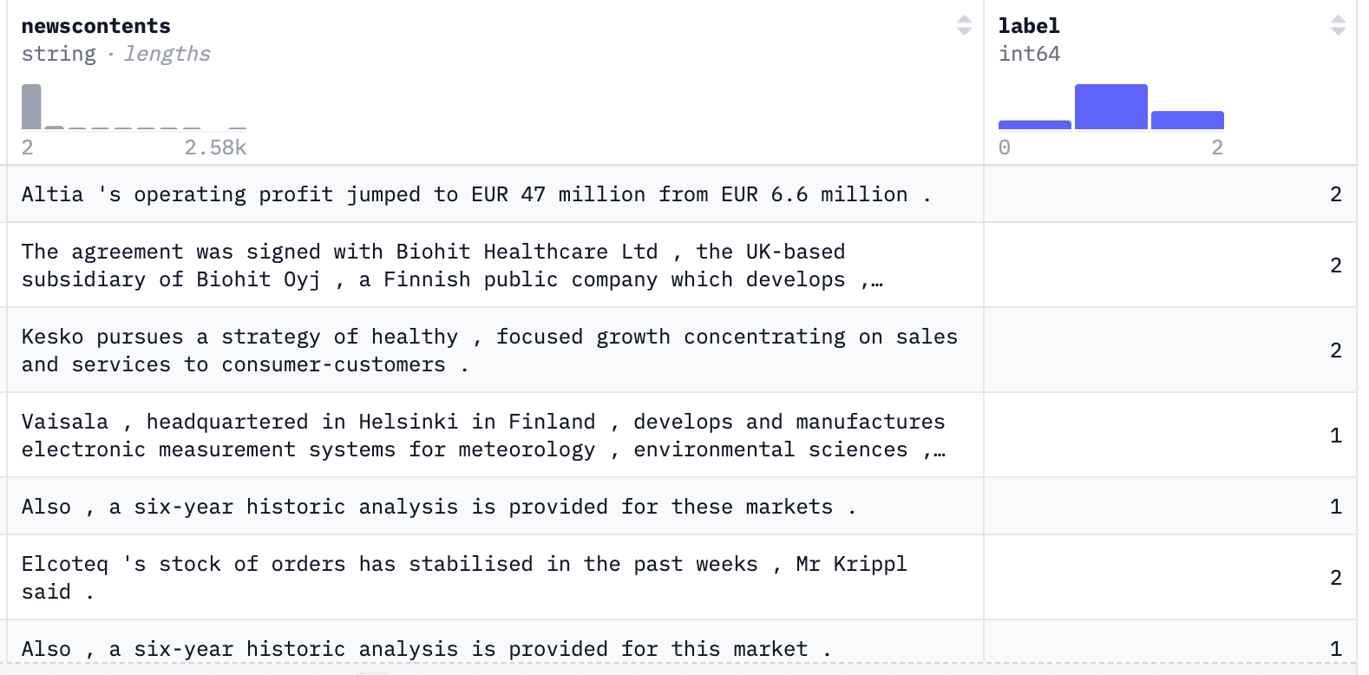
Dataset
English Financial News [3]
27,000 Observations of Financial News Articles
Imbalance
[3]
Notes:
For this project, perfect for these neural models, called HuggingFace.
- The dataset contains news headlines from various sources, along with their corresponding
sentiment labels (positive, negative, neutral).
Here's the thing though: it's imbalanced. About 62.5% are neutral, 25% positive, 12.5% negative.
That matters because models naturally get better at predicting the majority class.
So right from the start, all models will be biased toward saying "neutral."
The task is straightforward: predict sentiment. Given a headline, classify it as positive, negative,
or neutral. That's multi-class classification.

Slide 4
Methods
Tokenization and Embeddings
Models
TF-IDF
FinBERT
Logistic Regression
MLP
LSTM
Transformer
Notes:
- When completing natural language processing, the first step is to transform the text data into
a form that these networks can understand. The main way we did this was using FinBERT,
which is a pre-trained language model specifically designed for financial text. As well as using
TF-IDF vectorization for baseline.
Next, is where the fun starts - the models!

Slide 5
Models
Model
Multi-Layer Perceptron (MLP)
Long-Short Term Memory (LSTM)
Transformer
FinBERT Embedding Layer
FinBERT Embedding Layer
FinBERT Embedding Layer
Hidden Layer 1 – with Dropout
3 BiLSTM Layers
Normalisation Layer
Hidden Layer 2 – with Dropout
Normalisation Layer
Transformer Encoder Layer
Hidden Layer 3 – with Dropout
Attention Layer
Normalisation Layer
Normalisation Layer
Fully Connected Layer – With Dropout
2 Fully Connected Layers – With Dropout
Output Layer
Baseline: TF-IDF + Logistic Regression
Notes:
- We experimented with several neural network architectures, including:
- MLP (Multilayer Perceptron)
- LSTM (Long Short-Term Memory)
- and a Transformer model.
And a baseline tf-idf with LR

Slide 6
Methods
Tokenization and Embeddings
Models
Sentiment Prediction
TF-IDF
FinBERT
Logistic Regression
MLP
LSTM
Transformer
Multi-Class Classification
Probabilities of Each Sentiment Class
Notes:
Each model gave a different approach to learning patterns in the text data.
but ultimately, outputted a sentiment prediction for each headline.
- As you can see the models get more complex as we go along, but does that mean better performance?

Slide 7
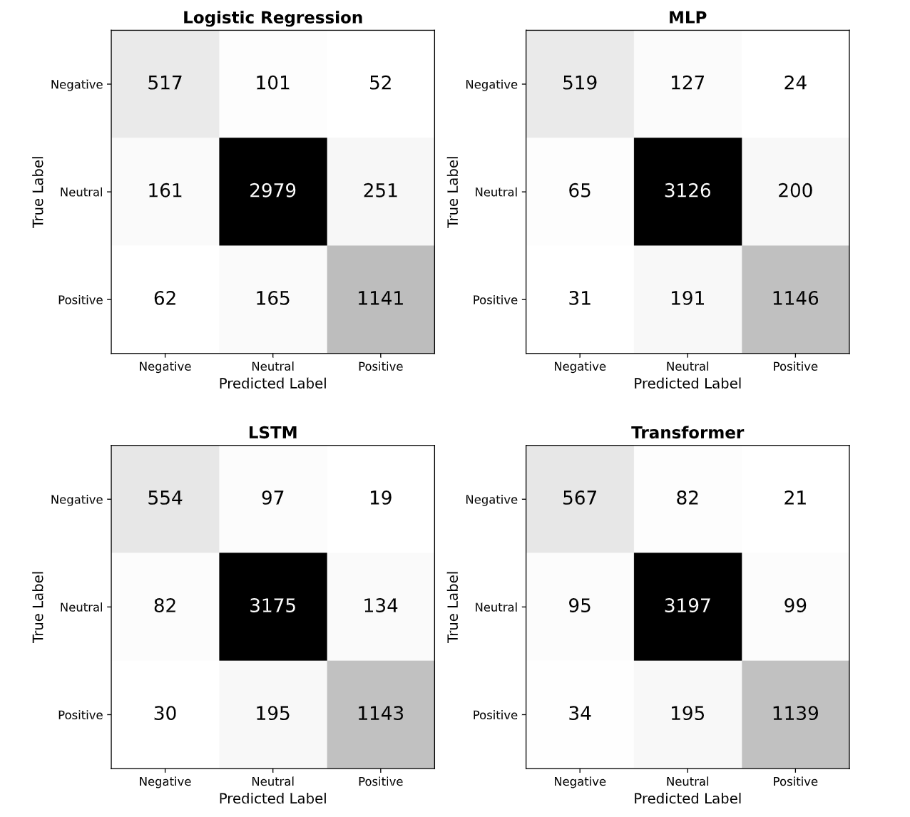
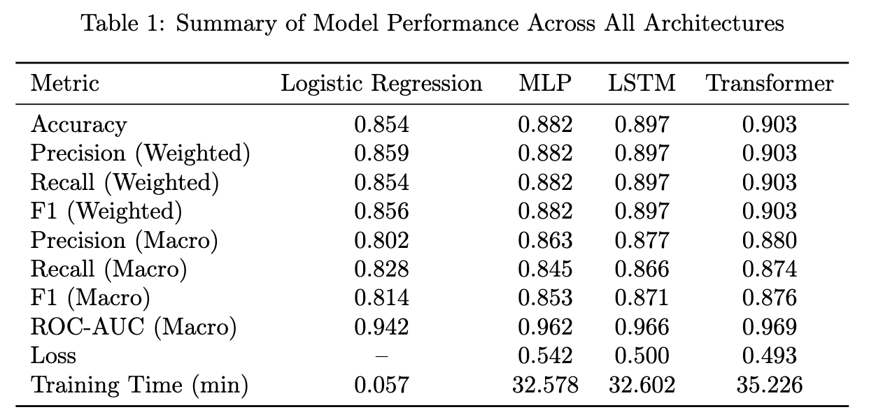
Results + Conclusions
Complexity = Accuracy?
Bias / Imbalance
Training time < Accuracy?
Notes:
Does compleixty actually = more accuracy, the short answer is yes if we look at the accuracy row of the table we can see that accuracy increases as we move up the moels
But look at how much we gain at each step. Going from Logistic Regression to MLP?
2.8 percentage points. LSTM to Transformer? Only 0.6 points.
That's the key insight.
More complexity doesn't mean proportionally more accuracy, potentially due to dataset size being the limiting
factor.
Look at those confusion matrices on the right. They tell the story of dataset imbalance and bias
the black boxes right in the center of each matrix? That's neutral sentiment.
The models got really good at predicting neutral. Why? Because 62.5% of the data is neutral.
The models learned that's the safe prediction.
Now look at the edges—top left and bottom right. Those areas are much lighter.
That's negative and positive sentiment. The models made more mistakes there.
So here's the answer to this question: Yes, bias and imbalance heavily affect performance.
The models are biased toward the majority class because that's what's dominant in the data.
But that bias also means they're worse at the minority classes, which is also reflected in the F1 scores
Now look at the bottom of the table: training time.
So Logistic Regression trains in less than a tenth of a minute. The neural models? 32 to 35 minutes.
That's 570 to 620 times longer.
Now the question is asking: is training time less important than accuracy? Or should we trade compute for performance?
Here's the honest answer: it depends.
If you need the best possible accuracy and you can afford the compute time?
Then Transformer at 90.3% is worth the extra 35 minutes.
But if you're thinking practically? MLP gets you 88.2% accuracy in 32.6 minutes.
That's pretty good. For most real-world applications, that might be enough.
Or if you need speed above all else? Logistic Regression is done in seconds.

Slide 8
Limitations + Future Work
Dataset Imbalance
Single Training Run
Frozen FinBERT Embeddings
Data Augmentation
Use Multiple Runs
Fine-tune FinBERT
Notes:
Before I wrap up, I want to be real about the limitations because they're important.
Limitation one: Data imbalance.
62.5% neutral skews everything. All models learned to exploit this.
Limitation two: I only trained each model once.
With computational constraints, I couldn't run multiple training sessions with
different random seeds. So I can't say definitively whether differences are real or just random.
Limitation three: I used frozen FinBERT.
I didn't fine-tune it on my data. That was a practical choice—saves time and memory,
and it prevented overfitting on imbalanced data. But it meant the model couldn't adapt to
the specific quirks of financial news.
But here's the good news: these limitations point to exactly what should happen next.
To improve the dataset imbalance, techniques like data augmentation or synthetic data generation
could help. Or collecting more negative sentiment headlines.
For the training variability, running multiple experiments with different seeds would give
more robust results, allowing for statistical significance testing.
And finally, fine-tuning FinBERT on this specific dataset could unlock better performance.

Slide 9
References
[1] Vecteezy, ‘Stock Graph’, Vecteezy, 2025. [Online]. Available: https://www.vecteezy.com/vector-art/27477384-stock-graph-technology-background-it-is-a-technology-that-shows-the-growth-price-of-a-company-on-the-stock-market-increasing-the-attractiveness-of-investors-green-and-red-charts-along-with-bars. [Accessed: 11-Nov-2025]
[2] ‘Home - Financial Times’, Financial Times [Online]. Available: https://www.ft.com/ [Accessed: 11-Nov-2025]
[3] L. Calarte, ‘English_Finance_News’, Huggingface.co, 2023. [Online]. Available: https://huggingface.co/datasets/lukecarlate/english_finance_news. [Accessed: 10-Oct-2025].

