Slide 1
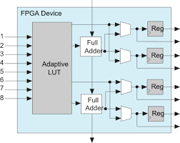
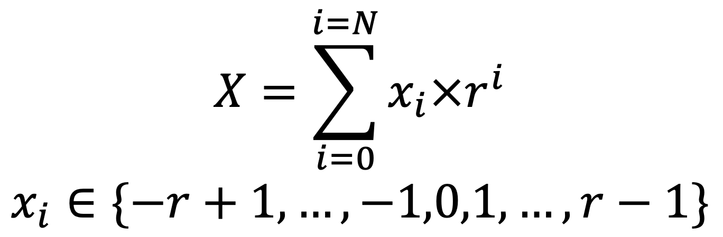
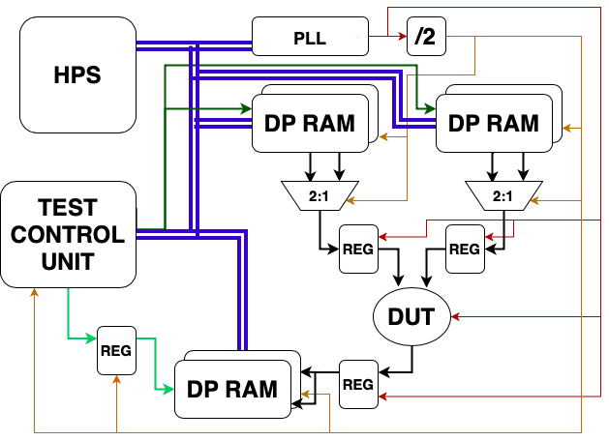
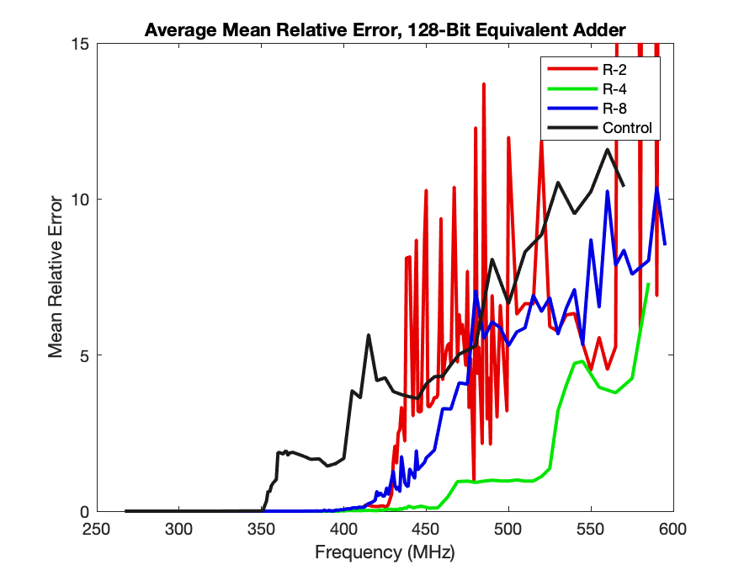
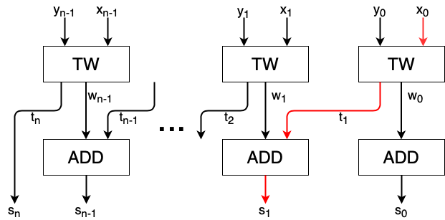
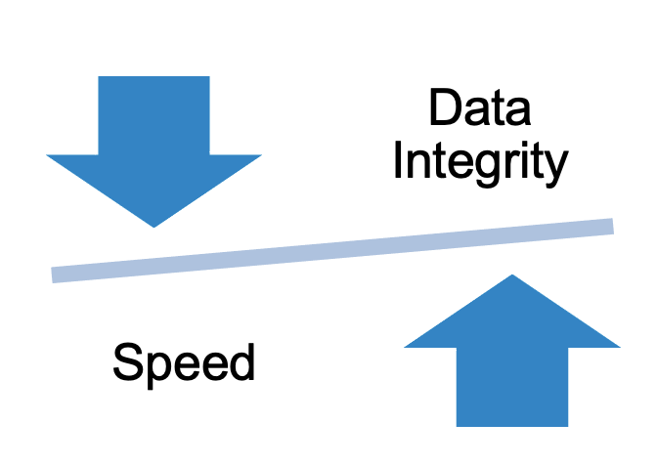
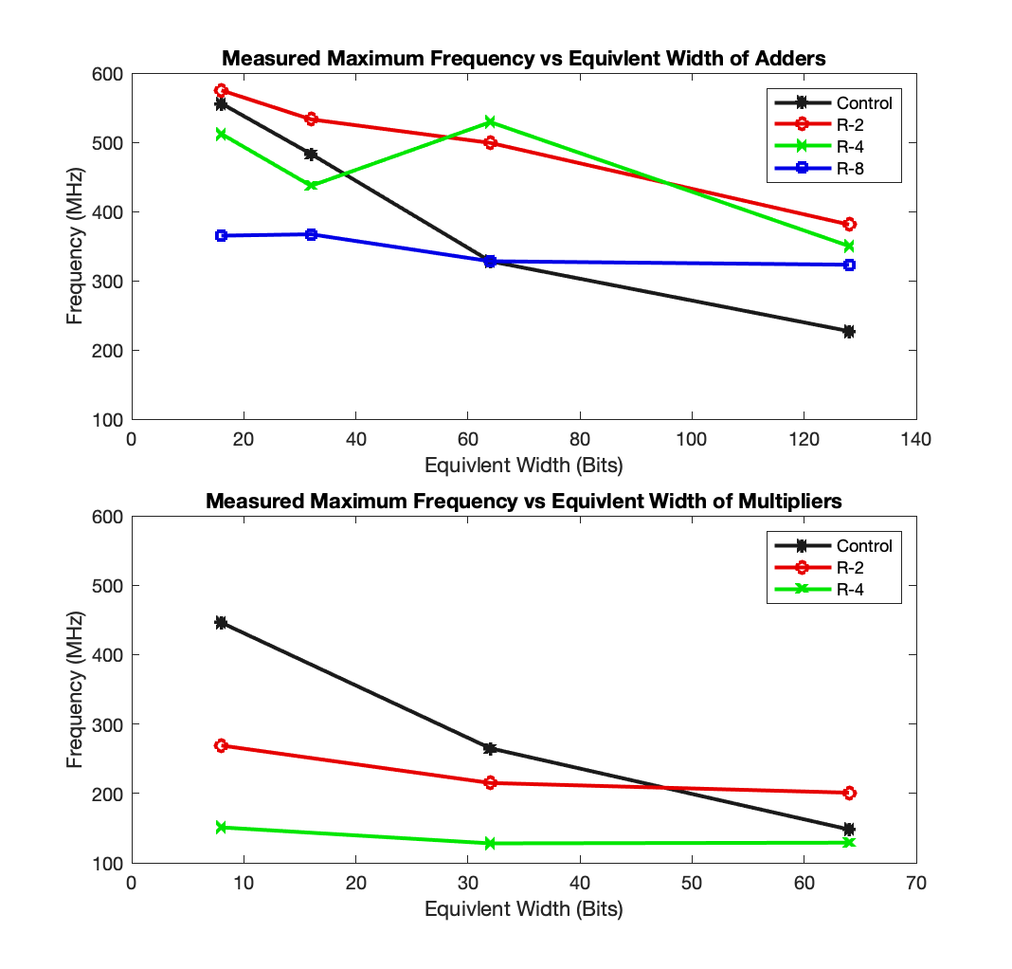
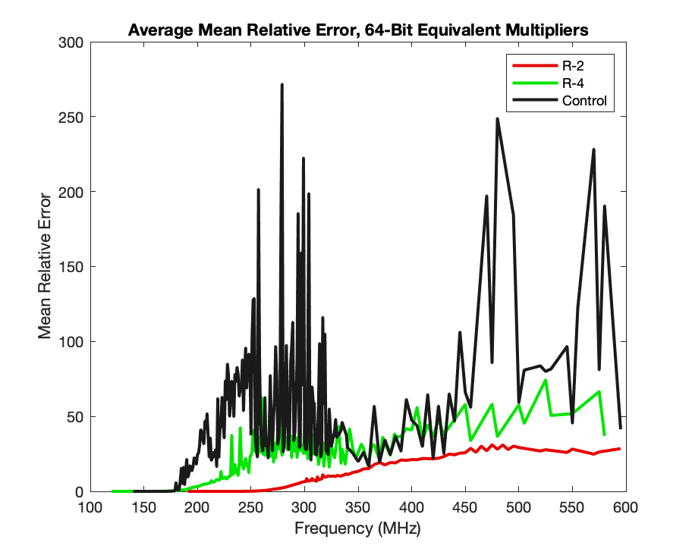
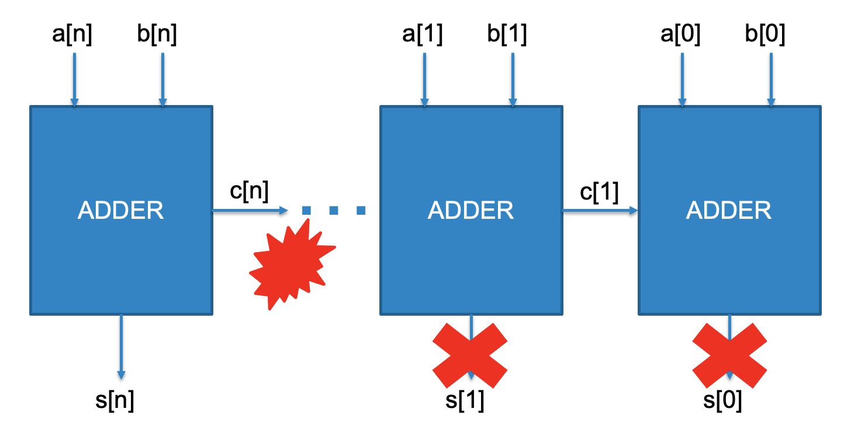
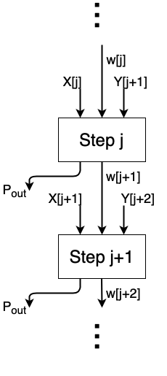
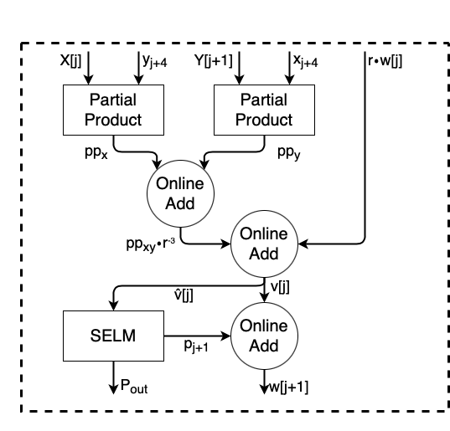
Graceful Degradation on FPGAs: A High-Radix Online Approach
Joshua Laney
Motivation
Implementation
Testing
Degradation Data
Radix-4 adders degrade more advantageously than radix-2
This is not the case for multipliers or higher radices
The key to online arithmetic is redundancy, allowing MSDs to be guessed and LSDs to correct for error
Image taken from Intel
FPGAs are configurable but have an unchangeable microarchitecture targeting LSD-first operation
The test bench must withstand higher frequencies than the DUT
Image adapted from Digital Arithmetic textbook by Milos Ercegovac
Speed Data
In some applications accuracy is forfeited in the pursuit of speed
Addition is done fully in parallel with a constant carry chain
Multiplication works through an iterative residual approach, and is pipelined
Online arithmetic leads to graceful degradation due to MSD-first carry chains
Does high-radix online arithmetic perform better than radix-2 on FPGAs?
Only radix-4 addition benefits from the FPGA microarchitecture over radix-2
Radix-2 is generally faster than higher radices, especially in the multiplier
Image adapted from Kan Shi’s PhD Thesis

