Slide 1
High Radix MSD-First Arithmetic for FPGA Overclocking
June 15, 2021
MSc Research Project
Joshua Laney, Department of Electrical and Electronic Engineering
Notes:
-still on-going

Slide 2
What my resume doesn’t say
Computing
Robotics
Semiconductor Devices
Analog & Mixed Signal IC
RTL Design & Computer Architecture
OS & Compilers
Applications & Web Dev
PCBA Design
Cable Harnesses
Embedded Programing
Computer Vision
Electro-mechanical Systems
Notes:
-Computing has been mainly academic
-Robotics has been mainly internships
-I HAVE DONE FAB
Arrow effect

Slide 3
High Radix MSD-First Arithmetic for FPGA Overclocking
What exactly does this mean?

Slide 4
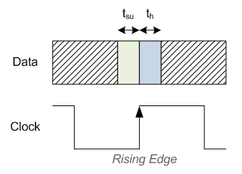
It’s all about speed
Motivation
Slow,
Cheap,
Dynamic
Fast,
Expensive,
Fixed
CPU
GPU
FPGA
ASIC
Data Integrity
Speed
Notes:
FPGAs have clear advantages
Not all applications care if data is exact

Slide 5
The issue with LSDF
Motivation
a[n]
b[n]
a[1]
b[1]
a[0]
b[0]
ADDER
ADDER
ADDER
…
c[n-1]
c[0]
s[n]
s[1]
s[0]

Slide 6
MSDF: Breaking things nicely
Motivation
a[n]
b[n]
a[1]
b[1]
a[0]
b[0]
ADDER
ADDER
ADDER
…
c[n]
c[1]
s[n]
s[1]
s[0]

Slide 7
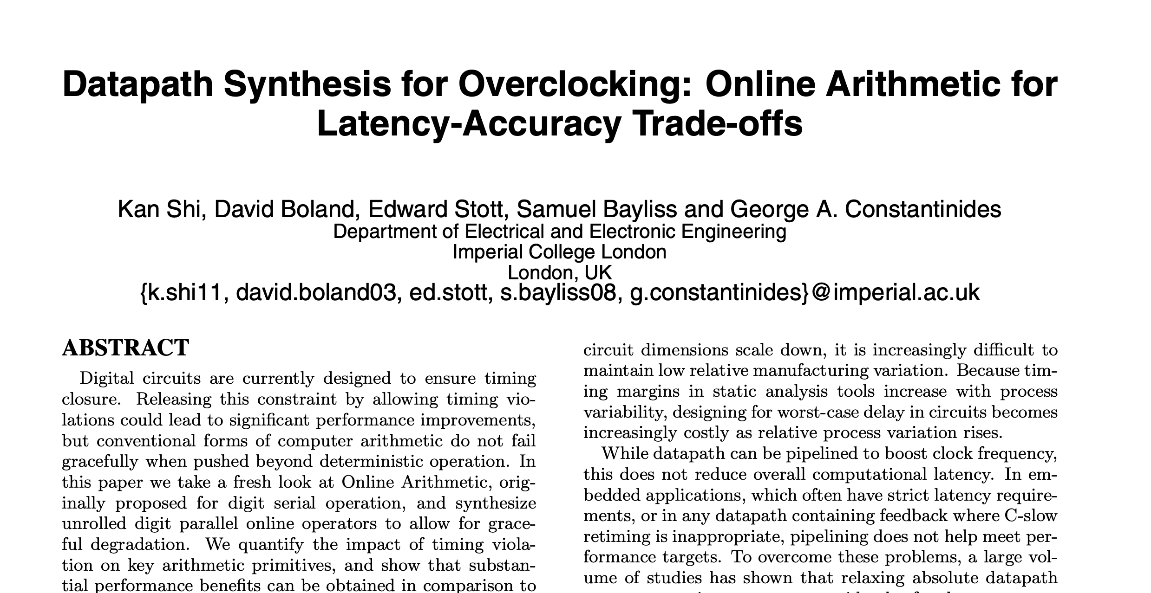
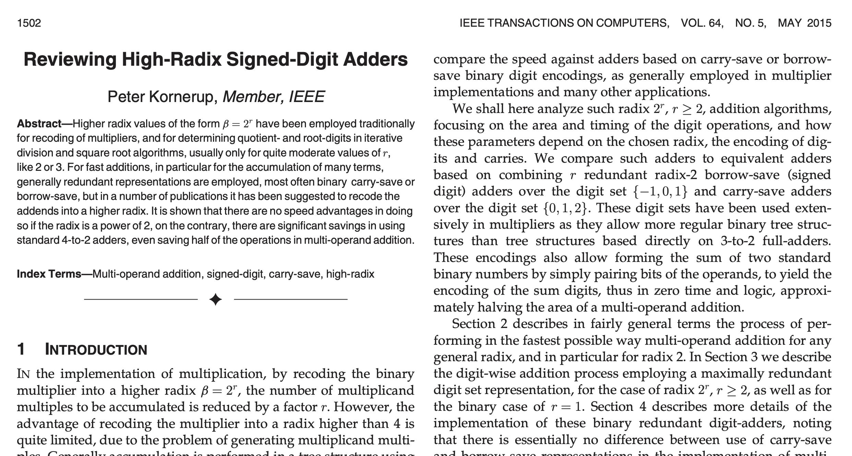
But this has already been shown!
Motivation
MSDF allows for increased overclocking
High-Radix is less efficient than Radix-2 in ASIC implementations
Notes:
-first paper only radix 2
-second paper only adders

Slide 8
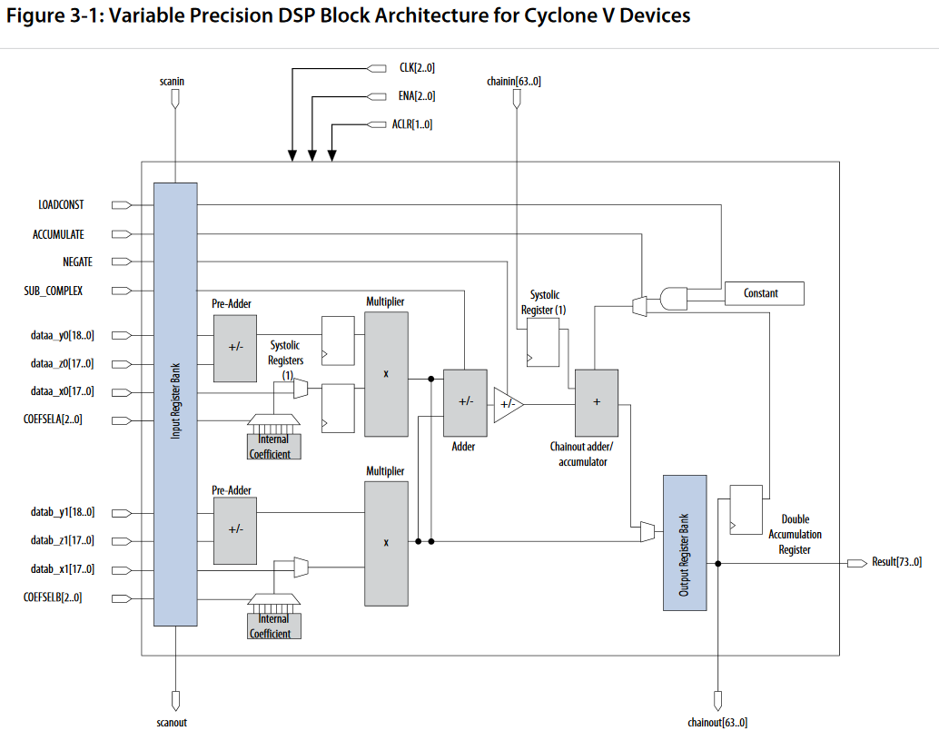
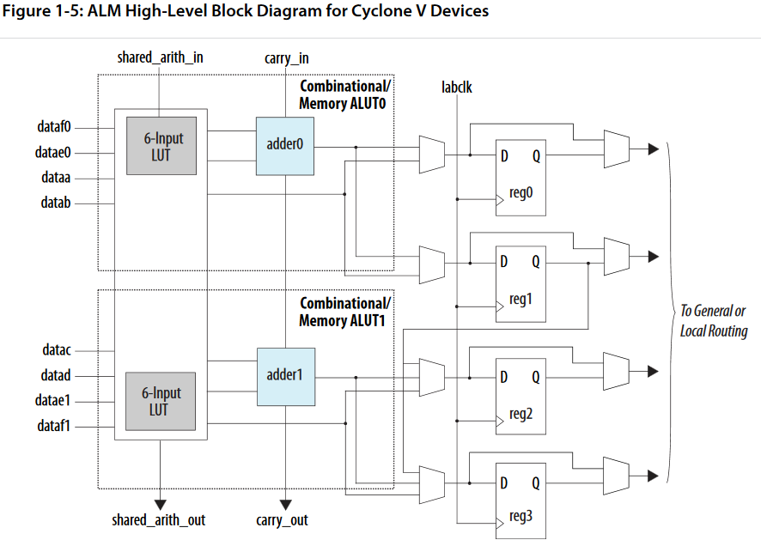
Is it beneficial to go beyond Radix-2?
Motivation
Cyclone V ALM
Cyclone V DSP
Notes:
On asic no, but fpga must be configured with set blocks

Slide 9
Project Aims
1. Arithmetic Design
Build MSDF Adder and Multiplier
2. Test
Create High-Frequency Test Bench
3. Interpret
Develop Metrics to Understand Results

Slide 10
MSDF Arithmetic
How does it work?

Slide 11
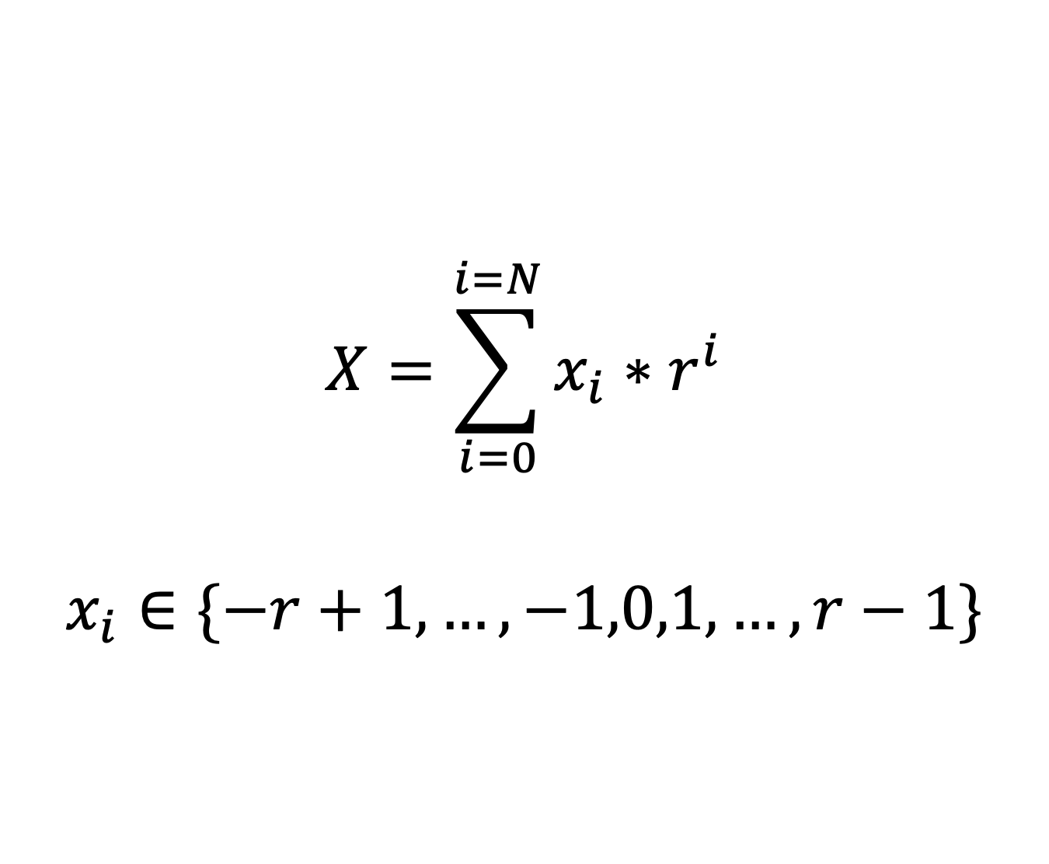
The key is redundancy
Arithmetic Design
$$X=\sum_{i=0}^{i=N}{x_{i}∗r^{i}}$$
$$x_{i}∈\{−r+1,…,−1,0,1,…,r−1\}$$

Slide 12
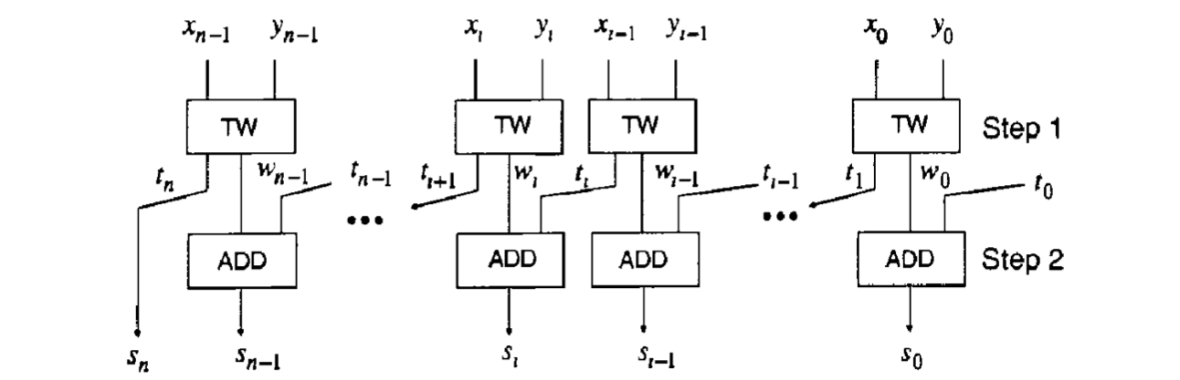
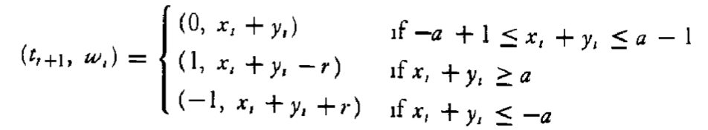

Addition all at once
Arithmetic Design
$$a≥\frac{\left(r+1\right)}{2}$$
$$a=r−1$$
Notes:
In the adder the delay chain is actually only 2

Slide 13
An R-10 Example in Action
Arithmetic Design
X Y
4 7 1 4
X Y t_{r+1} w_{r}
X Y t_{r} w_{r}
+ 3 2 3 9
0 1 0 1
0
+ 7 -1 4 3
0 8 -1 5 3
= 7 9 5 3
Notes:
-note the -1 in the sum!

Slide 14
A look at ‘false’ overflow
Arithmetic Design
X Y
4 0 0 0
X Y t_{r+1} w_{r}
X Y t_{r} w_{r}
+ 5 0 0 0
1 0 0 0
0
+ -1 0 0 0
1 -1 0 0 0
= 9 0 0 0
Notes:
Should this be called overflow?

Slide 15
Dealing with the growing problem
Arithmetic Design
Compress
Constrain
Ignore

Slide 16
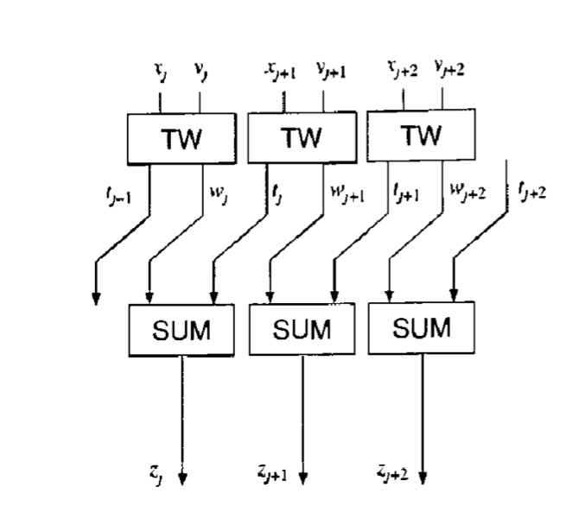
Compression
Arithmetic Design
Notes:
-Compression adds the potential of a reverse carry chain
-original designs called “online” developed for serial which has key adavantages

Slide 17
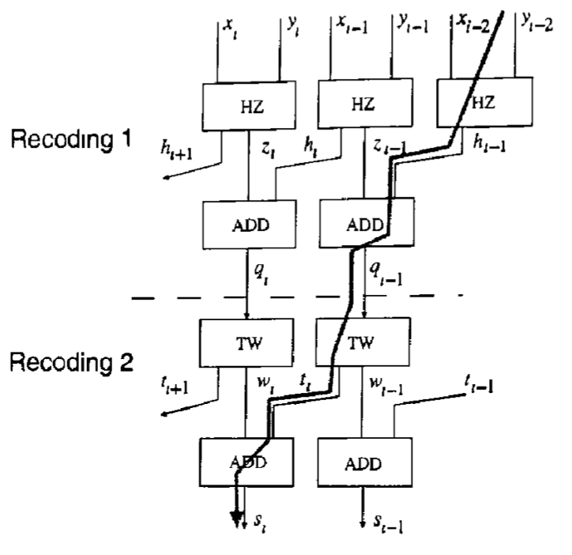
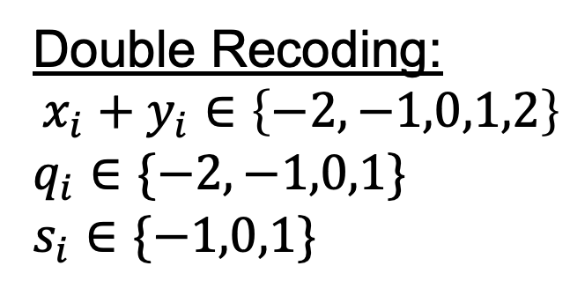
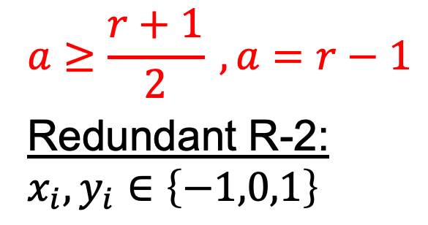
An aside on R-2
Arithmetic Design
$$a≥\frac{r+1}{2} , a=r−1$$
Redundant R-2:
$$x_{i},y_{i}∈\left\{−1,0,1\right\}$$
Double Recoding:
$$x_{i}+y_{i}∈\left\{−2,−1,0,1,2\right\}$$
$$q_{i}∈\{−2,−1,0,1\}$$
$$s_{i}∈\{−1,0,1\}$$

Slide 18
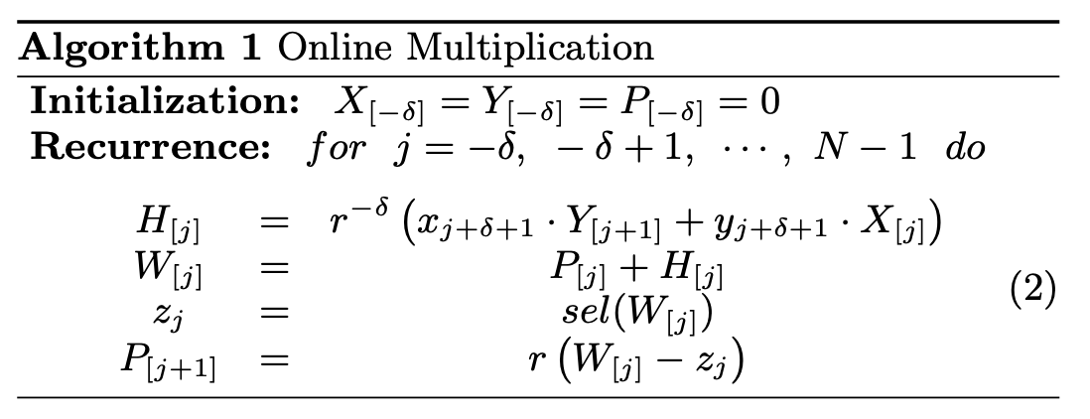
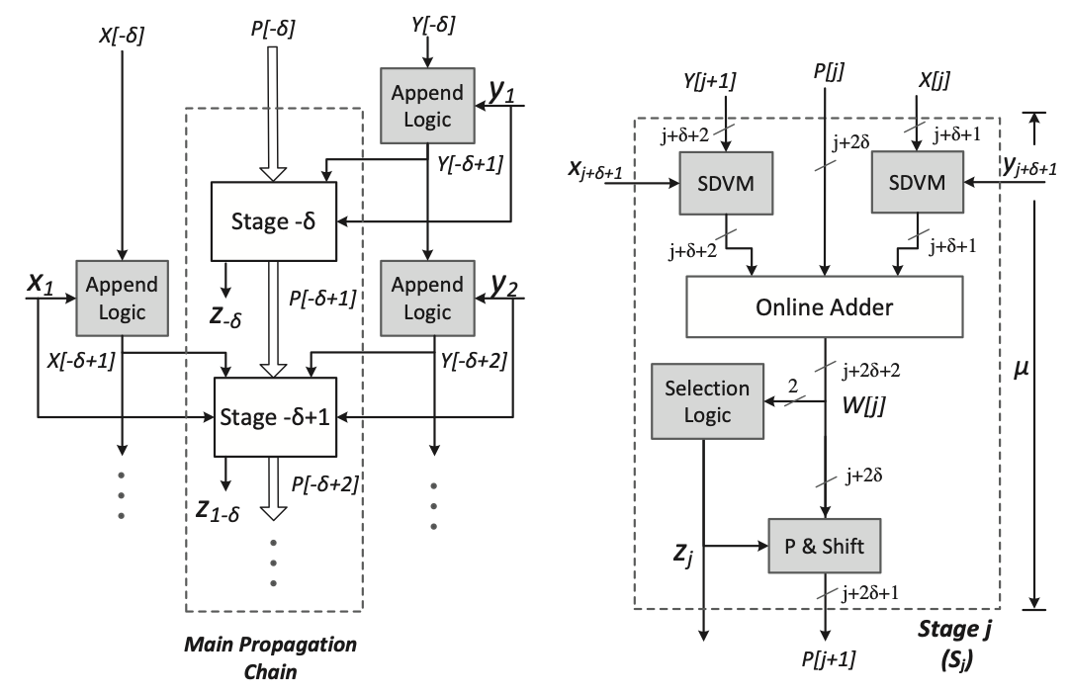
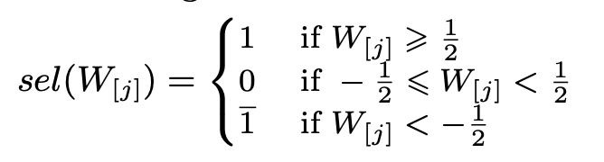
Let’s get multiplying
Arithmetic Design
Residual recurrences abound!

Slide 19
A new and dangerous frontier
Arithmetic Design
Long residual path
Parallel vs serial
Unreliable past papers
High-R partial product
'False' adder overflow

Slide 20
Testing the IP
If it has a clock, it can break

Slide 21
Data to be collected
Arithmetic Operator
Design
Radix
MSDF vs Traditional
Speed
Point of first failure
Gracefulness of degradation
Width
Number of Digits
Number of Bits

Slide 22
The test plan
Testing
Load Data
Retrieve Results
Verify
Configure Clock
Run Test
Continue Binary Search
Notes:
explain tech stack
cyclone 5 fpga

Slide 23
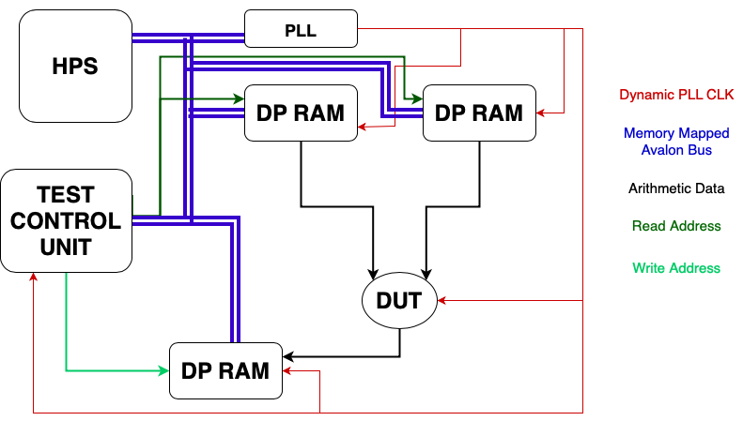
The test bench
Testing

Slide 24
How fast can these blocks get?
Testing
15 Digit R-2 Adder
M10K RAM Block
f_{max}: ~500MHz*
f_{max}: 315MHz
*Timing Analyzer Estimate

Slide 25
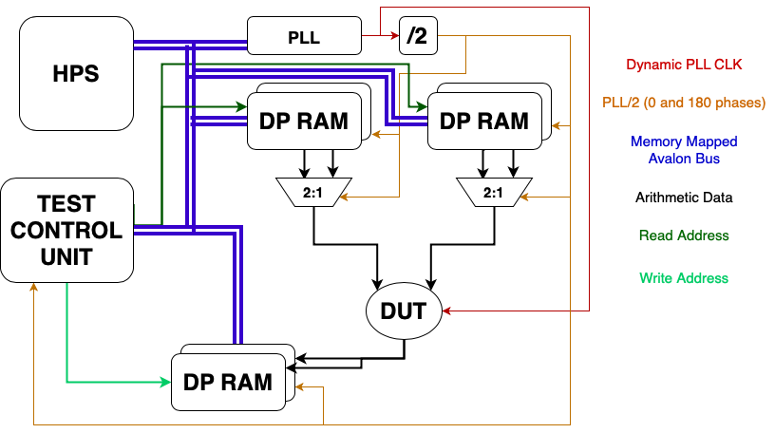
Double the RAM, double the fun
Testing

Slide 26
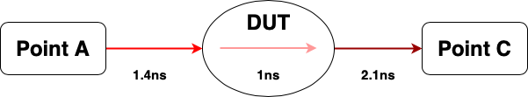
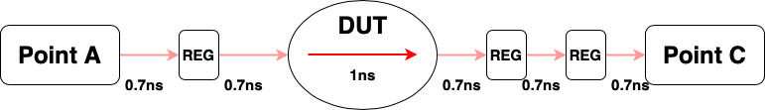
Feeding it forward
Testing

Slide 27
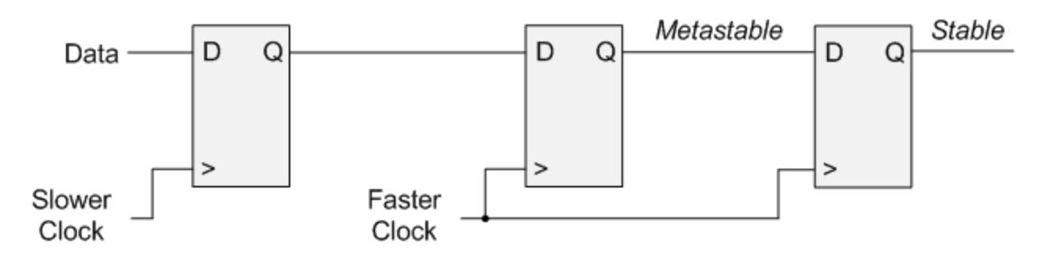
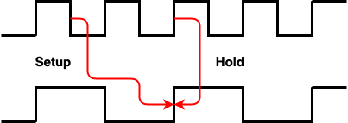
Cross-clock considerations
Testing
Notes:
-Double flopping
-Long hold times

Slide 28
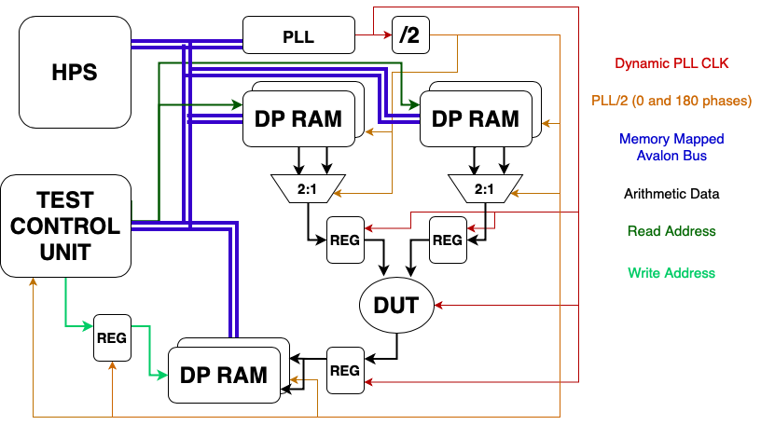
Test bench, take 3
Testing
Notes:
-still working out bugs in this.. PLL control, hidden timing failures, etc
-added registers

Slide 29
Interpreting the Data
What does it all mean?
Notes:
-warn I am not to this point in the project yet

Slide 30
Metrics make sense
Results
Max Frequency
Is higher radix worthwhile?
Mean Relative Error

Slide 31
Future directions
Results
Aggressive Optimization
Automated Toolchains
Full Pipelines
More Operators

Slide 32
Personal Takeaways
Results
Breadth and Depth
Timing is key
FPGAs are not ASICs
From the midst of the project
Notes:
Many different disciplines converging into one
Learn to speak the tools language
Fpga gives the allusion of asic

Slide 33
Acknowledgements and References
Advisor: Dr. James J. Davis {james.davis06@imperial.ac.uk}
[1] K. Shi, D. Boland and G. A. Constantinides, "Accuracy-Performance Tradeoffs on an FPGA through Overclocking," 2013 IEEE 21st Annual International Symposium on Field-Programmable Custom Computing Machines, Seattle, WA, USA, 2013, pp. 29-36, doi: 10.1109/FCCM.2013.10.
[2] M. D. Ercegovac and T. Lang, Digital arithmetic, Morgan Kaufmann, 2003.
[3] K. Shi, D. Boland, E. Stott, S. Bayliss and G. A. Constantinides, "Datapath synthesis for overclocking: Online arithmetic for latency-accuracy trade-offs," 2014 51st ACM/EDAC/IEEE Design Automation Conference (DAC), San Francisco, CA, USA, 2014, pp. 1-6, doi: 10.1145/2593069.2593118.
[4] K. Shi, D. Boland and G. A. Constantinides, "Efficient FPGA implementation of digit parallel online arithmetic operators," 2014 International Conference on Field-Programmable Technology (FPT), Shanghai, China, 2014, pp. 115-122, doi: 10.1109/FPT.2014.7082763.
[5] Yiren Zhao, J. Wickerson and G. A. Constantinides, "An efficient implementation of online arithmetic," 2016 International Conference on Field-Programmable Technology (FPT), Xi'an, 2016, pp. 69-76, doi: 10.1109/FPT.2016.7929191.
[6] P. Kornerup, "Reviewing High-Radix Signed-Digit Adders," in IEEE Transactions on Computers, vol. 64, no. 5, pp. 1502-1505, 1 May 2015, doi: 10.1109/TC.2014.2329678.
[7] J. Liang, J. Han and F. Lombardi, "New Metrics for the Reliability of Approximate and Probabilistic Adders," in IEEE Transactions on Computers, vol. 62, no. 9, pp. 1760-1771, Sept. 2013, doi: 10.1109/TC.2012.146.

Slide 34
Questions?
Thank you for listening!
Notes:
-also ask for some cheeky suggestions ☺

