Slide 1
High Radix MSD-First Arithmetic for FPGA Overclocking
June 15, 2021
MSc Research Project
Joshua Laney, Department of Electrical and Electronic Engineering

Slide 2
What my resume doesn’t say
Computing
Robotics
Semiconductor Devices
Analog & Mixed Signal IC
RTL Design & Computer Architecture
OS & Compilers
Applications & Web Dev
PCBA Design
Cable Harnesses
Embedded Programing
Computer Vision
Electro-mechanical Systems

Slide 3
High Radix MSD-First Arithmetic for FPGA Overclocking
What exactly does this mean?

Slide 4
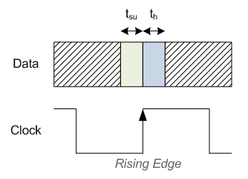
It’s all about speed
Motivation
Slow,
Cheap,
Dynamic
Fast,
Expensive,
Fixed
CPU
GPU
FPGA
ASIC
Data Integrity
Speed

Slide 5
The issue with LSDF
Motivation
a[n]
b[n]
a[1]
b[1]
a[0]
b[0]
ADDER
ADDER
ADDER
…
c[n-1]
c[0]
s[n]
s[1]
s[0]

Slide 6
MSDF: Breaking things nicely
Motivation
a[n]
b[n]
a[1]
b[1]
a[0]
b[0]
ADDER
ADDER
ADDER
…
c[n]
c[1]
s[n]
s[1]
s[0]

Slide 7
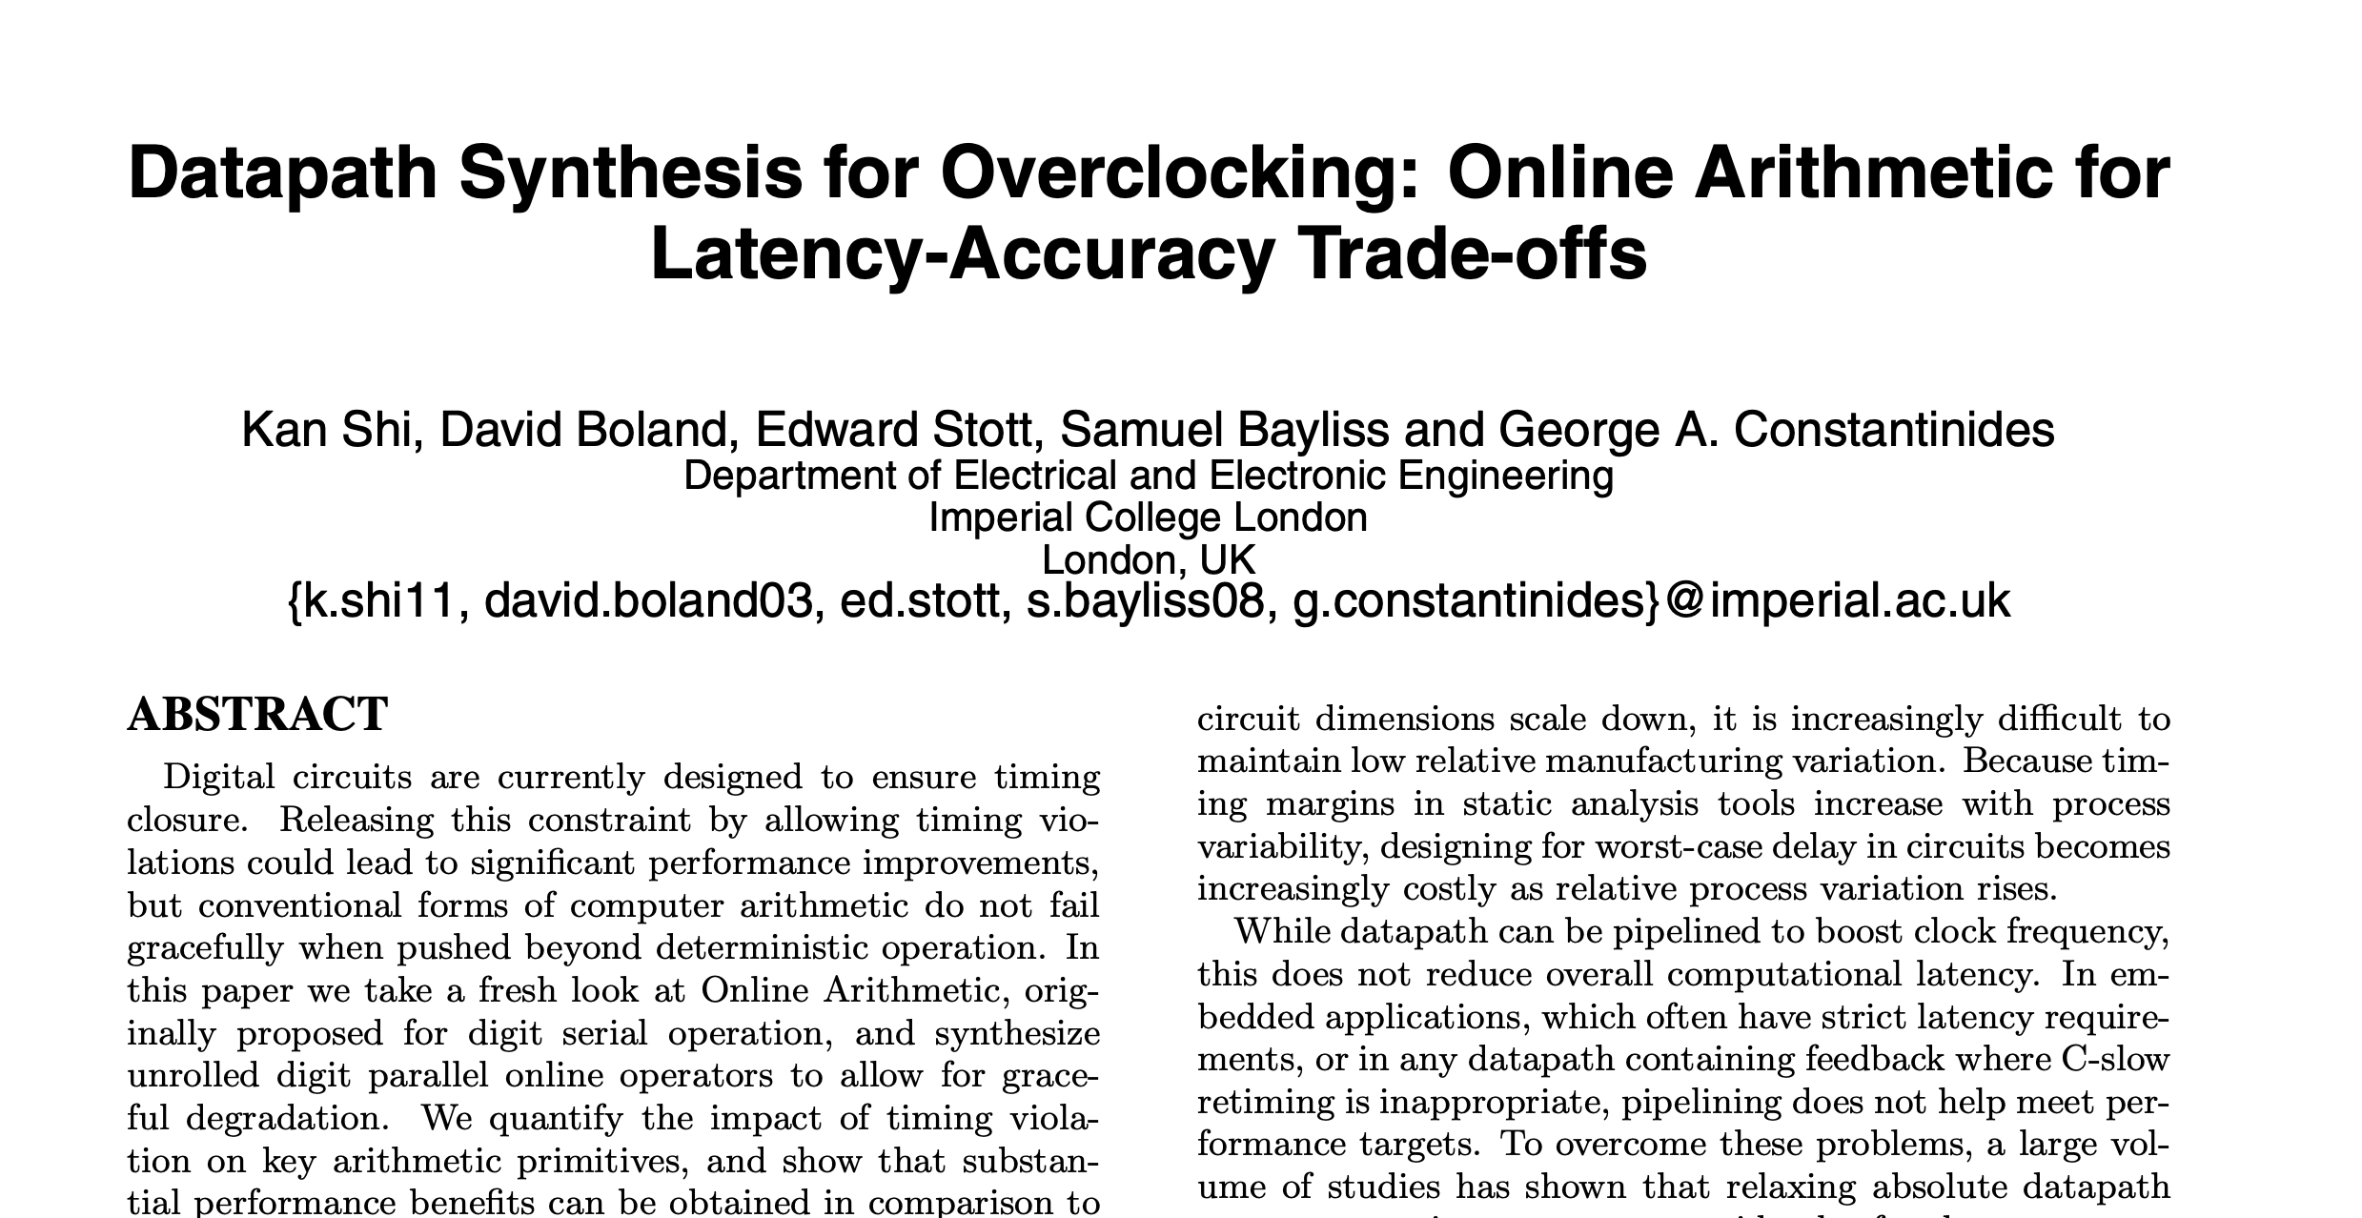
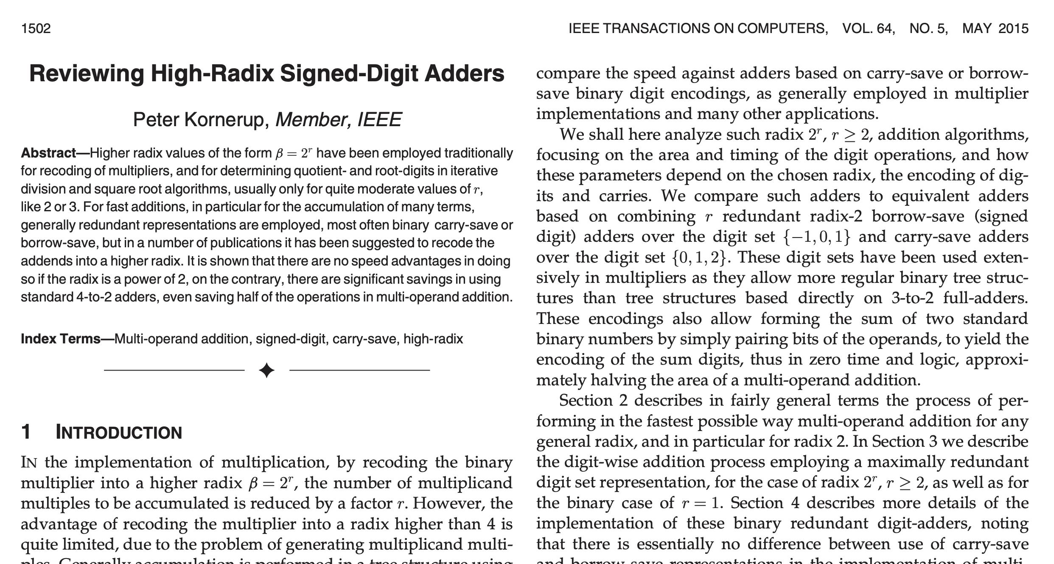
But this has already been shown!
Motivation
MSDF allows for increased overclocking
High-Radix is less efficient than Radix-2 in ASIC implementations

Slide 8
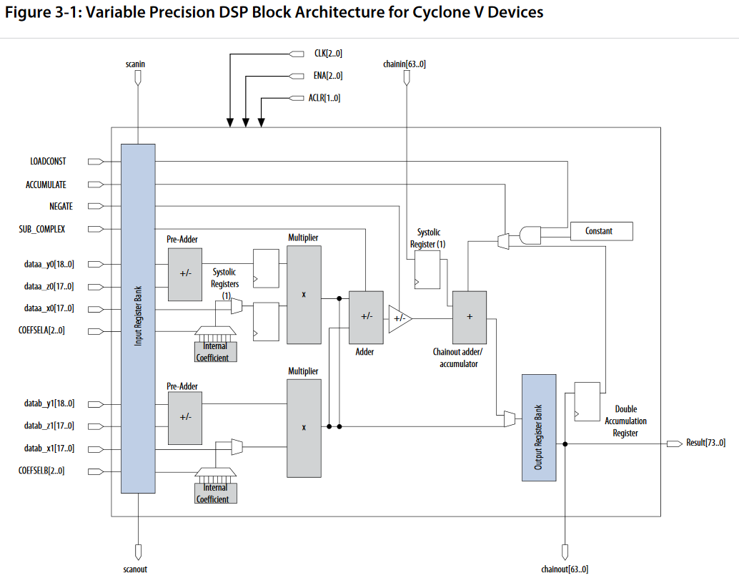
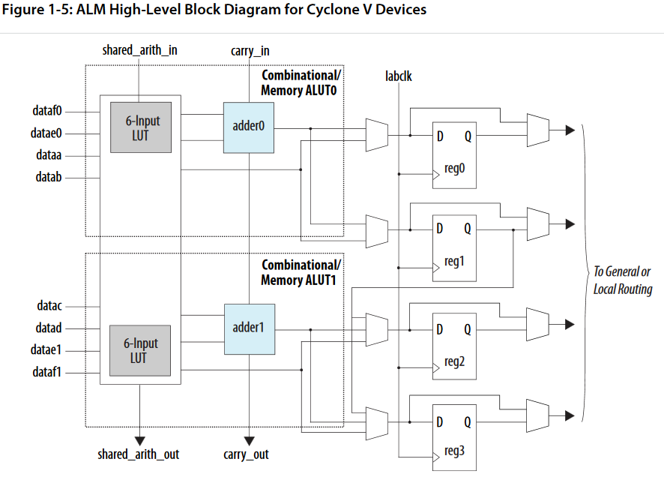
Is it beneficial to go beyond Radix-2?
Motivation
Cyclone V ALM
Cyclone V DSP

Slide 9
Project Aims
1. Arithmetic Design
Build MSDF Adder and Multiplier
2. Test
Create High-Frequency Test Bench
3. Interpret
Develop Metrics to Understand Results

Slide 10
MSDF Arithmetic
How does it work?

Slide 11
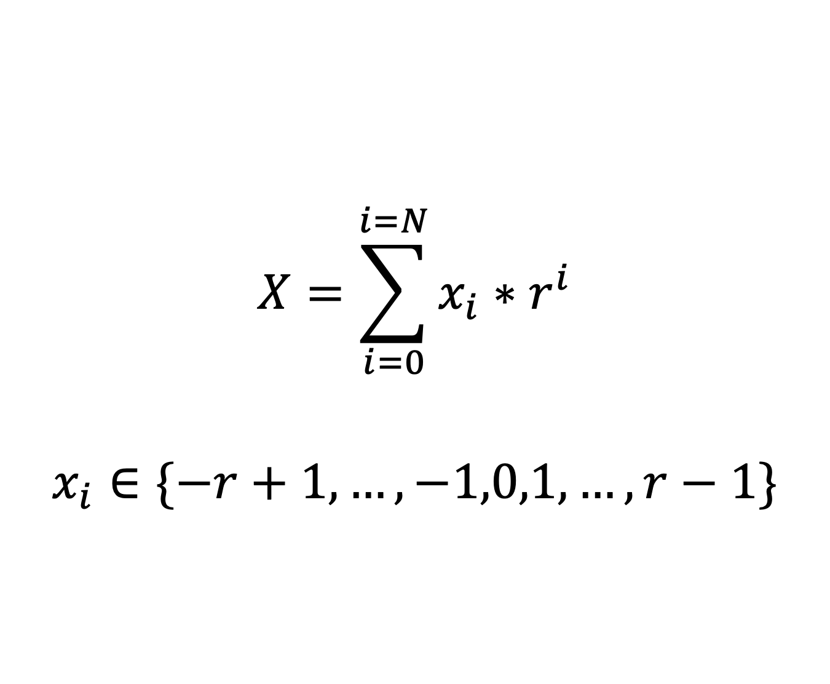
The key is redundancy
Arithmetic Design
$$X=\sum_{i=0}^{i=N}{x_{i}∗r^{i}}$$
$$x_{i}∈\{−r+1,…,−1,0,1,…,r−1\}$$

Slide 12
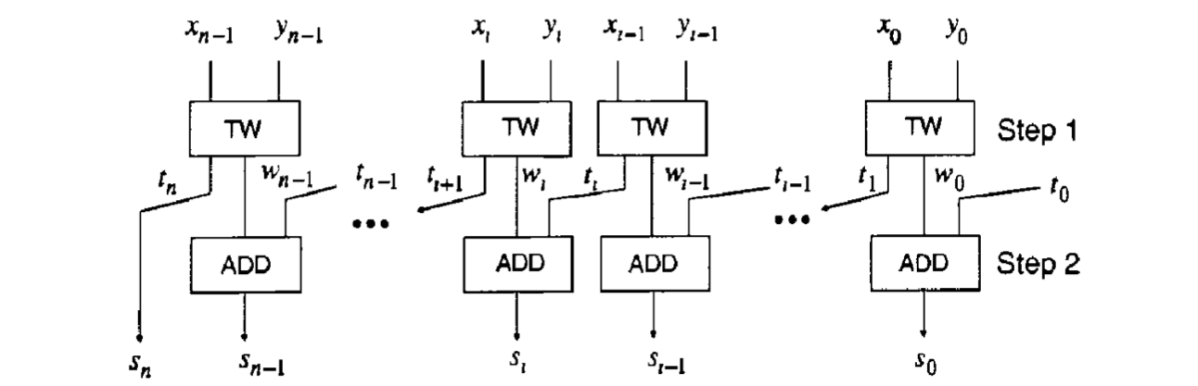
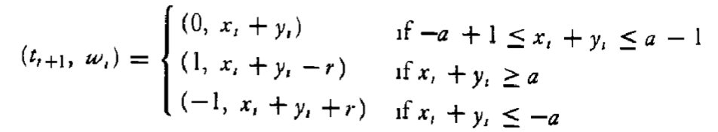

Addition all at once
Arithmetic Design
$$a≥\frac{\left(r+1\right)}{2}$$
$$a=r−1$$

Slide 13
An R-10 Example in Action
Arithmetic Design
X Y
4 7 1 4
X Y t_{r+1} w_{r}
X Y t_{r} w_{r}
+ 3 2 3 9
0 1 0 1
0
+ 7 -1 4 3
0 8 -1 5 3
= 7 9 5 3

Slide 14
A look at ‘false’ overflow
Arithmetic Design
X Y
4 0 0 0
X Y t_{r+1} w_{r}
X Y t_{r} w_{r}
+ 5 0 0 0
1 0 0 0
0
+ -1 0 0 0
1 -1 0 0 0
= 9 0 0 0

Slide 15
Dealing with the growing problem
Arithmetic Design
Compress
Constrain
Ignore

Slide 16
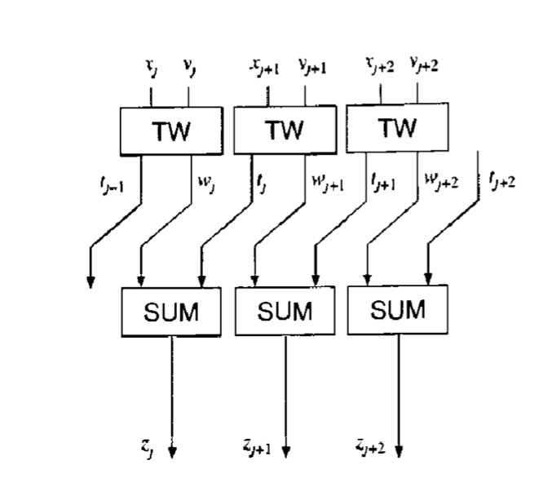
Compression
Arithmetic Design

Slide 17
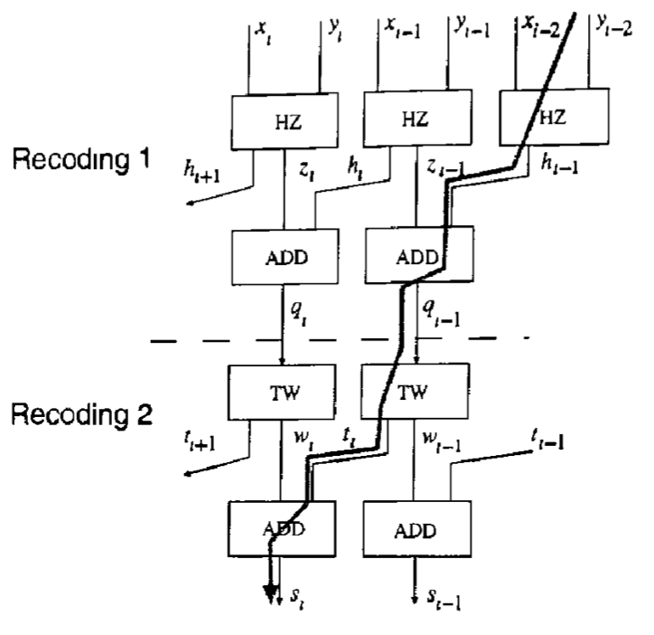
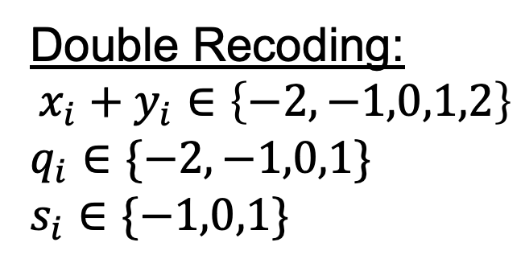
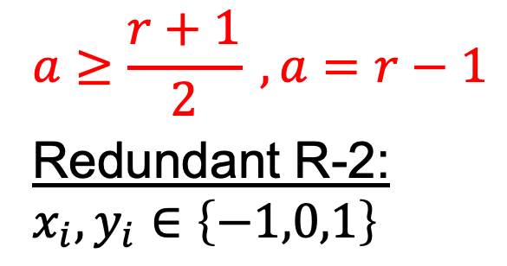
An aside on R-2
Arithmetic Design
$$a≥\frac{r+1}{2} , a=r−1$$
Redundant R-2:
$$x_{i},y_{i}∈\left\{−1,0,1\right\}$$
Double Recoding:
$$x_{i}+y_{i}∈\left\{−2,−1,0,1,2\right\}$$
$$q_{i}∈\{−2,−1,0,1\}$$
$$s_{i}∈\{−1,0,1\}$$

Slide 18
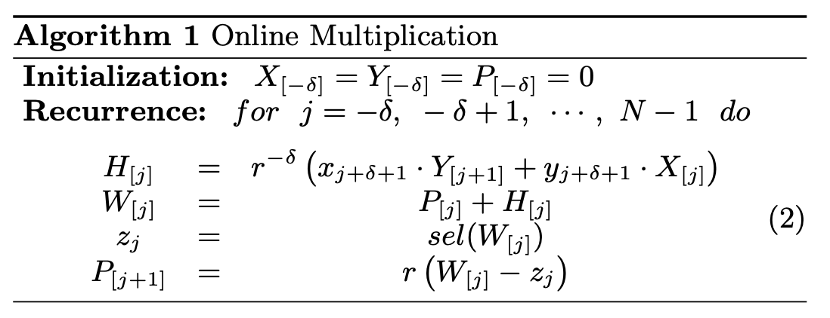
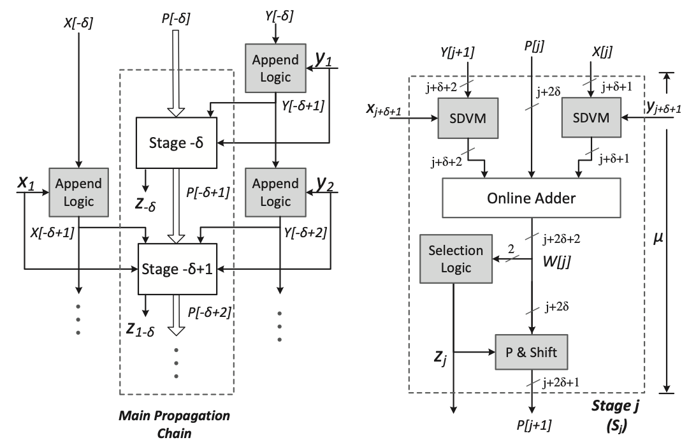
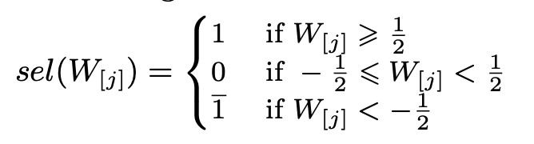
Let’s get multiplying
Arithmetic Design
Residual recurrences abound!

Slide 19
A new and dangerous frontier
Arithmetic Design
Long residual path
Parallel vs serial
Unreliable past papers
High-R partial product
'False' adder overflow

Slide 20
Testing the IP
If it has a clock, it can break

Slide 21
Data to be collected
Arithmetic Operator
Design
Radix
MSDF vs Traditional
Speed
Point of first failure
Gracefulness of degradation
Width
Number of Digits
Number of Bits

Slide 22
The test plan
Testing
Load Data
Retrieve Results
Verify
Configure Clock
Run Test
Continue Binary Search

Slide 23
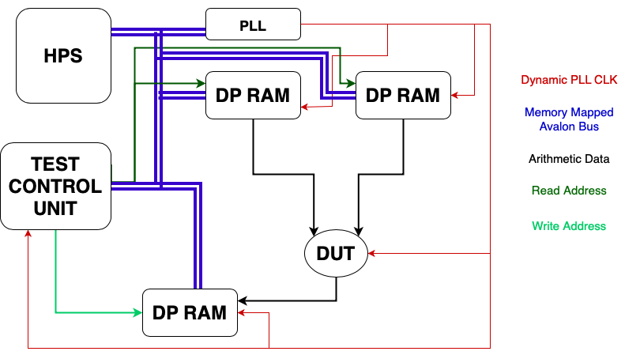
The test bench
Testing

Slide 24
How fast can these blocks get?
Testing
15 Digit R-2 Adder
M10K RAM Block
f_{max}: ~500MHz*
f_{max}: 315MHz
*Timing Analyzer Estimate

Slide 25
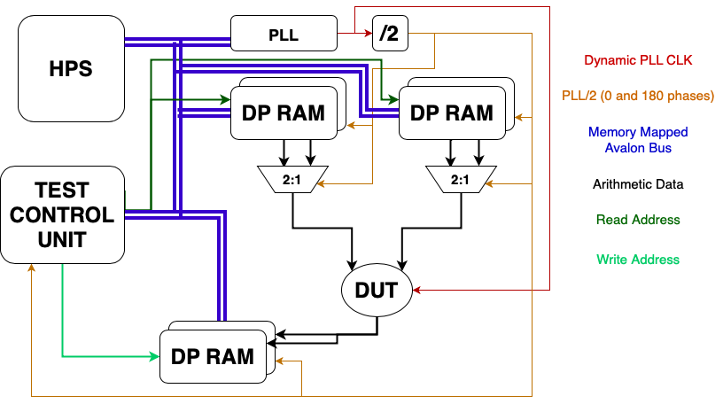
Double the RAM, double the fun
Testing

Slide 26
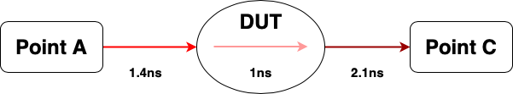
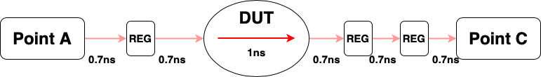
Feeding it forward
Testing

Slide 27
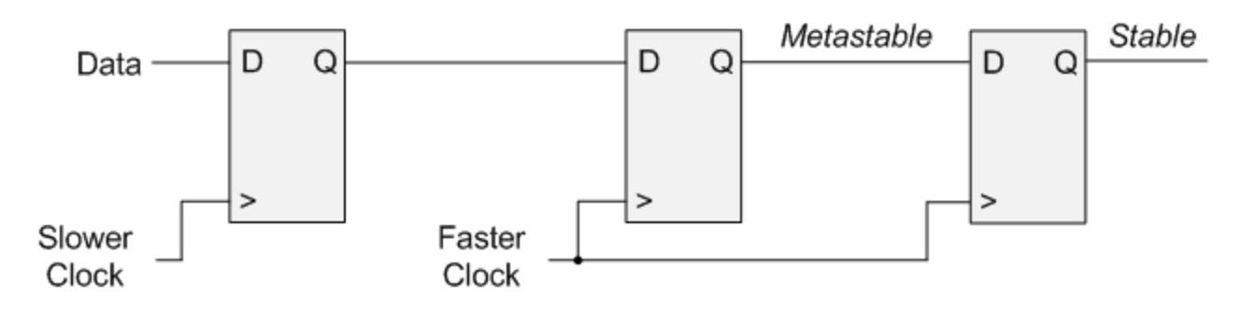
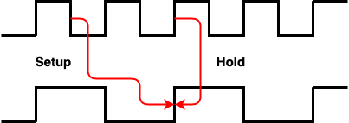
Cross-clock considerations
Testing

Slide 28
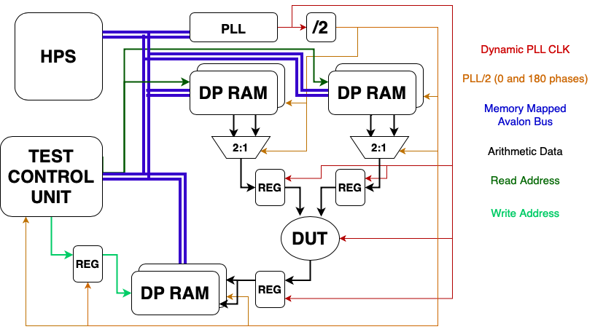
Test bench, take 3
Testing

Slide 29
Interpreting the Data
What does it all mean?

Slide 30
Metrics make sense
Results
Max Frequency
Is higher radix worthwhile?
Mean Relative Error

Slide 31
Future directions
Results
Aggressive Optimization
Automated Toolchains
Full Pipelines
More Operators

Slide 32
Personal Takeaways
Results
Breadth and Depth
Timing is key
FPGAs are not ASICs
From the midst of the project

Slide 33
Acknowledgements and References
Advisor: Dr. James J. Davis {james.davis06@imperial.ac.uk}
[1] K. Shi, D. Boland and G. A. Constantinides, "Accuracy-Performance Tradeoffs on an FPGA through Overclocking," 2013 IEEE 21st Annual International Symposium on Field-Programmable Custom Computing Machines, Seattle, WA, USA, 2013, pp. 29-36, doi: 10.1109/FCCM.2013.10.
[2] M. D. Ercegovac and T. Lang, Digital arithmetic, Morgan Kaufmann, 2003.
[3] K. Shi, D. Boland, E. Stott, S. Bayliss and G. A. Constantinides, "Datapath synthesis for overclocking: Online arithmetic for latency-accuracy trade-offs," 2014 51st ACM/EDAC/IEEE Design Automation Conference (DAC), San Francisco, CA, USA, 2014, pp. 1-6, doi: 10.1145/2593069.2593118.
[4] K. Shi, D. Boland and G. A. Constantinides, "Efficient FPGA implementation of digit parallel online arithmetic operators," 2014 International Conference on Field-Programmable Technology (FPT), Shanghai, China, 2014, pp. 115-122, doi: 10.1109/FPT.2014.7082763.
[5] Yiren Zhao, J. Wickerson and G. A. Constantinides, "An efficient implementation of online arithmetic," 2016 International Conference on Field-Programmable Technology (FPT), Xi'an, 2016, pp. 69-76, doi: 10.1109/FPT.2016.7929191.
[6] P. Kornerup, "Reviewing High-Radix Signed-Digit Adders," in IEEE Transactions on Computers, vol. 64, no. 5, pp. 1502-1505, 1 May 2015, doi: 10.1109/TC.2014.2329678.
[7] J. Liang, J. Han and F. Lombardi, "New Metrics for the Reliability of Approximate and Probabilistic Adders," in IEEE Transactions on Computers, vol. 62, no. 9, pp. 1760-1771, Sept. 2013, doi: 10.1109/TC.2012.146.

Slide 34
Questions?
Thank you for listening!

