Slide 1
ASE 230-02 Final Project
Josh Lohner, Amrutha Rao, Nat Levesque

Slide 2
The Project
The project was to design an entire database management system for a real world idea
Our idea: A website that would allow users to plan events
Features:
-User accounts
-Create events
-Create guestlists
-Create tasks for the guests

Slide 3
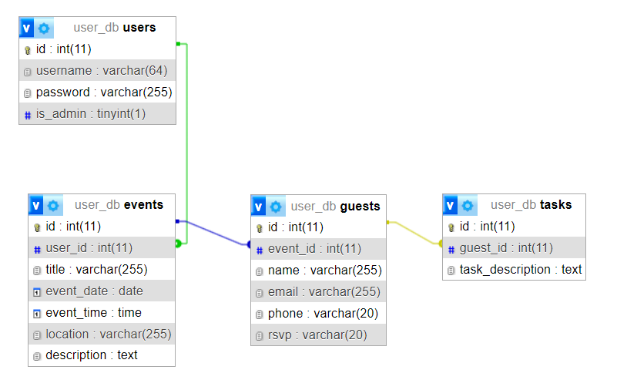
Database Design, ERD

Slide 4
Team Members
Josh Lohner: Event/guest/task, database, User Authentication
Amrutha Rao: Theme/CSS, Logic Layer
Nat Levesque: Admin, User Authentication, Documentation/ERD Powerpoint

