Slide 1
Welcome to the VISCREEN Tutorial

Slide 2
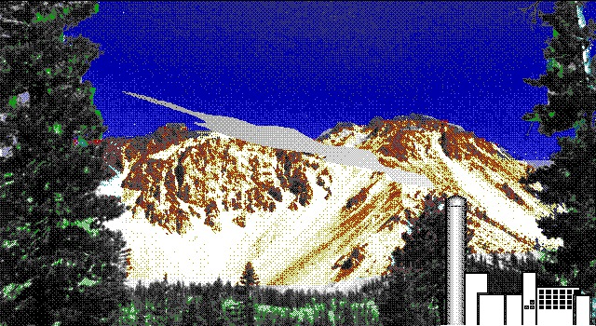
VISCREEN calculates visual effects parameters
(such as a color change) for plumes from a
single source against a terrain background.

Slide 3
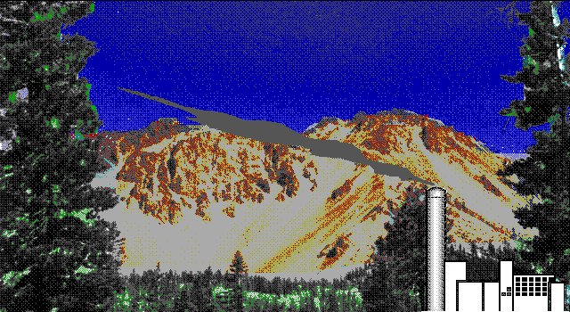
VISCREEN also calculates visual
effects parameters against a sky
background.

Slide 4
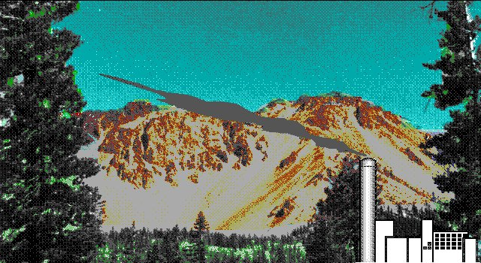
VISCREEN also calculates visual
effects parameters against a terrain
background.

Slide 5
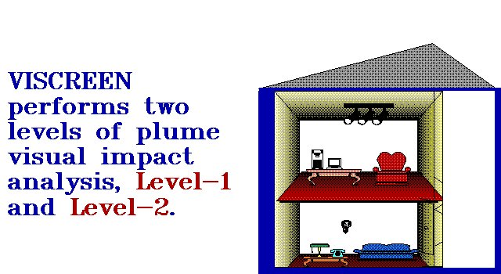


Slide 7
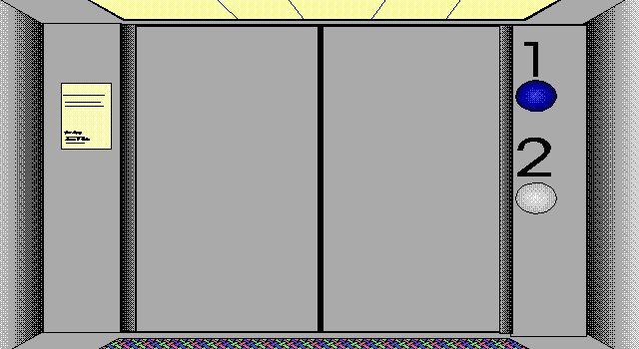
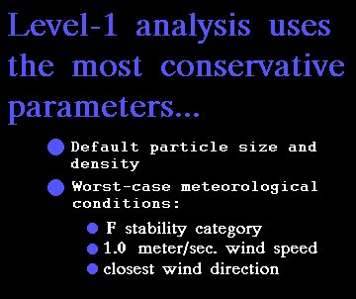



Slide 8
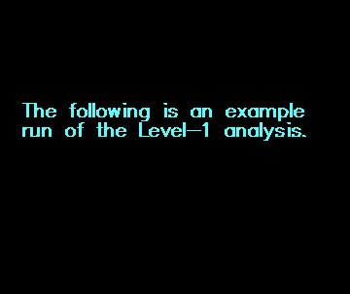

Slide 9
Here is an example of a Level – 1 interactive session. Inputs are in BLUE
==============================================
WELCOME TO PROGRAM VISCREEN! (Ver 1.01)
==============================================
Path & file name for Summary Report
(max 40 characters including file name & extension): exam1.sum
File Exists, do you want to overwrite it? Y <- might appear if this is a rerun
Path & file name for Results Output
(max 40 characters including file name & extension): exam1.tst
File Exists, do you want to overwrite it? Y <- might appear if this is a rerun
Input the name of the emissions source: Power Plant
Input the name of the receptor (Class I area): National Park
Select the units of mass for emission rates--
1=gram (g); 2=kg; 3=metric tonne (mt); 4=lb; 5=ton:
Enter no. (1-5): 1
Select the units of time for emission rates--
1=sec; 2=min; 3=hr; 4=day; 5=yr:
Enter no. (1-5): 1
Input the emission rates for the following species:
Particulates (G /S ): 25
NOx (as NO2) (G /S ): 380

Slide 10
Do you want to use default (zero) emission
rates for primary NO2, soot, and sulfate (y/n)? Y
SUMMARY: Emissions for power plant
Particulates 25.000000 G /S
NOx (as NO2) 380.000000 G /S
Primary NO2 0.000000E+00 G /S
Soot 0.000000E+00 G /S
Primary SO4 0.000000E+00 G /S
Are these the emission rates you meant to use (y/n)? Y
Input the distance between the emissions source and
the observer (in kilometers): 70
Input the distance between the emissions source and the
closest Class I area boundary (in kilometers): 70
Input the distance between the emissions source and the
most distant Class I area boundary (in kilometers): 90
Input the background visual range for the area (km): 170
Do you wish to use Level-1 default parameters (y/n)? y

Slide 11
Additional inputs will either be a “Y”, “N”, or just a press of the Enter key. You can use the vertical scroll bar to the right to follow along with the rest of this interactive session display.

Slide 12

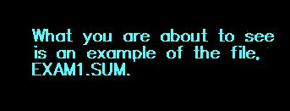

Slide 13
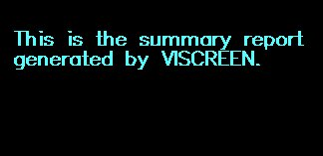

Slide 14
This is a copy of the EXAM1.SUM file. You can use the vertical scroll bar to the right to review the output of an EXAM1 interactive session.

Slide 15
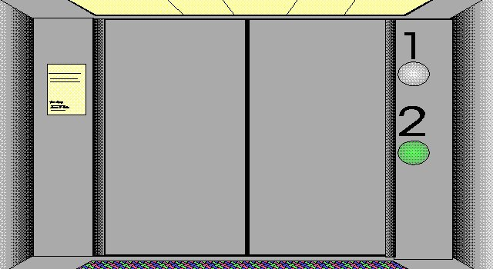
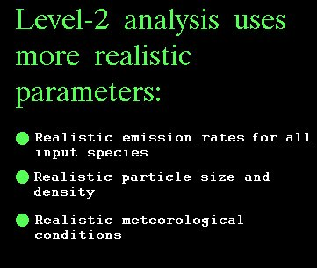

Slide 16
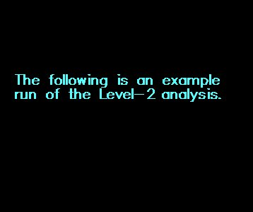

Slide 17
Here is an example of a Level – 2 interactive session. Inputs are in BLUE
==============================================
WELCOME TO PROGRAM VISCREEN! (Ver 1.01)
==============================================
Path & file name for Summary Report
(max 40 characters including file name & extension): exam2.sum
File Exists, do you want to overwrite it? Y <- might appear if this is a rerun
Path & file name for Results Output
(max 40 characters including file name & extension): exam2.tst
File Exists, do you want to overwrite it? Y <- might appear if this is a rerun
Input the name of the emissions source: Power Plant
Input the name of the receptor (Class I area): National Park
Select the units of mass for emission rates--
1=gram (g); 2=kg; 3=metric tonne (mt); 4=lb; 5=ton:
Enter no. (1-5): 1
Select the units of time for emission rates--
1=sec; 2=min; 3=hr; 4=day; 5=yr:
Enter no. (1-5): 1
Input the emission rates for the following species:
Particulates (G /S ): 25
NOx (as NO2) (G /S ): 380

Slide 18
Do you want to use default (zero) emission
rates for primary NO2, soot, and sulfate (y/n)? Y
SUMMARY: Emissions for power plant
Particulates 25.000000 G /S
NOx (as NO2) 380.000000 G /S
Primary NO2 0.000000E+00 G /S
Soot 0.000000E+00 G /S
Primary SO4 0.000000E+00 G /S
Are these the emission rates you meant to use (y/n)? Y
Input the distance between the emissions source and
the observer (in kilometers): 70
Input the distance between the emissions source and the
closest Class I area boundary (in kilometers): 70
Input the distance between the emissions source and the
most distant Class I area boundary (in kilometers): 90
Input the background visual range for the area (km): 170
Do you wish to use Level-1 default parameters (y/n)? n

Slide 19
SPECIFICATION OF PARTICLE DENSITY AND SIZE
Enter the density and the index corresponding to the
mass median diameter of the size distribution for
BACKGROUND fine and coarse particulate, and
PLUME particulate, soot, and primary sulfate).
Mass median diameter (in um): 1=0.1 um; 2=0.2 um;
3=0.3 um; 4=0.5 um; 5=1 um; 6=2 um; 7=5 um; 8=6 um;
9=10 um.
Enter density (g/cm3) and size index
(default values are shown in parentheses):
Background Fine Particulate Density (1.5): 1.5
Background Fine Particulate Size Index (3): 3
Background Coarse Particulate Density (2.5): 2.5
Background Coarse Particulate Size Index (8): 8
Plume Particulate Density (2.5): 2.5
Plume Particulate Size Index (6): 6
Plume Soot Density (2.0): 2.0
Plume Soot Size Index (1): 1
Plume Primary SO4 Density (1.5): 1.5
Plume Primary SO4 Size Index (4): 4
Are you sure these are the values you want for
particle densities and sizes (y/n)? Y

Slide 20
Enter Background Ozone (O3) Concentration in ppm
(default = 0.04 ppm): 0.04
Enter the wind speed (in meters/sec): 2.0
Enter the stability index--
(1=A; 2=B; 3=C; 4=D; 5=E; 6=F): 4
Enter the plume offset angle (i.e., the angle between
the plume centerline and the line between the
observer and the emissions source) in degrees.
Default is 11.25 degrees (1/2 sector width): 11.25

Slide 21
SUMMARY OF ALL EMISSIONS AND METEOROLOGICAL INPUT
Emissions for Power Plant in G /S :
Particulate = 25.000000
NOx = 380.000000
Primary NO2 = 0.000000E+00
Soot = 0.000000E+00
Primary SO4 = 0.000000E+00
Meteorological and Ambient Data for National Park
Wind speed (m/s) = 2.000000
Stability Index = 4
Visual Range (km) = 170.000000
Ozone Conc. (ppm) = 4.000000E-02
Plume Offset Angle= 11.250000 degrees
Distances Between Power Plant and National Park
Source-Observer = 70.000000 km
Min. Source-Class I = 70.000000 km
Max. Source-Class I = 90.000000 km
Are these input values ready for execution (y/n)? Y
Do you want to use the default screening threshold (y/n)? Y

Slide 22
Additional inputs will either be a “Y”, “N”, or just a press of the Enter key. You can use the vertical scroll bar to the right to follow along with the rest of this interactive session display.

Slide 23
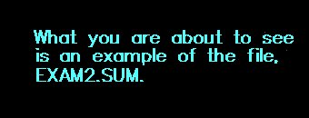

Slide 25
This is a copy of the EXAM2.SUM file. You can use the vertical scroll bar to the right to review the output of an EXAM1 interactive session.

Slide 26
The results of VISCREEN can be input into an Excel Spreadsheet.

Slide 27
The results can then be output as graphics.

Slide 28
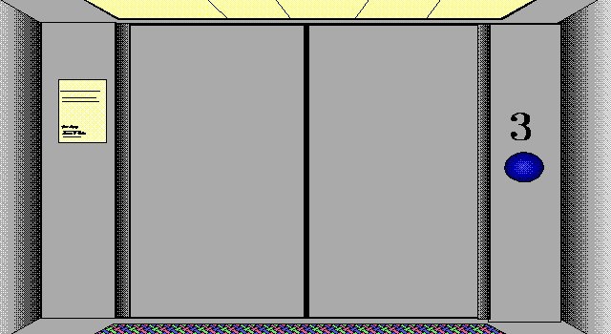
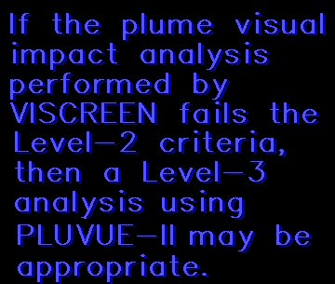


Slide 29
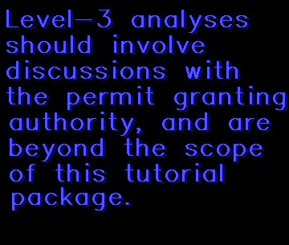

Slide 30
