Slide 1
Change Your Charts
They went through the region of Phrygia and Galatia and were prevented by the Holy Spirit from speaking the message in Asia. When they came to Mysia, they tried to go into Bithynia, but the Spirit of Jesus did not allow them. So, bypassing Mysia, they came down to Troas. 9During the night a vision appeared to Paul: A Macedonian man was standing and pleading with him, “Cross over to Macedonia and help us! ” After he had seen the vision, we immediately made efforts to set out for Macedonia, concluding that God had called us to evangelize them. Acts. 16:6-10

Slide 2
Average American?
Is a homeowner
Has a debt of 75,000 or more
Lives in a top 50 metropolitan area
Has trouble falling asleep at night
Owns two cars
Has never been divorced
Definitely believes in God
http://www.newstrategist.com/store/index.cfm/feature/57_15/50-facts-about-the-average-american.cfm

Slide 3
The Backstory
Paul has just picked up Timothy to travel with the team
They were passing on the decision that the apostles and elders had made during the Jerusalem conference
The churches were being strengthened
He wanted to go into Asia or to the northeast
God had different plans

Slide 4
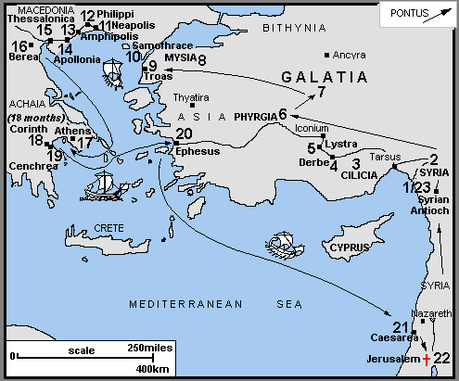

Slide 5
The Content
They were able to speak the gospel in certain areas but prevented by the Holy Spirit from doing so in others
Sometimes our plans are just that, “OUR PLANS” and no matter how much you pray about them, God’s not going to allow you to do it!
Even a guy as close to the Lord as Paul can sometimes get it wrong, and that fact should cause all of us to pause and make sure we have heard it right from the Lord
God spoke to Paul in a dream or a vision in the night

Slide 6
The Outcome
Notice the change in tense, it was “they” now it’s “we”
They immediately started making plans to cross over
They made it to Macedonia and the gospel gained a foothold in Europe
That eventually led to Rome and to the west including us!

Slide 7
The Call
Do you have a passport?
Use your study abroad to do more than study and be a tourist on the weekend!
Pray for the nations!
Plan your college experience to include two or more weeks outside the US sharing the gospel cross culturally!

Slide 8
The Call
Will you allow God to change your charts and set your course on a global excursion for the Gospel?

Slide 10
Announcements
Discipleship groups and relationships
Mystery Dinner Theater
Water Bottle Handout
Tailgator begins at 12:30 next Saturday
Big/Little meeting
Community groups and fish schools
Gospel Appointments

