Slide 1
Modern JavaScript for php developers
Derek Binkley - @DerekB_WI – dbinkley@ncbex.org

Slide 2
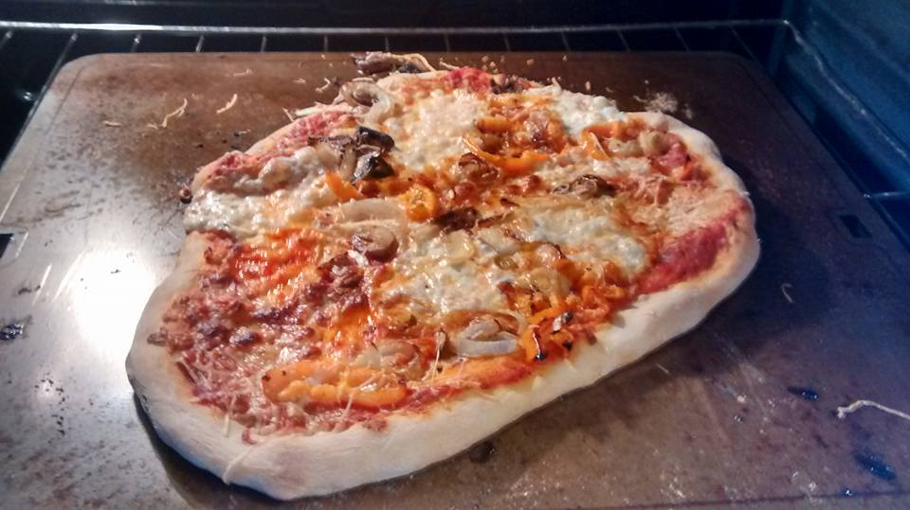
About me
Lead Developer at National Conference of Bar Examiners
Father of three
Home pizza chef

Slide 3
What will we learn
Using Javascript for Quick Prototyping
Ways to Incrementally Add Functionality to Existing Pages
Object Oriented Design
Testable and Modular Design

Slide 4

scared of javascript?
Early on we wanted to add functionality to our static pages
But browsers do not agree
Plugins for functionality, Flash, ActiveX
Big libraries start to evolve, Dojo, YUI

Slide 5
Jquery becomes go to tool
Selectors use same syntax as style sheets.
Allows for manipulation of DOM
Bind to events
Add-Ons for UI enhancements
AJAX also takes center stage.

Slide 6
making it modern

Slide 7

Vanilla js
Using the built in capabilities of the browser.
Standard core of ECMAScript
Many online references

Slide 8
All about the browser
For this talk we are only concerned with the browser.
Complementing not replacing PHP
Lots of browser tools for developers
For this talk we are not looking at a single page app or server side JS
Notes:
We’re PHP developers to this is complementing not

Slide 9
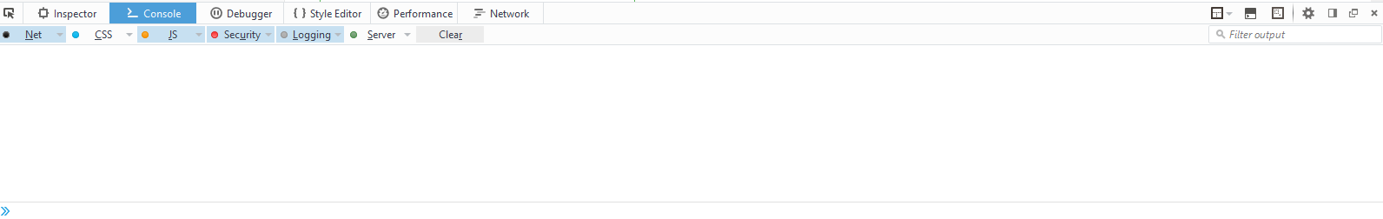
Firefox web console
Ctrl + Shift + K opens browser console.

Slide 10
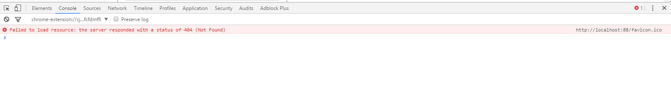
Chrome dev tools
Ctrl + Shift + I opens browser console.

Slide 11
Let's get to some code

Slide 12
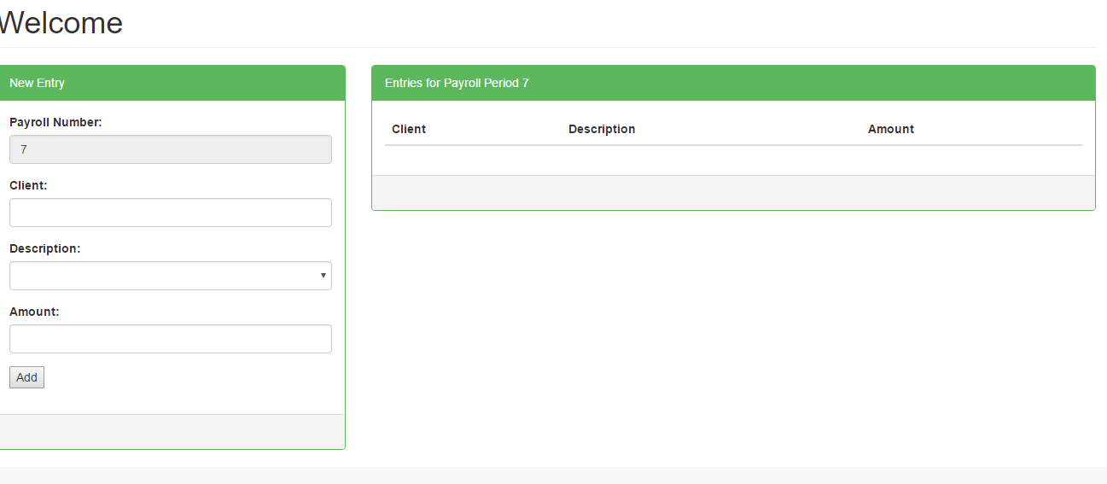
Old fashioned example

Slide 13
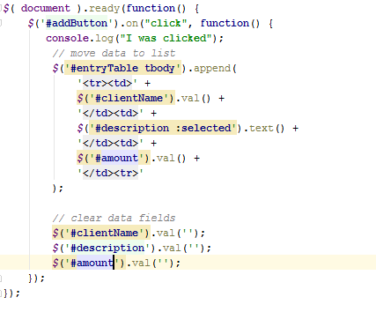
Old fashioned example
Notes:
Ask audience about problems with caveat that this is very simple code
No code re-use
View and code coupled too closely
Simple modifications will continue to clutter code exponentially.

Slide 14
Quick javascript basics

Slide 15


basics
By default scope is global, var makes it local.
Console let’s you print lines
Prototype based not class based.
Notes:
Prototypes define a model and decorate it instead of inheritance.
Watch out for properties getting passed by reference.

Slide 16
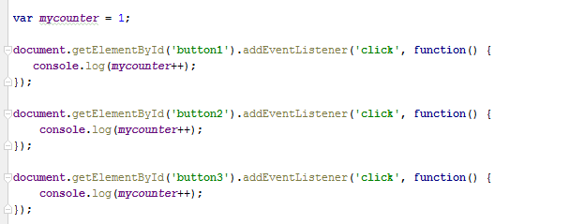
Event handling and closures
Notes:
This does not output 1, 2 and 3.

Slide 17
Objects for data/view
In PHP, we would separate into re-usable, carefully designed objects.
So let’s try it in JavaScript.

Slide 18
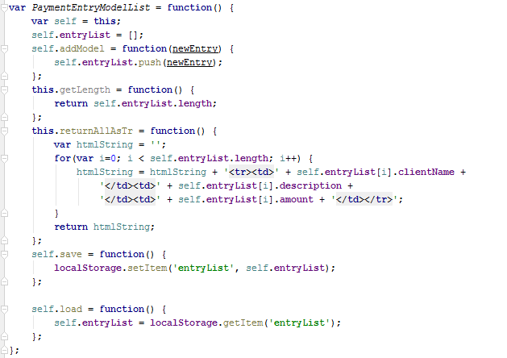
Object for data

Slide 19
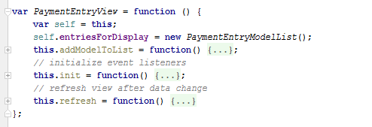
Object for view

Slide 20
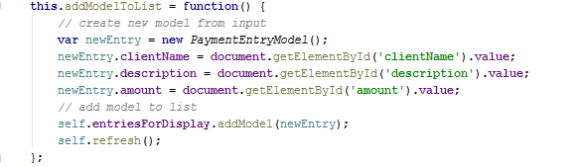
Object for view – list

Slide 21
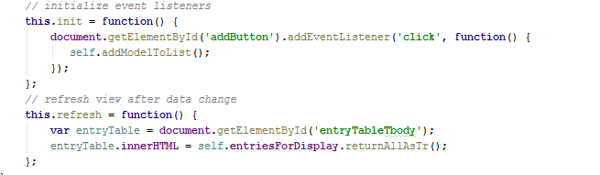
Object for view – initialize & REfresh

Slide 22
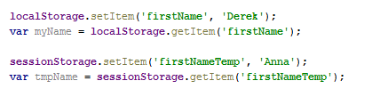
Browser storage
LocalStorage persists
SessionStorage tied to browser tab
Same origin policy for security, e.g. http://www.example.com
Notes:
Very important for prototyping.
Same origin means exact domain name

Slide 23


Browser storage example

Slide 24

A pattern develops

Slide 25

MVVM – Model View View Model
An alternative to Model View Controller
Well suited for browser based development
Model doesn’t interact directly with View
Notes:
This is one way to model your code and doesn’t fit in all cases. May be complex for this simple example but would be easier to expand.

Slide 26

MVVM example
Notes:
Pretty basic isn’t it.

Slide 27
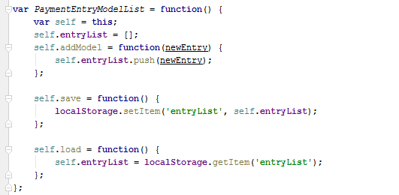
MVVM example
Notes:
A little more going on than the base model but still pretty simple.

Slide 28
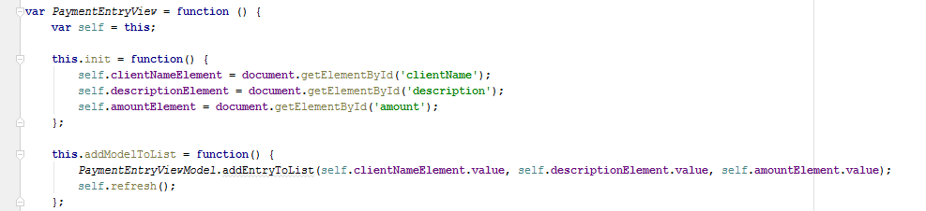
MVVM example

Slide 29
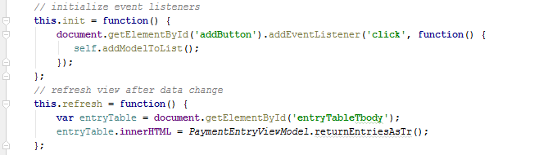
MVVM example

Slide 30
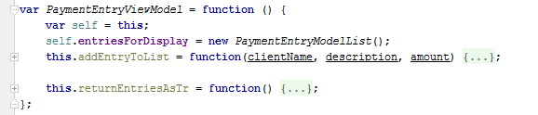
MVVM example
Notes:
This is the controller for this pattern.

Slide 31
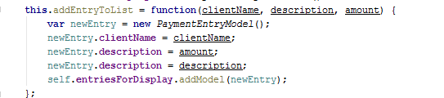
MVVM example

Slide 32
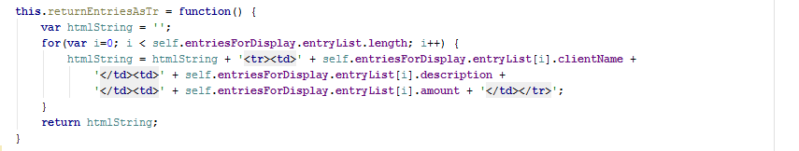
MVVM example
Notes:
This method could use some help but illustrates the point of seperation.

Slide 33
There is even more to add

Slide 34
Data binding
Examples using Knockout JS
Declarative data binding updates html in real time.
Works inside standard html tags
View object gets replaced by html parameters
Notes:
Knockout is easy to add to a project so easy to show. This is not an endorsement over other frameworks.

Slide 35
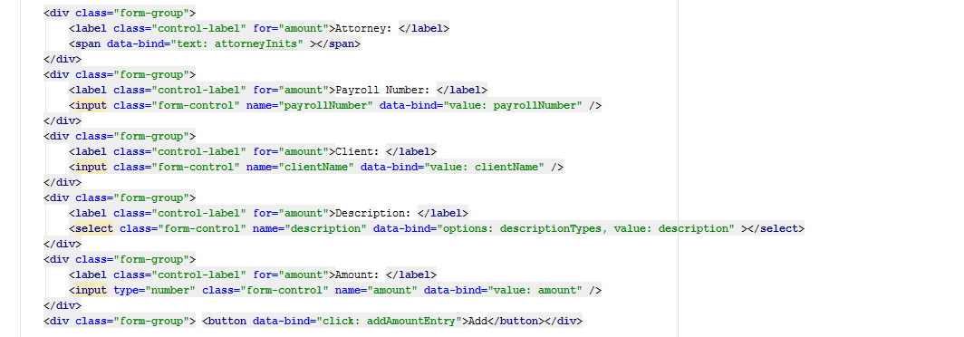
Data binding example
Notes:
Knockout is easy to add to a project so easy to show. This is not an endorsement over other frameworks.

Slide 36
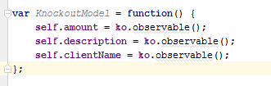
Data binding example
Variables become observable objects
Knockout also offers observable arrays
Notes:
Cleaner more understandable by taking html tags out of javascript code.

Slide 37

Data binding example
Notes:
Knockout is easy to add to a project so easy to show. This is not an endorsement over other frameworks.

Slide 38
Unit testing
By following separating concerns your code is now unit testable
Many tools out there but beyond the scope of this talk

Slide 39
Thanks
Give feedback at https://joind.in/event/madison-php-conference-2016/schedule/list
Download slides at http://www.slideshare.net/DerekBinkley/modern-javascript-talk

Slide 40
resources
http://vanilla-js.com/
https://developer.mozilla.org/en-US/docs/Web/JavaScript
https://msdn.microsoft.com/en-us/library/d1et7k7c(v=vs.94).aspx
http://javascriptissexy.com/javascript-objects-in-detail/
http://www.codeproject.com/Articles/278901/MVVM-Pattern-Made-Simple
https://www.sitepoint.com/javascript-testing-unit-functional-integration/
Derek Binkley - @DerekB_WI – dbinkley@ncbex.org

