Slide 1
Activision Breach
By: Josh S.

Slide 2
Activision Blizzard
Activision Blizzard is a video game company who are most famous for their Call of Duty games
Founded in July 2008 through the merger of Activision Inc. and Vivendi Games
Other popular games from Activision Blizzard include Overwatch, World of Warcraft, and Candy Crush Saga

Slide 3
Activision Breach
Details of the breach were first revealed by cybersecurity and malware research group and Twitter user vx-underground in December of 2022 (TechWorm)
Vx-underground revealed screenshots of data that was supposedly stolen from Activision (TechWorm)
Vx-underground also confirmed that threat actors successfully phished a privileged user on the network (TechWorm)

Slide 4
Activision Breach Cont.
A report from Insider Gaming revealed that data stolen contained plans for Modern Warfare 2’s upcoming DLC’s, Call of Duty 2023, Call of Duty 2024, and sensitive employee information
The sensitive employee information included full names, emails, phone numbers, salaries, places of work, and more (TechWorm)

Slide 5
Activision Response
Activision acknowledged that there was a breach that occurred in December 2022
However, they denied that no employee data, game source code, or player details had been accessed

Slide 6
Activision Response Cont.
Activision official statement on the breach: “The security of our data is paramount, and we have comprehensive information security protocols in place. On December 4, 2022, our information security team swiftly addressed an SMS phishing attempt and quickly resolved it” (Insider Gaming)

Slide 7
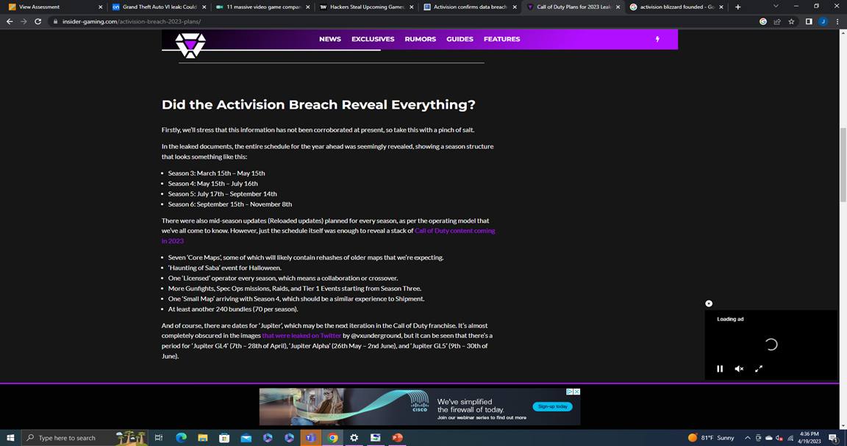
Call Of Duty Leaks
The Call of Duty leaks revealed that Activision plans
on releasing content for the 2022 Call of Duty
through November 8, 2023.
With this information, there has been
many rumors and reports that there will be a
new Call of Duty releasing in November 2023.

Slide 8
Employee Leaks
It was reported that Activision did not notify the employees of the breach for a while (TechCrunch)
A quote from one of the employees at Activision, “This is a problem. If there’s employee’s information involved, then they should have disclosed the breach.” (TechCrunch)
The hackers were able to access and steal a series of spreadsheets of employee data

Slide 9
Video Game Breaches
According to ESET UK, Activision Blizzard breach is one of the most-hacked video game companies in the world
ESET UK ranked this breach as the number one most significant video game breach
Other impactful video game breaches include the GTA VI leak and the EA breach

Slide 10
Sources
11 massive video game companies recently targeted by Cybercriminals. ESET. (2022, July 20). Retrieved April 19, 2023, from https://www.eset.com/uk/about/newsroom/blog/11-massive-video-game-companies-recently-targeted-by-cybercriminals/
Franceschi-Bicchierai, L. (2023, February 21). Activision did not notify employees of data breach for months. TechCrunch. Retrieved April 18, 2023, from https://techcrunch.com/2023/02/21/activision-did-not-notify-employees-of-data-breach-for-months/
Iyer, K. (2023, February 22). Hackers steal upcoming games, employee data in Activision Data Breach. TechWorm. Retrieved April 18, 2023, from https://www.techworm.net/2023/02/hackers-steal-upcoming-games-in-activision-data-breach.html
TRUȚĂ, F. (n.d.). Activision confirms data breach exposing plans for call of duty, employee data. Hot for Security. Retrieved April 18, 2023, from https://www.bitdefender.com/blog/hotforsecurity/activision-confirms-data-breach-exposing-call-of-duty-plans-employee-data/

