Slide 1

GameWinningStats
Joshua stradford

Slide 2
Problem Statement
Sports fans want quick access to player stats and comparison tools
Data is currently spread across multiple websites
Requires multiple searches and navigation steps
Leads to inefficient and frustrating fan experience

Slide 3
Purpose/ Solution
Build a centralized sports analytics platform
Combine data from multiple sources into one site
Provide
Player search
Player Profiles
Stats and analytics
Comparisons
Goal: Make Player data fast, simple, and accessible

Slide 4
Technologies Used
Languages:
Python
JavaScript for React and Gatsby
HTML and CSS
Tools
BeautifulSoup, pandas
Git
Netlify

Slide 5
System Architecture
Backend using Python
Web scraping scripts
Data processing into JSON file
Frontend using React and Gatsby
UI rendering
Player pages
Deployment
Deployed on Netlify

Slide 6
Key Features
Player search functionality
Player profile pages
Team pages
Stat Tables
Ranking Game and Comparison tool
Multi-sport support
NBA
NFL QBs
MLB pitchers

Slide 7

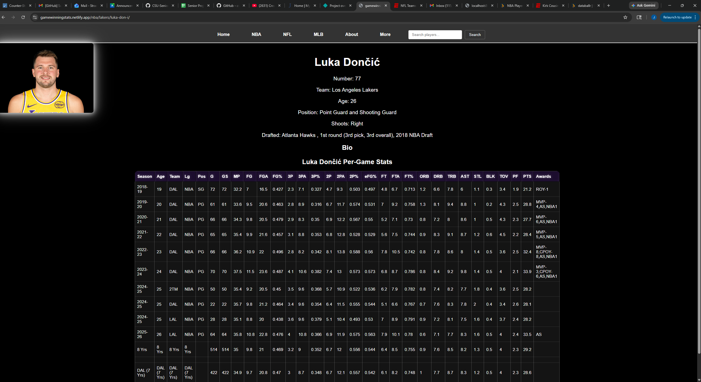
Player Profile Example
Fig 1. Player profile page

Slide 8
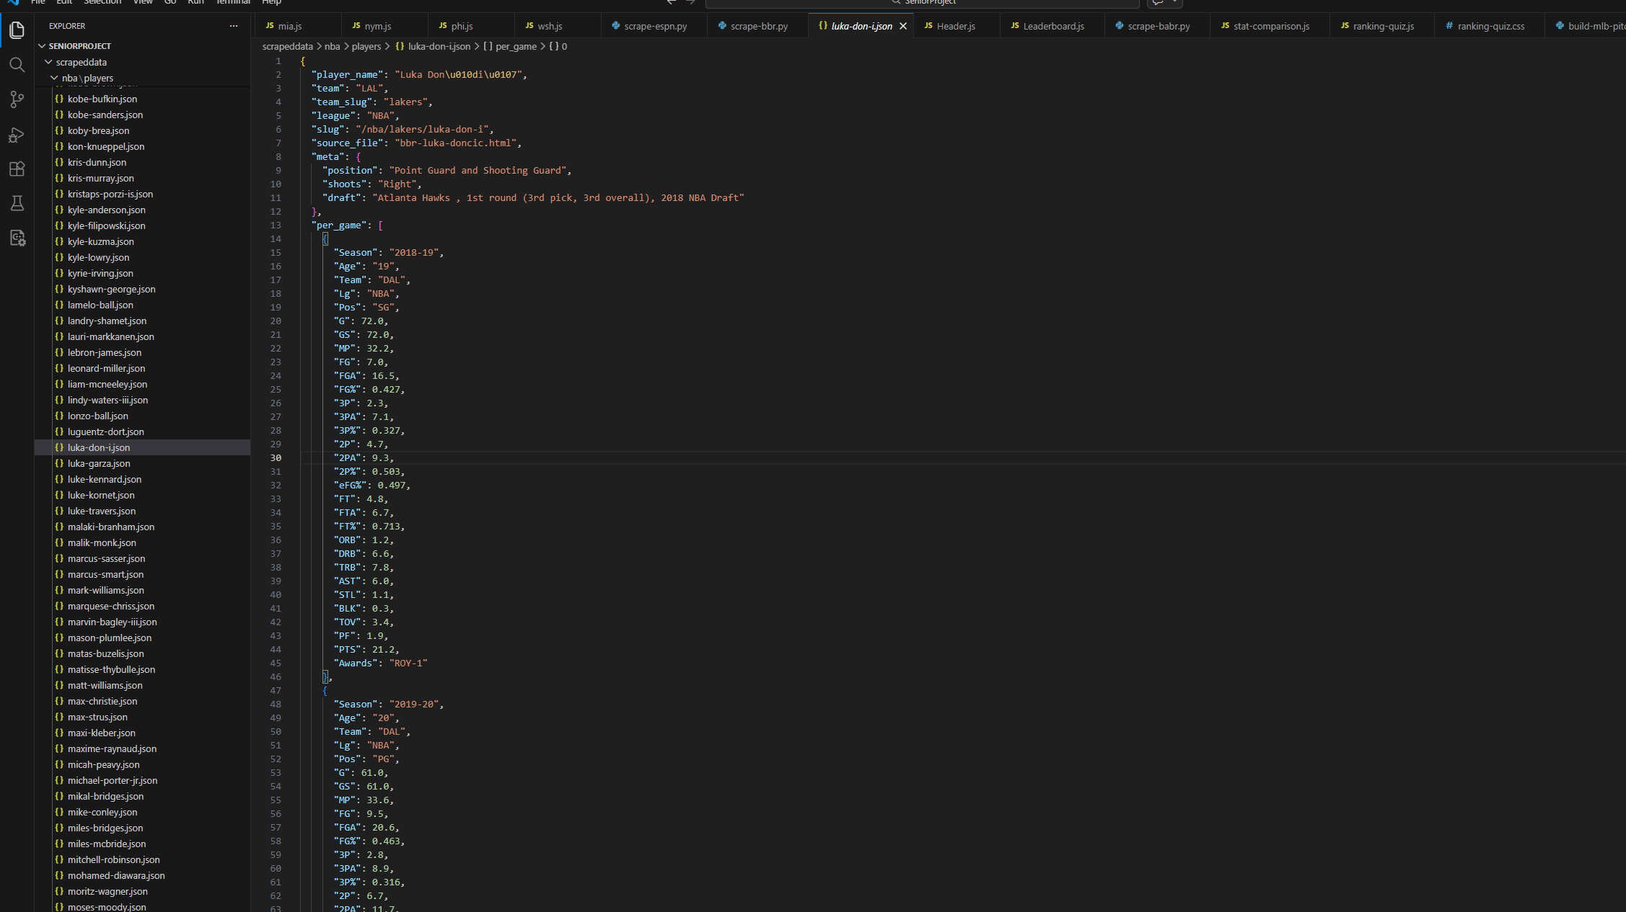
Data Pipeline -Scraped data from sports reference sites - Parsed HTML using beautifulSoup - Converted structure to JSON - JSON used in frontend

Slide 9
Challenges Overcome
Cloudflare website blocking
Solved by switching to offline/local craping method using curl commands
Hidden HTML tables
ESPN overwriting interceptions and sacks stats
Learned real-world debugging and problem solving

Slide 10
Test Plan
Manual and python testing using pytest
Tested
Player search
Page loading
Data accuracy
Results
All core features functional
Fast load times
Stable UI

Slide 11
Future Enhancements
Live API integration
More player comparison tools
User accounts
Real-time stats and game logs
More sports coverage

Slide 12
Conclusion
Gained experience in web scraping, react development, and website deployment
Questions?

