Slide 1
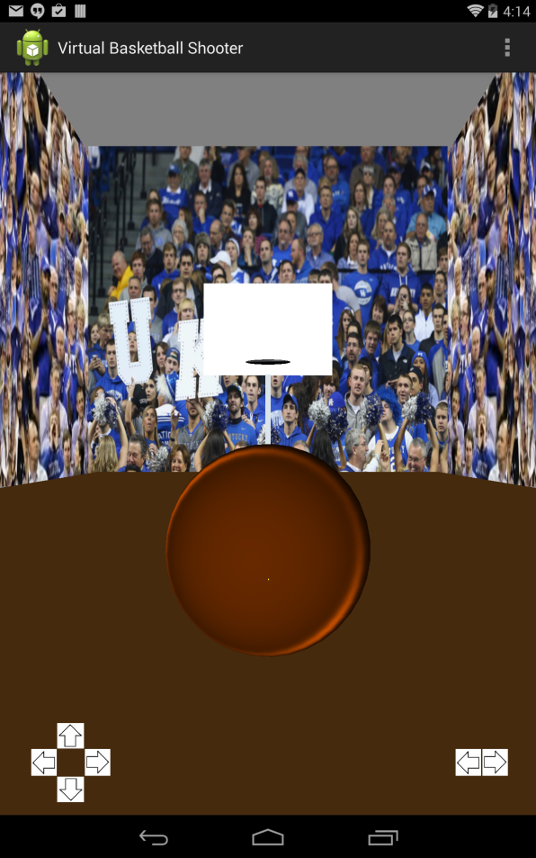
Virtual Basketball Shooter
By Josh Tuschl and Nick Hollis

