Slide 1
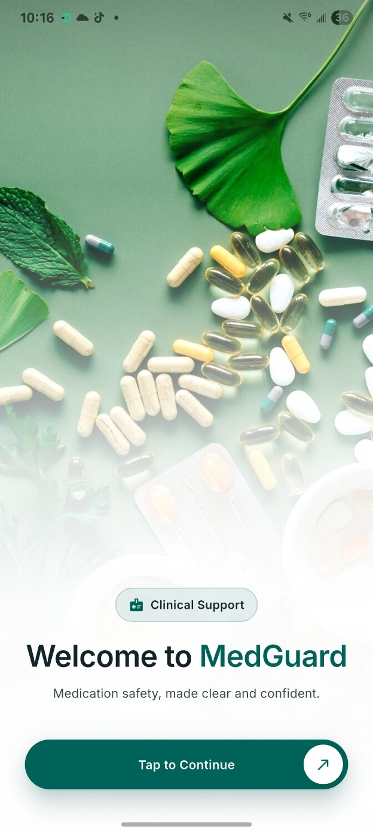
FINAL YEAR PROJECT DEFENCE
Implementation of a Machine Learning-Based Mobile Application for Drug Interaction Detection and Medication Safety Support
Department of Computer Sciences
Chrisland University, Abeokuta
August 2026
PRESENTED BY
SUPERVISED BY
Ubaga Joshua Chukwuebuke
Prof. Isaac Odun-Ayo
CSC/2022/009
Project Supervisor & Head of Department
Notes:
Good morning. My name is Ubaga Joshua Chukwuebuke, matriculation number CSC slash 2022 slash 009, supervised by Professor Isaac Odun-Ayo. This is my final year project: MedGuard.

Slide 2

PRESENTATION OUTLINE
What this presentation covers
01
Opening context
06
Review of related work
02
Background of the study
07
Existing systems and research gaps
03
Statement of the problem
08
System design and methodology
04
Aim and objectives
09
Implementation and results
05
Significance of the study
10
Conclusion and recommendations
Notes:
Here is the order of the presentation.

Slide 3
OPENING CONTEXT
One patient in every thirty is harmed by the medicines meant to help them
1 in 30
$42bn
50%
patients experience medication-related harm. More than a quarter of those cases are severe or life-threatening.
is lost each year to unsafe medication practice, close to one per cent of global health spending.
of all preventable patient harm is caused by medicines, and most of it is avoidable.
World Health Organisation, 2021 and 2023
Notes:
Start with the scale of the problem. These are WHO figures.

Slide 4
BACKGROUND OF THE STUDY
The checking burden grows fastest where the support is thinnest
Pairs a prescriber must check
0.53
74.7%
pharmacists per 10,000 people
of health spending paid out of pocket
2 drugs
1
5 drugs
10
50.5%
67.4%
8 drugs
28
of 430 Benin City admissions carried an interaction on day one
carried one by the time they were discharged
10 drugs
45
Web tools fail at the counter
Polypharmacy runs at 37% generally and 45% among older adults. DrugBank 6.0 documents 1.4 million interactions across 11,900 drugs.
Connectivity in community pharmacies and rural clinics is unreliable, yet 90.7% of Nigerians have mobile access. The phone is already in the room.
Notes:
The number of pairs to check grows much faster than the number of drugs. In Nigeria the support to do that checking is thin, and the evidence shows exposure is high.

Slide 5

STATEMENT OF THE PROBLEM
Reliable interaction checking is least available where medication risk is highest
Translation
Cost
Connectivity
Machine learning classifies interactions well in published work, but Wang et al. (2024) found most models stay on benchmarks and never reach an application anyone can open.
The most accurate platforms are subscription products priced for well-funded hospitals. They are out of reach for most public-sector facilities and individual practitioners in Nigeria.
Free checkers remove the cost barrier but need a live connection for everything they do. At the point of care in a rural clinic, that is exactly when they stop working.
No available tool combines offline-first operation, machine learning-based risk prediction and multiple safety checks in one application built for a low-resource setting. That is the gap this study addresses.
Notes:
Three barriers: cost, connectivity, and the fact that published models never reach a user.

Slide 6
AIMS AND OBJECTIVES OF THE STUDY
Specific objectives
Five, in order
01
Build the Flutter application on a bundled offline database
AIM OF THE STUDY
02
Train and compare classifiers that predict a risk tier
To build a mobile application that detects drug–drug interactions and grades their risk for patients and healthcare providers.
03
Integrate food, duplicate therapy, allergy and dose checks
04
Serve the model as an API and distil it for on-device use
05
Evaluate usability with users in Abeokuta
Notes:
The aim, then the five specific objectives in order.

Slide 7
SIGNIFICANCE OF THE STUDY
Who this work is for
Patients on several medicines
Practitioners without support tools
The research field
Immediate, evidence-based warnings about risky combinations, particularly for older adults who carry the highest interaction risk.
Decision support that needs no hospital infrastructure and no record-system integration, so judgement is spent where it matters.
A demonstration that a severity model can travel from training all the way to a working application built on free, open data.
Notes:
Three groups this work is for.

Slide 8
LIMITATION OF THE STUDY
What this study does not claim
Not clinically validated
No pharmacist or prescriber tested it
Never load-tested
The shipped database lags the model
No institutional trial and no regulatory review by NAFDAC or the FDA. It supports professional judgement; it does not replace it.
Latency was measured one request at a time. Nothing is known about the prediction service under concurrent use.
The cohort was students and clinic staff in one city, so it says nothing about the clinician the system is partly designed for.
13.9% of its records would move from Moderate to Major under the current classifier. DrugBank suspended academic downloads before it could be rebuilt.
The model results are unaffected: the classifier was trained on the corrected labels. It is the database that fell behind, not the model.
Notes:
State the limitations plainly before the panel asks.

Slide 9
REVIEW OF RELATED WORKS
Three approaches to predicting interaction risk, compared
Approach
Strength
Cost
Fit for this study
Graph neural networks
Strongest published benchmark accuracy
Needs a knowledge graph and GPU-class compute
Cannot run on a phone
Deep multimodal models
Combine structure, targets, enzymes and pathways
Opaque; needs a second model to explain each score
Too heavy, hard to audit
Tree ensembles
Native feature importances; strong on tabular features
Slightly behind deep models on raw accuracy
Deployable and interpretable
All three degrade on newly approved drugs
Severity datasets are dominated by moderate cases
Measured here in Chapter Four
Shared weakness
Wang et al. (2024) · Xia et al. (2025) · Zhang et al. (2023) · Pham et al. (2024)
Notes:
Three families of models. The forest was chosen because it can be deployed and audited, not because it beats the deep models on paper.

Slide 10
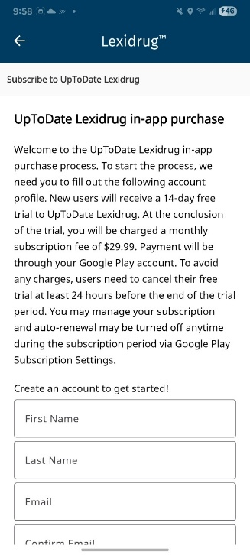
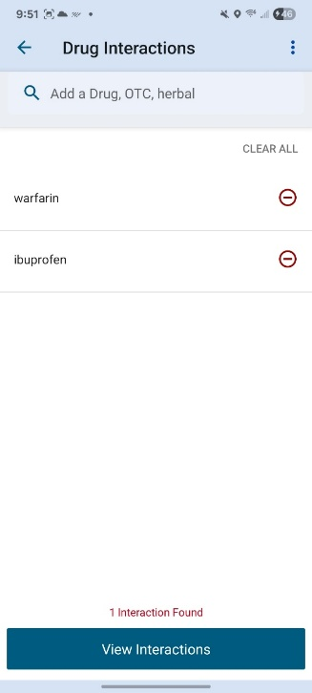
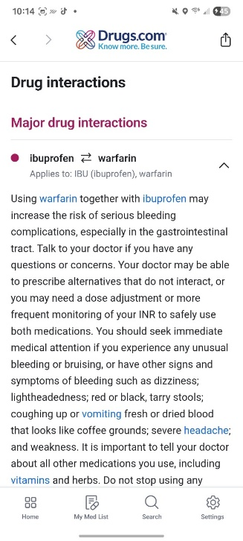
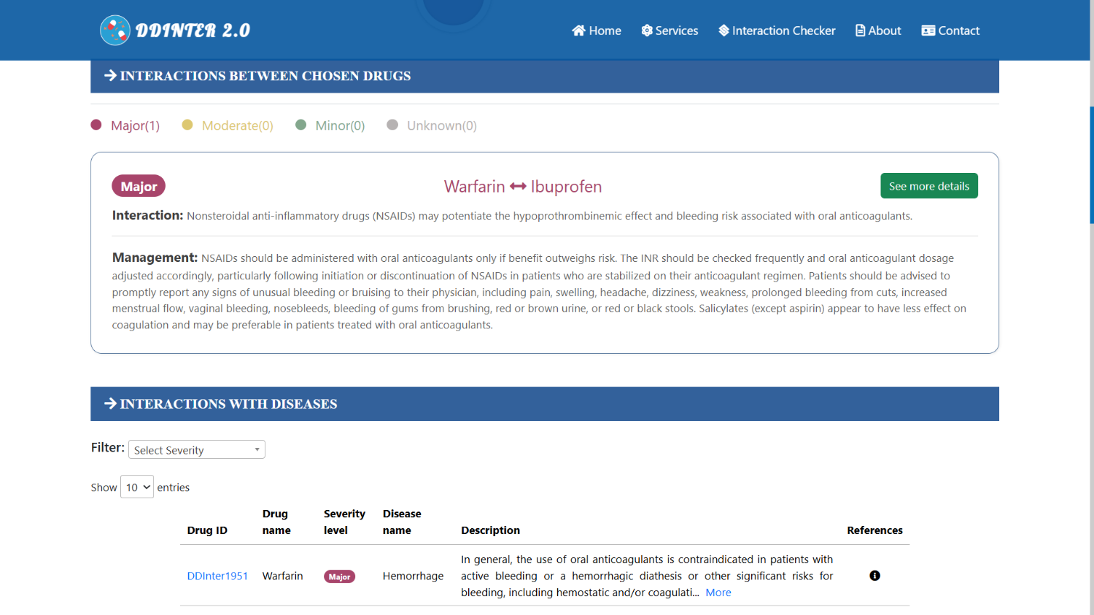
REVIEW OF EXISTING SYSTEMS
The tools clinicians reach for today
Lexicomp
Medscape
DDInter 2.0
Subscription
Free · online only
Drugs.com
Free · open access
First for accuracy and completeness. Priced beyond most Nigerian practice, and its severity ratings are editorial rather than derived.
No registration, three severity levels. Scored 202 of 400 for accuracy against Lexicomp's lead, with abbreviated descriptions.
Free · ad-supported
Pharmacist-reviewed ratings across about 240,000 interactions. Web only. MedGuard uses its ratings as an expert override layer.
A credible free alternative that has matched subscription tools on some interaction sets. Thin clinical depth, no offline mode.
Notes:
The four tools clinicians actually use today.

Slide 11
COMPARISON OF EXISTING SYSTEMS
Four checkers, and the one thing none of them does
System
Access model
Strength
Limitation
Offline
Lexicomp
Subscription
Detailed monographs and mechanisms
Costly; editorial severity assignment
No
Medscape
Free
No registration; multi-drug checks
Limited clinical depth
No
Drugs.com
Free, ad-supported
Easy to use; broad public access
Consumer-level detail only
No
DDInter 2.0
Open access
Pharmacist-reviewed severity ratings
Web only; no mobile application
No
GAP 1
GAP 2
GAP 3
No affordable checker works without a network
Interaction models stay in the laboratory
Severity rests on editorial consensus, not features
Notes:
The same four systems side by side. The last column is the point: not one of them works without a network.

Slide 12
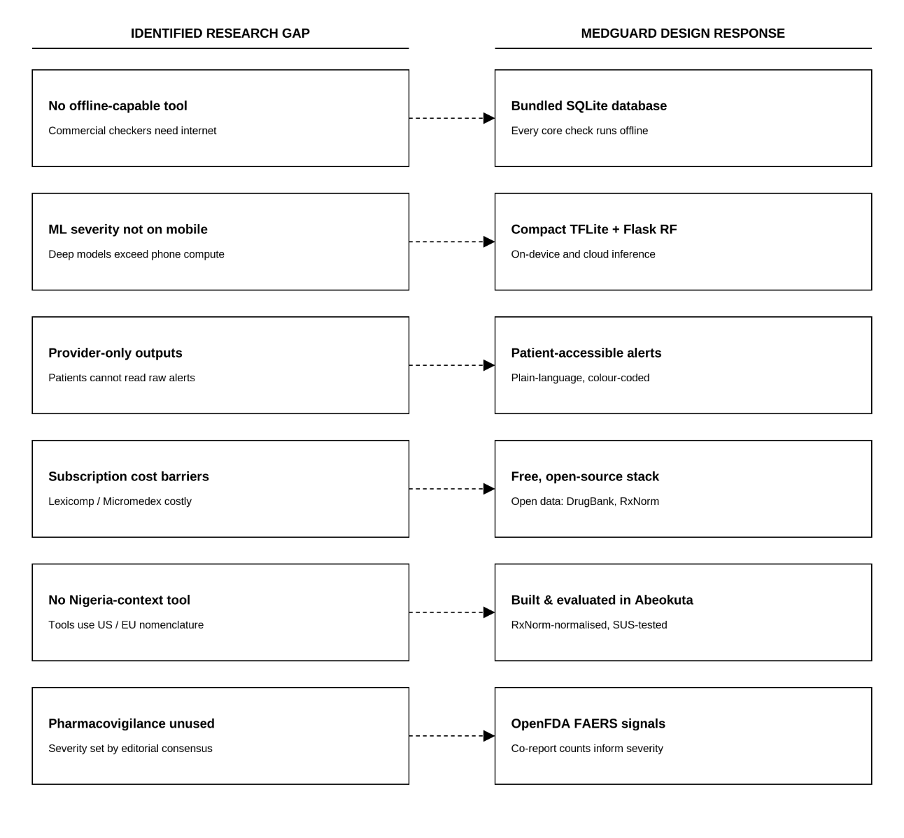
RESEARCH GAPS
Three gaps, and what each one asks the system to do
No genuine offline mode
Answered by shipping the whole database inside the app, so the network becomes an enhancement rather than a requirement.
Models never reach a user
Answered by carrying the model all the way: trained, served through an API, distilled onto the device, and tested with real users.
Severity rests on editorial consensus
Answered by deriving severity from pharmacology, with expert ratings kept as an override that can raise an alert but never suppress one.
Figure 1. Identified Research Gaps and Proposed System Features
Notes:
Three gaps come out of the review, and each one sets a requirement for the build. This is the bridge into Chapter Three.

Slide 13
RESEARCH METHODOLOGY
Design Science Research: build the artefact, then test it
PHASE 1
PHASE 2
PHASE 3
PHASE 4
PHASE 5
Problem and requirements
Data engineering pipeline
Model training and selection
Application and API build
Testing and user evaluation
Experimental
Functional
Usability
The classifier evaluated on a held-out test set and on a harder drug-disjoint split, against a majority-class baseline.
Automated tests over every safety check, including a group that runs with the network disabled.
Fifteen participants, five task scenarios each, and the ten-item System Usability Scale.
Notes:
Design Science Research. Five phases, and three kinds of evaluation.

Slide 14
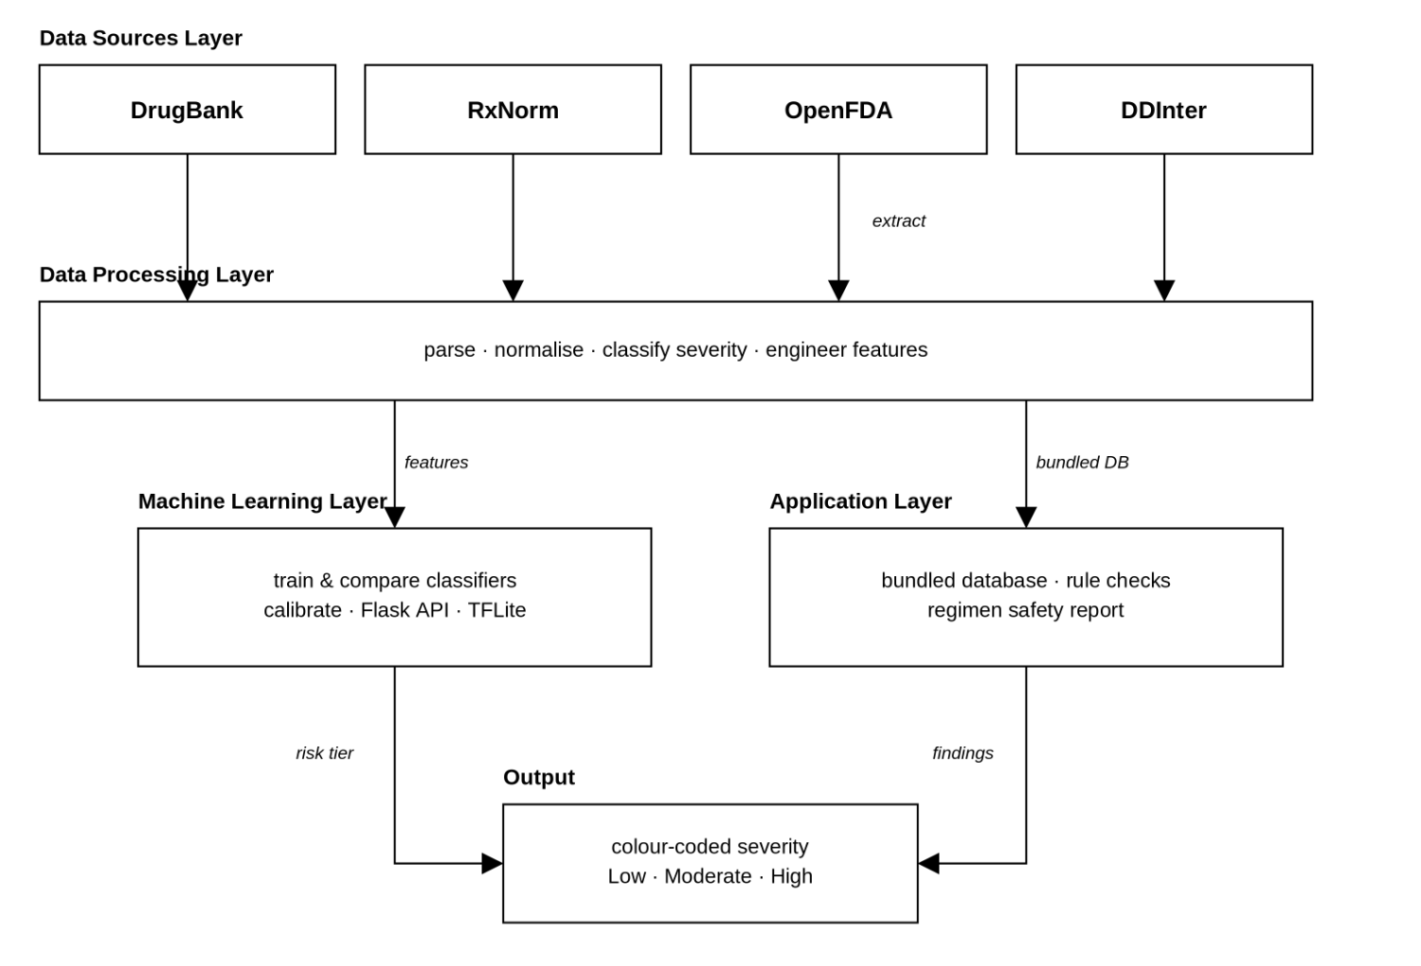
CONCEPTUAL FRAMEWORK
Four layers, one pipeline from open data to a single alert
DrugBank, RxNorm, OpenFDA and DDInter are parsed into one SQLite database. That database feeds two consumers: the model, which learns severity from pharmacological features, and the application, which bundles the same file for offline checking.
EVERYTHING ENDS IN ONE OF THREE TIERS
Low
Moderate
High
Figure 2. Conceptual framework of the MedGuard system.
Notes:
Figure 1.1. Four open sources parsed into one SQLite database, which feeds both the model and the application.

Slide 15
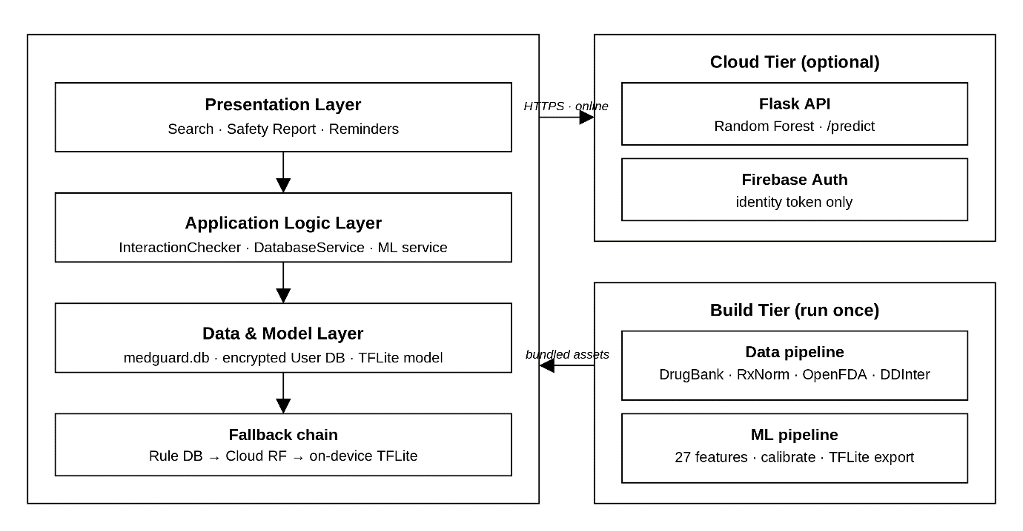
SYSTEM ARCHITECTURE
The phone holds everything it needs. The cloud is optional.
Presentation, checking logic, the 79 MB reference database and an 8 KB model all sit on the device. Only an uncatalogued pair reaches the network, and only as two drug identifiers.
FALLBACK ORDER
Local database → cloud model → on-device model. The feature degrades; it never fails.
Figure 3. High-level offline-first architecture of the MedGuard system.
Notes:
Figure 3.1. The phone holds everything it needs. Only an uncatalogued pair reaches the network, and only as two drug identifiers.

Slide 16
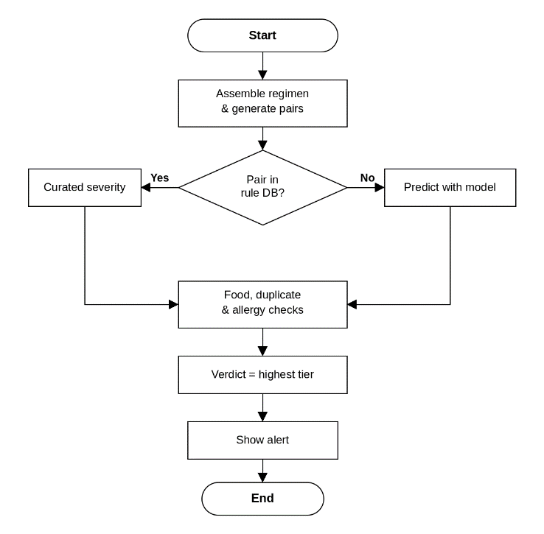
SYSTEM FLOWCHART
How one safety check runs, start to finish
A catalogued pair returns its curated severity grade straight from the bundled database.
An uncatalogued pair goes to the model: cloud when there is a network, on-device when there is not.
Food, duplicate-therapy and allergy checks then run, and the verdict is the highest tier present.
Figure 4. System flowchart of the MedGuard safety-check process.
Notes:
Figure 3.10. How one safety check runs from start to finish.

Slide 17
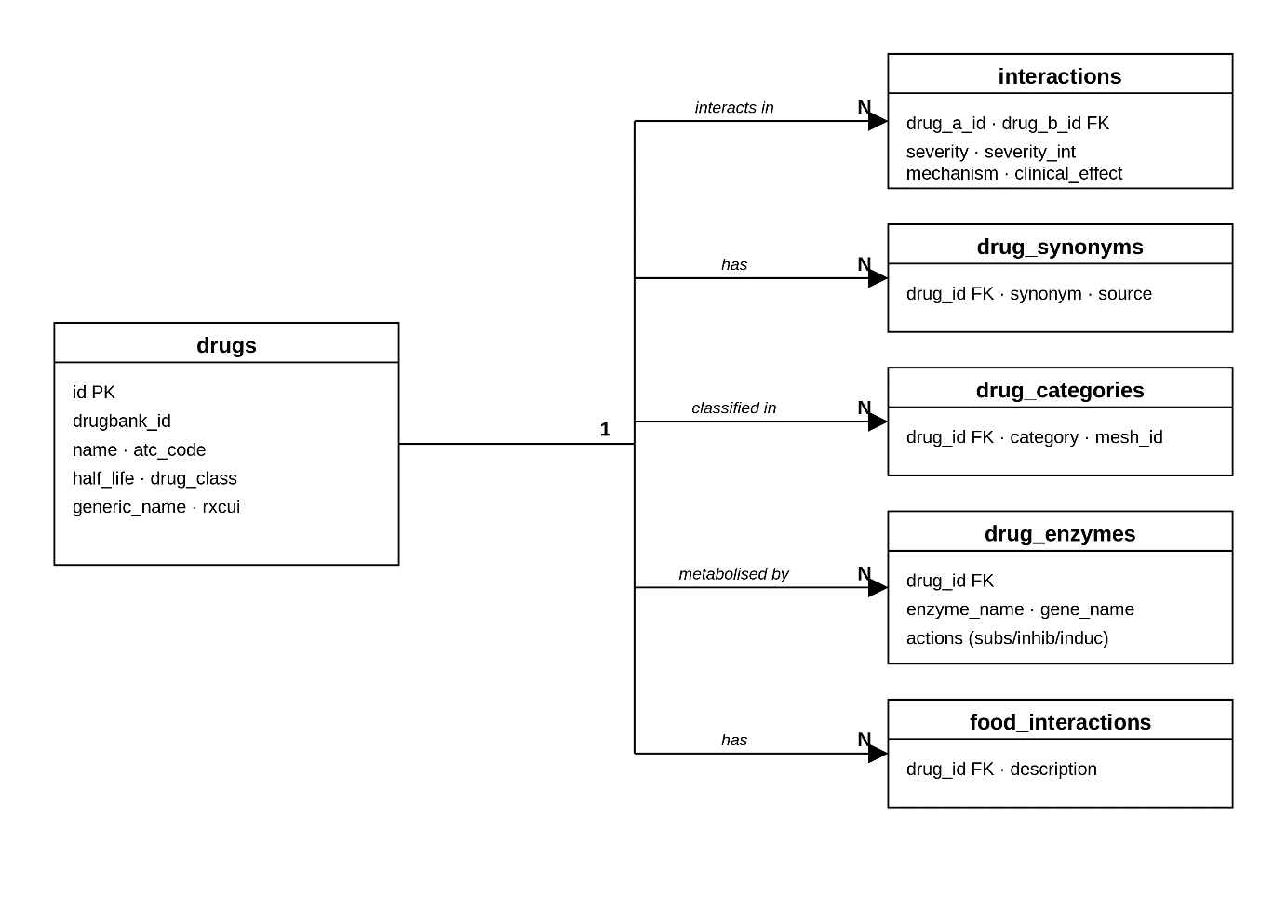
ENTITY RELATIONSHIP DIAGRAM
One drugs table at the centre, six spokes around it
Every spoke holds a foreign key back to drugs , normalised to third normal form. Repeated descriptions are stored as integer codes and rebuilt through a SQL view, which is what keeps the file small enough to ship.
4,955
851,868
drugs
interaction records
252,046
79 MB
synonyms for search
shipped inside the app
Figure 5. Entity–relationship diagram of the MedGuard reference database.
Notes:
Figure 3.2. One drugs table at the centre, six spokes around it, normalised to third normal form.

Slide 18
THE MACHINE LEARNING PIPELINE
Three classifiers were compared. The forest was kept.
Twenty-seven features per pair: shared enzymes, inhibition profiles, ATC-class overlap, half-life, narrow-therapeutic-index flags and each drug's recorded risk history.
Random Forest
0.562
Gradient Boosting
0.548
Logistic Regression
0.486
The forest was chosen for the highest macro-F1, a firmer hold on the minority High tier, and feature importances a clinician can interrogate without a second model to explain the first.
Validation macro-averaged F1 — same features, same splits
Notes:
Three classifiers compared on the same features and splits. The forest was kept.

Slide 19

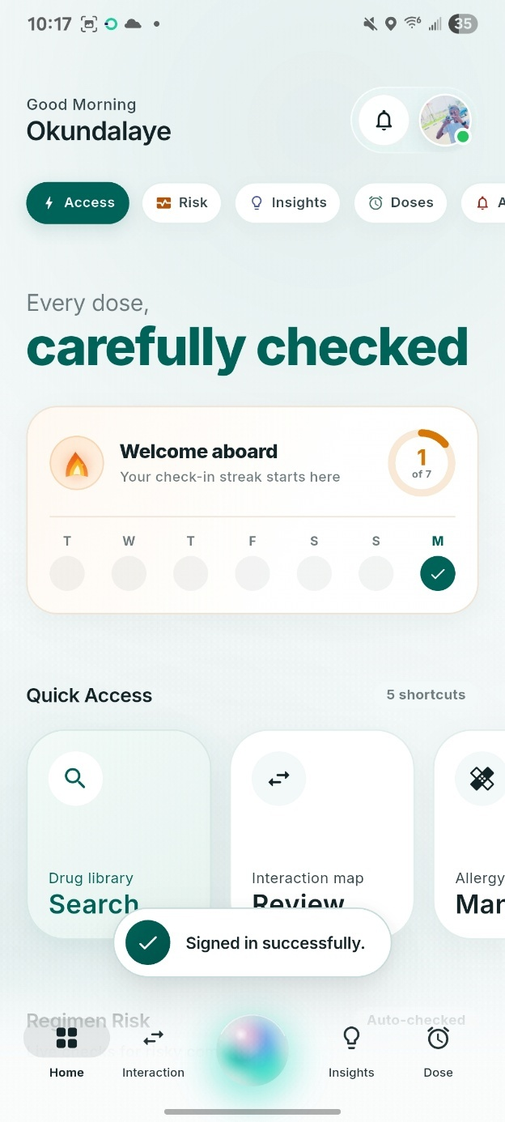
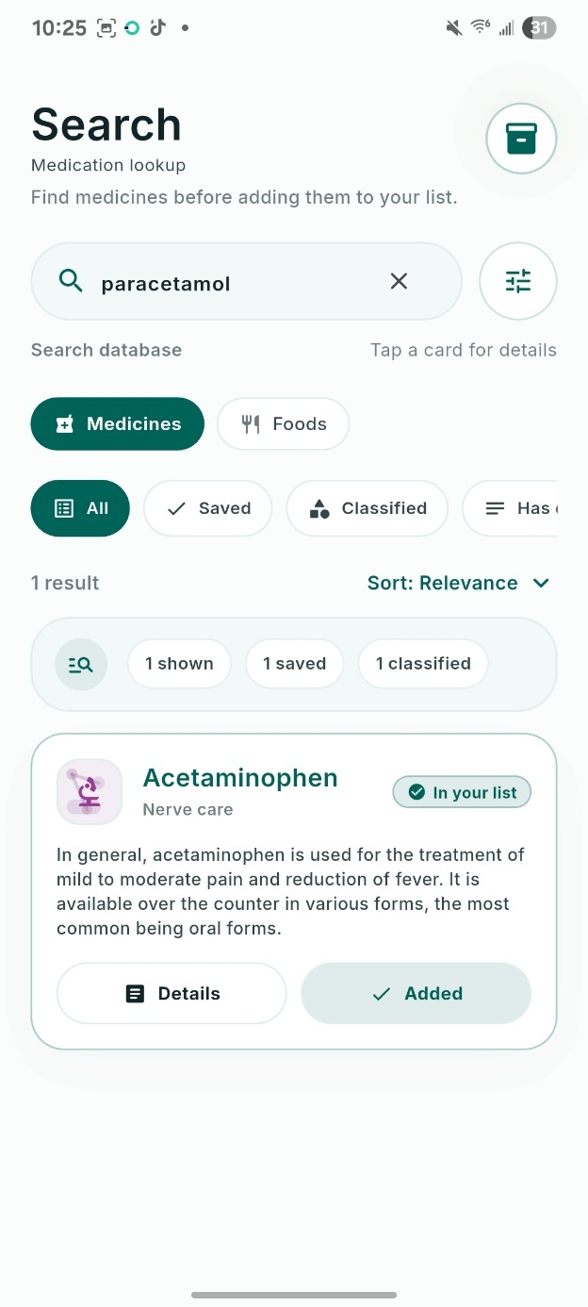
IMPLEMENTATIONS: HOME & SEARCH SCREEN
The regimen is the unit of safety, not the single drug
The dashboard opens on the current status of everything the user is taking. Drugs are added through autocomplete over 252,046 synonyms, so a brand name or a misspelling still resolves to one normalised medicine.
Adding or removing a medicine re-screens the whole list immediately. There is no separate check button to forget, and the lookup runs against the bundled database with no network call.
Home dashboard
Drug search
Notes:
The dashboard opens on the whole regimen. Drugs are added by autocomplete, so a brand name or a misspelling still resolves to one medicine.

Slide 20
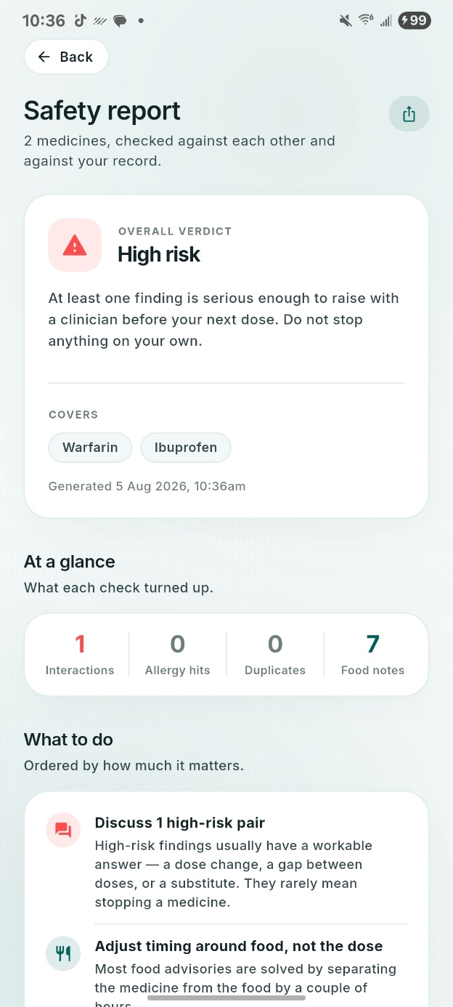
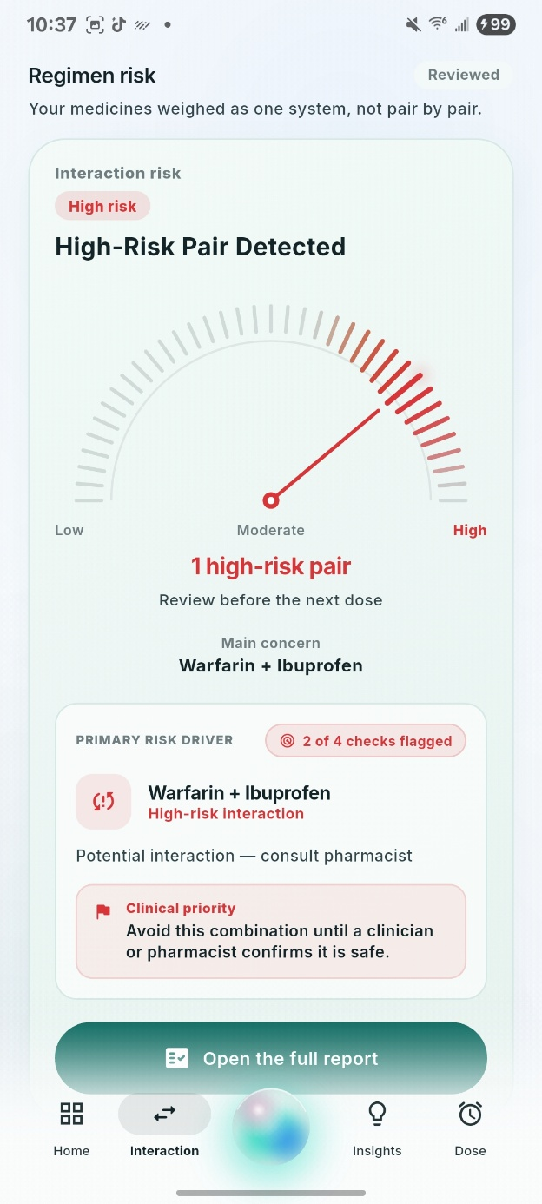
IMPLEMENTATION: SAFETY REPORT AND REGIMEN RISK
Four checks, one verdict, in plain language
Interactions, food conflicts, duplicate therapy and allergies resolve into a single verdict equal to the highest tier present. The report then says what to do about it, ordered by how much it matters.
1
2
3
Low
Moderate
High
No alert raised
Monitor or separate doses
Seek professional advice
Severity is carried by the fill of the dial, the colour and the wording together, so it still reads for a user who cannot tell red from amber.
Safety report
Regimen risk panel
Notes:
Four checks resolve into one verdict, equal to the highest tier present, and the report says what to do about it.

Slide 21
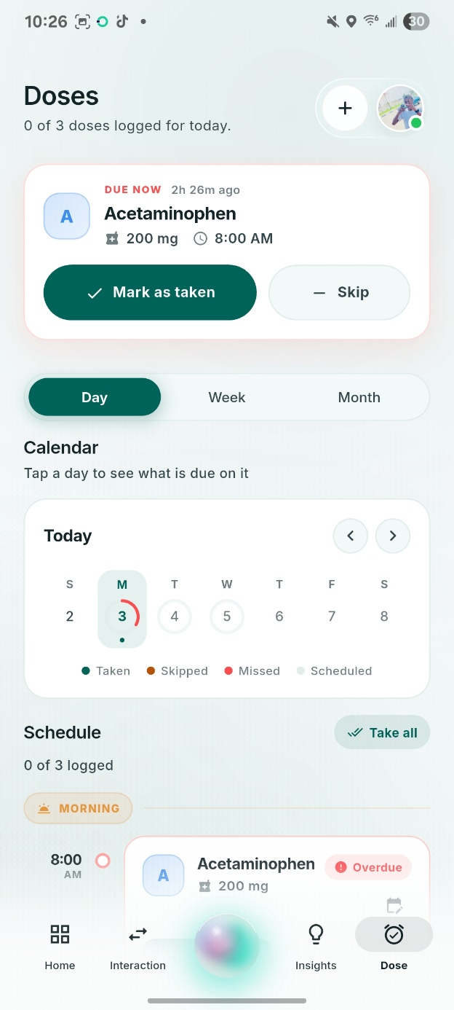
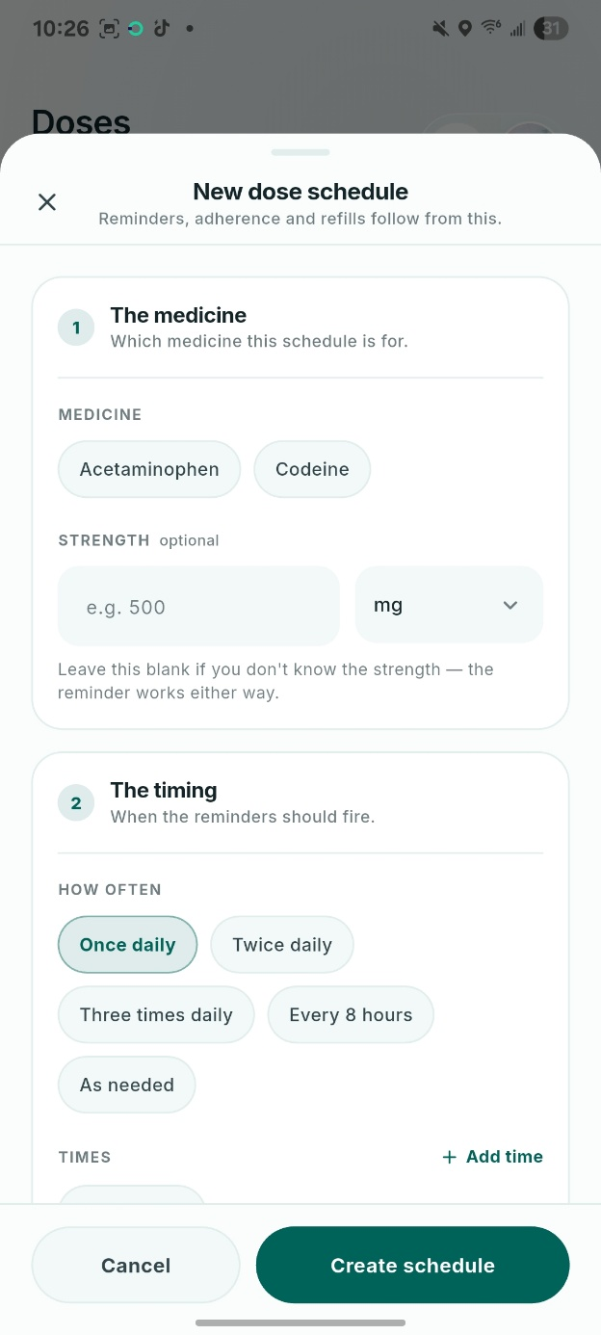
IMPLEMENTATION: DOSE SCHEDULER AND REMINDER EDITOR
Safety continues after the check
Dose scheduling, reminders, refill tracking and a QR emergency card. Every one of these runs against the bundled database, with the network switched off.
These features are what give the app a reason to be opened between checks, which is what keeps the medication list current enough for the checks to mean anything.
Dose calendar
Reminder editor
Notes:
Dose scheduling, reminders, refill tracking and the QR emergency card. All of it runs offline.

Slide 22
RESULTS: MODEL PERFORMANCE
The model catches nine in ten of the interactions that matter most
91.0%
86.3%
0.943
218,518
of High-risk interactions correctly flagged
accuracy, against a 76.1% baseline
macro AUC-ROC across the three tiers
held-out drug pairs in the test set
It over-flags, on purpose
The Low tier is weak, and rare
Precision on the High tier is 0.658. In a decision-support tool, a false alarm is the safer error.
Just 433 of 218,518 pairs. A Low prediction raises no alert, so the practical cost is small.
Notes:
The headline results, and the two honest caveats: it over-flags on purpose, and the Low tier is weak but rare.

Slide 23
RESULTS: FEATURE IMPORTANCE AND ERRORS
What the model leans on, and how it gets things wrong
TOP 6 FEATURE IMPORTANCES
CONFUSION MATRIX
TRUE
PREDICTED
Low
Moderate
High
0.197
0.182
Low
n = 433
63
14.5%
299
69.1%
71
16.4%
0.116
0.104
Moderate
n = 166,273
0.095
616
0.4%
141,249
85.0%
24,408
14.7%
0.082
High
n = 51,812
0
0.0%
4,642
9.0%
47,170
91.0%
Risk score
product
Risk score
minimum
Risk score
maximum
Drug A
risk score
Drug B
risk score
ATC class
missing
Gini importance · these 6 of 27 carry 77.5%
Row-normalised · 218,518 held-out drug pairs
Errors run upward. 24,408 Moderate pairs were graded High, while under 0.2% of High pairs fell to Low — the asymmetry that buys 91.0% High-tier recall.

Slide 24
RESULTS: COLD START EVALUATION
On drugs it has never seen, the model is measurably weaker
CATALOGUED DRUGS
DRUGS HELD OUT OF TRAINING ENTIRELY
Accuracy
86.3%
Accuracy
69.6%
Macro F1
0.594
Macro F1
0.472
High-tier recall
0.910
High-tier recall
0.864
The five strongest features are all measures of a drug's recorded risk history. That makes the model transparent and auditable, and it is exactly why a genuinely new medicine, with no history to draw on, is predicted less reliably.
Notes:
The harder test. On drugs held out of training entirely, the model is measurably weaker — and the reason is the same thing that makes it transparent.

Slide 25
RESULTS: DEPLOYMENT AND TESTING
Small enough to live inside the app, and tested against the real database
7,984
95.6%
34
bytes — the whole distilled on-device model
of its decisions match the full Random Forest
automated tests, including ten named clinical drug pairs
Warfarin with ibuprofen, simvastatin with clarithromycin, sildenafil with nitroglycerin — real pairs with known clinical outcomes.
A dedicated offline group confirms the rule-based checks still work with no network, which verifies the study's central architectural claim.
Notes:
The distilled model is under eight kilobytes and agrees with the forest 95.6% of the time. Thirty-four automated tests, ten of them named clinical pairs.

Slide 26
RESULTS: USABILITY TESTING
Fifteen users rated it 84 out of 100 — but not evenly
Physiotherapy students (5)
96.0
84.3
Nursing students (6)
89.2
Clinic staff (4)
62.5
mean System Usability Scale score, 16.3 points above the 68-point benchmark for an average system.
74 of 75 task scenarios completed · 71 with no assistance at all
The split is not about drug knowledge. Students tested in a quiet room; clinic staff tested during a working day. Every instance of a participant needing help came from that group, and all of it on one task — finding the allergy profile.
Notes:
Fifteen users, mean SUS 84.3. But the average hides a split, and the split is about testing conditions rather than drug knowledge.

Slide 27

CONCLUSION AND RECOMMENDATION
An offline-first medication safety tool, driven by a machine-learning severity model, can be built from freely licensed data and software — and used by the people it is meant for. MedGuard is a functioning academic prototype, not a clinically validated product.
RECOMMENDATION 1
RECOMMENDATION 2
RECOMMENDATION 3
RECOMMENDATION 4
Prompt for allergies during onboarding — the one fix the usability data asks for
Run a scripted load test against the API and the on-device model
Rebuild the reference database as soon as DrugBank restores downloads
Structured review by licensed pharmacists before any wider use
Notes:
The conclusion, then four recommendations that follow from the evidence.

Slide 28
REFERENCES
Sources cited
Bangor, A., Kortum, P. T., & Miller, J. T. (2008). An empirical evaluation of the System Usability Scale. International Journal of Human–Computer Interaction, 24 (6), 574–594.
Knox, C., Wilson, M., Klinger, C. M., et al. (2024). DrugBank 6.0: The DrugBank Knowledgebase for 2024. Nucleic Acids Research, 52 (D1), D1265–D1275.
Breiman, L. (2001). Random forests. Machine Learning, 45(1), 5–32.
Oriaifo, O. G., Opadeyi, A. O., Oriaifo, T. O., & Isah, A. O. (2024). Predictors of potential clinically harmful drug–drug interactions at the medical wards, UBTH. Clinical and Translational Science, 17(4).
Brooke, J. (1996). SUS: A quick and dirty usability scale. In Usability Evaluation in Industry (pp. 189–194). Taylor & Francis.
Sutton, R. T., Pincock, D., Baumgart, D. C., et al. (2020). An overview of clinical decision support systems. npj Digital Medicine, 3, 17.
Davis, F. D. (1989). Perceived usefulness, perceived ease of use, and user acceptance of information technology. MIS Quarterly, 13(3), 319–340.
Wang, Y., et al. (2024). Machine learning for drug–drug interaction prediction: A comprehensive review. Journal of Chemical Information and Modeling.
Delara, M., Murray, L., Jafari, B., et al. (2024). Global and regional prevalence of polypharmacy, 1997–2022: An umbrella review. Archives of Gerontology and Geriatrics, 124 , 105461.
Hevner, A. R., March, S. T., Park, J., & Ram, S. (2004). Design science in information systems research. MIS Quarterly, 28(1), 75–105.
Ekpenyong, A., Udoh, A., Kpokiri, E., & Bates, I. (2018). An analysis of pharmacy workforce capacity in Nigeria. Journal of Pharmaceutical Policy and Practice, 11 , 20.
World Health Organisation. (2021). Global patient safety action plan 2021–2030. WHO.
Notes:
References, APA 7.

Slide 29

MedGuard
Thank you
Questions welcome.
Ubaga Joshua Chukwuebuke
CSC/2022/009
Supervised by Prof. Isaac Odun-Ayo
Department of Computer Science,
Chrisland University, Abeokuta
Notes:
Thank the panel and open the floor.

