Slide 1



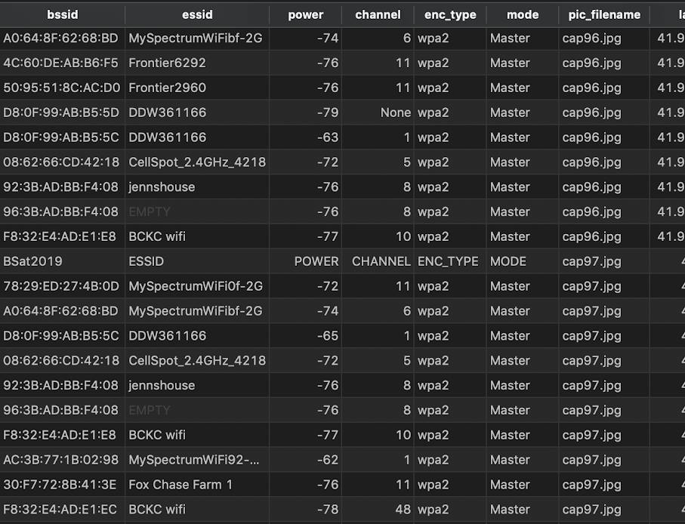
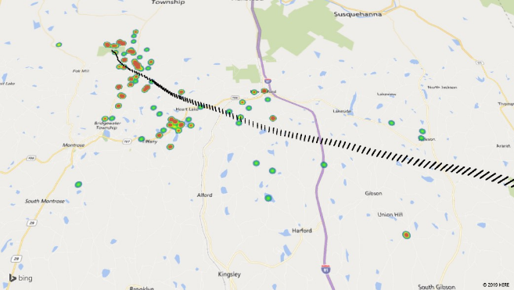
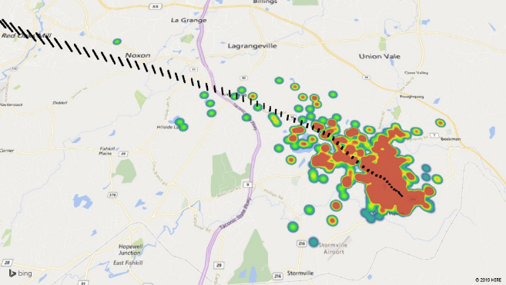
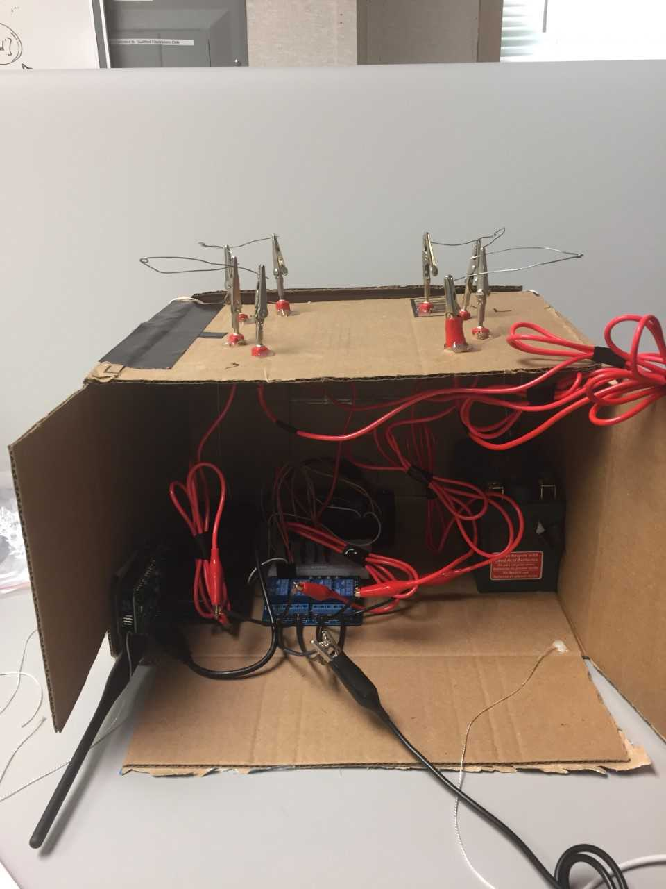
Analyzing Data and Problem-Solving Retrieval of Balloon Sat Payload Cadet Tyler Bull Cadet Josh Westerhaus
History
Started in 1950’s with project Beacon.
Explorer 9 was first successful balloon satellite program.
West Point Astronomy club launched the first balloon in 2011.
Balloon is launched every year with expanding capabilities and different measuring devices.
Future Tasks / Applications
Altitude control using Raspberry Pi GPIO pins.
Two-way communication using the HamShield for APRS packets for data redundancy.
War flying operations.
Data Acquired / Analytics
Wi-Fi, GPS, altitude, radiation readings, temperature are all collected during previous flight.
Various graphs were produced using analytics on the raw data.
Frequency of BSID’s over time.
Balloon Sat raw data.
Acknowledgements
We would like to thank the Army Cyber Institute at West point, the West Point Astronomy Club, the West Point Electrical Engineering department, Mrs. Castillo, and finally our sponsor, LTC Hamilton for his time and direction during the project lifespan.
Problems
Number crunching methods of data presents parsing problems.
Retrieval when the Balloon Sat lands in the Long Island Sound.
Balloon Sat gets stuck in trees causing a long and expensive retrieval process.
Balloon Sat take off (left) and landing (right) with Geolocated BSSID’s (heat map).
Balloon Sat prototype payload with release system.
Solutions
Python scripts to parse and analyze data in a visual format for ease of understanding.
Our solution for the payload getting stuck uses serial communication decoding APRS packets broadcast over HF. A python script running on a Raspberry Pi monitors the serial connection between itself and an Arduino. A HamShield connected to the Arduino provides transceiver capabilities for the payload. The Arduino coupled to the HamShield converts the APRS signal burst to text and sends over the serial to be converted by the Raspberry Pi. When the correct signal is received, the Raspberry Pi activates relays connected between Nichrome wire and a battery to melt the nylon cord holding up the payload.
References
www.github.com/enhancedradiodevices/hamshield
https://github.com/JoshWesterhaus/BalloonSat
https://www.facebook.com/West-Point-Balloon-Sat-204803066214455/

