Slide 1
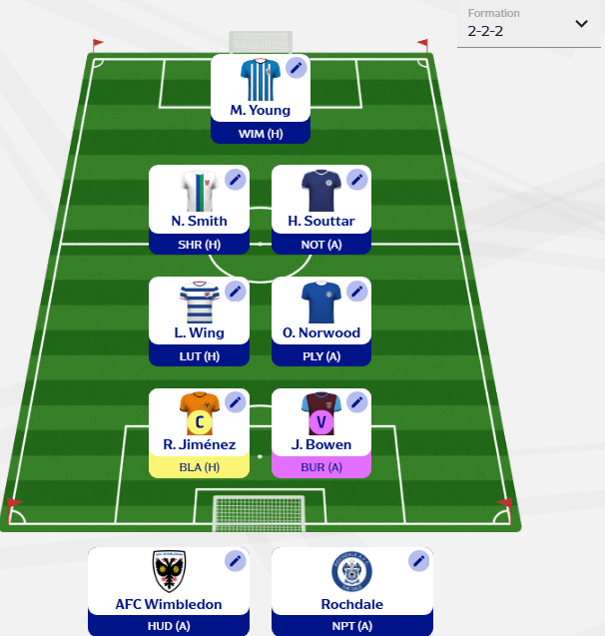
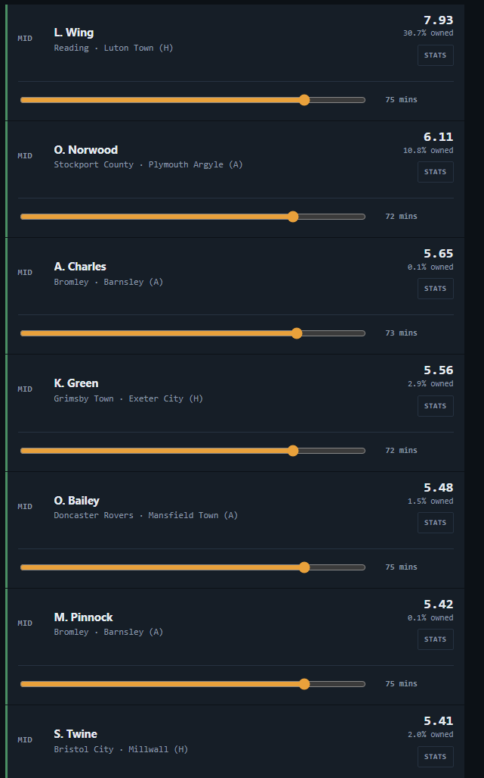
FEFL CLUB
Team Planner
Player Projections
Team Projections
Historical Data
Chips Available
Player/Team
Filters
Xpts, xmins, opp
Xpts, xmins, opp
Xpts, xmins, opp
Xpts, xmins, opp
Xpts, xmins, opp
Xpts, xmins, opp
Xpts, xmins, opp
xPts, opp
xPts, opp

Slide 2
FEFL CLUB
Team Planner
Player Projections
Team Projections
Historical Data
Filters
Player Breakdown:
Xpts, xints, xg, xa, xclears, xtackles etc etc whatever is relevant to their position – able to override these also
Maybe a section to load historical player overrides
When you edit xmins, it then maybe auto adjusts other players on his team in his position?

Slide 3
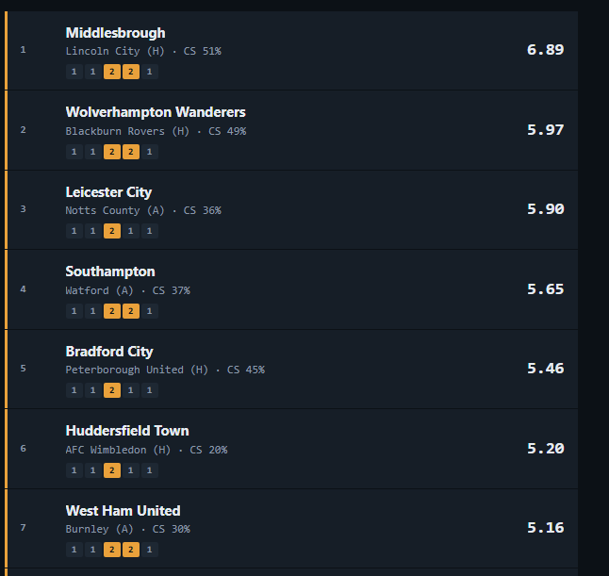
FEFL CLUB
Team Planner
Player Projections
Team Projections
Historical Data
Filters – here is each teams xpoints, their oppo etc
Team breakdown when click on them – eg cs odds, 2+ goals etc etc – then if it’s a double gameweek you can edit inputs or it shows you the inputs again
Projections of when you would likely end up picking each team over the course of the season, based on backend odds for every single gameweek

Slide 4
FEFL CLUB
Team Planner
Player Projections
Team Projections
Historical Data
Be able to load up past data for any player in the game – what they were projected in a gameweek, their breakdown, how many points they actually ended up scoring? See how model compares to actual results for each metric. This is to track accuracy of our forecasting for individual player stats
Maybe able to suggest the best ways to evaluate our processes and how to improve them as we get more and more data

