Slide 1
Distributed File Search System

Slide 2
Problem Statement: Traditional file search mechanisms struggle with performance bottlenecks when handling large-scale distributed datasets. This project addresses the challenge of efficiently searching for multiple keywords across files that are spread across multiple compute nodes in a distributed system. The solution dynamically distributes workloads using MPI for communication and openmp for parallel processing within each node, ensuring optimal load balancing and high-speed search performance.

Slide 3
Technologies & Tools Used: Programming Languages: C / C++ – Core implementation of the distributed search algorithm. Parallel Computing Frameworks: MPI (OpenMPI, MPICH) – Manages communication and coordination between distributed nodes. Cluster Management & Job Scheduling: SSH (Secure Shell Protocol) – Enables node-to-node communication in the cluster. Performance Monitoring & Optimization: Intel VTune Profiler – Analyzes and optimizes parallel execution.

Slide 4
Serial Code Algorithm:
Initialize Variables
Scan Directory (scan_directory function)
3.Search for Keyword in Files (search_in_file function)
End Timer and Display Results
Time Complexity Analysis:
Overall Complexity: Approximately O(N).

Slide 5
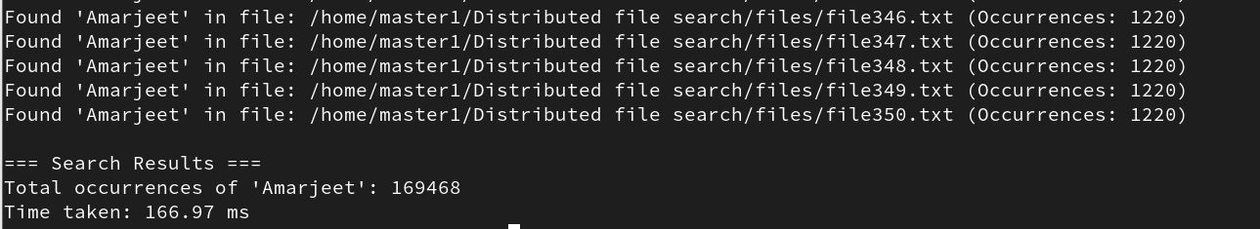
Serial Time Execution: Output

Slide 6
Parallel Code Algorithm:
1.Initialize MPI
2.Directory Scanning (Rank 0)
3.File Distribution
4.Parallel Search
5.Timing
6.Result Aggregation.
7.Output Results (Rank 0).
Time Complexity Analysis:
Result Reduction: O(log N).

Slide 7
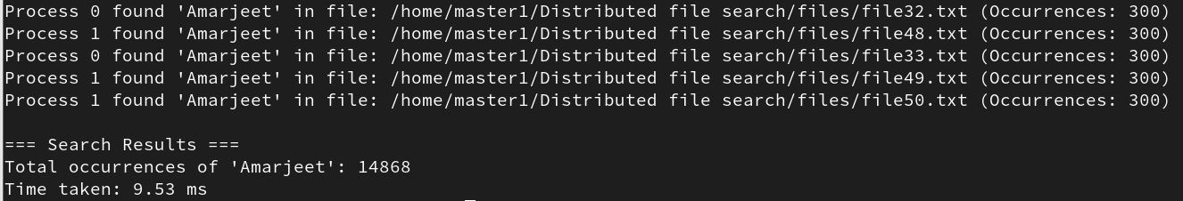
Parallel Time Execution : Output

Slide 8
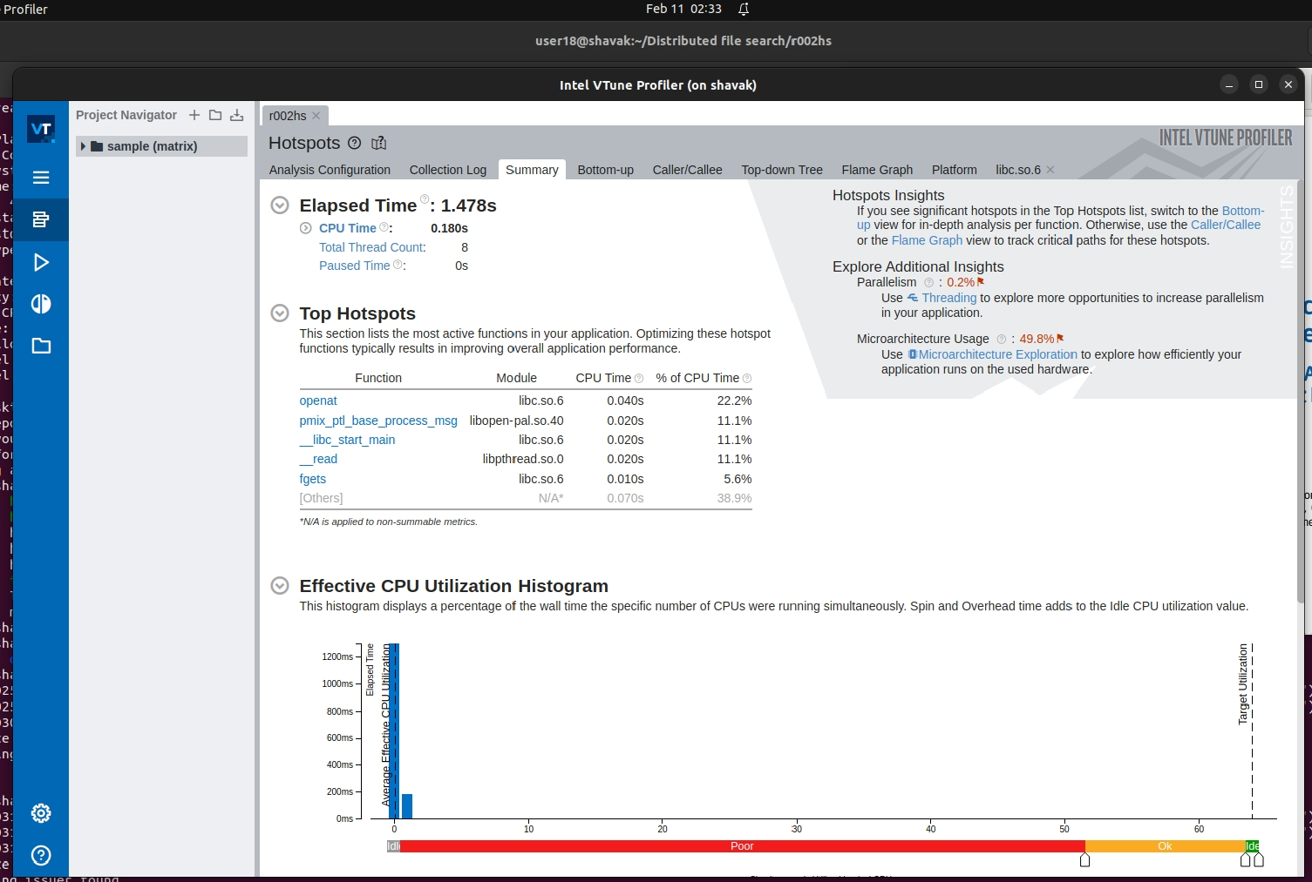
Intel Vtune Profiler :Summary

Slide 9
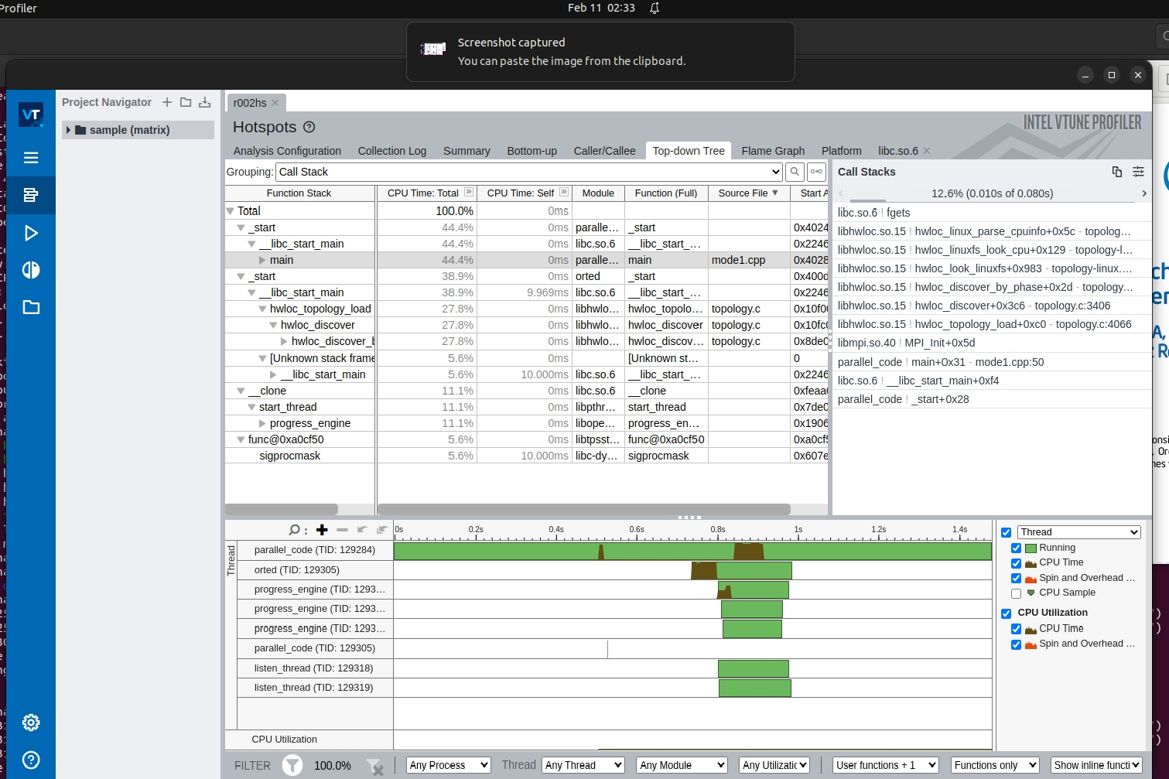
Top-Down Analysis:

Slide 10
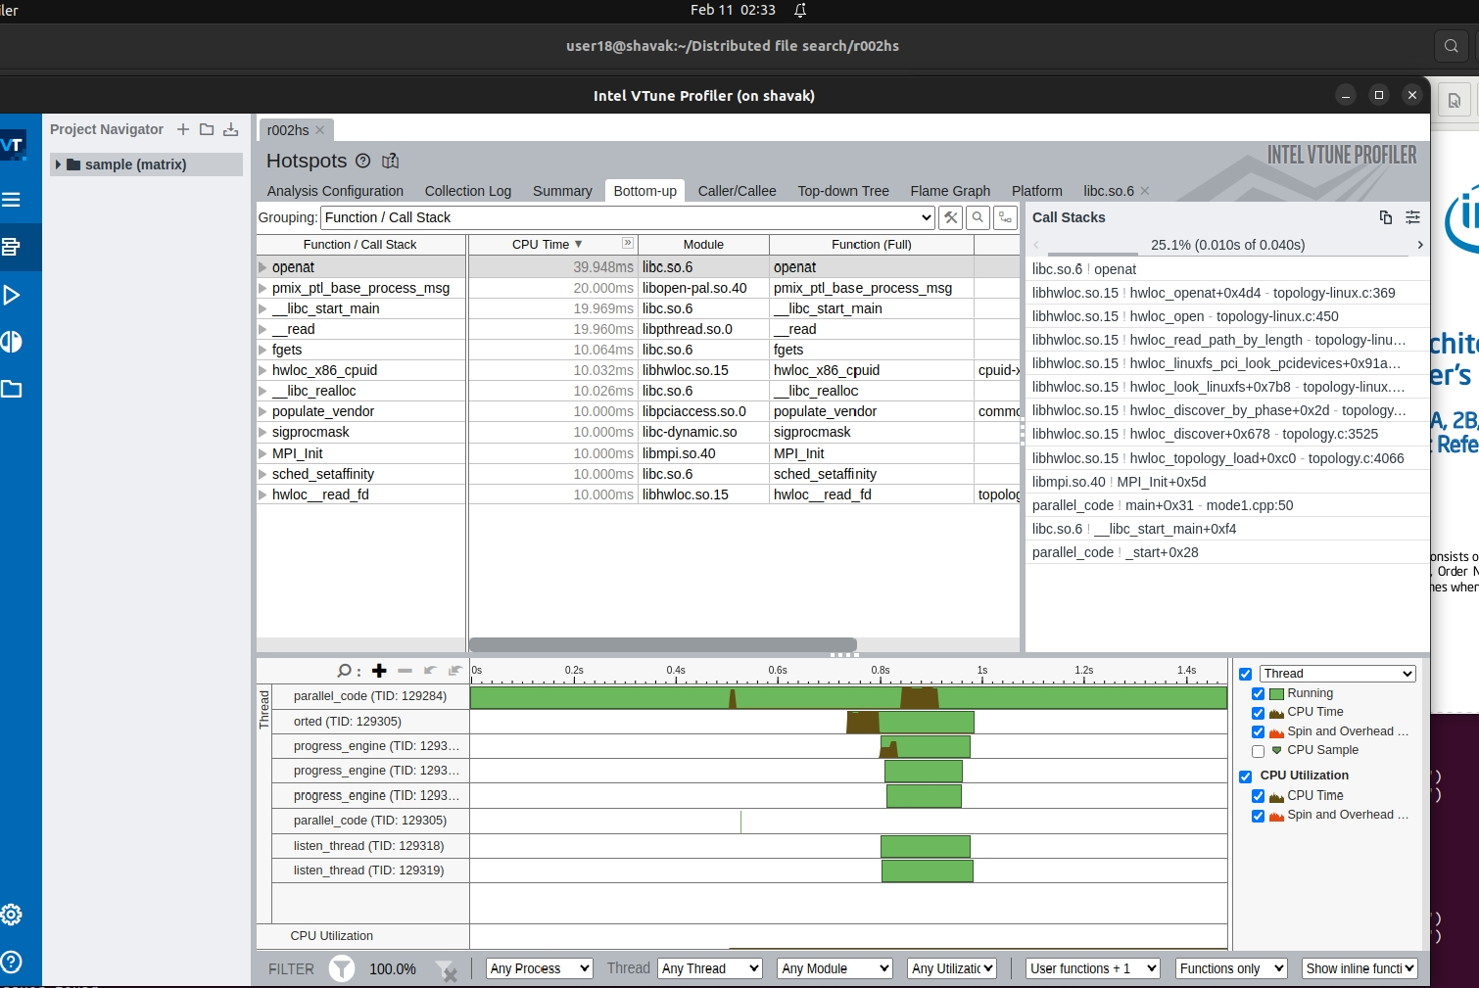
Bottom-Up Analysis

Slide 11
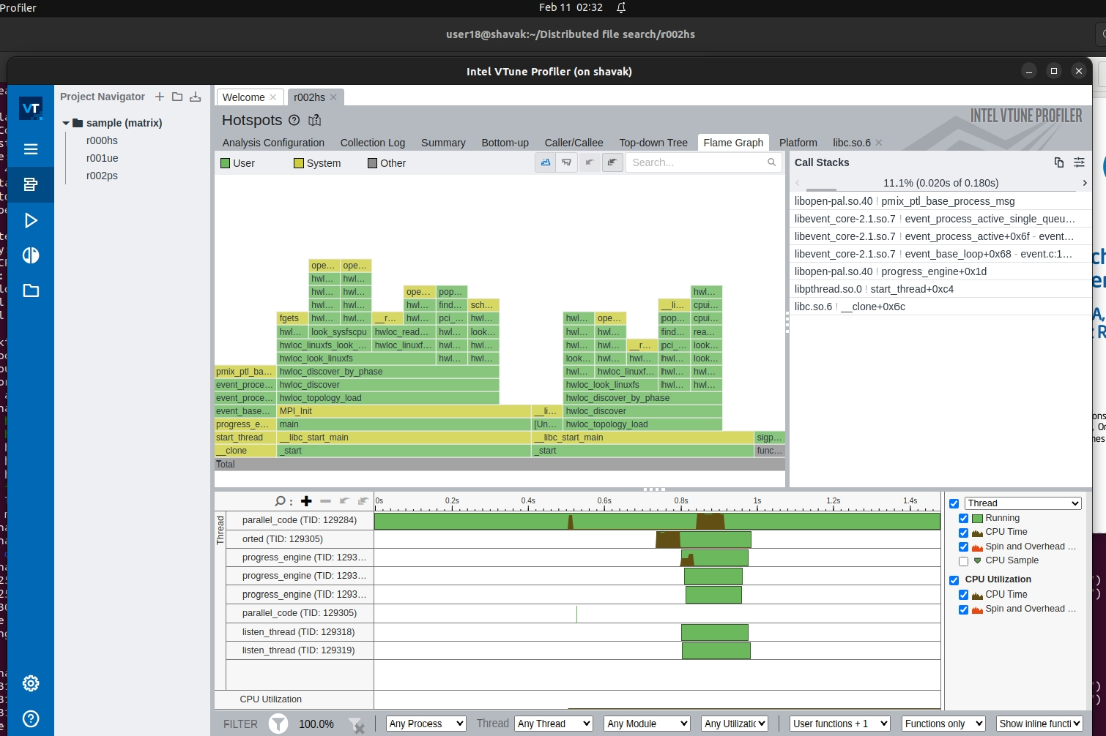
Flame Graph:

Slide 12
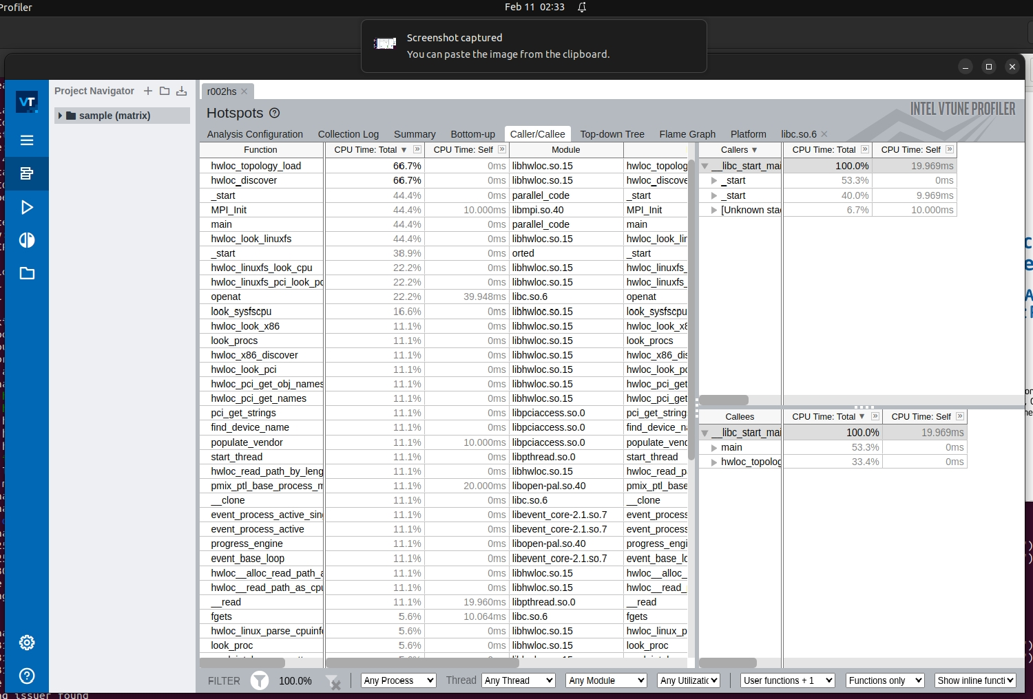
Caller/Callee

Slide 13
Percentage Reduction in Execution Time, we use the formula: Percentage Reduction=((Tserial​​−Tparallel​​)/Tserial)×100 Given: Serial Time = 166.97 ms Parallel Time = 9.53 ms Percentage Reduction=((166.97−9.53)/166.97)×100 =94.29% Conclusion By using parallel execution, the execution time reduces by 94.29%, which means the parallel version is significantly faster than the serial version.

Slide 14
Thank You

