Slide 1
GROUP 62
Robot presentation

Slide 2
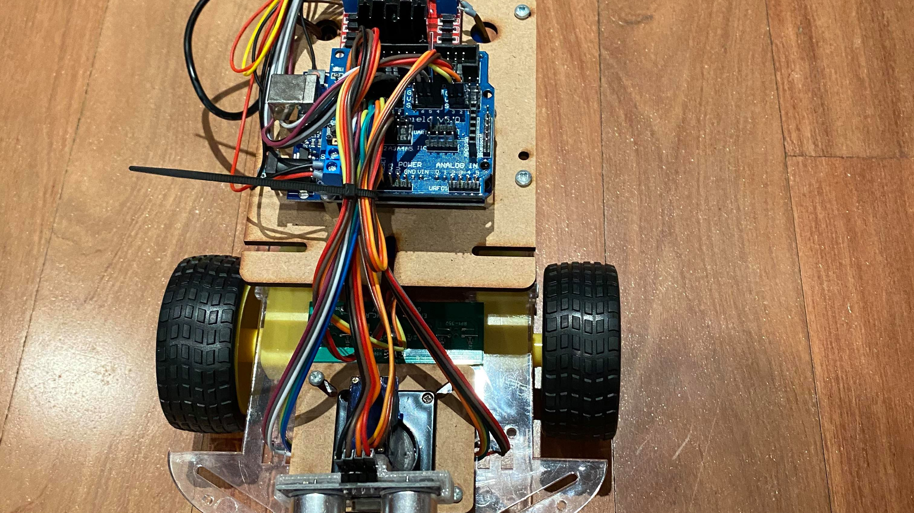
Design
4 Infrared sensors
1 ECHO sensor built on a servo base to allow rotation of ECHO sensor so that it can detect obstacles around the robot or in its path.
Code includes 3 libraries and the main code that calls functions in the libraries to determine what actions to take while on the track.
2 power wheels to allow movement and 1 swiveling wheel that assists in balance and turning.

Slide 3


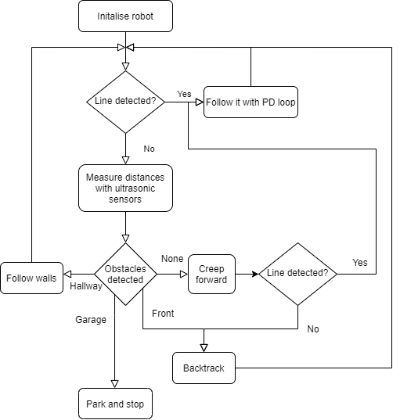



UML Diagram of code logic

Slide 4
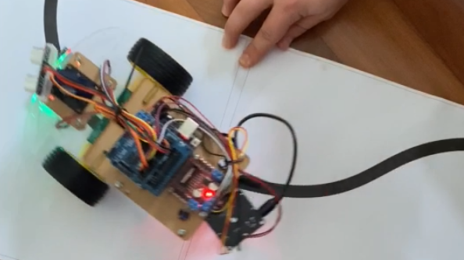
Performance
Though we have faced great challenges with the current learning environment our robot is able to get to the right-hand turn at the wall roughly 40% of the time. In some attempts it was able to get past this obstacle.

Slide 5
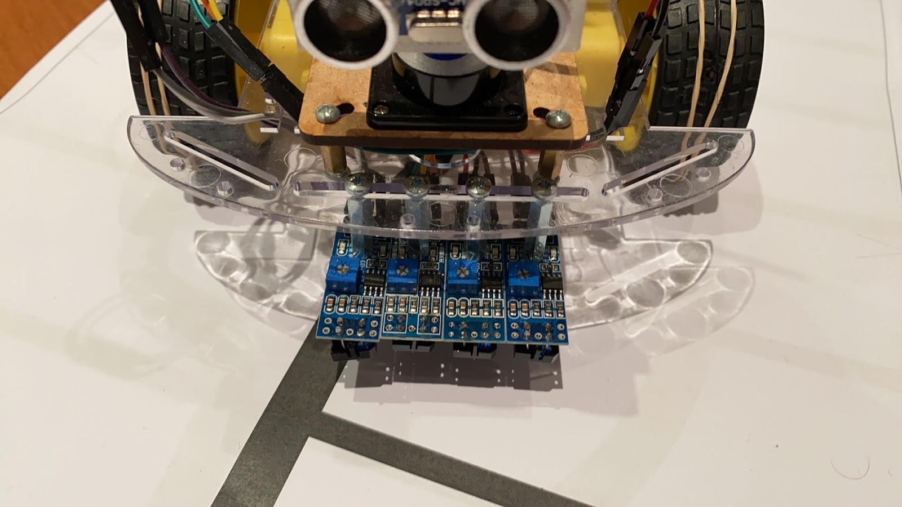
Results
Our robot is driven by code that works for most of the track as a result I believe our team deserves recognition for this accomplishment especially in the challenging learning environment that COVID-19 has presented us with.

