Slide 1
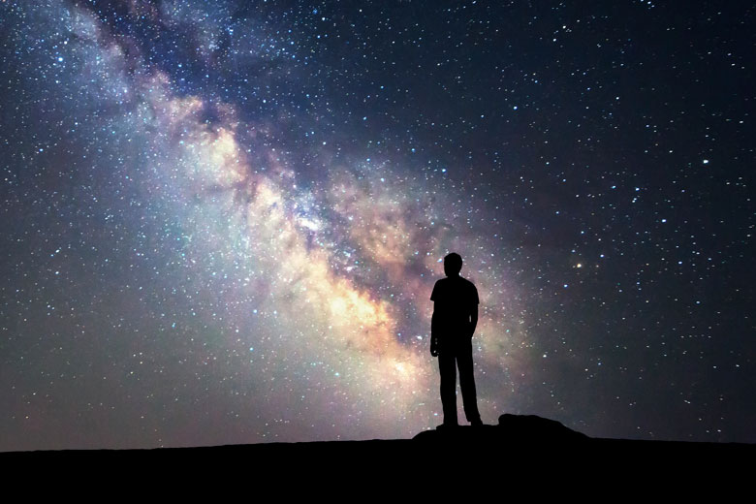
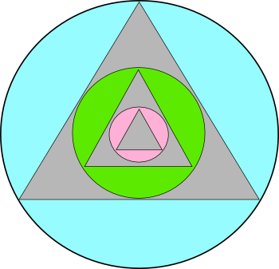

Cosmic Ecology An exploration of the cosmic significance of humanity based on the natural philosophy of J.G.Bennett and drawing on multiple sources of science and spirituality,
Part 1 – Human Beings in the Universe
Module 1 – From Terrestrial to Cosmic Ecology
Dr. Anthony Hodgson

Slide 2
Section 1
The Forbidden Zone

Slide 3
Cosmic Ecology – A New Field of Study
what is cosmic ecology as a field of study? What subject is this?
Other traditional disciplines have constraining assumptions usually with a price of rejection even ridicule to anything that does not fit. The traditions of religion and philosophy are even more constrained and punish with a process of excommunication even death.
Methods such as systems thinking, holism, integral frameworks and so on have made forages into transdisciplinarity.
Ecumenical movements have affirmed all beliefs lead to the same truth with at best only thepower to slightly slow the degeneration.
The fresh approach of cosmic ecology is another forage into this dangerous territory. Why is cosmic ecology dangerous?

Slide 4


The Challenge
There is a widespread social distortion which create a wilful pathology in our worldviews that block us from discovering a
cosmic ecology.
Yet in this ecosystem we live and have our being.
These distortions create a
Forbidden Zone*
*Note: Entering it can even attract the death penalty
Notes:
PATHOLOGIES IN WORLDVIEWS THAT PLACE EXPLORATION OF UNIVERSAL UINTELLIGENCE IN A FORBIDDEN ZONE.
LET’S EXPLORE ONE VERSION OF ‘THE FORBIDDEN ZONE’’
THEN WE CAN EVADE THE BLOCKS
AND EXPLORE

Slide 5

The Forbidden Zone
BOUNDARIES – These limits should not be crossed!
Humans are the only not-dumb in the Universe
Matter is dumb
All stuff out there is not brain therefore dumb
Only brain is
intelligent
HERE BE MONSTERS
Earth/biosphere are not brain therefore dumb
Human brains are the most intelligent
Notes:
A SAMPLE OF PSYCHOLOGICAL AND CULTURAL WALLS PREVENT US FROM ENTERING
OR EXCOMMUNICATE US FROM MAINSTREAM SOCIETIES IF WE DO VENTURE IN

Slide 6

Hypotheses opening the Cosmic Portal to the Happy Zone
Humans potentially have a participative role to be cosmically intelligent
Matter is intelligent; intelligence is matter
EXPLORATIONIS NOW PERMITTED
All visible stuff out there is a light manifestation of the hidden intelligence that is actually out there
Intelligence is prior to the brain
Human intelligence is currently cosmically primitive
Earth and its biosphere are cosmically intelligent
Notes:
FORBIDDEN ZONE AS A PORTAL TO THE GREATER UNIVERSE
MENTAL ‘STARGATE’ TO NEW POSSIBILITIES
PIRPOSE AND MEANING BRING HAPPINESS

Slide 7
Discussion Interlude 1
Share any feelings you have about your own experience of
“the forbidden zone”
RANDOM PAIRS

Slide 8
Section 2
The Greater Anthropocene

Slide 9
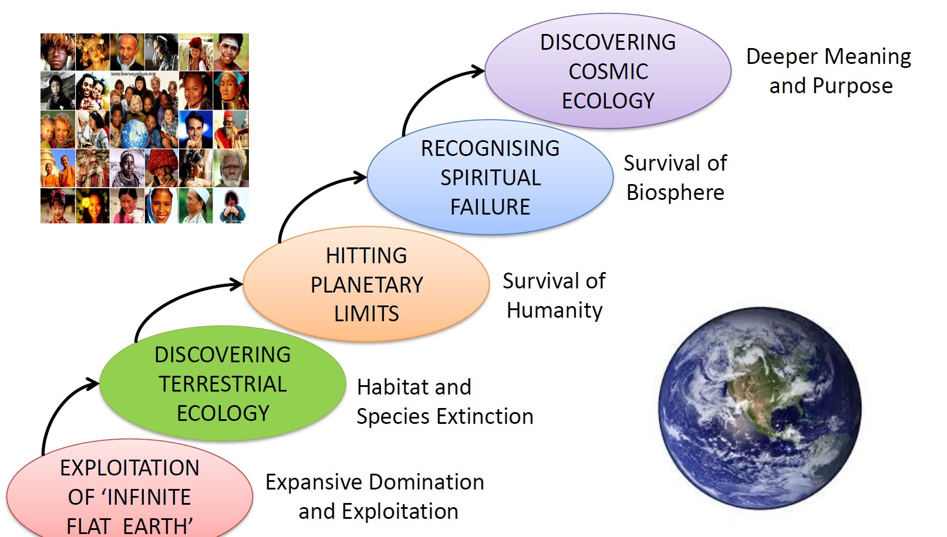
Waking up on Planet Earth – Learning the Hard Way

Slide 10
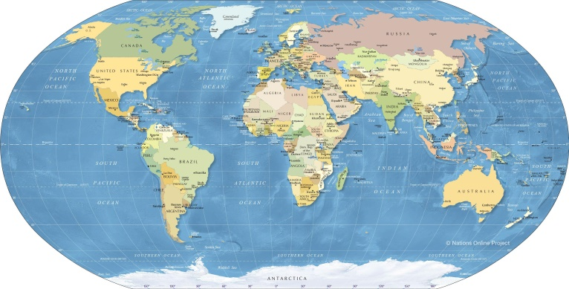
Acknowledging the Greater Anthropocene
Arrival of the Anthropocene
Has created a planet-wide impasse
X
We are
“off the map”
Impact is predominantly negative – why?

Slide 11
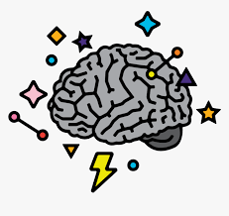
Fragmented Incomplete Understanding
distortion
ignorance
factional exploitation
fixated beliefs
fantasy

Slide 12
Accumulating Feedback from the Whole
For thousands of years we have lived in weakly connected domains and so our fragmentation catastrophies have not destroyed the Gaian system
But now all our domains are strongly connected and catastrophies are no longer in isolation
However, our minds remain fragmented with no effective collective basis for evoking behaviour congruent with our true human/planetary situation
This has led to a tragic situation for humanity

Slide 13
Entering the portal of opportunity, we can entertain alternative worldviews and see what new questions, learning and meaning they bring
Notes:
NOT A DOGMA BUT A SPACE OF EXPLORATION

Slide 14
Discussion Interlude 2
Do you agree that worldview is an important factor in the social global pathology of humans?
RANDOM PAIRS

Slide 15
Section 3
The Eternal Triangle

Slide 16
From Causal Chain to Eternal Triangle
COSMOS
solar system
NOT THIS, BUT THIS →
PLANET
Gaian system
HUMANITY
human system

Slide 17
The Eternal Triangle
solar system
COSMOS
Cosmo-genesis
Cosmic ecology
Total system
PLANET
HUMANITY
Gaian system
human system
Terrestrial ecology

Slide 18
Avidya
solar system
COSMOS
It all started with a Big Bang
The stuff of the universe is blind and unintelligent
HOPELESSNESS
EXPLOITATION
BLINDNESS
PLANET
HUMANITY
Gaian system
Only the human brain has evolved intelligence
human system

Slide 19
Vidya
solar system
COSMOS
The stuff of the universe is conscious and intelligent according to level of being
Humanity has the potential to be a cocreator of worlds
COCREATION
COOPERATION
PLANET
CONSCIOUSNESS
HUMANITY
Gaian system
The human brain has the potential for greater universal intelligence
human system

Slide 20
So what are the drivers of global tragedy?
A tragedy occurs when an action, thought to be in the best interests of the actor, turns out to provoke a destructive even catastrophic collapse on a scale that no single actor or collective can avert.
Three global tragedies arise from the blinkered human purposes of
Acquiring sufficiency for self without consideration for other
Getting it now without consideration for future generations
Assuming complete knowledge and awareness with the false sense of certainty that it gives rise to

Slide 21


Waking Up to the Anthropocene Predicament
C- Tragedy of Consciousness
GLO
The Anthropocene Predicament
A- Tragedy of the Commons
B- Tragedy of the Horizons
Notes:
The tragedy of the Commons is well known. Individual actors use a common resource, for example grazing cattle on common green land. What begins as a limited consumption of those resources attracts more and more actors such that the common land becomes increasingly degraded. Although this degradation is of interest to all actors it is not in the interest of anyone actor to reduce or withdraw exploitation, especially if there is no alternative means of livelihood. Global measurement, for example of planetary limits and safe space for living, show that the whole of humanity are now engaged in that tragedy on a global scale. We have only one planet and we are not only using it up, we are to kicking its systems into irreversible irrecoverable change. For example the rate of species extinction, the destruction of living habitats and the poisoning of places and life essentials.
This is exacerbated by a second tragedy, the tragedy of horizon. The systems in which we live and have our being our complex and interconnected on many levels and over many timescales. Whether the pressure is to survive or to sustain instant gratification, our attention span is kept on the near horizon. It is also kept limited in scope since we shy away from the actual complexity of the situation. Decisions and actions being made now within the small bubble of time overlook the impact they have on the disregarded systems that are running on longer timescales of feedback. This applies not only to external conditions, such as those that have led to global warming and climate change, but also to human community conditions that affect multiple generations into the future.
The third tragedy of consciousness embraces both of these since it is the basic human condition that prevents awareness and response to the previous two tragedies. This tragedy arises out of the deeply ingrained psychological conditions which have been summed up in some places as greed, anger and delusion. Greed drives the clinging to the exploitation mentality and the pursuit of more and more without regard to the contextual implications. Anger drives the polar energy of acquisition and defence and the indignation and covetousness of not having. Delusion is the common human condition of believing we are we understand and we are right.

Slide 22
Discussion Interlude 3
As you see it, why is there a tragedy of consciousness?
RANDOM PAIRS

Slide 23
Section 4
The Three Aspects of Experience

Slide 24
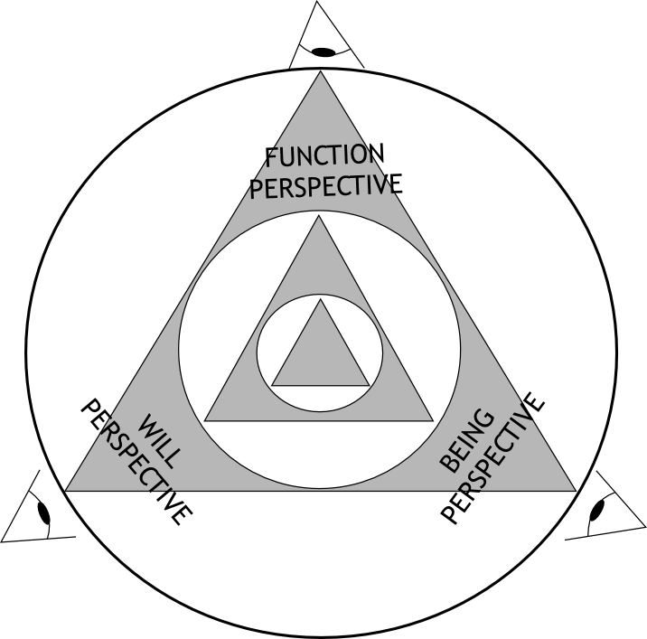
Function Being Will

Slide 25
The Three Aspects of Experience
UNITY – Non-duality (Advaita) is beyond experience and “closer than your jugular vein”
The foundation of cosmic ecology is to unpack unity into three distinct but inseparable aspects. This is already dualistic device, but it is counter balanced by knowing it is that.
Our experience (phenomena and noumena; objective and subjective) presents us with a huge diversity of occasions (“an occasion like this”) which is still a very small sample of what David Bohm called the qualitative infinity of the universe.
The advantage of seeing in three aspects of function, being and will is that it acts as an antidote to getting stuck in the dualistic trap (mind/matter; spiritual/material; conscious/inert) and, analogous to map making, enables a method of philosophical triangulation.
So what are these aspects ?

Slide 26
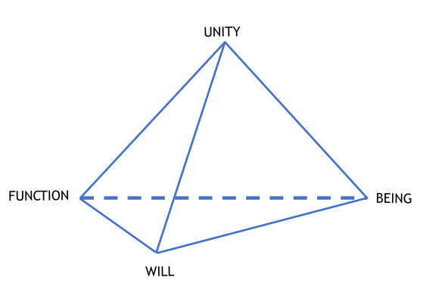
The Triad Beyond Unity
FUNCTIONAL ASPECT
Experience as ‘goings on’ through material processes and transformations articulating differentiation and diversity in the ONE.
BEING ASPECT
Experience as an appreciation of entities and qualities identified by their inner togetherness, their patterning, independent of what is ‘going on’.
WILL ASPECT
Experience as specific instantiations of intent, choice, connectivity and value meaning.

Slide 27
Universality of Function, Being and Will
Cosmic ecology proposes that in a conscious universe, the unfolding of unity through Monad, Dyad to Triad takes place at every level and every scale.
We encounter it anthropomorphically through our own experience, but that is simply what we are given to start with.
FUNCTION – HOW? Behaviour over time
BEING – WHAT? Bounded inner-togetherness?
WILL – WHY? Value, meaning, purpose

Slide 28

Example 1 – Experience as a room
Room in Darkness
Lit by candles
Lit by electricity
Window flung open
Tools = function
Light = being
Choice of action = will

Slide 29
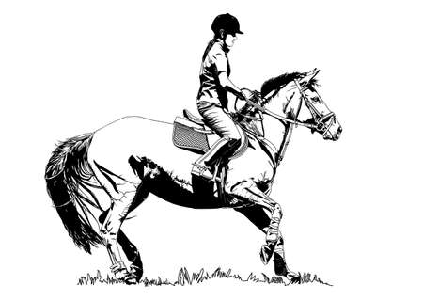
Example 2 – Riding a horse
The rider needs a functional behaviour of getting from A and B faster than walking and so co-opts the speed of a different being – a horse.
The inner character of a human and of a horse are different so a way of cooperation is needed.
The horse does not share the rider’s needs but, trained to do so, will subject its will to the will of the rider.
FUNCTION – rider and horse trot the journey
BEING – a temporary hybrid holon (human/horse) is formed
WILL – rapporte between are established enabling the event

Slide 30
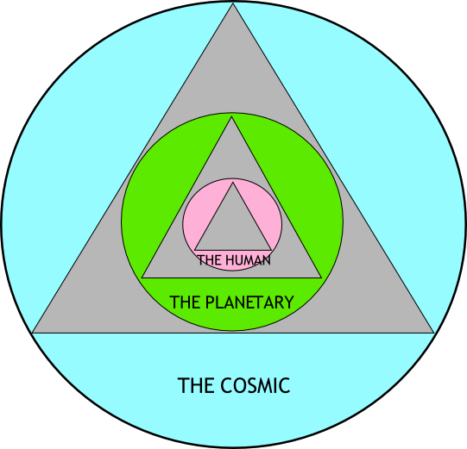
Hints of the Cosmic Ecology Curriculum

Slide 31
Three Aspects v Three Perspectives
FUNCTION
BEING
WILL
COSMIC
PROCESS
HOLONS
LAWS
PLANETARY
BEHAVIOUR
ENERGY
PATTERNS
HUMAN
KNOWLEDGE
CONSCIOUSNESS
PARTICIPATION

Slide 32
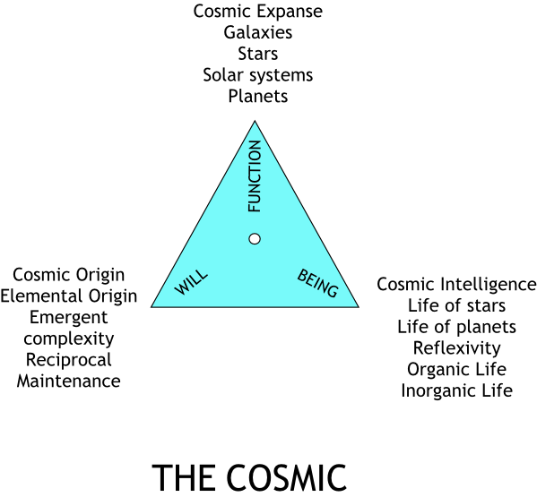
The Cosmic Triad

Slide 33
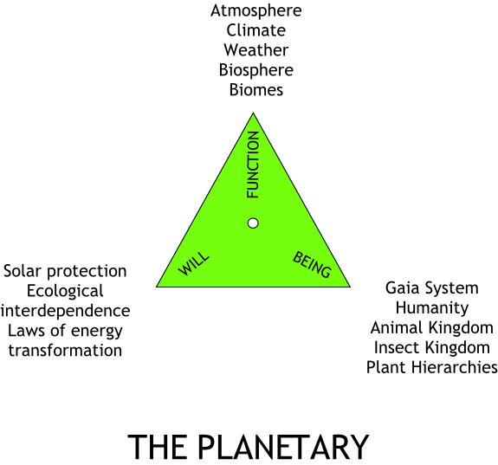
The Planetary Triad

Slide 34
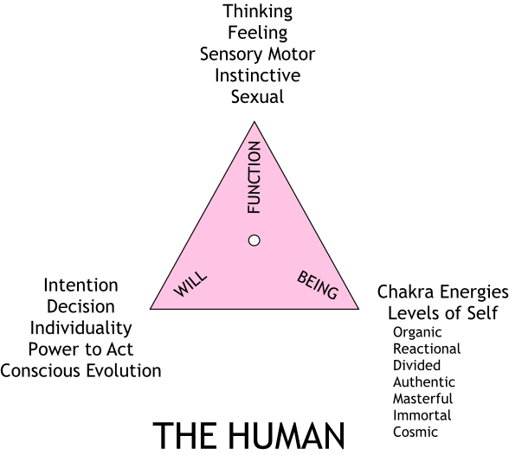
The Human Triad

Slide 35
Discussion Interlude 4
Share any specific are of interest that you hope the cosmic ecology will shed light on.
OPEN PLENARY

Slide 36
Conclusion
Crucial Thinking Tools

Slide 37
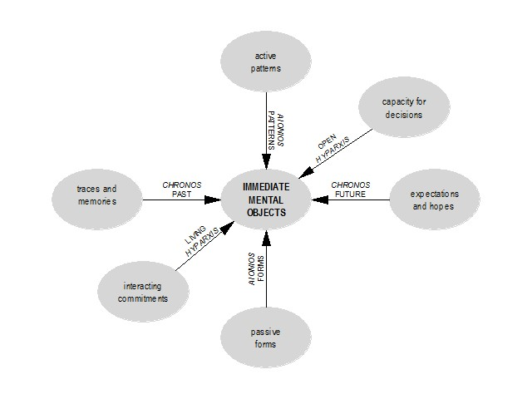
Stepping out of Space-time Limitations – the 7 Dimensions of experience

Slide 38
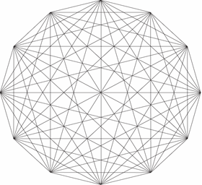
Seeing the Cosmos Through the Lens of Pattern Dynamics

Slide 39
Consciousness, Hazard and Intelligence – the DRAMATIC Universe
J.G.Bennett indicated that the presence of uncertainty and hazard are essential for there to be a consciousness that can exercise free will and responsibility. He affirmed that hazard is a fundamental correlating condition for intelligence.
No hazard, no intelligence.
The universe as intelligence requires the universe to be inherently uncertain as well as law conformable. Given the postulate of universal hologen as intelligent substance then the principle of uncertainty must be extended from the quantum level to be a property of the entire range of universal substance to absolute substance itself and its correlating property of qualtum systems.
Bennett, J.G., 1991, Hazard: The Risk of Realization, Bennett Books, Santa Fe, New Mexico

Slide 40
Cosmic Ecology END Module 1

