Slide 1
Tim’s Musings on Cosmic Ecology and Education CE Study Group 16/11/2022
How might four Tetrads of western philosophy help support the potentials unfolded in the Pentads of Cosmic Ecology?
How might the 12 Energies and 8 Cosmos Key to Reciprocal Maintenance help re-integrate and re-focus the philosophical Tetrads for educational purposes?

Slide 2
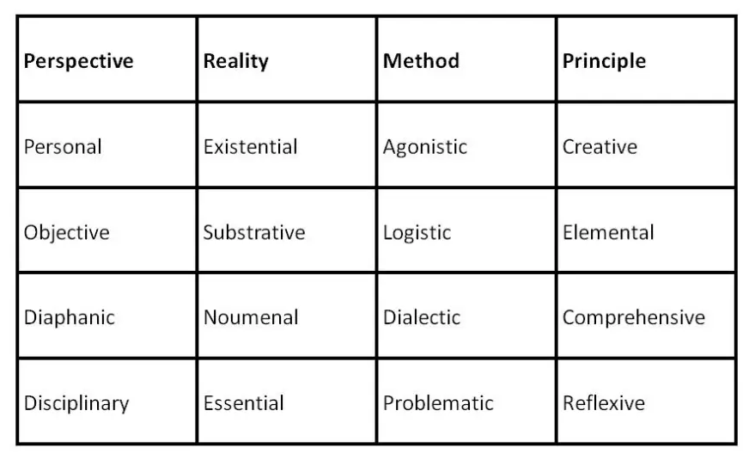
The Archic Matrix* of philosophical pluralism
Sophist
Democritean
Platonic
Aristotelian
* Derived from the collaborative work of Watson and Dilworth
Watson, Walter (1985). The Architectonics of Meaning: Foundations of the New Pluralism. University of Chicago Press.
Dilworth, David A. (1989). Philosophy in World Perspective a Comparative Hermeneutic of the Major Theories. Yale University Press.
Website that summarises Dilworth’s profiling of western and eastern philosophers/philosophies
https://www.ottobwiersma.nl/philosophy/archic_matrix.php

Slide 3

Tetradic Correlations
Bennett
Bennett-Hodgson
Bennett-Aristotle
Dilworth-Aristotle
Goal
Ideal Pattern
Formal Cause
Method
Instrument
Instrumental Capacity
Efficient Cause
Perspective
Direction
Directive Agency
Final Cause
Principle
Ground
Medium/Material Ground
Material Cause
Reality

Slide 4
Agonistic
Sophistic
Heuristic
paradoxical, contrasting concepts
Goal
Ideal Pattern
Formal Cause
Method
Instrument
Instrumental Capacity
Efficient Cause
Perspective
Direction
Directive Agency
Final Cause
Principle
Personal
Creative
subjective, idiocentric,
self-referent, I, we as exclusive group
volitional, making a difference in which the new replaces the old
Ground
Medium/Material Ground
Material Cause
Reality
vivid experience, immediately lived, historically contingent
Existential

Slide 5
Logistic
Democritean
Heuristic
computational, relating discrete (simple) units, mechanical
Goal
Ideal Pattern
Formal Cause
Method
Instrument
Instrumental Capacity
Efficient Cause
Perspective
Direction
Directive Agency
Final Cause
Principle
Objective
Elemental
impersonal, dispassionate, observing objects & effects, it
simple, self-same, repetitious,
recycling the same basic element, nature or essence
Ground
Medium/Material Ground
Material Cause
Reality
Invisible, material particles, vitalistic forces, underlying causes
Substrative

Slide 6
Dialectical
Platonic
Heuristic
sublational, synthetic unity of contrasts, emerging wholes
Goal
Ideal Pattern
Formal Cause
Method
Instrument
Instrumental Capacity
Efficient Cause
Perspective
Direction
Directive Agency
Final Cause
Principle
Diaphanic
Comprehensive
religious, witness to higher wisdom, revelation of absolute knowledge
all-embracing
hierarchically
encompassing
perfect form of the whole
Ground
Medium/Material Ground
Material Cause
Reality
transcending appearances, transphenomenal, supersensible, eternally perfect realm, ideal
Noumenal

Slide 7
Synoptic
Aristotelean Heuristic
problematic, analysis of features, whole and parts seen together as form and matter of the same holistic function
Goal
Ideal Pattern
Formal Cause
Method
Instrument
Instrumental Capacity
Efficient Cause
Perspective
Direction
Directive Agency
Final Cause
Principle
Disciplinary
Reflexive
community of inquiry, disciplinary and transdisciplinary
autonomously active self-completion of specific nature,
actualisation of variety of intrinsic functions
Ground
Medium/Material Ground
Material Cause
Reality
gradated patterns, functions and values, realizable in nature and experience
Essential

Slide 8
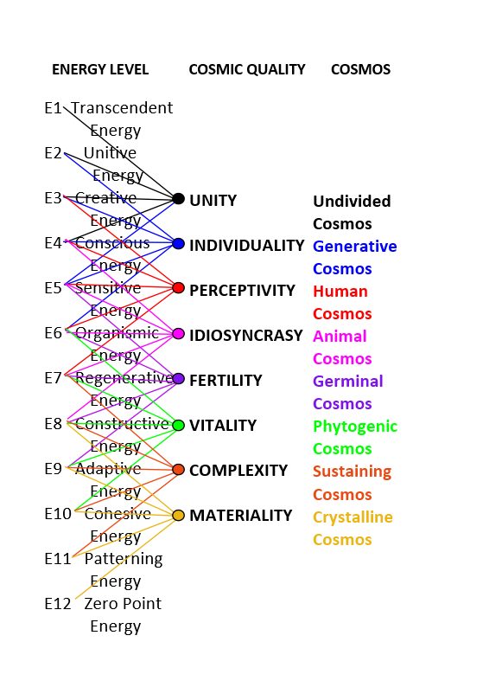

The Eight Cosmos Key to Reciprocal Maintenance
Inquiry 1
Platonic/Cosmic?
Sophistic/Vitalist?
Aristotelian/Integrative?
Democritean/Material?

Slide 9

The Ecologically Reflective Practitioner: Aristotelian/Heron* Focusing of 12 Energies
Inquiry 2
CONCEPTUAL MODE
Reflection
Platonic/Cosmic
Sophistic/Vitalist
Democritean/Material
E3 Creative Energy
E4 Conscious Energy
E7 Regenerative Energy
E8 Constructive Energy
E11 Patterning Energy
Discrimination
E12 Zero Point Energy
Imaginal Mode
Practical Mode
Intuition
Imagery
Action
Intention
E10 Cohesive Energy
Emotion
E9 Adaptive Energy
E6 Organismic Energy
E5 Sensitive Energy
E2 Unitive Energy
E1 Transcendent Energy
Feeling
Affective Mode
* Heron, John. (1992). Feeling and Personhood. Psychology in a Another Key. Sage

Slide 10
The Eight Cosmos Key to Reciprocal Maintenance
Inquiry 3
Philosophy as Caring for a particular Cosmos centred in a form of Energy
---- Platonic Heuristic centred in Creative Energy
---- Aristotelian Heuristic centred in Conscious Energy
---- Democritean Heuristic centred in Sensitive Energy
---- Sophist Heuristic centred in Organismic Energy

Slide 11
The Eight Cosmos Key to Reciprocal Maintenance
Inquiry 3
Philosophy as Caring for a particular Cosmos centred in a form of Energy
---- Platonic Philosophy centred in Creative Energy
---- Aristotelian Philosophy centred in Conscious Energy
---- Democritean Philosophy centred in Sensitive Energy
---- Protagorean Philosophy centred in Organismic Energy
Harmonising four modes of philosophy re-centred in their original energies.
Serving to re-integrate fragmented, reductive, absolutizing and opposing western ‘worldviews.’

Slide 12
The Eight Cosmos Key to Reciprocal Maintenance
Inquiry 4
Educational Philosophy as
Cosmic Caretaking
Contemplative Philosophy centred in Creative Energy – Platonic
Caretaker of the Undivided Cosmos and Crystalline Cosmos

Slide 13
The Eight Cosmos Key to Reciprocal Maintenance
Inquiry 4
Educational Philosophy as
Cosmic Caretaking
Generative Philosophy centred in Conscious Energy – Aristotelian
Caretaker of the Generative Cosmos and Sustaining Cosmos

Slide 14
The Eight Cosmos Key to Reciprocal Maintenance
Inquiry 4
Educational Philosophy as
Cosmic Caretaking
Empirical Philosophy centred in Sensitive Energy – Democritean
Caretaker of the Human Cosmos and Phytogenic Cosmos

Slide 15
The Eight Cosmos Key to Reciprocal Maintenance
Inquiry 4
Educational Philosophy as
Cosmic Caretaking
Vital Philosophy centred in Organismic Energy – Protagoras (Shamanic/Animist?)
Caretaker of the Animoid and Germinal Cosmos

Slide 16
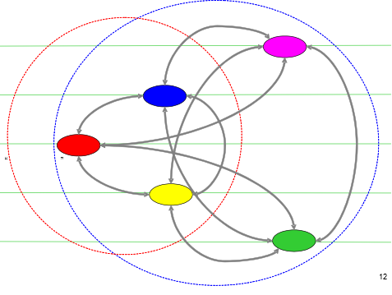

Contemplative Education For Co-creative Humanity and the Undivided Cosmos
Inquiry 5
Transcendent Energy
Unitive Energy
UNDIVIDED
Creative Energy
GENERATIVE
Conscious Energy
HUMANOID
ANIMOID
Sensitive Energy
Undivided Cosmos
Energy Transformation System
FERTILE
PHYTOGENIC
Contemplative Education in Creative Energy
Noumenal Reality
Diaphanic Perspective
Dialectical Method
Comprehensive Principle
Dilworth (1989) & Watson (1985)
SUSTAINING
CRYSTALLINE
Notes:
THE TRUE HUMAN COSMOS OPERATES AT THE NEXT UP SET OF LEVELS
THIS REQUIRES CULTIVATION OF POSITIVE EMOTIONS, SERVICE AND WISDOM
IT REQUIRES TO LOVE TO REALEASE THE NEEDED CREATIVITY

Slide 17
Generative Education For Conscious Humanity and the Generative Cosmos
Inquiry 5
Unitive Energy
Creative Energy
UNDIVIDED
GENERATIVE
Conscious Energy
HUMANOID
ANIMOID
Sensitive Energy
FERTILE
Regenerative Energy
Generative Cosmos
Energy Transformation System
PHYTOGENIC
SUSTAINING
Generative Education in Conscious Energy
Essential Reality
Disciplinary Perspective
Synoptic Method
Reflexive Principle
Dilworth (1989) & Watson (1985)
CRYSTALLINE
Notes:
THE TRUE HUMAN COSMOS OPERATES AT THE NEXT UP SET OF LEVELS
THIS REQUIRES CULTIVATION OF POSITIVE EMOTIONS, SERVICE AND WISDOM
IT REQUIRES TO LOVE TO REALEASE THE NEEDED CREATIVITY

Slide 18
Empirical Education For Sensitive Humanity and the Humanoid Cosmos
Inquiry 5
Creative Energy
UNDIVIDED
Conscious Energy
GENERATIVE
HUMANOID
Sensitive Energy
ANIMOID
FERTILE
Regenerative Energy
PHYTOGENIC
Organismic Energy
Humanoid Cosmos
Energy Transformation System
SUSTAINING
CRYSTALLINE
Empirical Education in Sensitive Energy
Substrative Reality
Objective Perspective
Logistic Method
Elemental Principle
Dilworth (1989) & Watson (1985)
Notes:
THE TRUE HUMAN COSMOS OPERATES AT THE NEXT UP SET OF LEVELS
THIS REQUIRES CULTIVATION OF POSITIVE EMOTIONS, SERVICE AND WISDOM
IT REQUIRES TO LOVE TO REALEASE THE NEEDED CREATIVITY

Slide 19
Vital Education For Regenerative Humanity and the Animoid Cosmos
Inquiry 5
UNDIVIDED
GENERATIVE
Conscious Energy
HUMANOID
Sensitive Energy
ANIMOID
Regenerative Energy
FERTILE
PHYTOGENIC
Organismic Energy
SUSTAINING
Adaptive Energy
Animoid Cosmos
Energy Transformation System
CRYSTALLINE
Vital Education in Regenerative Energy
Existential Reality
Personal Perspective
Agonistic Method
Creative Principle
Dilworth (1989) & Watson (1985)
Notes:
THE ANIMOID COSMOS IS AN ESSENTIAL TRANSFORMER IN THE COSMIC SCHEME
IN EVOLUTIONARY TERMS HUMANITY IS LARGELY STUCK AT THIS LEVEL
THIS WAY OF LIFE IS DESTRUCTIVE BECAUSE IT DOES NOT DEVELOP THE WISDOM TO USE OUR SCEINTIFIC AND TECHNOGICAL POWER IN A HARMONIOUS WAY

Slide 21
