Slide 1
Images of Qualsystems
Octad
Septad
Hexad
Pentad
Tetrad
Triad
Dyad
Monad
Nullad
Ali and Anthony Hodgson
May 2021

Slide 2
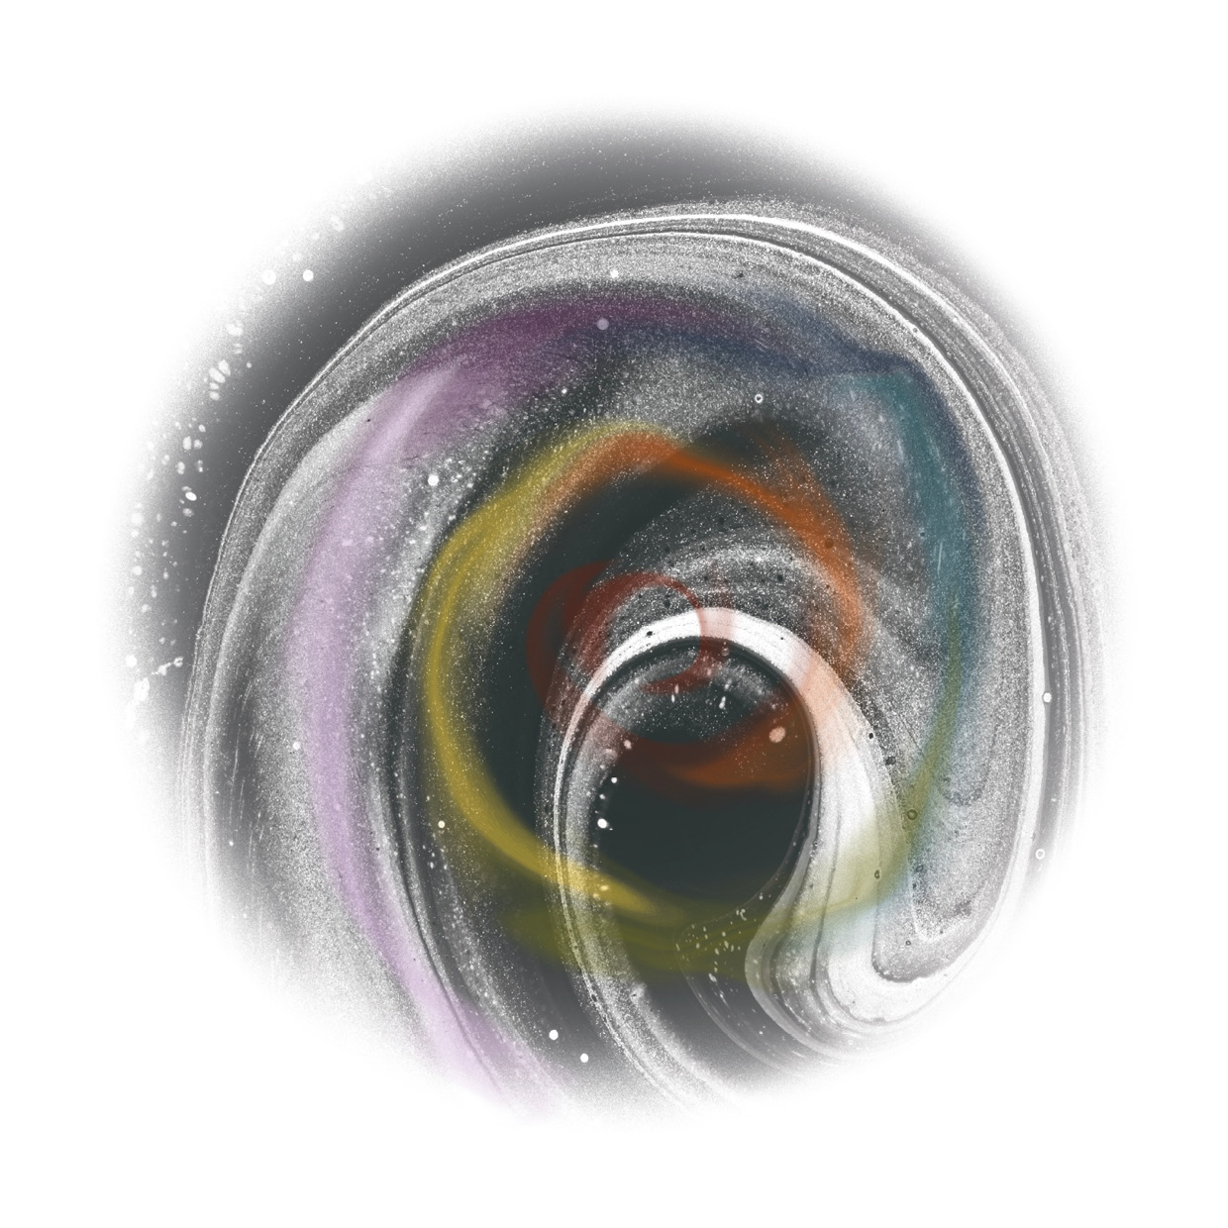
MOOD SETTING NULLAD
Ali Hodgson
© 2021 Ali Hodgson

Slide 3
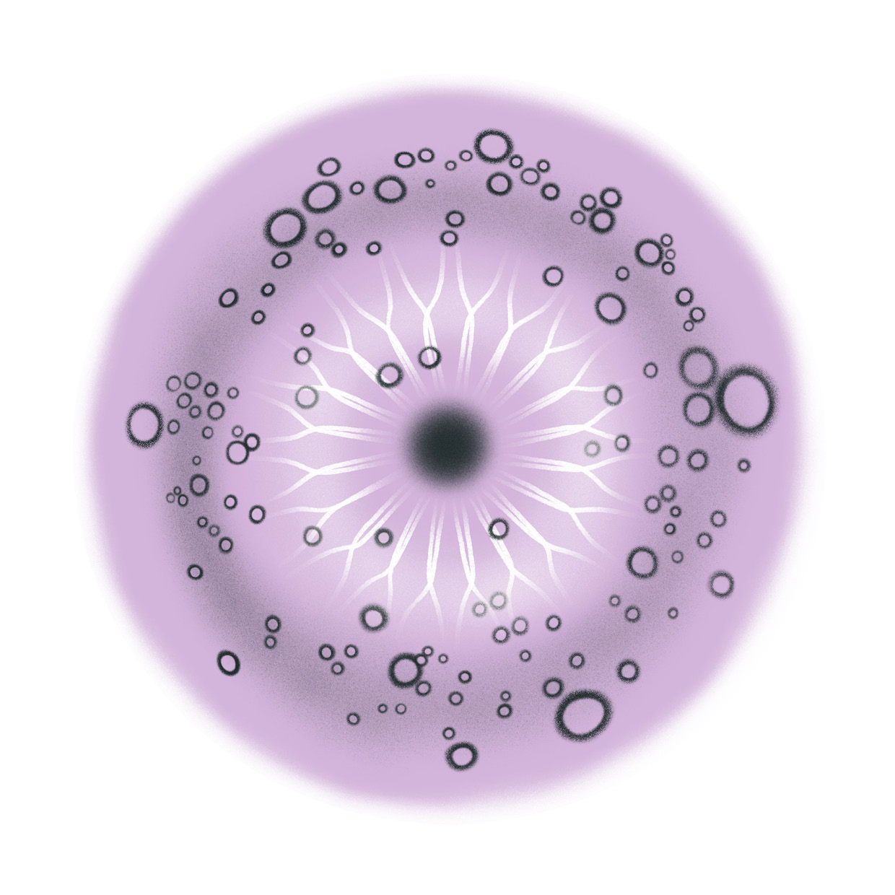
MOOD SETTING MONAD
Ali Hodgson
© 2021 Ali Hodgson
3

Slide 4
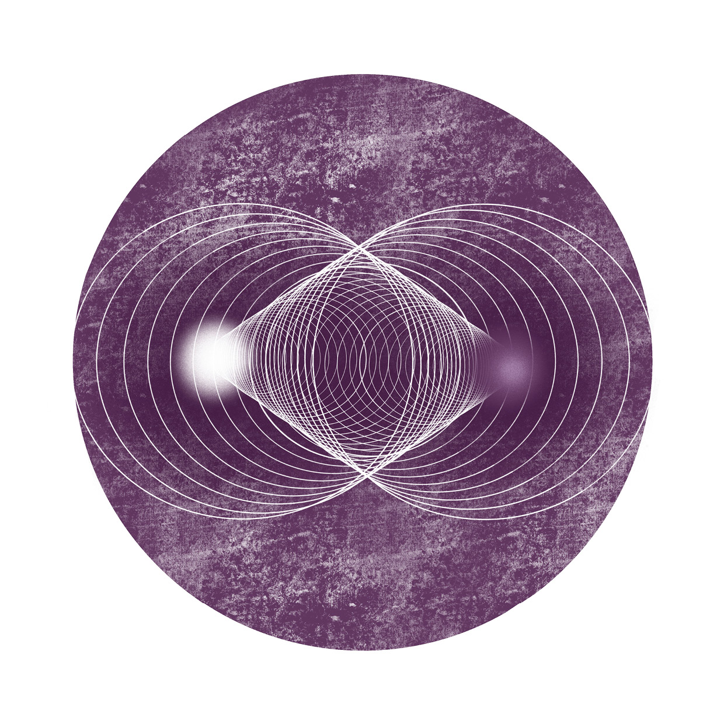
MOOD SETTING DYAD
Ali Hodgson
4
© 2021 Ali Hodgson

Slide 5
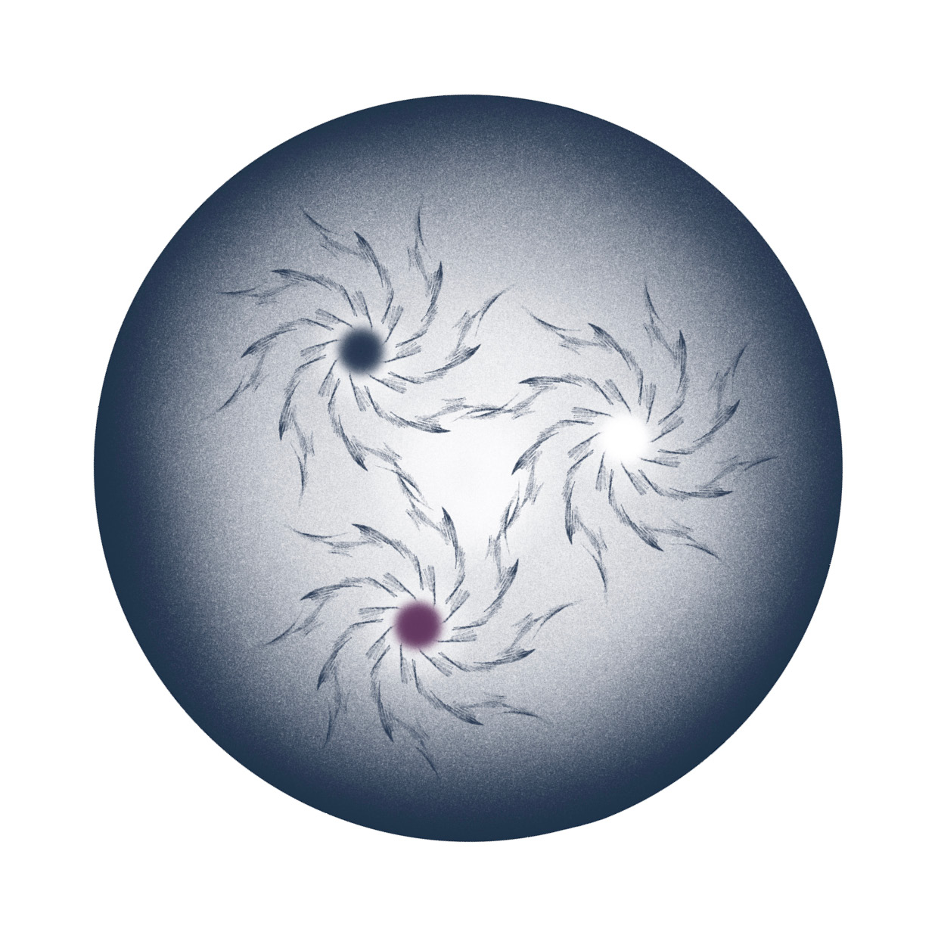
MOOD SETTING TRIAD
Ali Hodgson
© 2021 Ali Hodgson
5

Slide 6

MOOD SETTING TETRAD
Ali Hodgson
© 2021 Ali Hodgson
6

Slide 7
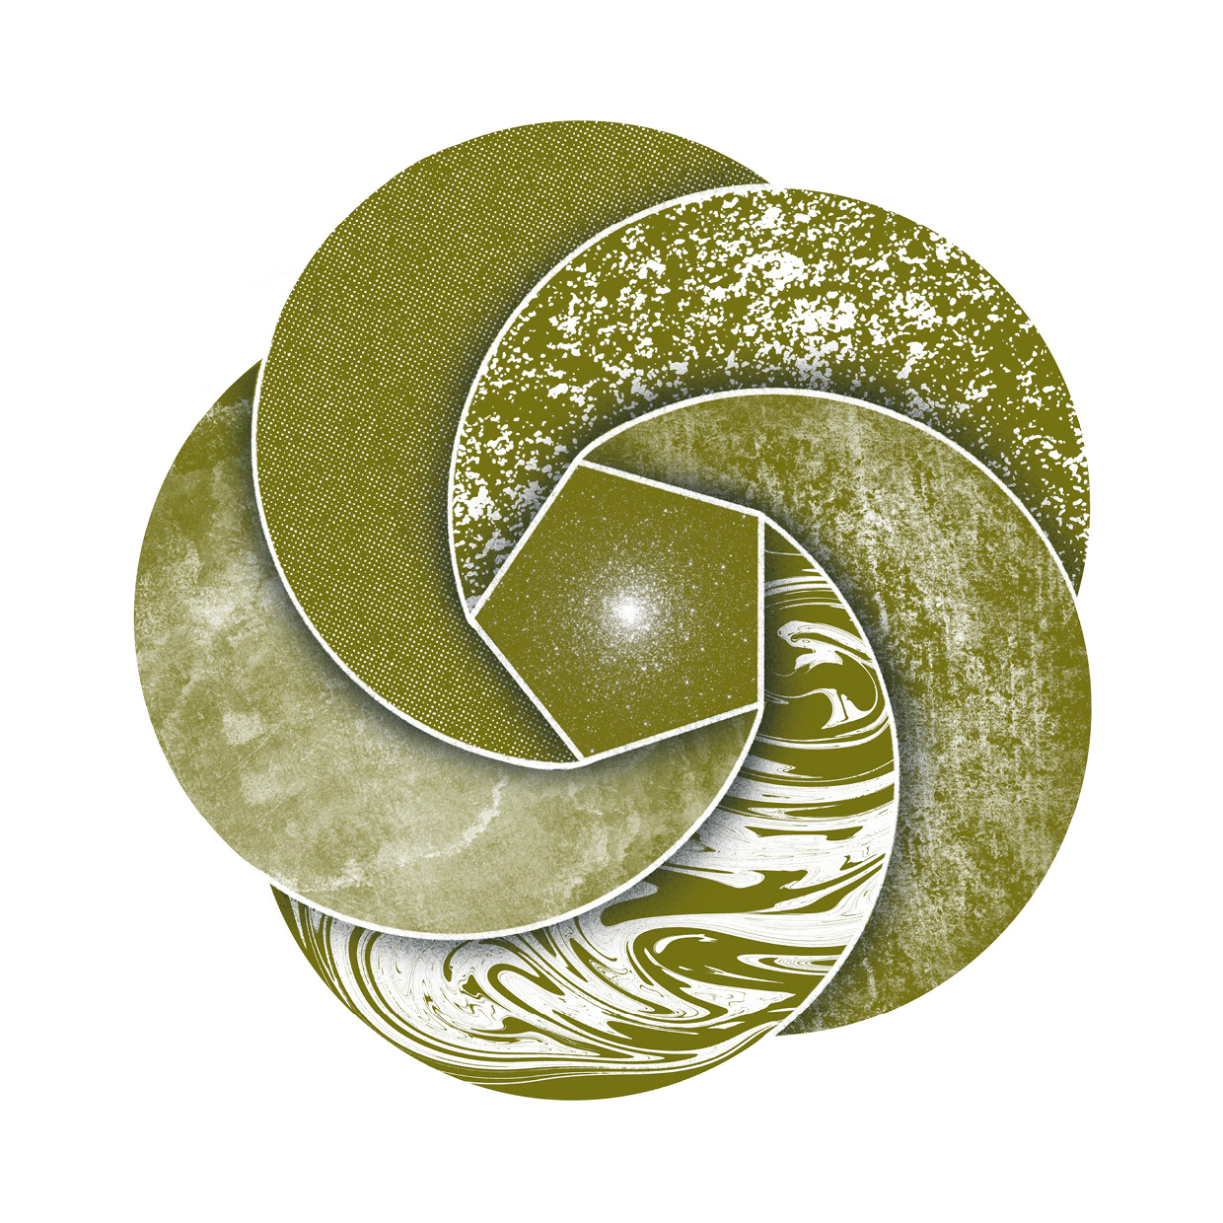
MOOD SETTING PENTAD
Ali Hodgson
© 2021 Ali Hodgson
7

Slide 8

MOOD SETTING HEXAD
Ali Hodgson
© 2021 Ali Hodgson
8

Slide 9
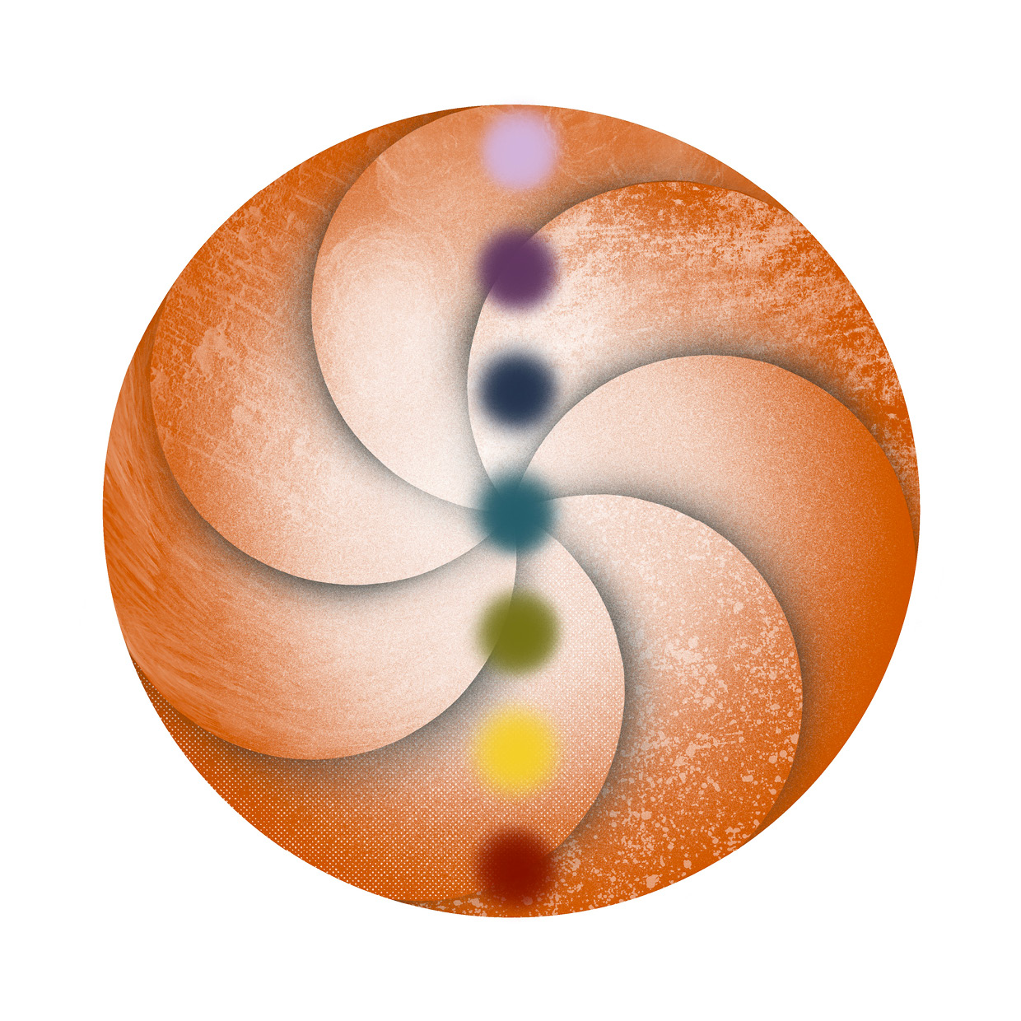
Ali Hodgson
© 2021 Ali Hodgson

Slide 10
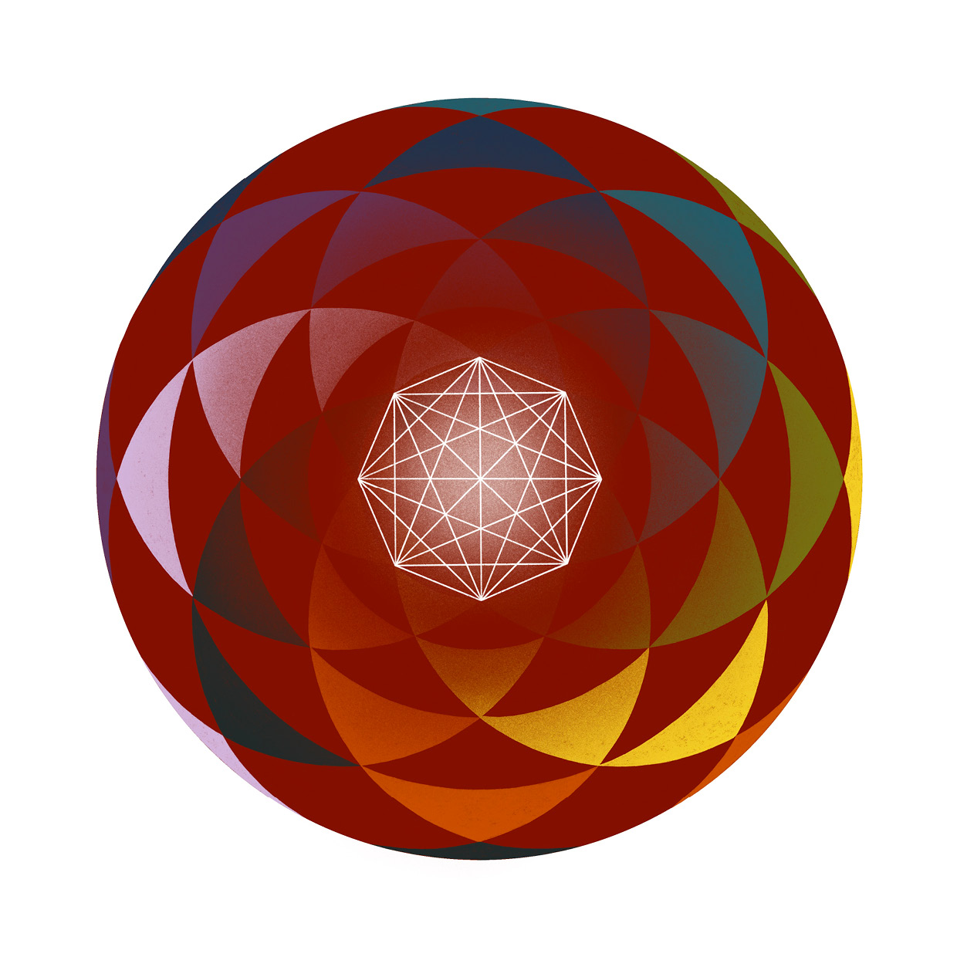
Ali Hodgson
© 2021 Ali Hodgson

