Slide 1


Busk Ltd.
Social Music Discovery Engine
Josh Fairhead – 21057665
Darren Jennings – 20256232
Miguel de Campos- 20267289
Ross Drysdale - 20274284

Slide 2
Executive Summary
Busk is a social music discovery tool and direct to fan platform.
It’s a multifunction service that concentrates on independent music for artists, fans and labels offering artist/label support, legal music sharing, streaming, distribution and discovery.

Slide 3
Mission Statement
Traditional busking shows that people are happy to support good music in a small way. The sudden upheaval of the music industry due to the internet has left few viable ways of earning a living from music. Our aim is to bring traditional busking to a larger audience through the internet to the benefit of all involved.

Slide 4
Busk is for:
Music fans
Artists
Labels

Slide 5
Music fans unhappy with:
Ways of discovering new music
(Lamere+ Volodkin 2009)
Ways to legally share music (Digital Trends 2009)
Ways to support artists they like
(survey in appendix)

Slide 6
Artists who are unhappy with:
Traditional business models (Masnick 2010)
Their current connectivity with fans (Ibid)
The current difficulties of gaining exposure (Ibid)

Slide 7
Labels who are unhappy with:
Unviable distribution methods and legal complications in respect to copyright (Torrent freak 2009)
The current issues monitoring fan base and trends (Masnick 2010)
The current difficulties of independent artist promotion (Ibid)

Slide 8
What is Busk?
Music fans:
On-demand independent music streaming service focused on discovery and sharing
Artist/Labels:
Online distribution channel direct to profiled listeners

Slide 9




Proof of concept
: Recommendation API for license
: The music industries new internet problem
: Flattr micropayments
: Connect with fans + Reason to buy case
study
Artist Magnus Uggla claimed about royalty payments from Spotify that he “earned as much in six months as a BUSKER could earn in a day.” (Torrent freak 2009)

Slide 10
Busk benefits for:
Music fans
Artists
Labels

Slide 11
Busk for music fans
Intelligent music discovery service
Legal music sharing and rating tool
Options to support artists and labels through micropayments

Slide 12
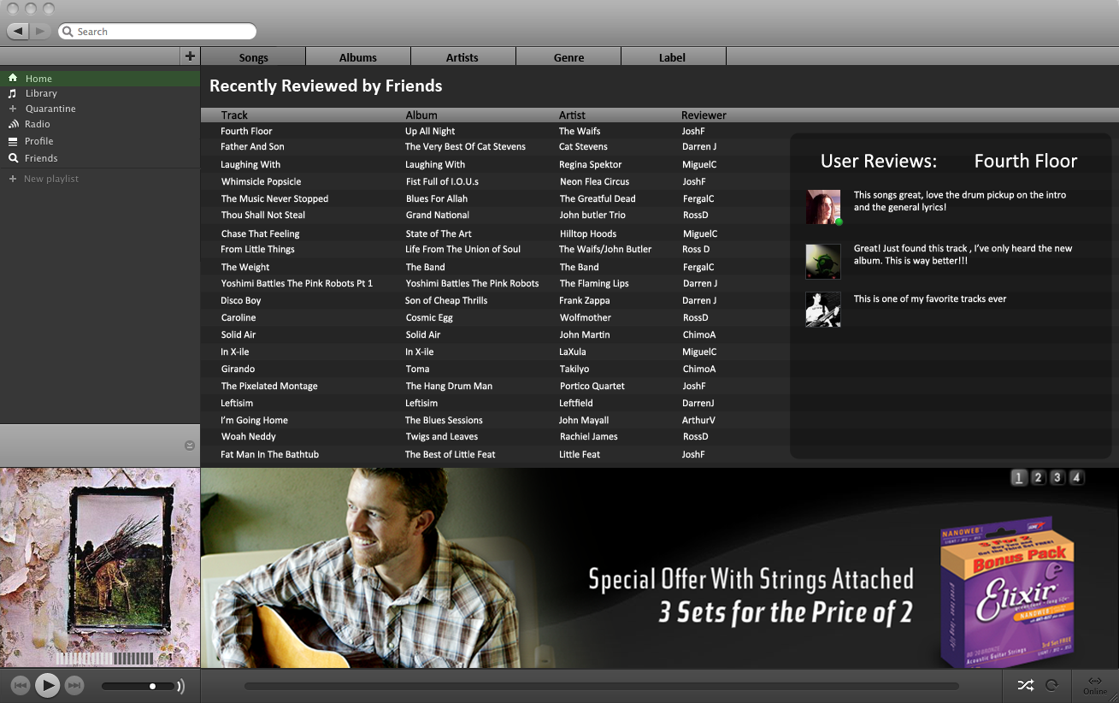

Slide 13
Busk for artists/labels
Cost effective open distribution channel
A way of connecting with interested fans and receiving feedback
Alternative revenue source

Slide 14
Shares important features with
Deezer – Music streaming
Plugola – Social independent music community
mTraks – Independent music streaming
Last.fm – Social music streaming
Stumbleupon – Social discovery tool

Slide 15
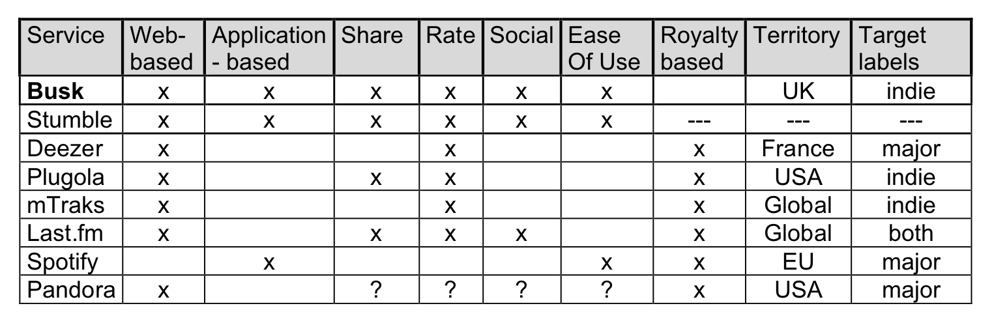

Slide 16
A more complete product offering:
Heavily personalised discovery
Intelligent library and sorting features
Legal sharing
Micropayments
Industry networking
Viral promotion

Slide 17
Initial stages strategy
Make agreements with copyright owners for content (mTracks 2007)
Development and establishment of a small user base during beta testing
Research on existing user base

Slide 18
Promotion
Viral advertising (e.g. stumbleupon).
Possible collaboration with ISP.
Fundraisers and events.
Through established relationships with artists, labels and their fans.
Website.
Offers and promotions (e.g. gift subscriptions)

Slide 19
Revenue sources
General advertising
Targeted advertising
Artist/Label targeted promotions
Premium and gift accounts

Slide 20

Expenditure:
Programming and maintenance
Hosting and streaming (£6.95 p/m)
Associated business costs

Slide 21
Startup capital
DTI small project grant (Initiatives)
EU 7th framework programme grant (EU Commission 2007-13)
Enterprise guarantee scheme (BIS 2009)
Private investment

Slide 22
Future Plans
Properly establish service
Attract more advertisers
Increase catalogue
Increase user base
Expand service features
Download store
Lossless audio

Slide 23
Any questions?

Slide 24
References
BIS (2009) http://www.berr.gov.uk/whatwedo/enterprise/finance/efg/page37607.html
Business week (2009) http://www.businessweek.com/technology/content/mar2009/tc2009035_000194.htm
Digital Trends (2009) http://www.digitaltrends.com/lifestyle/uk-music-piracy-falls-streaming-rises/
EU Commission (2007-13) http://cordis.europa.eu/fp7/understand_en.html
HSBC (2010) http://www.hsbc.co.uk/1/2/business/finance-borrowing/flexible-business-loan;jsessionid=0000ZRvCmcXYL1bbV_HUsGojMtz:14et5lljg
Initiatives: http://www.innosport.eu/docs/Natonal_Initiatives_UK.pdf
Lamere+ Volodkin (2009) http://musicmachinery.com/2009/03/26/help-my-ipod-thinks-im-emo-part-1/
Masnick. M (2010) http://www.youtube.com/watch?v=Njuo1puB1lg
mTracks ( 2007) Terms of service. http://www.mtraks.com/page/terms_of_service
Torrent freak (2009) http://torrentfreak.com/id-rather-be-raped-by-pirate-bay-than-go-with-spotify-090813/

Slide 25
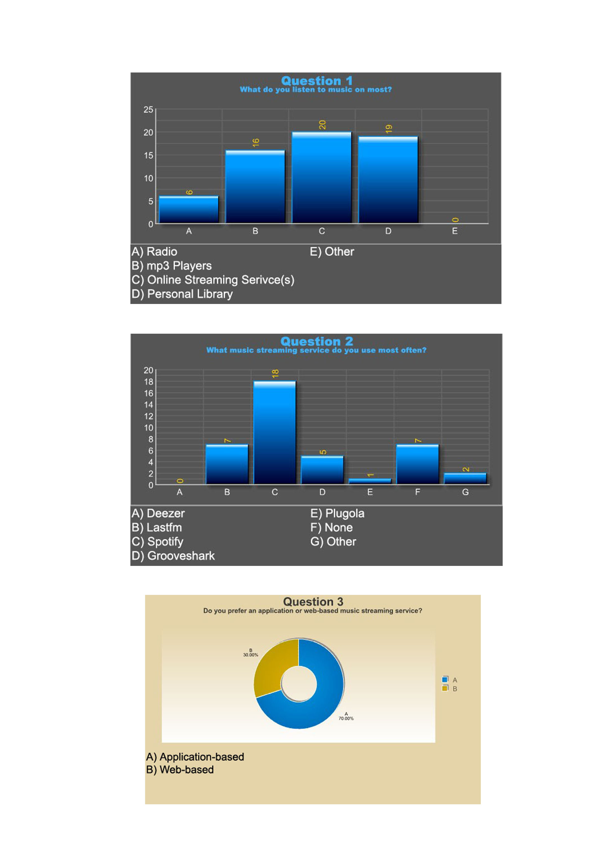
Appendix

Slide 26
Appendix

Slide 27
Appendix

Slide 28
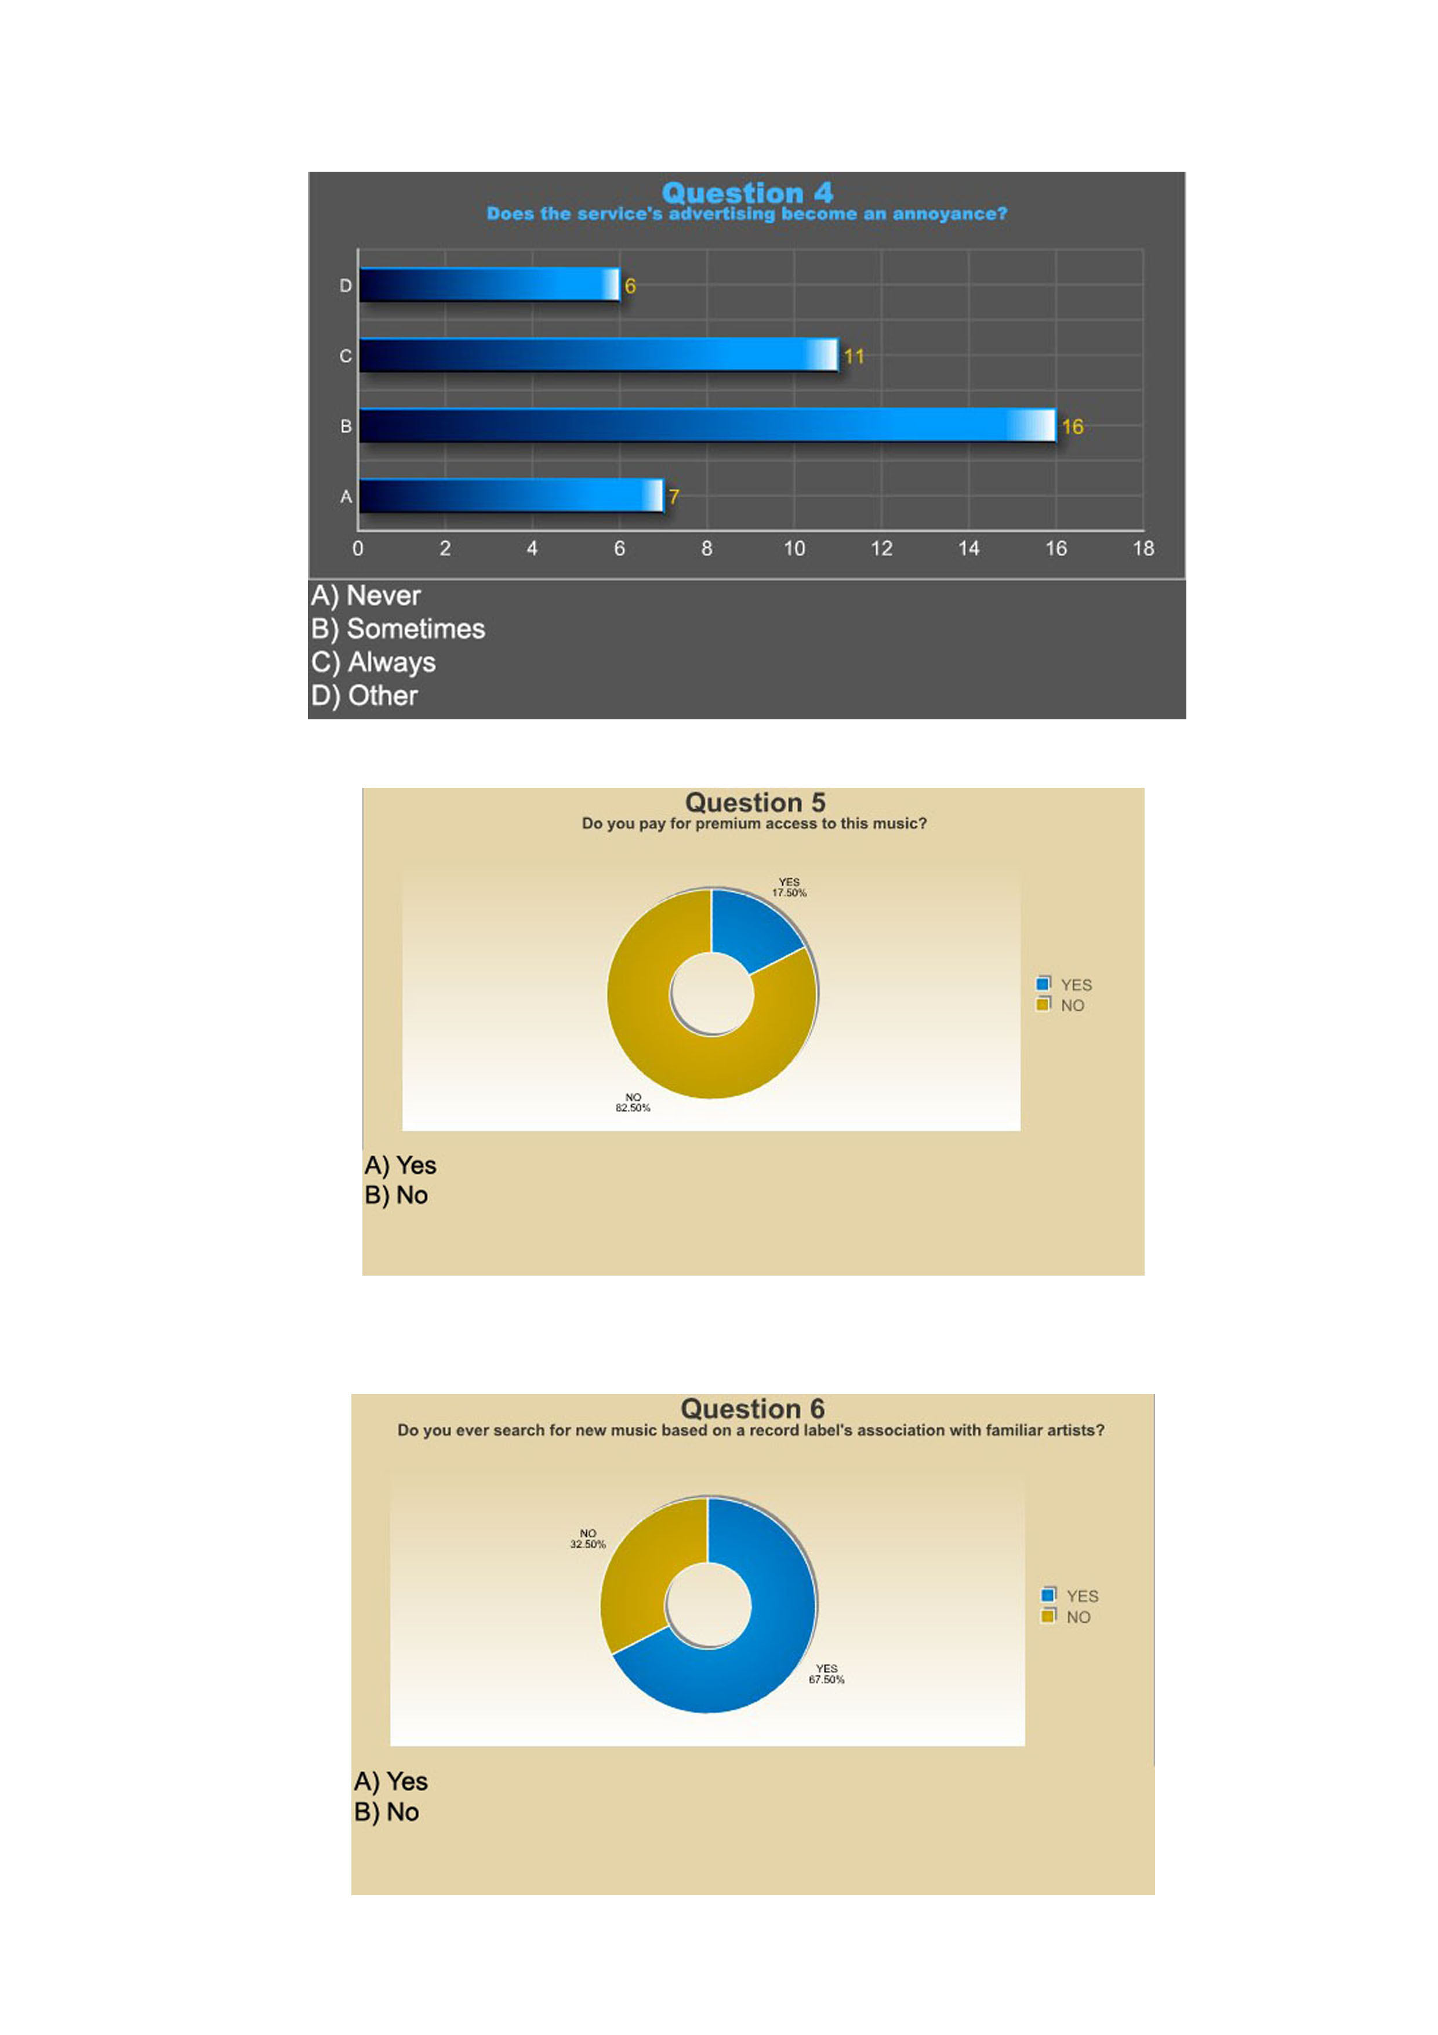
Appendix

Slide 29
Appendix

Slide 30
Appendix

Slide 31
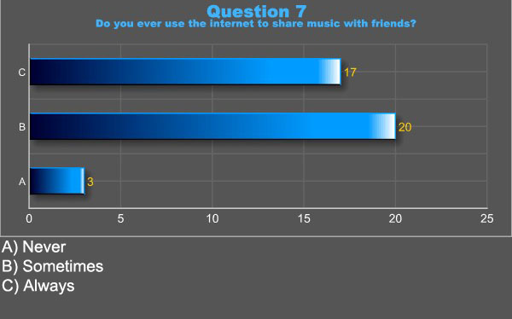
Appendix

Slide 32
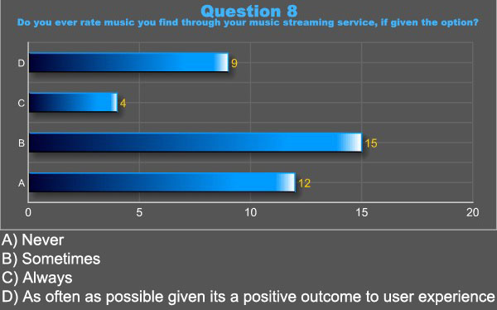
Appendix

Slide 33
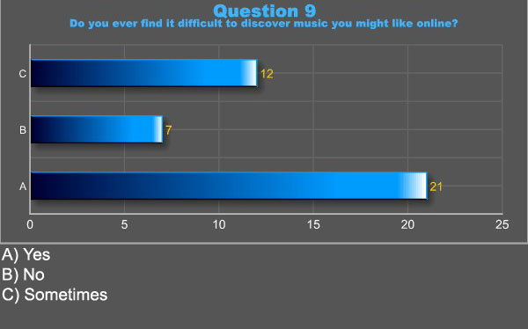
Appendix

Slide 34
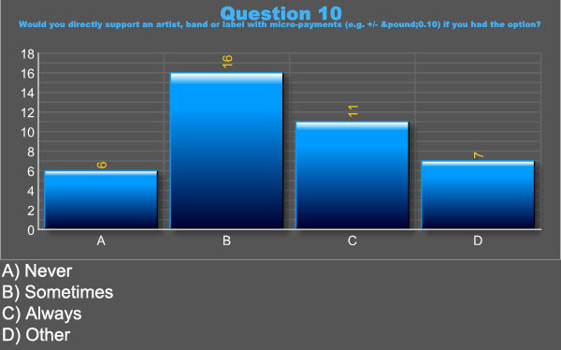
Appendix

Slide 35
Appendix (S.W.O.T.)
Strengths:
Growing service area & marketplace of music streaming
Aimed at untapped area of market with independent artist & labels
Service appeals to wide range of users, not just general listeners

Slide 36
Appendix (S.W.O.T.)
Weaknesses:
Large marketplace where business establishment can be difficult
Current issues regarding internet distribution & royalties for music
Economic climate could present some financial problems

Slide 37
Appendix (S.W.O.T.)
Opportunities:
Change in public’s access of music from ‘physical’ purchases to streaming
Continuous growth in amount of independent music being created & the need to promote it
Music industry’s issues with illegal music downloads

Slide 38
Appendix (S.W.O.T.)
Threats:
Unpredictable economic conditions & their financial effect on business
Public users still opting to illegally attain music without support for the artist
Difficulties related to copyright ownership if user doesn’t understand agreement terms

Slide 39
Appendix (P.E.S.T.)
Political:
Government schemes & grants designed to support technological business enterprises
Laws regarding copyright & music distribution are currently a hot topic

Slide 40
Appendix (P.E.S.T.)
Economical:
Current economic ‘depression’ could pose as a problem to the business
Small economic costs involved in IT based services

Slide 41
Appendix (P.E.S.T.)
Sociological:
Public’s movement towards music streaming and legal sharing methods
Ever increasing number of people gaining access to and heavily using the internet

Slide 42
Appendix (P.E.S.T.)
Technological:
Internet computing and services constantly in development for better solutions & lower running costs
Increasing numbers of artists looking to internet technology & promotion of their music

