Slide 1
“Project Vector”

Slide 2
Original Proposal
“Project Vector”
2D platformer with fast paced movement
Player navigates through obstacles and puzzles by manipulating gravity
Player movement mechanics: Jump, Grappling Hook, Short Blink

Slide 3
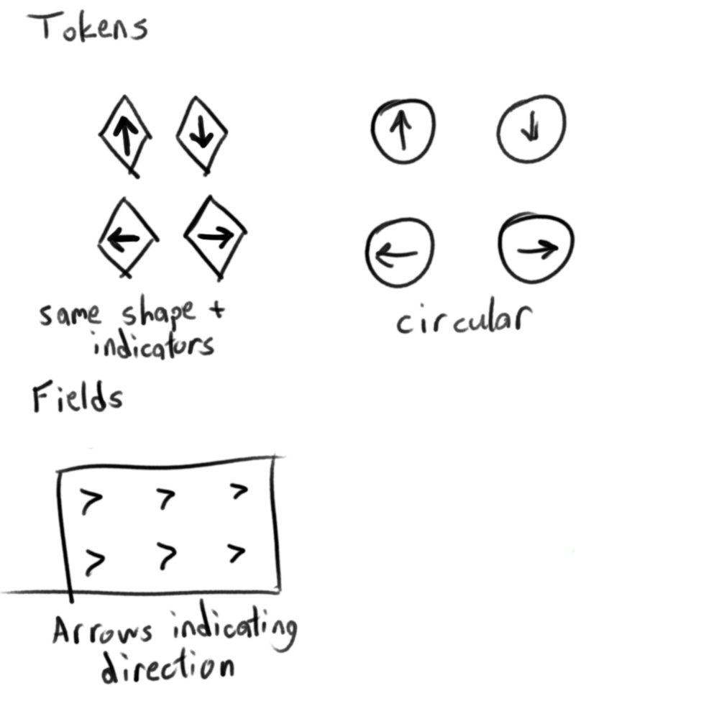
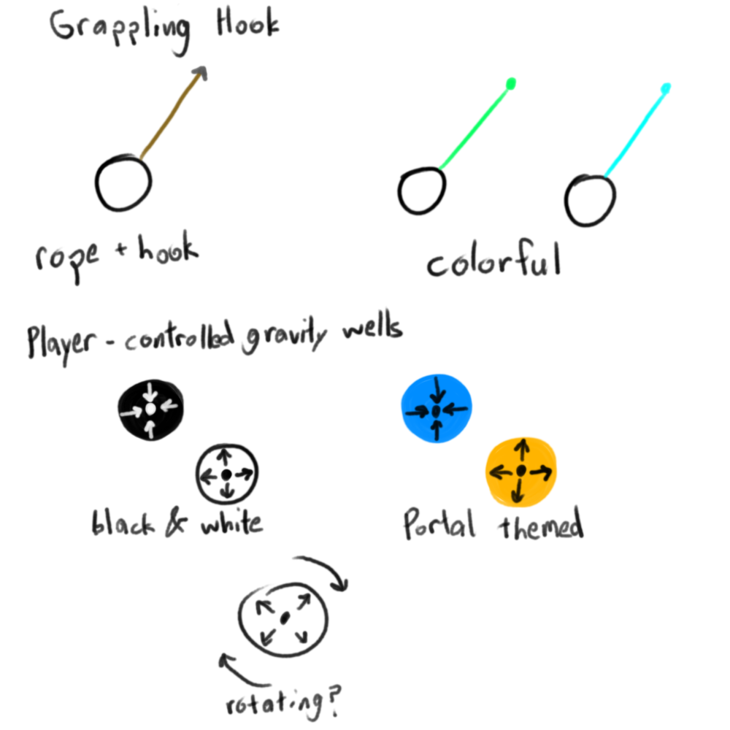
Original concept art

Slide 4
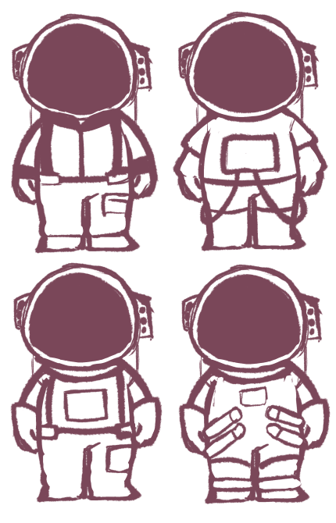
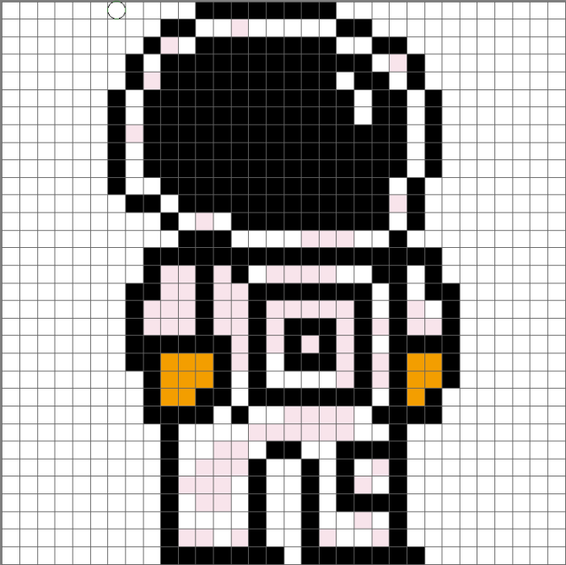
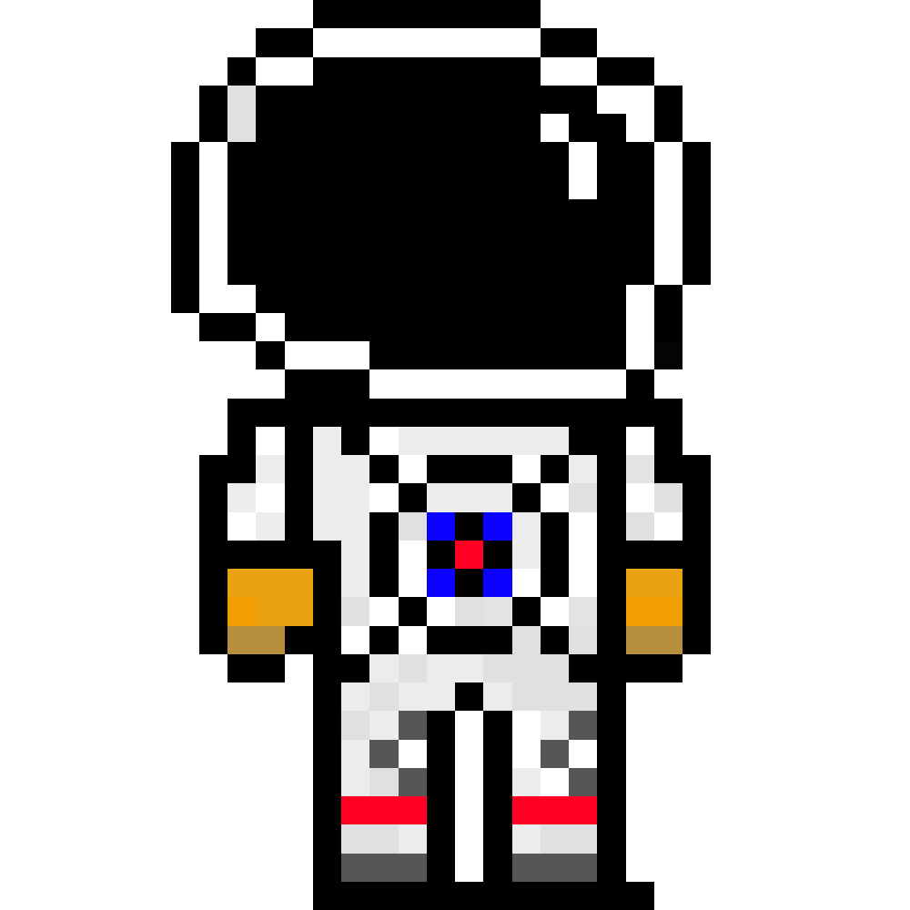
Art Updates: Character
New sprite added for the playable character

Slide 5
Gravity Mechanics
Gravity Swap Tokens
changes the orientation of the player’s gravity
Gravity Manipulation Zones
adds force in a particular direction based on the fields’ type
Anti-Gravity Zones
halts the player’s gravity while inside allowing player to float freely
Orbit Points
the player enters orbit around the point upon button-press and is released in a direction tangent to the orbit upon button-release

Slide 6
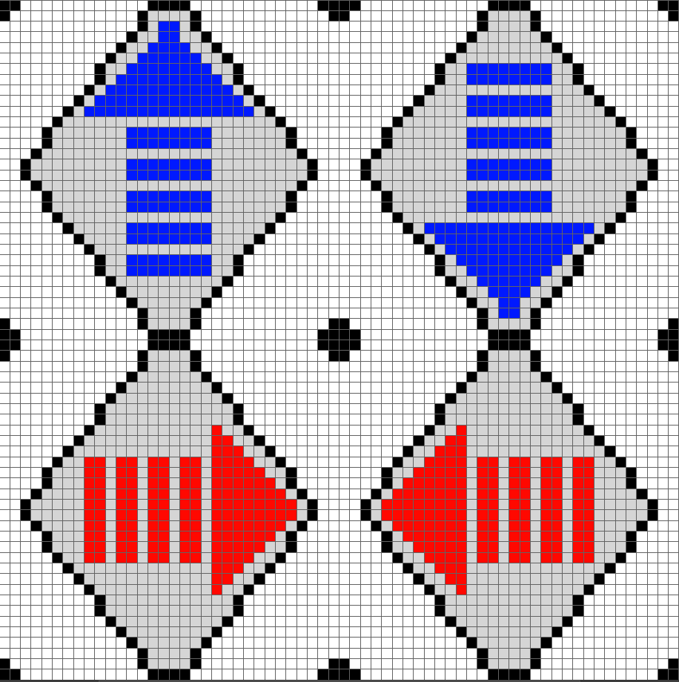
Gravity Swap Tokens

Slide 7
Movement Mechanics
WASD controls
Grappling Hook
Usable at Grapple Points
Short Blink
Maintains momentum
Resets on landing/pickup
Standard Jump

Slide 8
Puzzle Design
Players will utilize their tools to overcome obstacles and reach objectives
EX: Player changes gravity to preserve momentum, while changing direction to cross gap
Some paths may only be accessible with specific gravity orientation
EX: A door could slide open when gravity is flipped
Certain objects in the environment may react to player gravity changes
EX: Puzzle blocks/intractable points slide into place
The goal is to come up with new ways to test the player’s problem solving skills through coming up with more challenging levels
EX: Including unnecessary gravity swap tokens to confuse the player

Slide 9
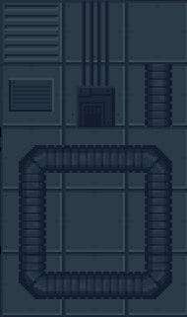
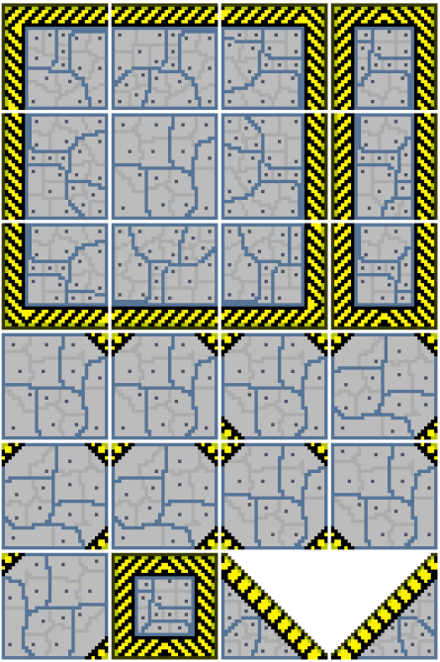
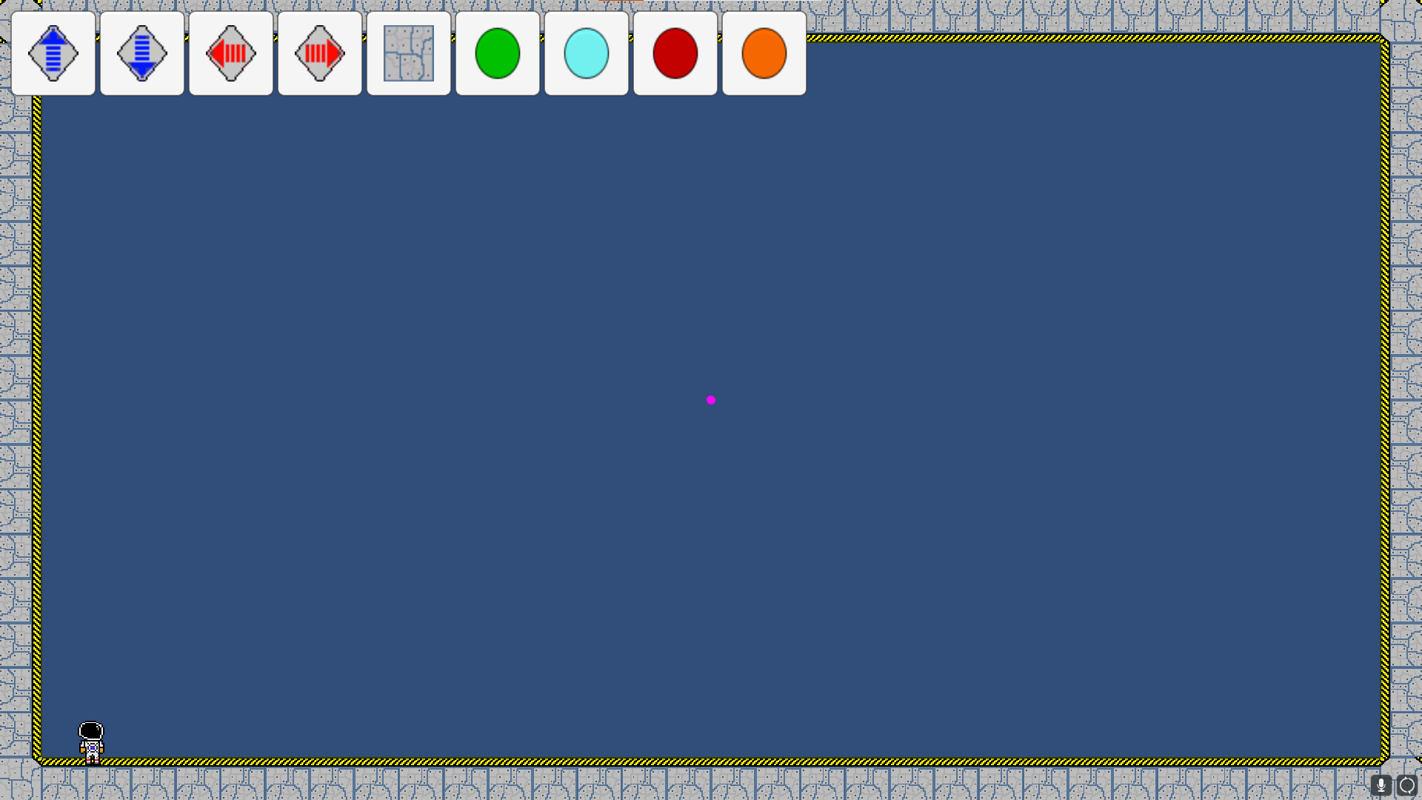
Level Editor
Gravity-altering mechanics meets sandbox style level editor
Allows user created levels

Slide 10
Moving Forward with “Project Vector”
My group was interested in furthering the game through:
Designing more textures for both the gameplay and level editor
Test playing new level ideas
Further developing Level Editor
Possible enemy encounters
Deepening puzzle elements

Slide 11
GAME DEMO

