Slide 1

Spam Classifier using NLP

Slide 2
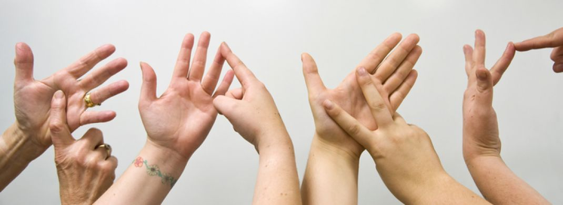
Real Time Sign Language Detection using Image Processing

Slide 3

Music Analysis and Recommendation

Slide 4

Automated Attendance System using Face Recognition

Slide 5

Visualizations in Tableau

