Slide 1
AI · EDUCATION · CAREER
AI Career
Navigator
An Intelligent AI-Powered Career Guidance and Skill Recommendation System
Presented by: [Your Name] · B.Tech Artificial Intelligence and Machine Learning — 2nd Year · [Your College Name]

Slide 2




2
THE CHALLENGE
The Career Confusion Challenge
Career opportunities
Learning resources
Career roadmap
Students often have limited awareness of career opportunities after graduation.
Job requirements, learning resources, and certifications are difficult to connect.
Academic qualifications do not automatically translate into a clear career roadmap.
Target users: Degree, B.Tech, MCA, and MBA students.
Core problem: students need personalized, accessible, practical guidance based on education, skills, and goals.

Slide 3




3
THE PLATFORM
Introducing AI Career Navigator
An intelligent platform that analyzes educational background, skills, interests, and career goals to recommend relevant opportunities and personalized learning plans.
From career confusion to a clear, personalized action plan.
AI career chatbot
Personalized career recommendations
Career roadmap generation
Skill-gap analysis
Learning resources plus resume and portfolio guidance

Slide 4




4
ONE PLATFORM · MANY PATHS
Degree
B.Tech
Software development, data analytics, business analysis, digital marketing, and pathways shaped by specialization and skills.
AI/ML engineering, software development, data engineering, and cloud computing.
Designed for Every Student’s Career Journey
MCA
MBA
Recommendations depend on qualifications, skills, interests, and role requirements.
Software engineering, AI/ML, data science, application development, and IT careers.
Business analytics, finance, marketing, human resources, and product management.

Slide 5






5
THE TOOLKIT
Intelligent Features That Make a Difference
Each module turns a student question into a practical next step.
AI Career Chatbot
Smart Career Matcher
Skill Gap Analyzer
Natural-language answers to career questions.
Transparent matching logic based on the student profile.
Compares current skills with a selected career’s requirements.
Personalized Roadmap
Career Explorer
Resume and Project Advisor
Turns missing skills into stages, milestones, and projects.
Shows roles, qualifications, and required skills.
Supports portfolio and internship preparation.

Slide 6
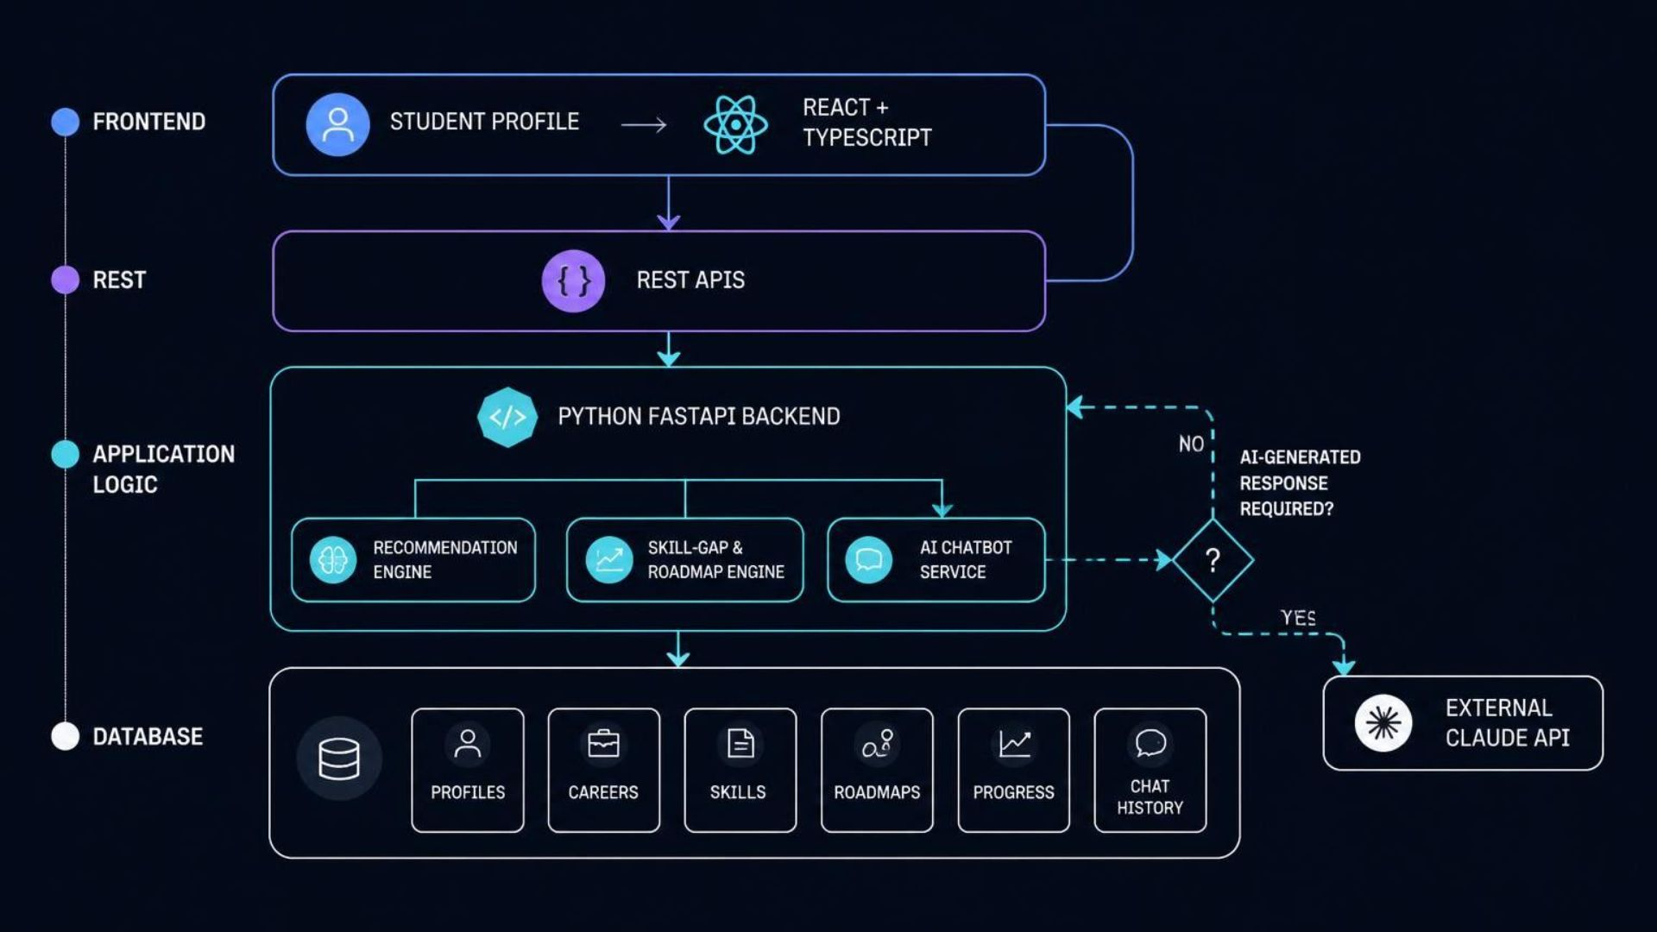
6
TECHNOLOGY ARCHITECTURE
How AI Career Navigator Works
A layered AI system connects student data, application logic, and personalized output.
Stack: React, TypeScript, Tailwind CSS · Python, FastAPI, Pydantic · SQLAlchemy · SQLite prototype with PostgreSQL as a future option · Git and GitHub.

Slide 7





7
The Intelligence Behind the System
Application logic handles matching and gap calculations; Claude assists with natural-language understanding when required.
Rule-based career matching
Skill-gap analysis
Qualification, interest, skill, and eligibility matching with explainable recommendations.
Compares current and required skills, then prioritizes learning tasks.
Claude API integration
Structured career knowledge
Understands natural-language questions and assists with explanations and learning plans.
Stores career descriptions, qualifications, skills, and resources for consistent retrieval.
Student profile
Career matching
Skill-gap identification
AI-assisted roadmap
Actionable recommendations
The initial version uses an existing AI model through an API plus a custom recommendation engine; it does not train a large language model from scratch.

Slide 8
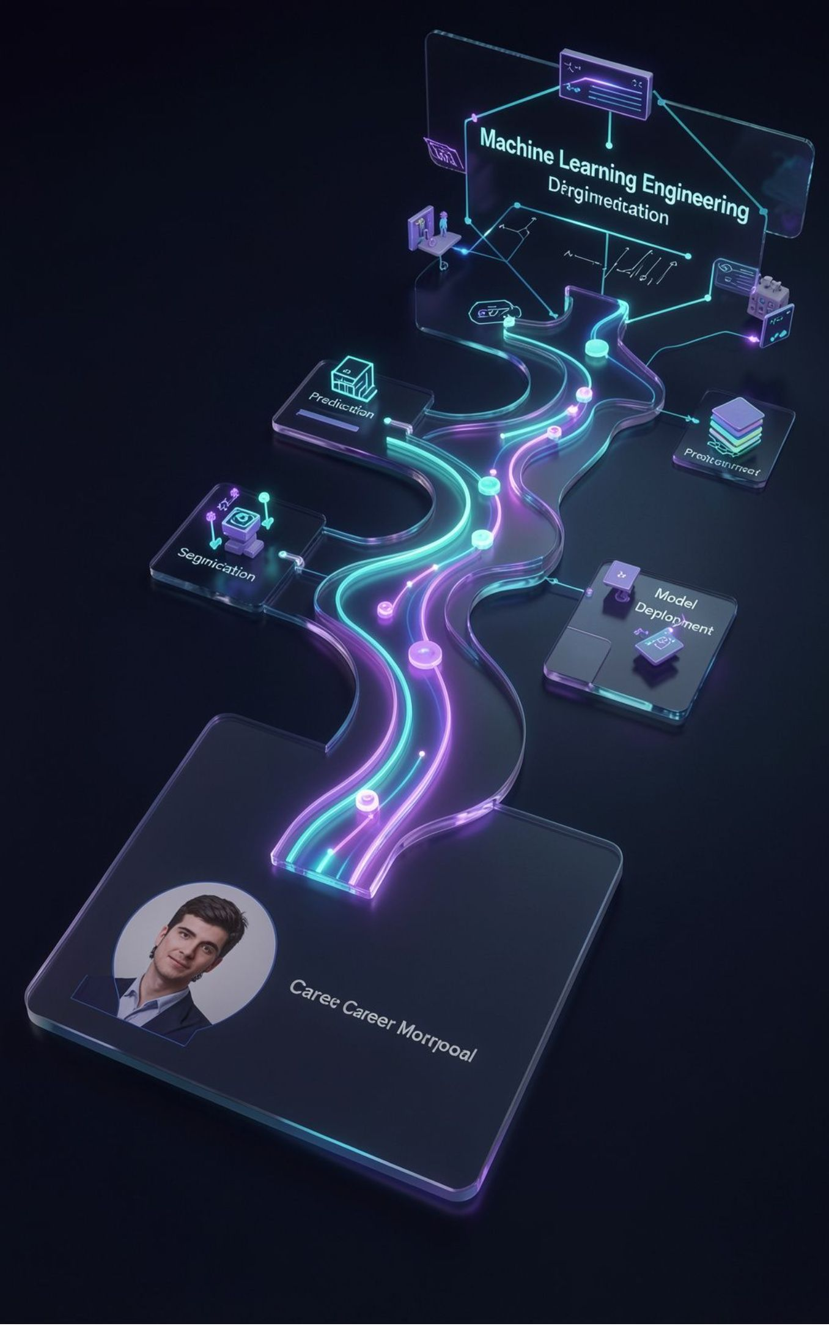
8
ILLUSTRATIVE WORKFLOW · NOT A REAL TEST RESULT
From Student Profile to
Career Roadmap
Create profile: B.Tech in AI/ML, second year, basic Python and introductory programming, 8 hours per week.
Select target: Machine Learning Engineer.
Compare skills: current skills against role requirements.
Identify priorities: mathematics, Python, data handling, machine learning fundamentals, and model evaluation.
Receive resources and projects: learning resources and projects.
Track staged roadmap: follow staged progress toward the target.
Example projects: student performance prediction · house price prediction · customer segmentation · model deployment.

Slide 9
9
Building a Reliable and Useful Career Guidance Platform
Implementation
Testing checklist
Requirements and architecture → backend and database → matching and skill-gap logic → Claude integration → frontend dashboard → integration and testing → deployment and documentation.
Validate inputs, matching rules, gap calculations, chatbot failures, database persistence, responsive layouts, relevance, and explainability.
Limitations
Expected outcomes
AI responses may be inaccurate; job-market information needs current sources; results depend on data quality and user inputs; API usage may incur costs.
Easier access to career information, more personalized learning plans, clearer job-skill requirements, and organized career preparation.
No measurable improvement is claimed without evaluation.

Slide 10
THE NEXT DECISION IS YOURS
Empowering Students to Make Informed Career Decisions
Future scope
Verified live jobs and internships · resume analysis · semantic search and Retrieval-Augmented Generation · regional and international pathways · trusted learning-platform integrations · multilingual guidance · progress-based recommendations · evaluated user feedback.
Thank You
AI Career Navigator combines career-matching logic, skill-gap analysis, structured learning roadmaps, and AI-powered conversation to make career exploration more personalized, accessible, and actionable.
Your Education. Your Skills. Your Future. One Intelligent Career Navigator.
Questions & Answers

