Slide 1
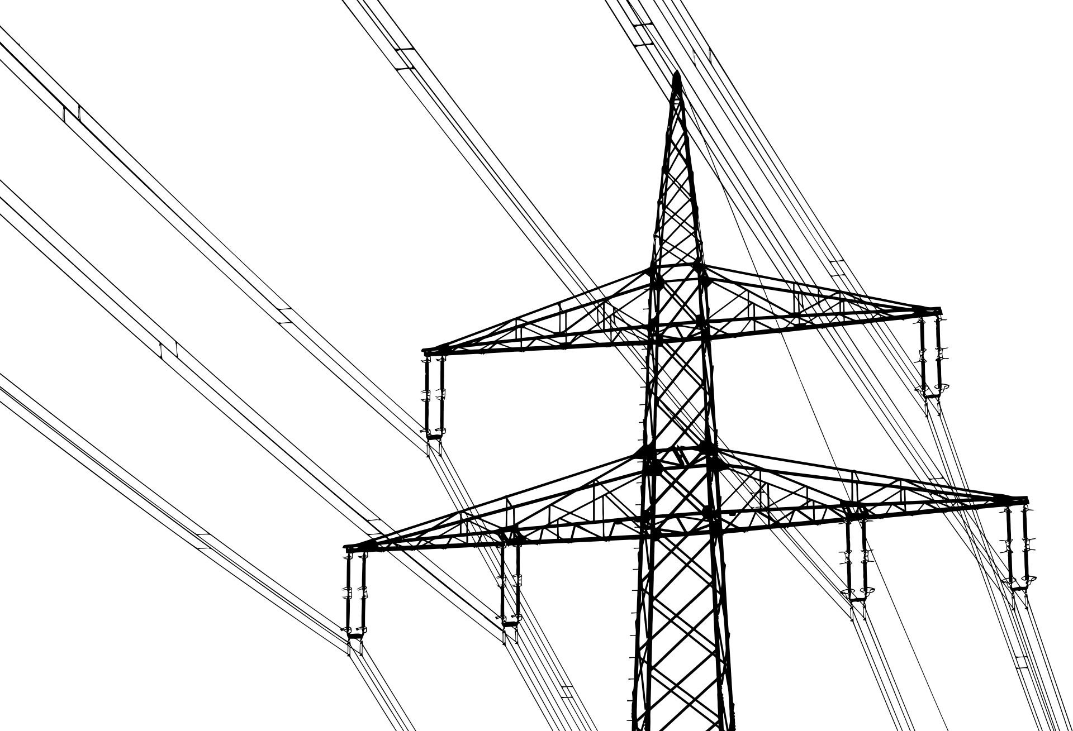
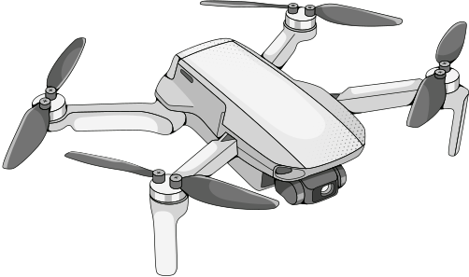
Deep Learning Techniques for Accurate Detection of Insulator Defects in Power Transmission Systems
Project Supervisor: Dr. K. Sri Phani Krishna
521214 Joshi P
521144 Manish
521146 Thrishank

Slide 2
Abstract
Our project proposes an effective deep learning-based method for detecting insulator defects on power transmission lines using aerial images captured by Unmanned Aerial Vehicles (UAVs).
The project highlights the importance of accurate and timely identification of insulator defects to ensure the safe and reliable operation of power systems.
The proposed algorithm leverages advancements in deep learning techniques to achieve high accuracy and efficiency in defect detection

Slide 3
Problem Statement
Insulator defects in power transmission systems pose significant challenges to the reliability and safety of electrical infrastructure. These defects can result from various environmental factors such as extreme weather conditions, pollution, and material degradation over time. Traditional inspection methods, which often rely on manual checks or ground-based visual assessments, are not only labor-intensive but also susceptible to human error.
As a result, defects may go undetected or be misclassified, leading to potential power outages, equipment failures, and safety hazards for both personnel and the public. The increasing complexity and scale of modern power systems further exacerbate these issues, necessitating a more efficient and accurate detection approach.

Slide 4
Methodology for Solution
Data Collection: Acquire aerial images of power transmission lines with various insulator conditions.
Preprocessing: Enhance image quality through techniques like normalization and augmentation.
Model Development: Utilize one-stage target detection algorithms like YOLOv10, and YOLOv11 to train a model for defect detection.
Training and Validation: Split the dataset into training and validation sets, optimizing the model parameters to improve accuracy.
Comparison of results: Compare the results of various target detection models based on multiple metrics and analyze the best model to deploy on edge devices.

Slide 5
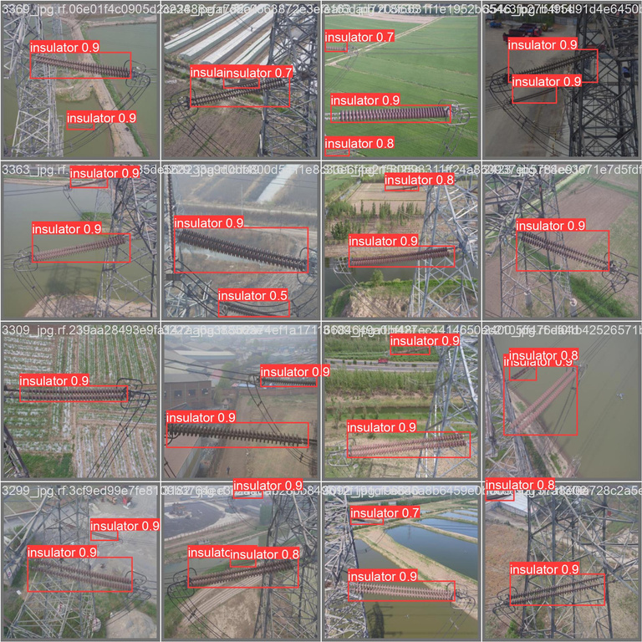
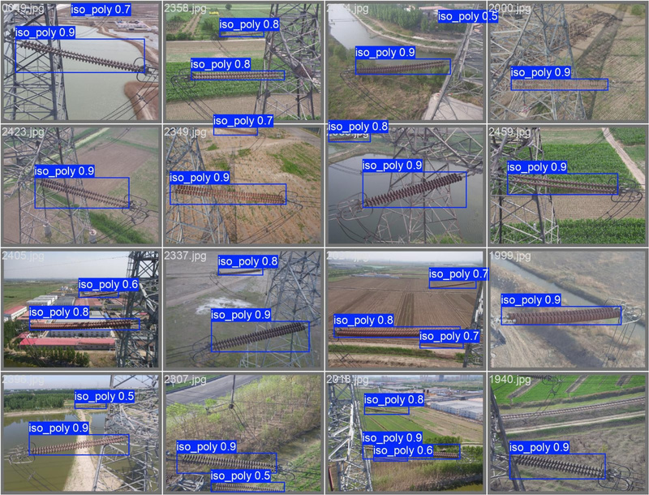
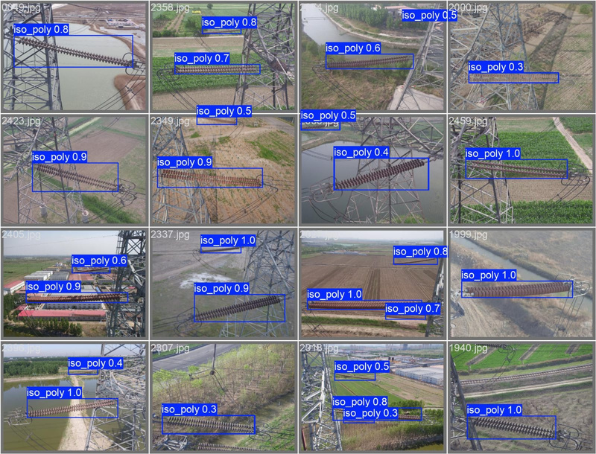

Expected Outcome
Ground Truth
YOLOv11
YOLOv10
Obtained outcome till now

Slide 6
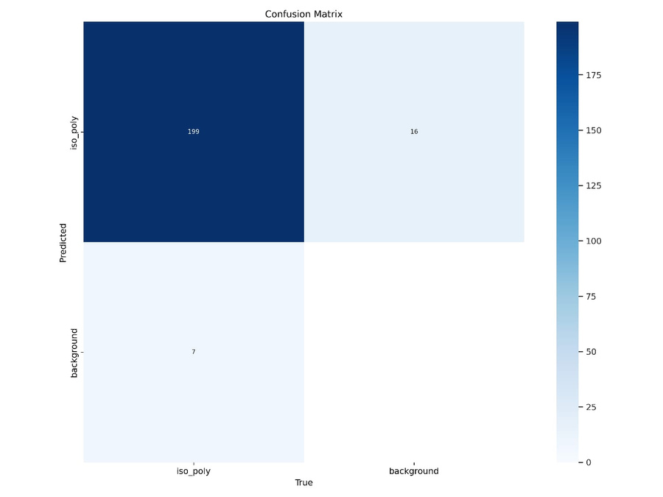
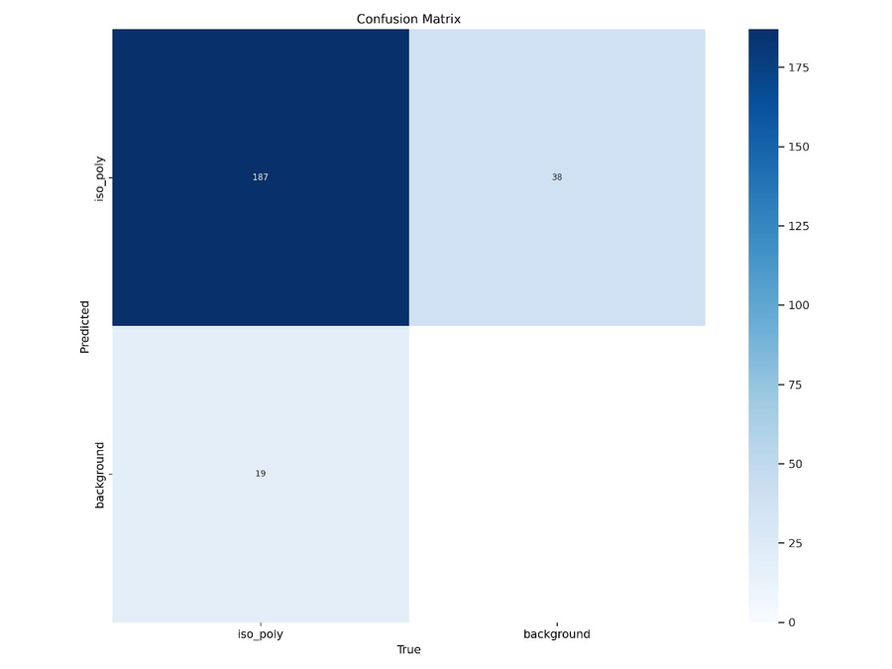
Comparison of Metrics
Model | Precision | Recall | mAP50 | mAP50-95 | Training Time(hrs) | Speed (ms)
YOLOv10n | 0.874 | 0.879 | 0.936 | 0.813 | 0.104 | 2.2
YOLOv11n | 0.947 | 0.961 | 0.986 | 0.859 | 0.113 | 1.7
YOLOv11
YOLOv10

Slide 7

Targets
Target1 : Training one stage target detection algorithms like YOLOv10 , YOLOv11 on CPLID dataset to draw the bounding boxes for insulators and compare the results.
Target2 : Training one stage target detection algorithms like YOLOv10 , YOLOv11 on CPLID dataset to draw the bounding boxes for the defective part of insulators.
Target3 : Combining one stage target detection algorithms with vision attention models, to increase model performance and accuracy
Target4 : Deployment of the model on edge devices

Slide 8

Objectives
To develop a robust deep learning model for accurate detection of insulator defects using UAV imagery.
To improve the efficiency of defect identification in power transmission lines.
To establish a methodology for real-time monitoring and assessment of insulator conditions.

Slide 9
Deployment
Data Pipeline Construction: Designed and managed the data pipeline, utilizing Docker to containerize the ETL processes, ensuring consistent environments for data ingestion, transformation, and storage.
Containerized Model Deployment: Deployed machine learning models using Docker containers, enabling smooth and scalable deployments across different environments, with minimal configuration changes.
MLOps with Docker: Integrated Docker into the MLOps workflow to streamline continuous integration and deployment (CI/CD) pipelines, ensuring reproducibility, model versioning, and automated model retraining with containerized environments.

Slide 10
References
[1] A. Odo, S.J. Mckenna, D. Flynn, et al., Aerial image analysis using deep learning for electrical overhead line network asset management, IEEE Access 9 (2021) 146281–146295.
[2] Jiang, T., Hou, X. & Wang, M. Insulator Defect Detection Based on the CDDCR–YOLOv8 Algorithm. Int J Comput Intell Syst 17, 245 (2024)
[3] Zhang, L., Li, B., Cui, Y., et al.: Research on improved YOLOv8 algorithm for insulator defect detection. J. Real-Time Image Proc. 21(1), 22 (2024)
[4] Ao Wang, Hui Chen, Lihao Liu, Kai Chen, Zijia Lin, Jungong Han, and Guiguang Ding. "YOLOv10: Real-Time End-to-End Object Detection." arXiv, 2024.

