Slide 1
Stock Investment Detection

Slide 2
Contents
Objective
Database
Architecture
Technology
Scope
Model Description
Predictions

Slide 3
Objective:
To ensure the success of the stock price investment app project, it’s crucial to define and monitor Key Performance Indicators (KPIs). These KPIs will help measure the effectiveness, efficiency, and overall impact of the app.
.Benefits:
Real Time access to market Data
Enhance Investment Knowledge
User friendly Interface
Customeeizable Alerts and Notifications

Slide 4
Data Sharing Agreement :
Sample file name (ex fraudDetection_20062021_101010)
Length of date stamp(8 digits)
Length of time stamp(6 digits)
Number of Columns
Column names
Column data type

Slide 5
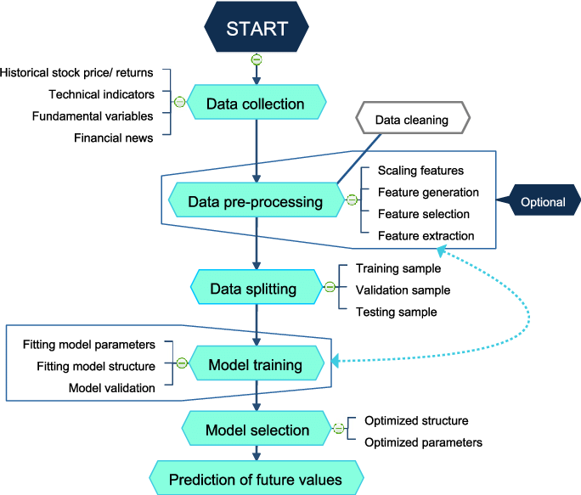
Architecture

Slide 6
Technologies:
Programming Language: Node.js (JavaScript/TypeScript) or Python (Django/Flask).
Frameworks: Express.js (for Node.js) or Django/Flask (for Python).
Database:
Primary Database: PostgreSQL or MySQL for relational data.
NoSQL Database: MongoDB for unstructured data.
API Development:
RESTful APIs: For standard operations and integration.
GraphQL: For flexible and efficient data querying.
Authorization: Role-based access control (RBAC)
".

Slide 7
Scope:
Core Features and Functionalities
User Interface and Experience:
Develop a clean, intuitive, and responsive user interface (UI).
Design customizable dashboards for personalized user experiences.
Stock Information and Real-Time Data:
Integrate APIs to provide real-time stock prices and market data.
Include detailed stock information such as historical prices, company profiles, financial reports, and analyst ratings.
Provide sector and industry performance data.
Portfolio Management:
Allow users to create and manage multiple investment portfolios.
Track and display portfolio performance metrics such as returns, volatility, and risk.

Slide 8
Model Training:
Data Export from Db :
The accumulated data from db is exported in csv format for model training
Data Preprocessing
Performing EDA to get insight of data like identifying distribution , outliers ,trend
among data etc.
Check for null values in the columns. If present impute the null values.
Encode the categorical values with numeric values.
Perform Standard Scalar to scale down the values.

Slide 9
Model Selection –
After the clusters are created, we find the best model for each cluster. By using 2 algorithms “SVM” and "XGBoost". For each cluster both the hyper tunned algorithms are used. We calculate the AUC scores for both models and select the model with the best score. Similarly, the model is selected for each cluster. All the models for every cluster are saved for use in prediction

Slide 10
Predictions
The user base is expected to grow significantly, particularly among millennials and Gen Z, who show a strong interest in digital investment tools.
Revenue from subscriptions, premium features, and advertisements will increase as the user base expands
Supporting Data: Increasing trends in mobile app usage and stock market participation among younger demographics
Predi

Slide 11
conclusion
The development and launch of the stock price investment app mark a significant milestone in empowering individual investors with the tools, resources, and information they need to make informed investment decisions. Throughout this project, we've focused on delivering a user-centric, technically robust, and secure application that meets the evolving needs of modern investors.

Slide 12
THANK YOU

