Slide 1
Project Planning with virtual ai agents for Renters Insurance phase 2
By
SNEHA JOSHI

Slide 2
Overview
The project aims to create AI agents using generative AI for project management for a renter's insurance web based platform.
These agents assist project managers with planning, progress monitoring, delay prediction, and resource optimization.
The agents improve efficiency, scalability, and responsiveness in enterprise applications.
We have used GPT-4o-mini model

Slide 3
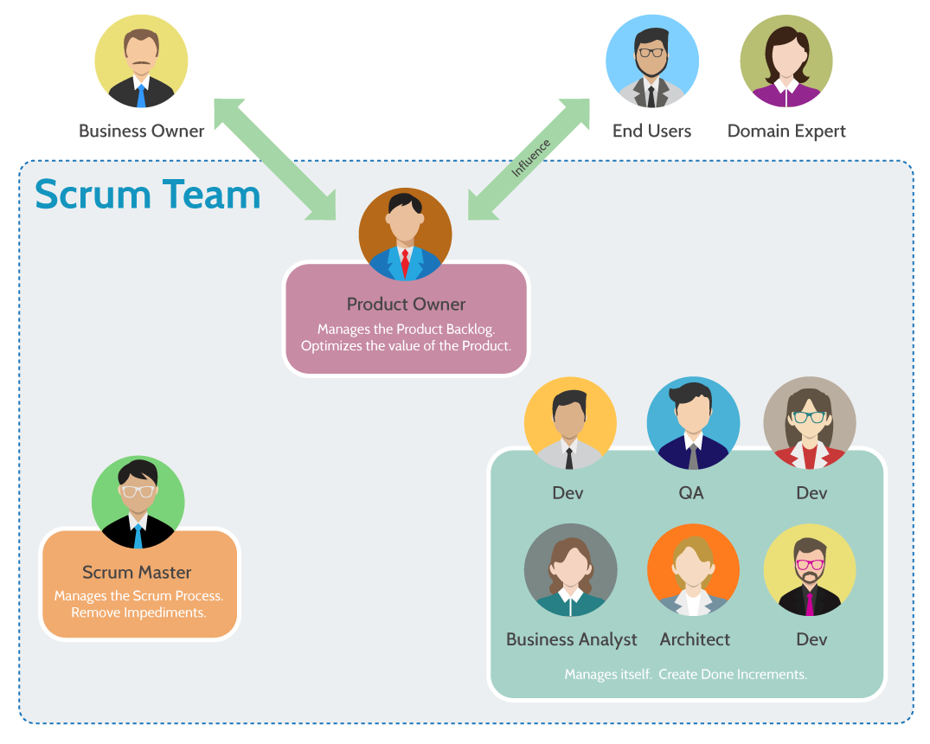
Rental insurance Platform
The Renters Insurance Platform aims to provide users with a seamless way to manage insurance quotes and process claims in an intuitive and user-friendly environment.
The platform's core functionalities are divided into two major areas: quotes management and claims processing.
Users can generate, modify, and delete insurance quotes, as well as submit claims for damages or losses.
The platform also supports administrators, who have full visibility into user accounts, quotes, and claims for auditing purposes.
Given the dynamic nature of the requirements and the potential for evolving project needs, the Scrum development methodology was chosen. Scrum offers an iterative and flexible approach, emphasizing collaboration, adaptability, and incremental delivery of value through regular sprints. This ensures continuous feedback, improvement, and alignment with stakeholder expectations.

Slide 4
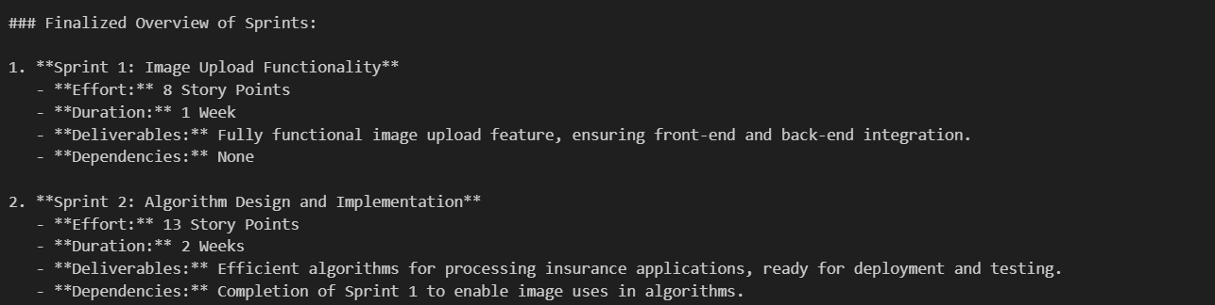
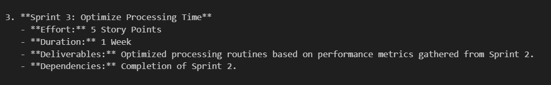
Experiment 1 (Autogen)

Slide 5
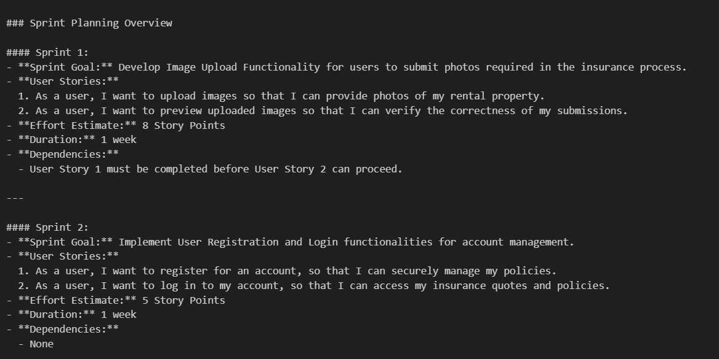
Experiment-2 (Autogen)

Slide 6
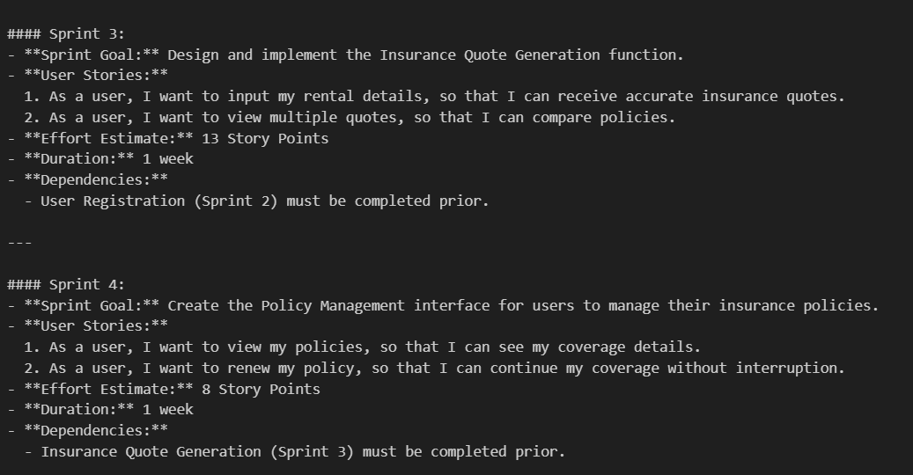

Slide 7
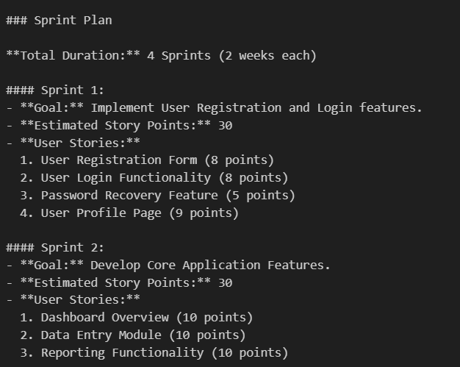
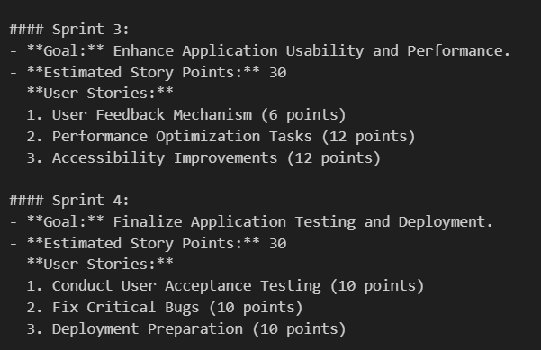
Experiment 3(LangChain)

Slide 8
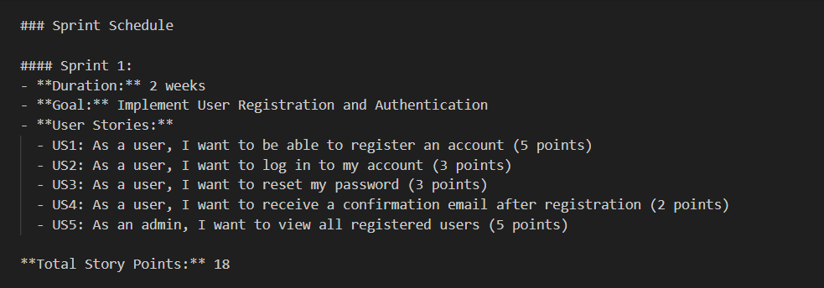
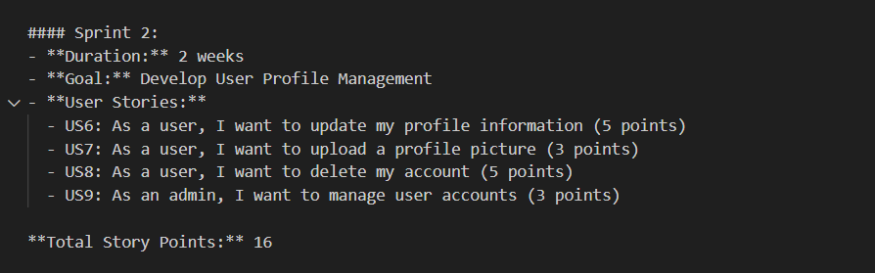
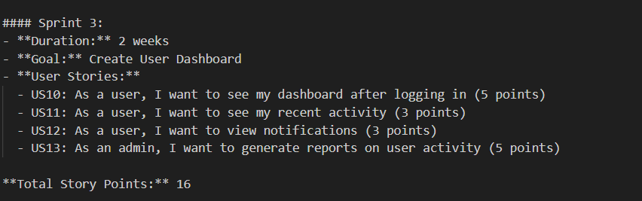
EXPERIMENT 4(LangChain)

Slide 9
Comparative analysis
 | Autogen 1 | Autogen 2 | LangChain 1 | LangChain 2
Sprint | 3 | 4 | 4 | 3
Duration | 4 weeks = 28 days | 4 weeks = 28 days | 8 weeks = 56 days | 6 weeks= 42 days
Effort | 8+13+5= 26 story Points | 8+5+13+8= 34 story points | 30+30+30+30 = 120 story Points | 18+16+16 = 50 Story Points

Slide 10
Analysis Report Accuracy
Performance: Experiment 4 is the best, with detailed SLOC estimates, modularity, and performance strategies (e.g., 2FA, HTTPS).
Duration: Experiment 4 balances 4 sprints over 8 weeks, ensuring steady progress and workload management.
SLOC: Experiment 4 provides accurate SLOC estimates for modules, aiding resource allocation and task planning.
Experiment 3: Focuses on sprint planning but lacks SLOC and detailed performance considerations.
Experiment 1 Highlights sprint outcomes and performance metrics but lacks a complete roadmap.
Experiment 2 Focuses on user stories and dependencies with limited technical depth.

Slide 11
CONCLUSION AND FURTHER IMPROVEMENT
The AI-driven project for rental insurance successfully automated key project management tasks like task scheduling, resource allocation, risk analysis, and progress tracking.
This system streamlined workflows, improved decision-making, and optimized resource utilization.
A challenge encountered was that in the first experiment - the AI agents gave a rough estimate of the
This issue was addressed by fine-tuning agent prompts to include realistic constraints.
Further improvements can be made by specifying each responsibility in more detail.

