Slide 1
A Survey of Web Service Composition Methods and Techniques
Archit Joshi | Athina Stewart | Chung-An Huang

Slide 2
Outline
Introduction
Background
Literature Review
Methodology
Results
Discussion
Conclusion
Future Work
References

Slide 3
Web Service Composition

Slide 4
Introduction
Web service composition is the process of combining functionalities offered by individual web services to create a more complex service that fulfills a specific user need. Imagine it like building with Legos – you take smaller, pre-built components (web services) and snap them together to create a larger, more intricate structure (the composed service)
Web service composition emerged along with the rise of service oriented computing. Initial focus was on standardizing protocols (SOAP, WSDL). Later on, REST APIs became more popular. They use simpler formats like JSON, making composition easier. The dimensions of web service composition include: (1) participant model (2) orchestration model (3) data-access model and (4) service selection model.
Notes:
** expound on the models while presenting

Slide 5
Introduction
Web services have evolved so profoundly that they have become more complex to access and integrate than ever before
Developers rely on web services to inspire more applications
Review a series a web composition related papers
Comparison between our implementation and that of the paper
Discussion of our design decisions and initial results

Slide 6
Background
Web Service: an interface over the internet that serves web content.
Web Service Composition: result from combining existing web services to form new ones. The combination can also be used in a further web composition process (recursive nature).
API vs. Endpoint: API serves as a standardized interface enabling communication between software applications, while an endpoint represents a specific URL within that API for accessing particular resources or functionalities.
Reinforced learning: A machine learning paradigm where an agent learns to make decisions by interacting with an environment to maximize cumulative rewards.
Service Level Agreements (SLAs): A commitment between provider and client.

Slide 7
How Composable is the Web? An Empirical Study on OpenAPI Data model Compatibility
S. Serbout, C. Pautasso and U. Zdun, "How Composable is the Web? An Empirical Study on OpenAPI Data model Compatibility," 2022 IEEE International Conference on Web Services (ICWS), Barcelona, Spain, 2022, pp. 415-424, doi: 10.1109/ICWS55610.2022.00068.

Slide 8
Overview
“How Composable is the Web? An Empirical Study on OpenAPI Data model Compatibility”
An in-depth study of a large collection of OpenAPI definitions on the web
A set of validation rules have been developed for data analysis
A transformation process has been implemented to form a baseline for API comparison
Compatibility is determined at different levels of the OpenAPI schemas

Slide 9
Research Problem
There has not been any study that examines compatibility at the schema level
The levels of compatibility APIs exhibit have not been explored
Two API schemas are compatible if they require little or no manipulations
An example of no manipulation is the conversion from a number to a string
How compatible are Web APIs?
On which level are most API compatible?
What is the likelihood that a random pair of APIs has at least one compatible endpoint?
To what extent are the APIs endpoints compatible?

Slide 10
Key Contributions
Aggregated API compatibility statistics at the property and the data type levels
The compatibility at the property name level is generally lower than data type level
The more endpoints, the more likely they have a compatible counterpart
The first tool that separates property name comparison and data type comparison in JSON format

Slide 11
Methods - Key Phases
Dataset Collection: 106,873 APIs collected from GitHub, APIs.Guru, etc.
Dataset Preparation: Select those with valid base URIs, endpoints, and paths
Schema Validation: Filter out those that do not meet the validation criteria
Canonical Form Transformation: Unify schemas for consistent comparison
Schema Matching Algorithm: Match APIs using property names/data types

Slide 12
Methods - Data Collection
Data Sources:
GitHub Data from GitHub API
APIs.Guru
SwaggerHub
Rapid7’s HTTP and HTTPs datasets (only scanned port 80 and 443)
An internet wide masscan (only scanned port 80 and 443)
Data Format:
YAML
JSON

Slide 13
Methods - Data Preparation
APIs should contain a openapi (3.0) or swagger (2.0) field for versioning
APIs should have an info field followed by a title field
APIs with referenced schemas are downloaded (except Assetnote’s)
APIs should have a server (3.0) or basePath field (2.0)
At least one consumed or produced endpoint should be present
At least three paths should be in the API

Slide 14
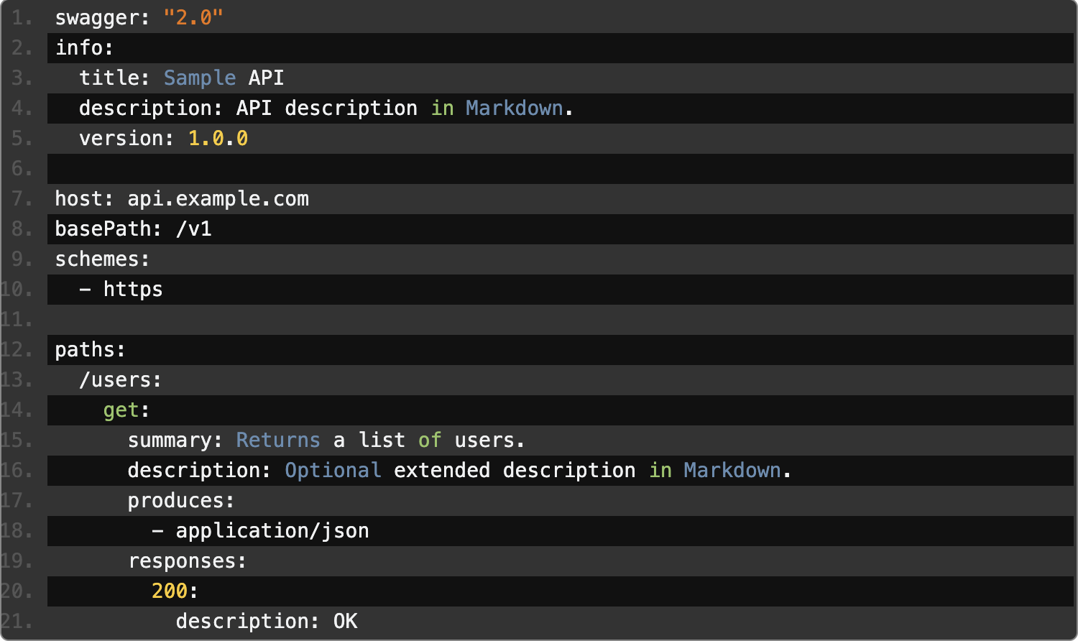
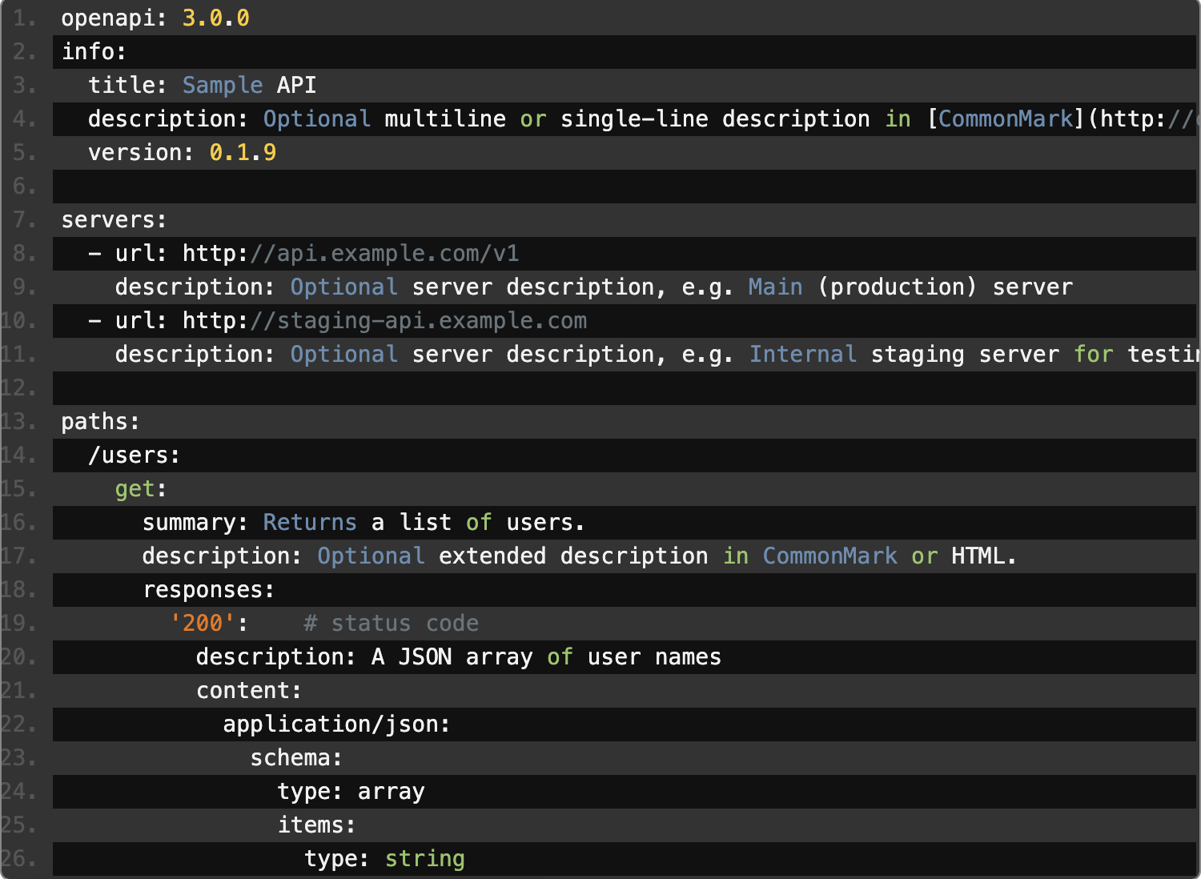
Methods - OpenAPI 2.0 vs. OpenAPI 3.0

Slide 15
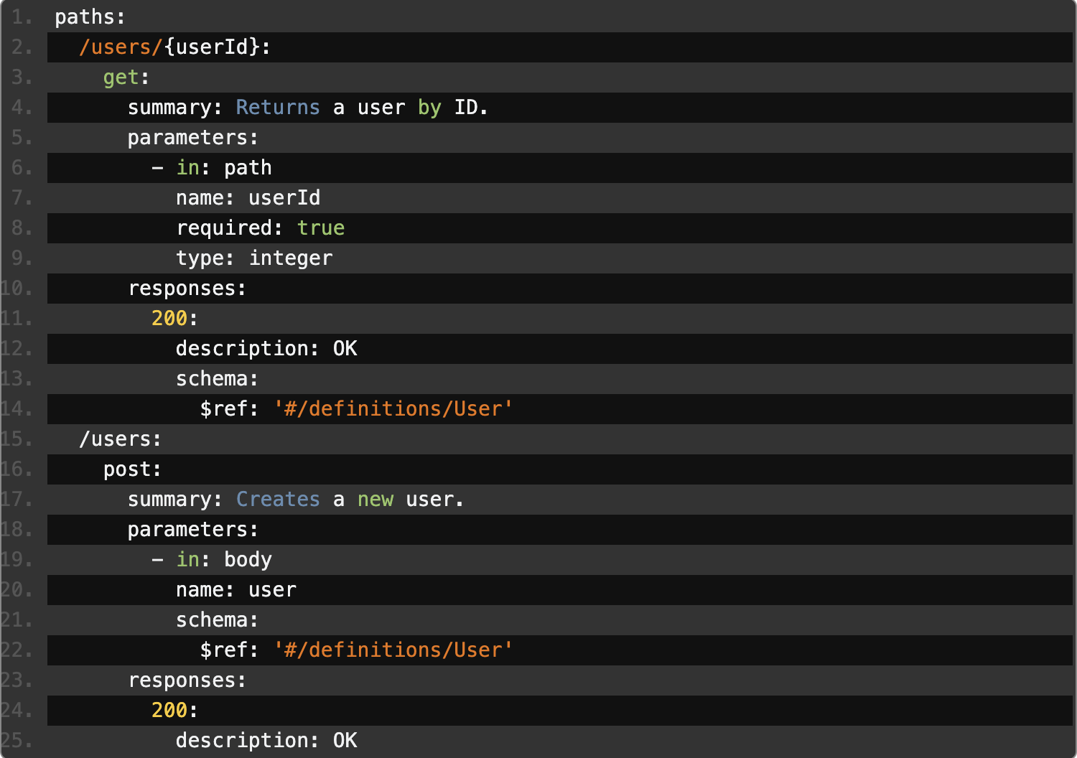
Methods - OpenAPI Referenced Schema
Referenced Schemas

Slide 16
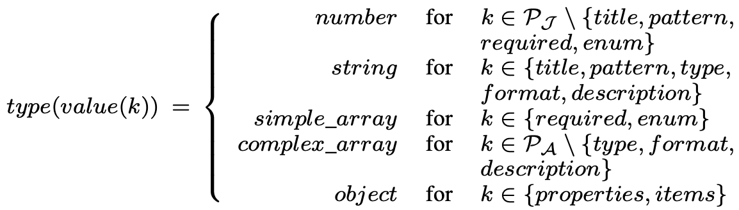
Methods - Schema Validation
P_J = ["title", "multipleOf", "maximum", "exclusiveMaximum", "minimum", "exclusiveMinimum", "maxLength", "minLength", "pattern", "maxItems", "minItems", "uniqueItems", "maxProperties", "minProperties", "required", "enum"]
P_A = ["type", "allOf", "oneOf", "anyOf", "not", "items", "properties", "additionalProperties", "description", "format", "default"]

Slide 17
Methods - Canonical Form Transformation
Canonical form transformation ensures stricter consistency in matching.
Irrelevant properties removal: description, title, default, example, readOnly, writeOnly, example, P_J.
Complex operators simplification: allOf, oneOf, anyOf.
Schema properties sorting: number of schema objects -> number of nodes -> depth -> alphabetically by type.
Schema property label abstraction: object keys are replaced with abstract labels.

Slide 18
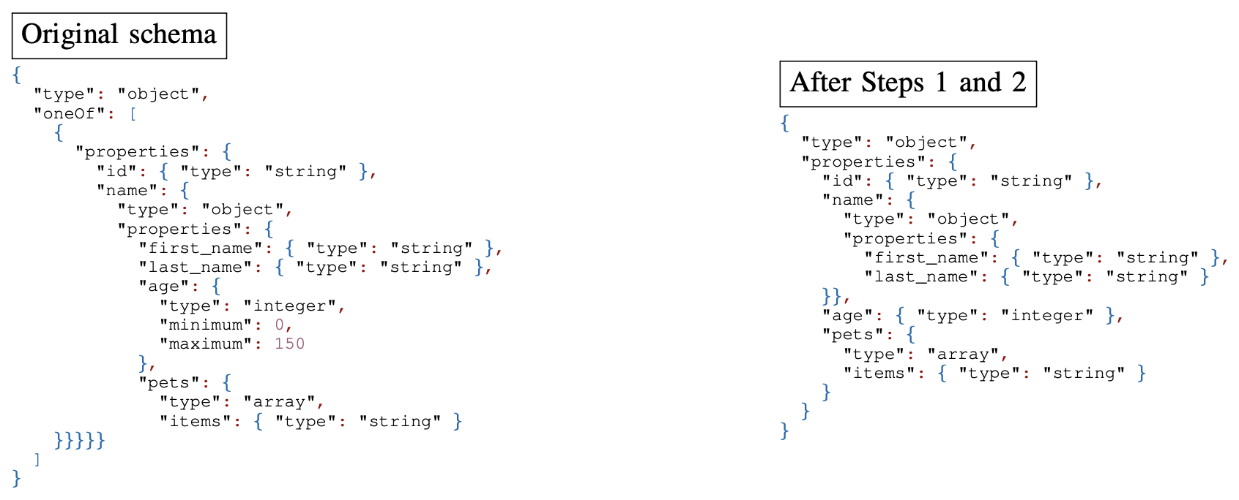
Methods - Canonical Form Transformation

Slide 19
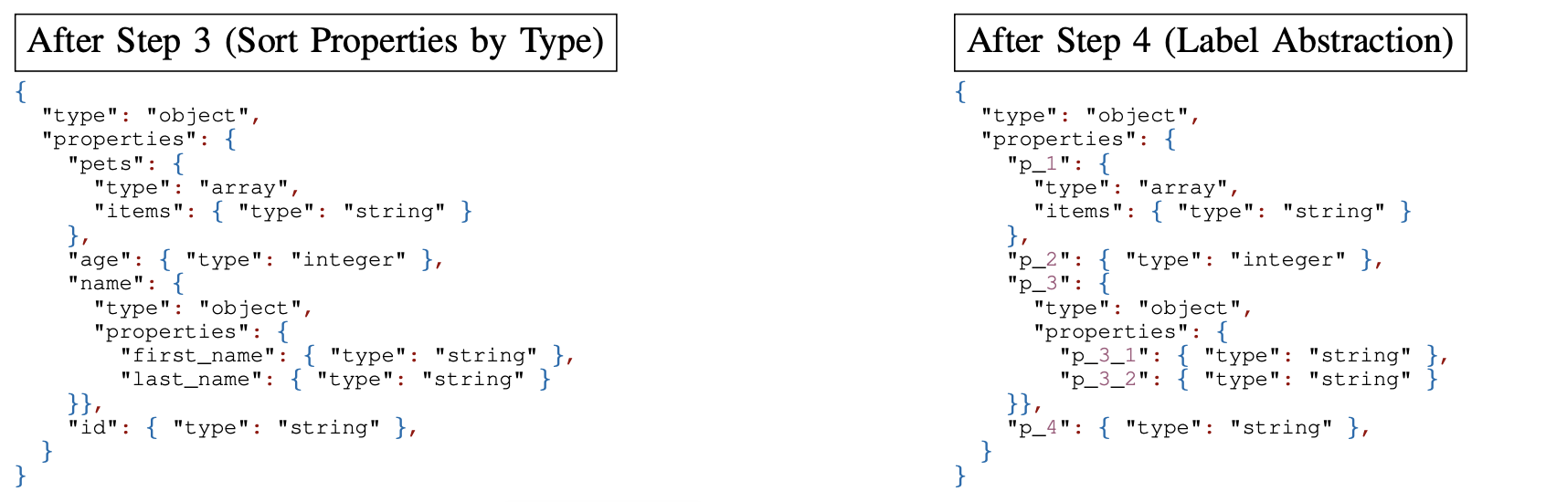
Methods - Canonical Form Transformation

Slide 20
Methods - Schema Matching Algorithm
Three types of matches
Endpoint Match: 1+ request-response match within the same/different APIs
API Match: A pair of APIs with 1+ Endpoint Match
Compatible API: An API with 1+ Endpoint Match
Three levels of matches
Data-Type Match: A pair of schemas with matching data types for each element
Property-Name Match: A pair of schemas with matching element names (objects and array of objects); data type conversion may be needed for data to be forwarded correctly
Property-Name and Data-Type Match: The combination of the above two without any renaming or data type conversion

Slide 21
Methods - Schema Matching Algorithm
Compatibility does not guarantee composability
Directly Composable Match: Schemas with Property-Name and Data-Type Match or request schemas containing only string data types
Indirectly Composable Match: 1) Schemas with Identical data types but require property name mapping or renaming 2) Schemas with identical property names but require data type conversion
Not Composable Match: No data-type or property-name match exists

Slide 22
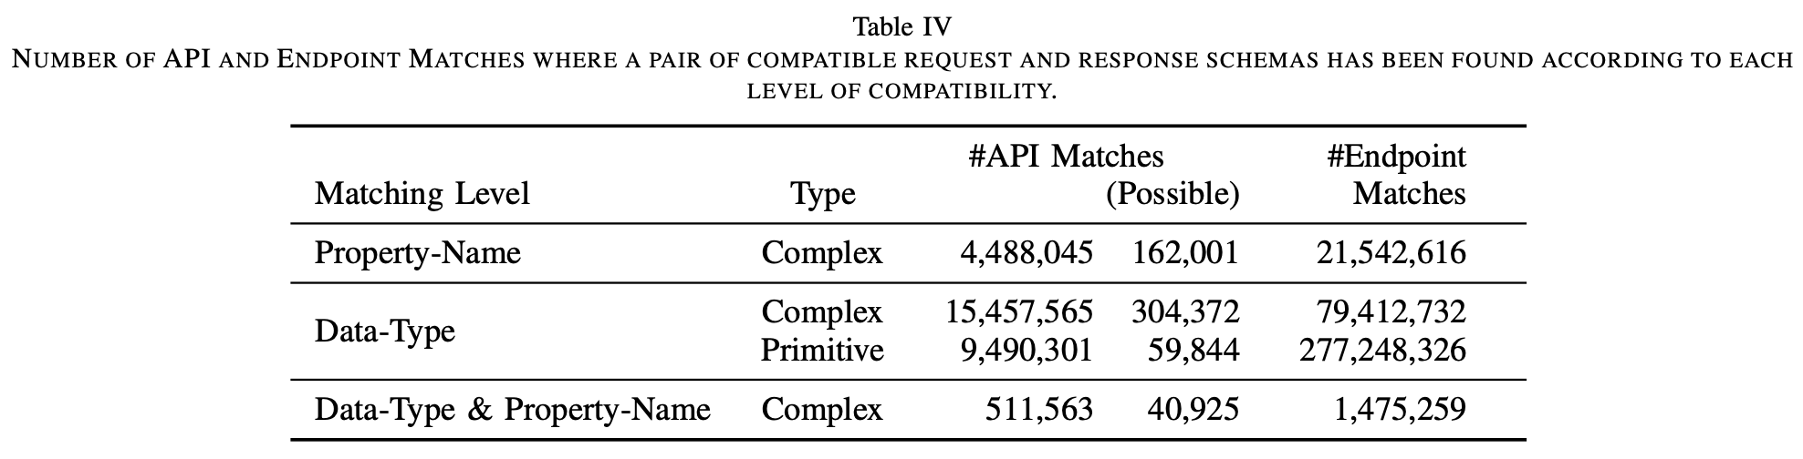
Results

Slide 23
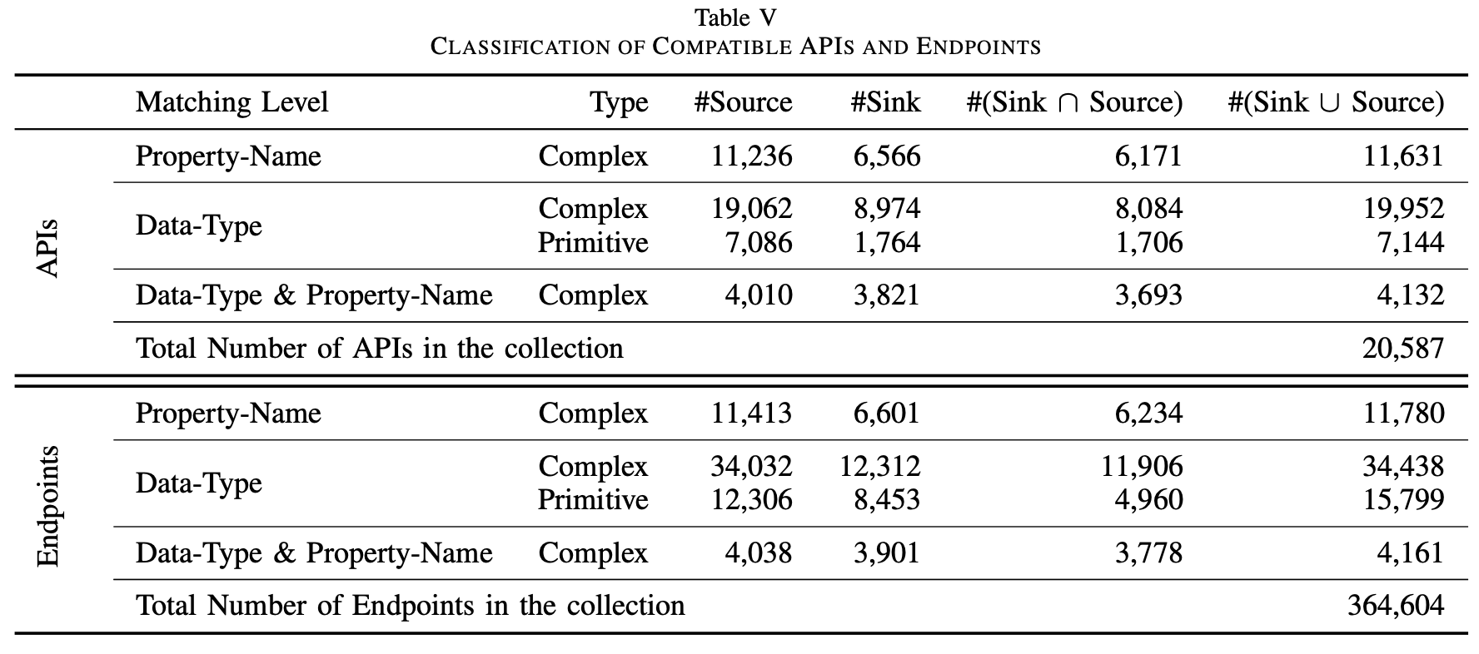
Results

Slide 24
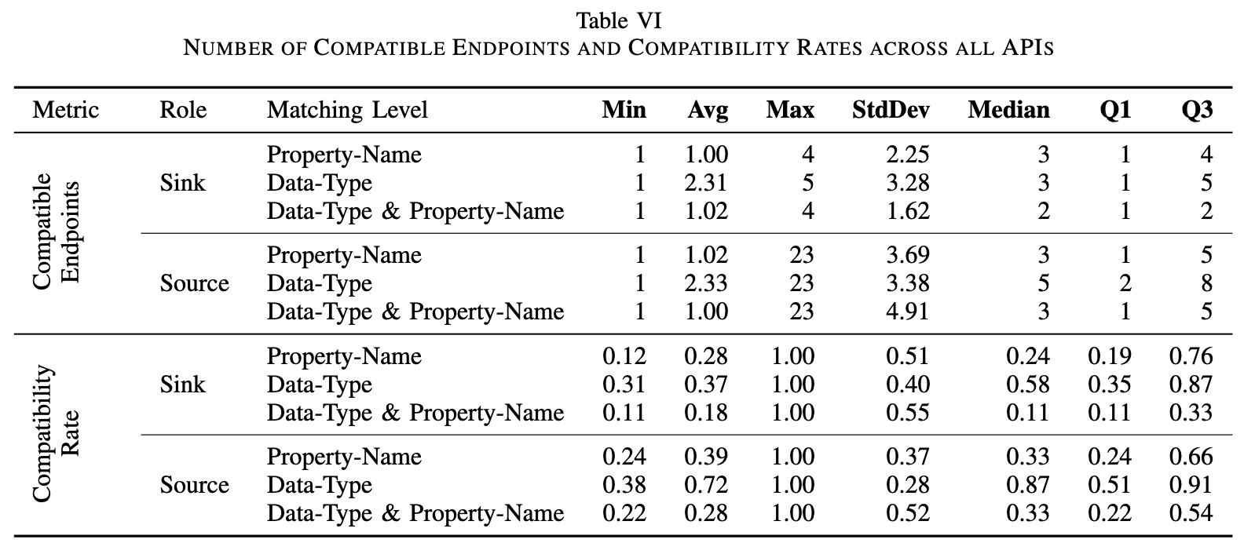
Results

Slide 25
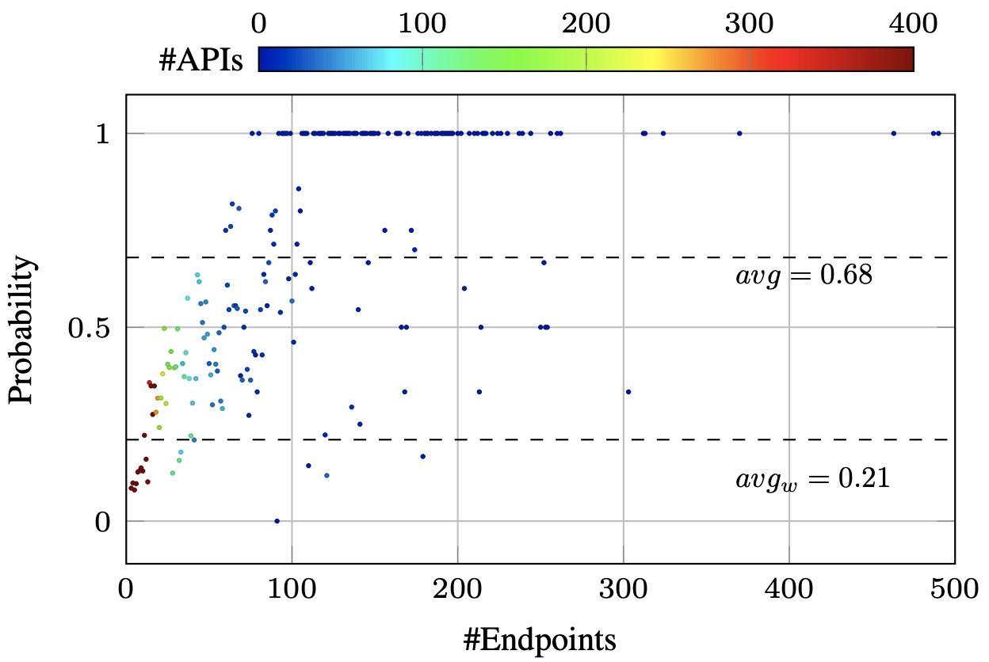
Results

Slide 26
Related Work
"Composing JSON-Based Web APIs": Similar in examining element names and types
"An Empirical Study of GraphQL Schemas": Discovered naming convention issues and denial-of-service (DoS) security risks, but does not discuss the compatibility of GraphQL API schema
"Web APIs Structures and Data Models Analysis": Only measures the size of API structures and their data model schemas instead of the compatibility challenges

Slide 27
Towards an Adaptive Curation Services Composition based on machine learning
F. Zouari, C. Ghedira-Guegan, N. Kabachi and K. Boukadi, "Towards an adaptive curation services composition based on machine learning," 2021 IEEE International Conference on Web Services (ICWS), Chicago, IL, USA, 2021, pp. 73-78, doi: 10.1109/ICWS53863.2021.00022. keywords: {Web services;Conferences;Data visualization;Reinforcement learning;Big Data;Cleaning;Complexity theory;Data curation services;Service composition;Artificial Intelligence;Machine Learning;Reinforcement Learning},

Slide 28
"Towards an Adaptive Curation Services Composition based on machine learning"
The Problem
The problem addressed in the paper revolves around the need for adaptive and context-aware data curation in web service composition. Traditional static approaches to service composition struggle to adapt to evolving user requirements, changing environmental conditions, and diverse data sources.
As a result, there is a gap in effectively curating data from various sources while considering factors such as user preferences, content characteristics, and quality of service (QoS) requirements.
What are traditional service composition methods?
Workflow-based composition: compositions are defined using modeling languages like BPEL and BPMN.
Service Choreography: interactions defined between services in a decentralized manner. Choreographies specify communication patterns and message exchanges between services statically, typically using standards like Web Services Choreography Description Language (WS-CDL).
Service Orchestration: A central orchestrator defines the sequence of services based on a predefined protocol.
Notes:
In the era of big data, effective data curation becomes paramount for informed decision-making. However, traditional approaches often overlook critical factors such as user preferences, decision context, and data source characteristics. To address this gap, Adaptive CUration SErvice Composition (ACUSEC) leverages reinforcement learning to dynamically curate data while considering user constraints and the ever-changing environment. By categorizing curation services and employing the Q-Learning algorithm, ACUSEC offers real-time adaptive composition, ensuring timely and effective data preparation. Unlike existing methods, ACUSEC not only incorporates quality of service (QoS) values and user preferences but also integrates decision context, providing a holistic approach to data curation. Through this presentation, we aim to demonstrate how ACUSEC revolutionizes data curation by intelligently adapting to diverse data sources and user requirements.

Slide 29
"Towards an Adaptive Curation Services Composition based on machine learning"
How Traditional Static Models Fail (Workflow-based Composition)
Scenario: Dynamic Approval Process in E-Commerce
The platform employs workflow-based composition to handle processing and refund requests. There are approval steps where orders or refunds over a certain amount require managerial approval.
If there is a sudden surge in orders or requests, BPMN or BPEL models which specify fixed approval paths and decision logic, will struggle to accommodate variations in workload.
This leads to bottlenecks or delays in processing orders.
Why does it fail?
Orders need to pass through sequential approval steps such as order verification, payment processing, and shipping confirmation.
Approval thresholds could be hardcoded based on predefined criteria like customer status.
With a surge in orders or refund requests, the system may continue using predefined workflow, even when a expedited processing is necessary to handle the volume.

Slide 30
"Towards an Adaptive Curation Services Composition based on machine learning"
How Traditional Static Models Fail (Choreography-based Composition)
Scenario: Supply Chain Management in Retail
Multiple suppliers, warehouses, and distribution centres interact to fulfill customer orders. Service Choreography defines the exchanges between the entities.
When there is a sudden change like a disruption in supply chain from bad weather, the predefined choreography may not have mechanisms to reroute orders to alternate suppliers or adjust inventory levels.
Why does it fail?
Service choreography models in languages like Web Services Choreography Description Language (WS-CDL) (XML based), lack dynamic adaptation capabilities. They define fixed interaction patterns and message exchanges between services without provisions for runtime adjustments based on changing conditions.

Slide 31
"Towards an Adaptive Curation Services Composition based on machine learning"
Traditional Static Service Composition Methods
Advantages
Traditional static composition methods provide a predictable structure and behavior for service compositions.
These methods are easier to implement and deploy since the comparison structure is fixed and known in advance
Disadvantages
Static compositions lack flexibility to adapt to changing requirements or unforeseen circumstances.
Static compositions face scalability challenges when dealing with large, heterogeneous datasets or complex business processes. They do not efficiently handle dynamic scaling requirements or evolving service landscapes.

Slide 32
"Towards an Adaptive Curation Services Composition based on machine learning"
ACUSEC: (Adaptive CUration SErvice Composition) ensures adaptive curation services by considering different features: the source type, the user constraints and preference, and the decision context.
Advantages
ACUSEC dynamically adjusts the composition structure based on changing requirements, user preferences, and contextual factors. It can efficiently adapt to new data sources, business processes, or user constraints without manual intervention.
Considers contextual information like user preference, content characteristics and quality of service requirements when composing services. This enables it to tailor curations to specific scenarios.
Leverages reinforcement learning to learn optimal curation strategies from experience and feedback.
Disadvantages
Learning Overhead: there is an initial training and optimization phase that can involve significant computational resources and time.
Machine learning integration adds additional complexity in design. Developing and training the reinforcement learning modes requires expertise in machine learning techniques.

Slide 33
"Towards an Adaptive Curation Services Composition based on machine learning"
Data curation services
Purpose
Curation services are algorithms or processes used to clean, enrich, transform, or otherwise prepare data for analysis or consumption.
They aim to improve the quality, usability, and relevance of data.
Functionality
Curation services encompass a wide range of functionalities, such as data cleaning, normalization, entity extraction, sentiment analysis, etc.
Each curation service performs a specific data processing task to enhance the data's value or usability.
Implementation
Curation services can be implemented using various technologies and algorithms, depending on the specific task they perform.
They may involve machine learning, natural language processing, statistical analysis, or rule-based approaches..
Notes:
Extraction Services: These services extract structured or unstructured data from various sources, employing techniques such as Natural Language Processing (NLP) for tasks like named entity extraction, POS tagging, and stem extraction.
Enrichment Services: Enrichment services enhance the extracted data by adding semantic annotations and improving its quality through knowledge-based mechanisms and term similarity extraction.
Data Quality Control Services: These services detect missing values and anomalies in the data, such as value deviations, enabling data cleaning processes to enhance overall data quality.
Data Standardization Services: These services unify data across diverse sources by applying operations based on a reference model, ensuring consistency by aligning variables according to predefined types and ranges.

Slide 34
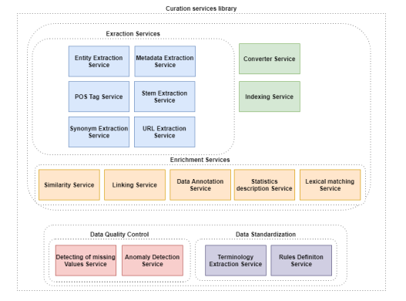
"Towards an Adaptive Curation Services Composition based on machine learning"
Data curation sources:
Extraction Services
Performs tasks like named entity extraction, Part-of-Speech tagging, and stem extraction.
Useful for extracting features embedded in text for later data analysis.
Enrichment Services
Enhances the data by adding context and labeling based on existing knowledge
Data quality Control Services
Ensures detection of missing values and data anomalies (e.g., value deviation)
Data Standardization Services
Helps standardize data variables with their types and ranges, enhancing consistency and usability.
F. Zouari, C. Ghedira-Guegan, N. Kabachi and K. Boukadi, "Towards an adaptive curation services composition based on machine learning," 2021 IEEE International Conference on Web Services (ICWS), Chicago, IL, USA, 2021, pp. 73-78, doi: 10.1109/ICWS53863.2021.00022. keywords: {Web services;Conferences;Data visualization;Reinforcement learning;Big Data;Cleaning;Complexity theory;Data curation services;Service composition;Artificial Intelligence;Machine Learning;Reinforcement Learning}
Notes:
Extraction Services: These services extract structured or unstructured data from various sources, employing techniques such as Natural Language Processing (NLP) for tasks like named entity extraction, POS tagging, and stem extraction.
Enrichment Services: Enrichment services enhance the extracted data by adding semantic annotations and improving its quality through knowledge-based mechanisms and term similarity extraction.
Data Quality Control Services: These services detect missing values and anomalies in the data, such as value deviations, enabling data cleaning processes to enhance overall data quality.
Data Standardization Services: These services unify data across diverse sources by applying operations based on a reference model, ensuring consistency by aligning variables according to predefined types and ranges.

Slide 35
"Towards an Adaptive Curation Services Composition based on machine learning"
ACUSEC is a two-step process:
Step 1: The Training Stage
Objective: Identifying the optimal policy for performing the curation services composition in dynamic environments.
Methodology: Reinforcement learning is used to handle scenarios in dynamic decision context
Model Representation: All the valid curation service compositions are presented in a Markov Decision Process (MDP) model, specifically a Web Service Composition MDP
Q-Learning Algorithm: After getting the WSC-MPD, this algorithm learns the weights associated with each service based on the factors: QoS associated with each service and decision context
Q-Table: After each epoch, the learned weights are stored in a updated matrix known as the Q-Table. At the end of training, the matrix represents the optimal policy for curation services composition.
** A Markov Decision Process is a mathematical framework for modeling decisions. It is widely used in reinforcement learning where processes happen in discrete steps. In the WSC-MDP model, states represent different configurations or compositions of web services, and actions correspond to selecting or executing particular web services. Transition probabilities define the likelihood of moving from one state (composition) to another. Rewards represent the benefits or costs associated with each state-action pair, reflecting the quality or utility of the composed web service.

Slide 36
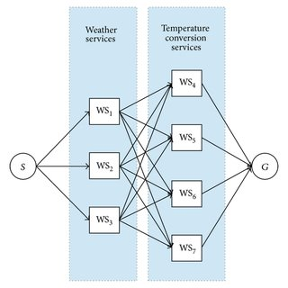
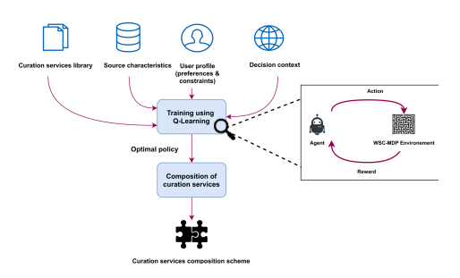
"Towards an Adaptive Curation Services Composition based on machine learning"
Uc-Cetina, Víctor & Moo-Mena, Francisco & Hernandez-Ucan, Rafael. (2015). Composition of Web Services Using Markov Decision Processes and Dynamic Programming. TheScientificWorldJournal. 2015. 545308. 10.1155/2015/545308.
F. Zouari, C. Ghedira-Guegan, N. Kabachi and K. Boukadi, "Towards an adaptive curation services composition based on machine learning," 2021 IEEE International Conference on Web Services (ICWS), Chicago, IL, USA, 2021, pp. 73-78, doi: 10.1109/ICWS53863.2021.00022. keywords: {Web services;Conferences;Data visualization;Reinforcement learning;Big Data;Cleaning;Complexity theory;Data curation services;Service composition;Artificial Intelligence;Machine Learning;Reinforcement Learning}

Slide 37
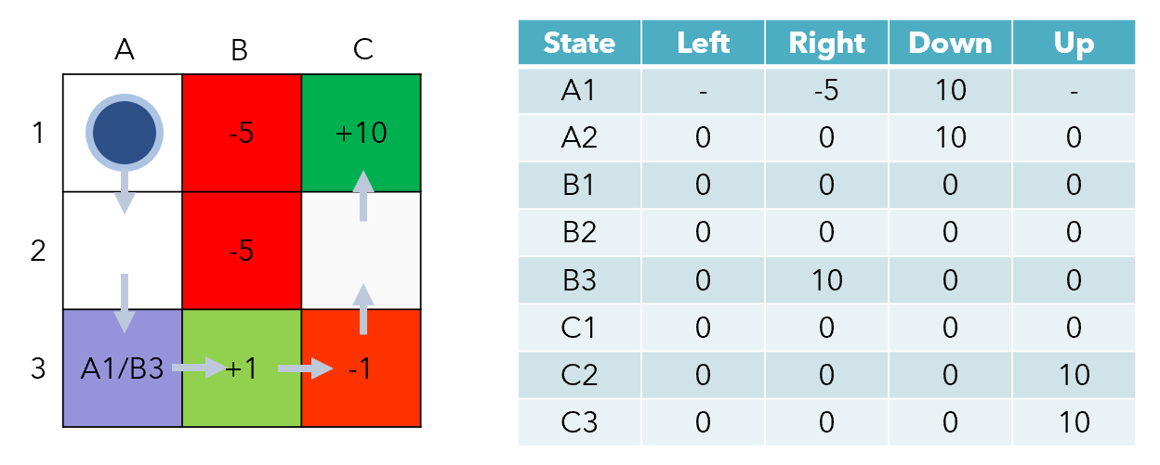
"Towards an Adaptive Curation Services Composition based on machine learning"
Ye, A. (2023, August 25). Markov decision process in reinforcement learning: Everything you need to know. neptune.ai. https://neptune.ai/blog/markov-decision-process-in-reinforcement-learning

Slide 38
"Towards an Adaptive Curation Services Composition based on machine learning"
ACUSEC is a two-step process:
Step 2: The Composition Stage
Objective: Execute the optimal service composition.
Utilization of Q-Table: Retrieve the most suitable service composition. To do this, an algorithm is employed that selects the next state iteratively from the Q-Table, prioritizing states with the maximum reward.
State Transition: At each step, the algorithm chooses the next state (composition serve) from the Q-Table and appends it to the list of visited states, and eliminated it front he list of available states.
Termination: The composition stage continues until there are no more states to visit or the desired composition is reached,

Slide 39
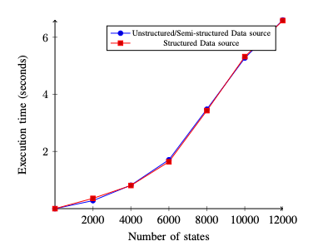
"Towards an Adaptive Curation Services Composition based on machine learning"
Results of the Paper
Reinforcement Learning Performance Evaluation
First, defined a WCS-MDP environment consisting of 18 states . The states are interconnected to ensure there is a transition from one state to another. Each transition action corresponds to a composition serve present in the library.
The D-Table was of size 18 x 18 and at the end of the learning process contains the optimal policy.
Semi-Structured data was used from the National Center for Biotechnology Information and structured data from FluPrint.
Semi-structured data is often found in formats like JSON, XML, or YAML, where data elements may have some structure but not necessarily follow a strict schema.
Number of states increased progressively and random rewards defined to generate Q-Tables of different sizes.
F. Zouari, C. Ghedira-Guegan, N. Kabachi and K. Boukadi, "Towards an adaptive curation services composition based on machine learning," 2021 IEEE International Conference on Web Services (ICWS), Chicago, IL, USA, 2021, pp. 73-78, doi: 10.1109/ICWS53863.2021.00022. keywords: {Web services;Conferences;Data visualization;Reinforcement learning;Big Data;Cleaning;Complexity theory;Data curation services;Service composition;Artificial Intelligence;Machine Learning;Reinforcement Learning}

Slide 40
"Towards an Adaptive Curation Services Composition based on machine learning"
Results of the Paper
Adaptivity to Changes Evaluation
Adaptability to Data Source Type
Process:
Defined different data source types: structured and unstructured/semi-structured.
Set user preferences equal for all QoS dimensions (Quality of Service).
Performed curation service composition for each data source type.
Results:
ACUSEC successfully distinguished which curation services were suitable for each data source type based on their structure.
Services applicable only to specific data structures (e.g., structured vs. unstructured) were included/excluded accordingly.

Slide 41
"Towards an Adaptive Curation Services Composition based on machine learning"
Results of the Paper
Adaptivity to Changes Evaluation
2. Adaptability to User Preferences
Process:
Defined user preferences with specific weights for each QoS dimension:
Accuracy: 10%
Availability: 10%
Reliability: 50% (highest weight)
Response Time: 10%
Reputation: 10%
Security: 10%
Performed curation service composition for a structured data source.
Results:
Composition differed from the one obtained with equal preferences for all QoS dimensions.
User preferences influenced the chosen services.
Example: Entity extraction service was replaced by stem extraction service due to its higher reliability (90% vs. 80%)

Slide 42
"Towards an Adaptive Curation Services Composition based on machine learning"
Results of the Paper
Adaptivity to Changes Evaluation
2. Adaptability to User Preferences - Constraint Influence
Process:
Defined a user constraint: Accuracy >= 80% for a structured data source.
Maintained equal preferences for all QoS dimensions.
Performed curation service composition with the constraint.
Results:
Composition differed from the one without constraints.
Services not meeting the accuracy constraint (e.g., rules extraction and linking services with accuracy 76% and 71% respectively) were excluded.

Slide 43
"Towards an Adaptive Curation Services Composition based on machine learning"
Results of the Paper
Adaptivity to Changes Evaluation
3. Adaptability to QoS Changes
Process:
Assigned random QoS values to curation services.
Performed multiple curation service compositions for each data source structure with these varying QoS values.
Results:
ACUSEC considered the changing QoS values.
The generated service composition adapted to the newly assigned QoS values, demonstrating flexibility (the authors do not expand on this).

Slide 44
"Towards an Adaptive Curation Services Composition based on machine learning"
Results of the Paper
Adaptivity to Changes Evaluation
4. Adaptability in Critical Decision Context
Process:
Simulated curation for semi-structured data sources using a static pipeline (Stem Extraction, Synonym Extraction, Linking Services).
Assumed user constraints: Accuracy > 75% and Response Time > 70%.
Used ACUSEC with these defined constraints.
Results:
ACUSEC generated a composition that met the constraints: Stem Extraction -> Synonym Extraction Service.
Linking service, although having a good response time, was excluded due to not meeting the accuracy constraint.

Slide 45
Towards Representing Time-Cost Tradeoffs for Service Compositions
F. S. Hollauf, M. Franceschetti and J. Eder, "Towards Representing Time-Cost Tradeoffs for Service Compositions," 2021 IEEE International Conference on Services Computing (SCC), Chicago, IL, USA, 2021, pp. 79-88, doi: 10.1109/SCC53864.2021.00020.

Slide 46
The Problem
A large number of web services being offered to developers rely on service level agreements (SLAs) for capturing the utilisation and time taken by the services to fulfill tasks.
This relationship is not always monotonous considering the actual time taken by the services to fulfill requests and the way multiple services that build an application are considered an indivisible unit when it comes to pricing.
Notes:
The authors argue that traditional Service Level Agreements (SLAs) may not adequately capture the dynamics of this relationship which may not always be monotonous, particularly when considering the actual time taken by services to fulfill requests.
To address this shortcoming, the paper introduces an algorithm designed to compute a time-cost table, which offers a more detailed understanding of how time and cost interact within service compositions.
Instead of packaging a composite service as one divisible unit when it comes to pricing , the authors propose breaking it down into composition trees which give a better modular understanding of each service which can help visualizing this complex temporal relationship.

Slide 47
Solutions
A new, more nuanced definition of the time-cost relationship in web-service composition.
Composition Trees - A new way to visualize composite services.
Time-Cost Tables - The principle contribution of the paper. A tuple (f, t, c) which represents the duration d for an activity between minimum f and maximum t time units (f≤ d ≤ t) which costs c units.
Notes:
The authors argue that traditional Service Level Agreements (SLAs) may not adequately capture the dynamics of this relationship which may not always be monotonous, particularly when considering the actual time taken by services to fulfill requests.
To address this shortcoming, the paper introduces an algorithm designed to compute a time-cost table, which offers a more detailed understanding of how time and cost interact within service compositions.
Instead of packaging a composite service as one divisible unit when it comes to pricing , the authors propose breaking it down into composition trees which give a better modular understanding of each service which can help visualizing this complex temporal relationship. By focusing on the temporal aspects of SLAs, the authors aim to contribute to ongoing research in service composition and enable finer tuning of requirements, which can potentially leverage machine learning techniques discussed in Paper 2 of our literature review to construct composite services that satisfy the users exact needs while abiding to their budgetary constraints.

Slide 48
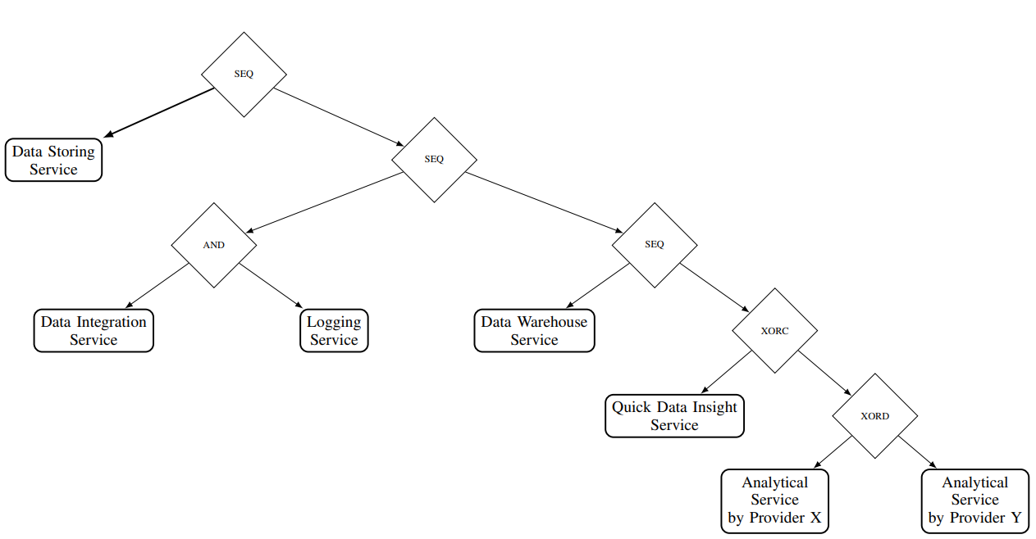
Composition Trees
Used to represent a composed web service.
Comprise of leaf nodes and ‘constructors’.
Leaf nodes are individual services.
Constructors are conditional operators.
Figure - Composition tree for the custom application created by the authors^{[2]}.
Notes:
To understand service compositions, the authors propose a new way to visualize the structure of composite services in the form of composition trees.
These include leaf nodes that denote individual services and inner nodes that act as constructors which provide pathways to more constructors or basic services.
Constructors can be thought of as conditional operators that decide which service to invoke (SEQ, XOR, XORC and XORD) or parallelized execution of two services at once (AND).

Slide 49
Constructors in a Composition Tree
Constructors help in understanding and orchestrating the logical flow of the composed web service.
AND - Parallel execution.
SEQ - Sequential execution.
XOR, XORC, XORD - Choose either of the services.
Figure - Composition tree for the custom application created by the authors^{[2]}.
Notes:
AND - Signifies parallel execution of web services.
SEQ - Signifier sequential execution of web services.
The primary difference between the XORC and the XORD constructors is the presence of choice. For the XORC constructor it is a binary choice between True or False, it evaluates an expression which tells it which path is True and False. The True path is the service that it will eventually choose. For the XORD on the other hand, both paths are valid continuations and it depends on the competence of the controller to choose the path (free choice XOR).

Slide 50
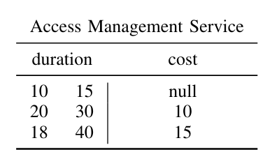
Time Cost Tables
Derived from composition trees in form of a (f, t, c) tuple which represents the duration taken by a service between start f and end t with the associated cost c.
Each leaf node has its own time-cost table.
The time-cost table is in place to simply denote the temporal-monetary relationship for a service.
There is no optimization objective in mind when building a time-cost table.
If the service is used between 10-15 minutes, we don't incur any charges; if we use it between 20-30 minutes we will be charged 10 USD.
Notes:
These time-cost tables along with the constructors provide a way to visualize web-service mashups before a composite services can be created. Hence these allow clients to get the best of both worlds - satisfy functionality while keeping the costs in check.

Slide 51
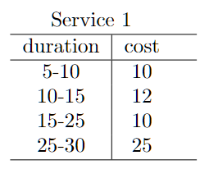
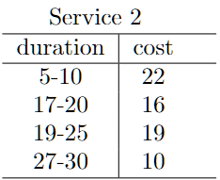
Properties of Time-Cost Tables
Range - The range of a time-cost table T refers to the spread of possible operation completion times. It’s identified by the minimum and maximum durations listed in the table.
Dense Tables - The intervals are continuous and if no intervals are missing. If intervals are missing its a non-dense table.
Functional Tables - Each value in its range is covered at most by one interval and there is no overlap between the intervals.
Directly Proportional - Its cost increases proportionally as the duration increases.
Service 1 Range - [5-30)
The time-cost table is Functional, Dense and Directly Proportional
Service 2 Range - [5-30)
The time-cost table is Non-functional, Non-dense and Indirectly Proportional

Slide 52
Computing Time-Cost Tables
Composition Trees are used to visualise the individual services and their positions help in constructing the time-cost tables.
The Time-Cost tables for each service assume that the tables for its child nodes are available which means that this is a bottom-up approach.
Time-Cost tables are calculated for each node thats a service and the intermediate results might be used to build tables for composite services.
Note - The authors do not provide their code or calculations for the time-cost tables but just a top-level overview using set notation. These next few slides are our understanding and interpretation of the concepts presented using our own examples.

Slide 53
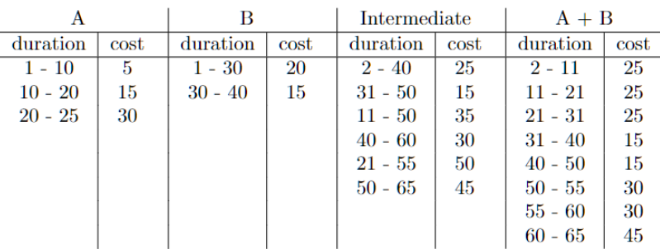
A brief overview of how tables are calculated for constructors.
SEQ - To create the time-cost table of sequencing two operations the authors adding all intervals, creating a dense table and then assigning the lowest correlated cost for that interval.
Figure - Time-Cost table for Sequential execution of Service A and Service B
Notes:
Choice case : Explain 21-31 interval because it has 2 values.

Slide 54
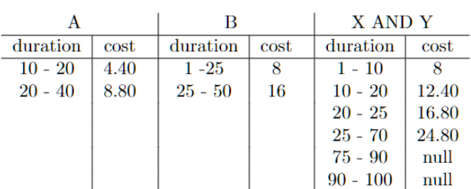
A brief overview of how tables are calculated for constructors.
AND - This constructor assumes that both services are running parallely and hence the intervals are exactly the same for both services. In such a case a simple addition of the costs suffices. In case the intervals are not the same, some idle time is introduced in the tables which is equal to the largest interval value. In the example below, a delay of 50 was added.
Figure - Time-Cost table for Parallel execution of Service A and Service B

Slide 55
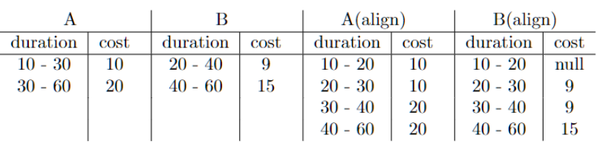
A brief overview of how tables are calculated for constructors.
Alignment operation - This operation allows easier calculations for XOR constructors. This operation expands the tables such that non-overlapping intervals overlap and match. For a set of 2 tables we can have 2 alignments, one each from each table’s perspective.
Figure - Time-Cost table for Alignment of Service A with respect to Service B and vice versa

Slide 56
A brief overview of how tables are calculated for constructors.
XORD Operator - For the Decisional XOR, a service is selected by the controller and the decision is based on which service costs the least. Thus after aligning two tables from our previous example, XORD will choose service B as its cost is less.
XORC Operator - For the Conditional XOR, a service is selected on the basis of fulfillment of a condition, this condition is usually not known until execution and hence by default the selection is done for the worst case, i.e the highest cost, thus service A will be chosen.
Figure - Time-Cost table for Sequential execution of Service A and Service B

Slide 57
Why calculate Time-Costs tables at all?
It would help clients in choosing one service over the other based on their budgets or time constraints.
It can answer questions such as “With a minimum deadline of 10 minutes and maximum deadline of 25 minutes, what is the minimal cost for service invocation within this interval?” - Looking at the table we can say its 10 USD.
Figure - Example of a Time-cost table calculated for a composite service

Slide 58
The Experiment

Slide 59
Experiment Overview
Sample collection
Data preparation & validation
Canonical form transformation
Compatibility analysis
Assumptions -
The authors do not provide code samples or the exact data that they use and hence our implementation represents our understanding of the algorithm.
The experiment is performed on a smaller subset as the larger data set required computing power not at our disposal.
Canonical transformations discussed above are not completely implemented as per the paper, we have taken some liberties in the transformations as the paper only gives a surface level definition of the said transformations without specifying implementation details.

Slide 60
Sample Collection
Data Sources:
APIs.Guru
3,992 API descriptions
Scraped from the internet
67,423 API descriptions
(Both the datasets include Swagger and OpenAPI specifications)

Slide 61
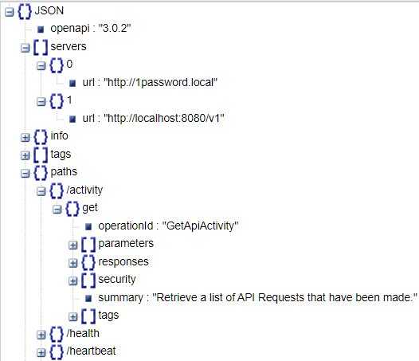
Data Preparation & Validation
Check for GET/ POST parameters
Each API must have at least one endpoint with a description of schemal for consumed (GET) and produced (POST) data.
Validate Endpoints
APIs must have at least three endpoints to avoid biasing the average composability rate.
Requirement for Realistic URL
APIs must have at least one realistic server and base path.
Figure - Example of a “valid” API

Slide 62
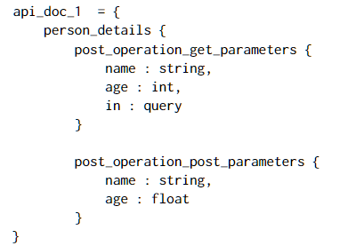
Canonical Form Transformation
Transform Default JSON Schema - Convert all to one uniform representation to make comparison easier.
Ignore Non-Contributing Properties
Ignore the following that do not contribute to the matching process: description, title, default, example, readOnly, writeOnly, example
Extract GET/ POST operations in a standardized format
Store the post and get operations in a uniform format
Store Simplified Forms
Store the simplified GET/ POST forms in respective GET/ POST folders.
Figure - Example of a uniform representation for API with POST method

Slide 63
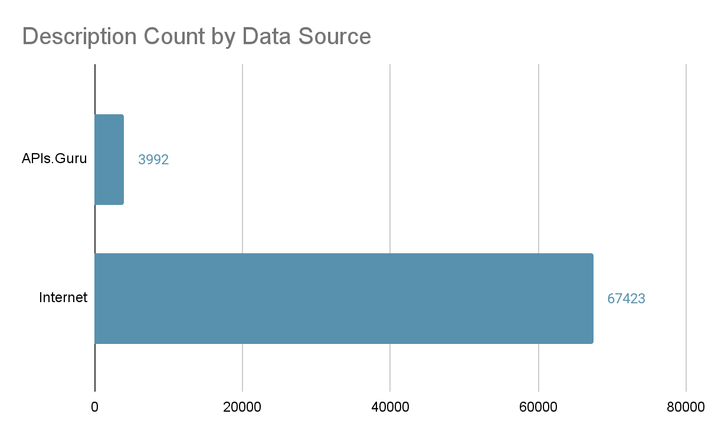

Slide 64
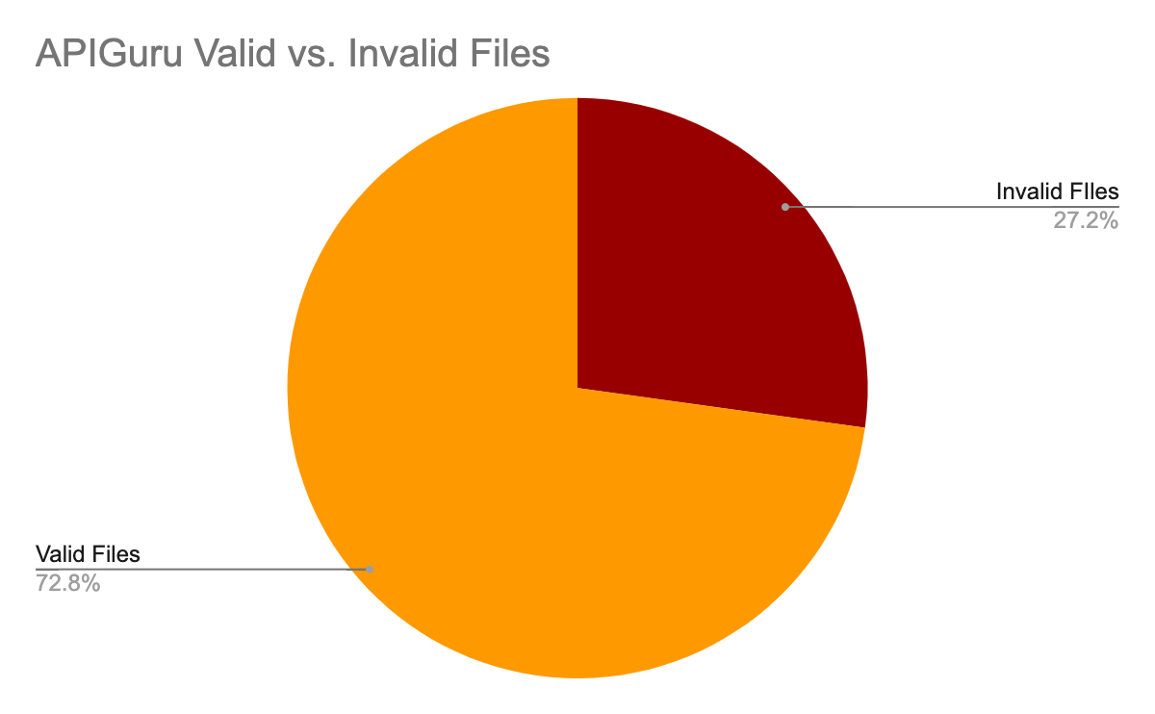

Slide 65
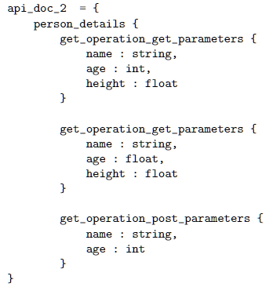
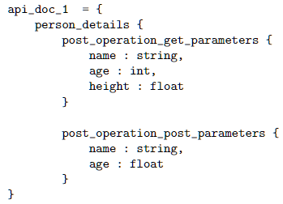
Compatibility Analysis : Data - Type match
For two APIs to have a data-type match, the keys in which they share must have the same type.
Notes:
For example, in the description below, the 1st post operation matches with the 1st and 3rd get operations. It does not match with the 1st get operation because the datatype of age is float. The 2nd post operation has one match, being the 2nd get operation.

Slide 66
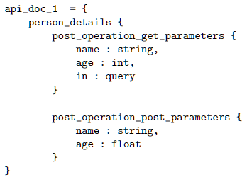
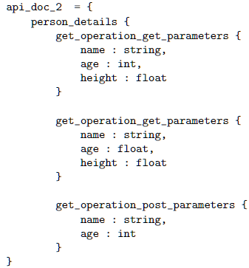
Compatibility Analysis : Property-Name match
For two APIs to have a property-name match, the keys must be exactly the same. Here, we do not consider the values, aka, the data types of the keys.
Notes:
For two APIs to have a property-name match, the keys must be exactly the same. Here, we do not consider the values, aka, the data types of the keys. For example, in the description below, there is only one property-name match being that the 2nd post operation matches the 3rd get operation.

Slide 67
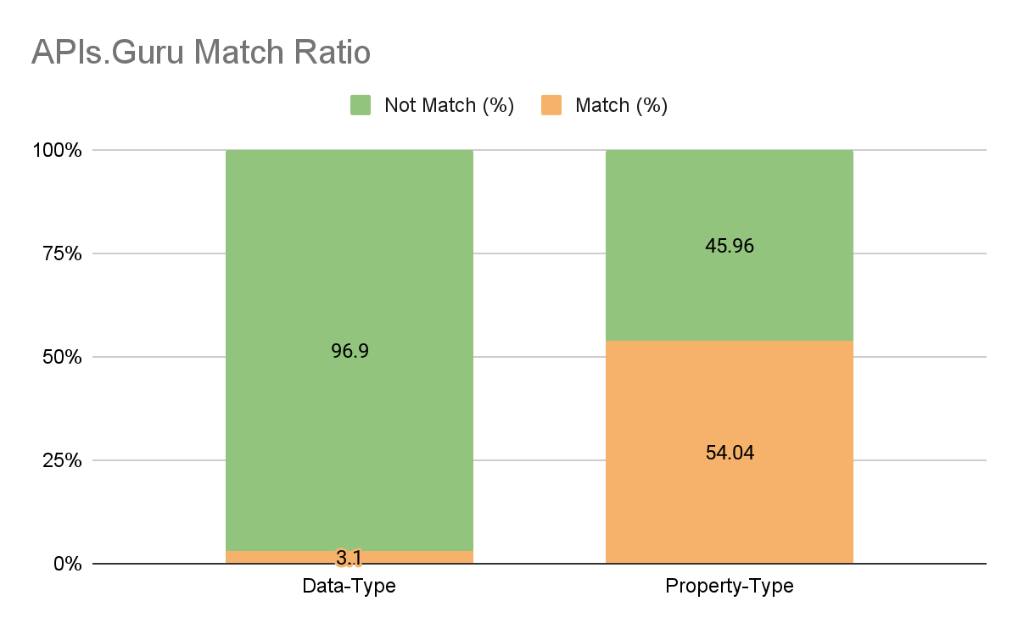
Compatibility Analysis - Results
Notes:
** We can discuss the answers to the questions in the Summary paper

Slide 68
Discussion & Conclusion
Discussion
More data is needed to justify our experimental findings.
The runtime complexity of the matching algorithm can be further optimized.
Canonical form transformation can help streamline the analysis but the authors of the paper are not completely clear on their justifications and process to clean the data.
There exists discrepancy between our result and the paper’s due to the fact that we lack resources such as data and computing power to implement the algorithm on a full scale dataset.
Conclusion
Overview of web service composition and its applications
Review on recent publications in the area of web service composition
Implementation of Paper 1 and initial results
Challenges and design decisions encountered during implementation.

Slide 69
References
[1] Aram AlSedrani and Touir Ameur. 2016. Web Service Composition Processes: A Comparative Study. International Journal on Web Service Computing 7 (03 2016), 1–21. https://doi.org/10.5121/ijwsc.2016.7101
[2] Franziska S. Hollauf, Marco Franceschetti, and Johann Eder. 2021. Towards Representing Time-Cost Tradeoffs for Service Compositions. In 2021 IEEE Inter- national Conference on Services Computing (SCC). 79–88. https://doi.org/10.1109/ SCC53864.2021.00020
[3] Javier Luis Cánovas Izquierdo and Jordi Cabot. 2014. Composing JSON-Based Web APIs. In Web Engineering, Sven Casteleyn, Gustavo Rossi, and Marco Winckler (Eds.). Springer International Publishing, Cham, 390–399.
[4] Sangwon Lee and Kwang-Kyu Seo. 2016. A Hybrid Multi-Criteria Decision- Making Model for a Cloud Service Selection Problem Using BSC, Fuzzy Delphi Method and Fuzzy AHP. Wirel. Pers. Commun. 86, 1 (jan 2016), 57–75. https: //doi.org/10.1007/s11277-015-2976-z
[5] Souhaila Serbout, Fabio Di Lauro, and Cesare Pautasso. 2022. Web APIs Structures and Data Models Analysis. In 2022 IEEE 19th International Conference on Software Architecture Companion (ICSA-C). 84–91. https://doi.org/10.1109/ICSA-C54293. 2022.00059
[6] Souhaila Serbout, Cesare Pautasso, and Uwe Zdun. 2022. How Composable is the Web? An Empirical Study on OpenAPI Data model Compatibility. In 2022 IEEE International Conference on Web Services (ICWS). 415–424. https: //doi.org/10.1109/ICWS55610.2022.00068

Slide 70
References
[7] Shubham Shah. 2021. Contextual content discovery: You’ve forgotten about the API endpoints. https://www.assetnote.io/resources/research/contextual- content-discovery-youve-forgotten-about-the-api-endpoints
[8] Hongbing Wang, Xuan Zhou, Xiang Zhou, Weihong Liu, Wenya Li, and Athman Bouguettaya. 2010. Adaptive Service Composition Based on Reinforcement Learning. Service-Oriented Computing 6470, 92–107. https://doi.org/10.1007/978- 3-642-17358-5_7
[9] Erik Wittern, Alan Cha, James C. Davis, Guillaume Baudart, and Louis Mandel. 2019. An Empirical Study of GraphQL Schemas. arXiv:1907.13012 [cs.SE]
[10] Yuhong Yan, Pascal Poizat, and Ludeng Zhao. 2010. Self-Adaptive Service Composition Through Graphplan Repair. In 2010 IEEE International Conference on Web Services. 624–627. https://doi.org/10.1109/ICWS.2010.91
[11] Firas Zouari, Chirine Ghedira-Guegan, Nadia Kabachi, and Khouloud Boukadi. 2021. Towards an adaptive curation services composition based on machine learning. In 2021 IEEE International Conference on Web Services (ICWS). 73–78. https://doi.org/10.1109/ICWS53863.2021.00022

