Slide 1
MarketCast Lab
Four daily markets · fourteen models · three forecast horizons
How does forecast behavior change across asset class and horizon?
Historical evaluation, not investment advice
MarketCast Lab · Educational analysis · Source: saved Phase 3 runs

Slide 2
Four series, four observation calendars
BTC/USD
Seven-day crypto close
SPY
Adjusted ETF close
EUR/USD
ECB reference fixing
WTI Cushing
EIA spot assessment
Horizon counts future observed sessions. Missing market dates stay missing.
MarketCast Lab · Educational analysis · Source: saved Phase 3 runs

Slide 3
One defensible evaluation contract
Three expanding validation folds per asset
Twenty observations per fold and locked holdout
Same target timestamps across models within an asset
Recursive forecasts at 1, 5 and 20 observed sessions
672 saved metric rows reproduced from fold predictions
MarketCast Lab · Educational analysis · Source: saved Phase 3 runs

Slide 4
Model families and controlled compute
Baselines: last value, drift, seasonal naive
Statistical: exponential smoothing, Holt-Winters, ARIMA, SARIMA
Lag models: Ridge, Lasso, Random Forest, XGBoost
PyTorch sequences: RNN, LSTM, GRU
Small networks and fixed statistical orders bound runtime
MarketCast Lab · Educational analysis · Source: saved Phase 3 runs

Slide 5
Recommendations differ by asset and horizon
Selected on validation mean RMSE and fold variability
Asset | 1 | 5 | 20
crypto:BTC-USD | holt_winters | last_value | xgboost
equity:SPY | last_value | last_value | last_value
forex:EUR-USD | last_value | last_value | last_value
oil:WTI-CUSHING-SPOT | ridge | xgboost | xgboost
Complex models need at least a 5% validation gain on mean and mean plus one standard deviation.
MarketCast Lab · Educational analysis · Source: saved Phase 3 runs

Slide 6
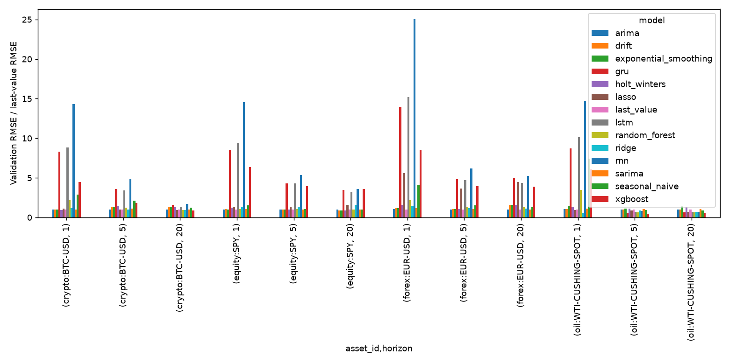
Validation gains can reverse on holdout
Fold spread and final-test results must be read together
BTC and WTI longer-horizon XGBoost selections weakened on the locked holdout.
MarketCast Lab · Educational analysis · Source: saved Phase 3 runs

Slide 7
Failure cases and limits
Three folds and one short holdout leave ranking uncertainty.
Recursive 20-step errors can compound.
ECB fixes and EIA spot assessments differ from exchange closes.
BTC provenance and SPY redistribution remain unresolved.
One FX statistical fit produced a convergence warning.
MarketCast Lab · Educational analysis · Source: saved Phase 3 runs

Slide 8
Reproduce and inspect
python main.py four-markets --config configs/four_asset_full.json
python main.py audit-four-markets
python main.py build-deliverables
The dashboard and report use the same four run IDs in artifacts/phase3/run_index.json.
MarketCast Lab · Educational analysis · Source: saved Phase 3 runs

Slide 9
Conclusion
Select by asset and horizon.
Inspect fold variation before trusting a small gain.
Treat a holdout reversal as evidence of instability.
Historical analysis only. No trading recommendation.
MarketCast Lab · Educational analysis · Source: saved Phase 3 runs

