Slide 1

RESTAURANT ORDER ANALYSIS REPORT (SQL + POWER BI)

Slide 2
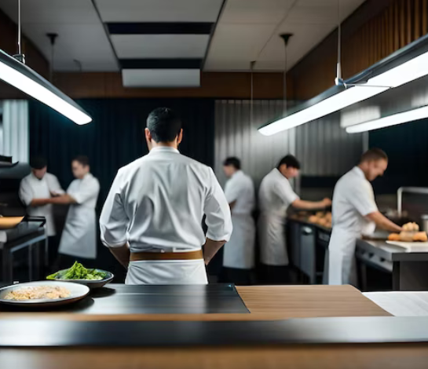
Problem Statement
The restaurant is facing significant challenges in understanding and leveraging customer behavior and sales patterns due to the complexity of data analysis and the need for actionable insights.
The restaurant struggles to optimize its operations, meet sales targets, and enhance overall performance. This hinders its ability to make informed strategic decisions, improve customer satisfaction, and achieve sustainable profitability.

Slide 3
Objectives
Analyze Sales Data: Examine the number of orders, total sales, and sales trends to understand overall performance and identify peak times and seasonal variations.
Identify Item Popularity: Determine the most and least ordered items to optimize the menu and manage inventory more effectively.
Segment Sales Distribution: Assess sales distribution and growth percentages across food categories to identify strengths and opportunities.
Examine Hourly Sales Patterns: Analyze hourly distribution of sales to optimize staffing levels and improve operational efficiency.
Evaluate Performance Metrics: Track key performance indicators (KPIs) such as average order value, average order quantity to measure and enhance performance.
Develop Actionable Insights: Provide data-driven recommendations to improve strategic decision-making, meet sales targets, and enhance customer satisfaction and profitability.

Slide 4
Data Collection And Tools Used
Data Sources:
SQL Database: Collected data from online sources into a SQL database with two tables detailing restaurant orders and sales (including menu items, date and time ordered, order IDs, and food categories).
Data Analysis Tools:
SQL: Used for writing queries to extract and analyze data, identifying insights like total sales, order trends, and item popularity.
Power BI:
Data Export: Transferred data from SQL to Power BI.
Data Exploration and Visualization: Conducted in-depth exploration and created visual representations to aid decision-making and enhance profitability.

Slide 5
Challenges Faced
Database Linking: The tables were not initially linked, requiring the creation of foreign keys to establish relationships between them.
SQL Query for creating foreign key to link the tables
alter table order_details add foreign key (item_id) references menu_items(menu_item_id);
Quantity Calculation: Used count formulas to determine quantities, as tables lacked quantity columns.
Record Mismatch: Eliminated mismatched records with an inner join, ensuring only common data was analyzed.
Power BI Analysis: Created new tables in Power BI for specific results, in addition to measures and columns.

Slide 6


SQL Queries And Exploratory Data Analysis

Slide 7
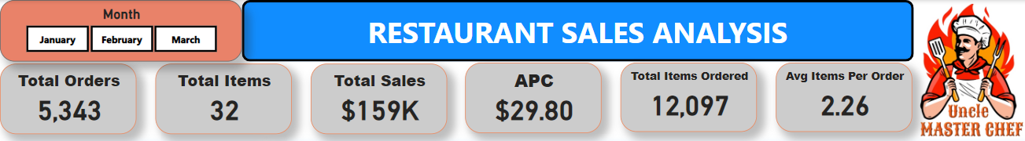
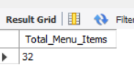



Key Performance Indicators
select count(distinct item_name) as Total_Menu_Items from order_details od inner join menu_items mi on od.item_id = mi.menu_item_id;
SQL View Creation:
Created a SQL view to streamline repeated joins of the two tables, simplifying queries and improving efficiency.
create view joined_data as select order_details.*, menu_items.* from order_details inner join menu_items on order_details.item_id = menu_items.menu_item_id;
select count(distinct order_id) as Total_Orders from joined_data;
select sum(price) as Total_Sales from joined_data;
select sum(price)/count(distinct order_id) as Average_Per_Cheque from joined_data;

Slide 8


Key Performance Indicators
The data reveals that over the course of January to March, the restaurant processed 5,343 orders, generating a total of $159,000 in sales. With 32 distinct menu items, the average customer order (cheque) was approximately $29.80, and on average, customers ordered about 2.26 items per order.
The total number of items ordered was 12,097, showing a healthy demand for the menu offerings. These insights can help the restaurant in inventory management, menu optimization, and enhancing customer satisfaction through targeted marketing strategies.
select count(item_name) as Total_Items_Ordered from joined_data;
select count(item_name)/count(distinct order_id) as Average_Items_Per_Order from joined_data;
Recommendation: Encourage customers to order more items per visit. Implement combo offers or loyalty programs that reward customers for purchasing additional items.

Slide 9
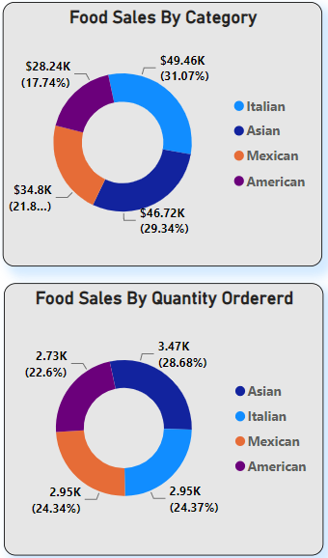
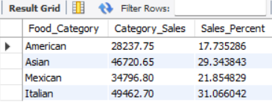
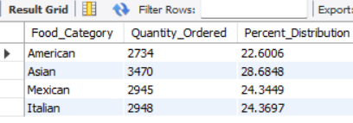
Analysis of Food Sales by Category and Quantity Ordered
select mi.category as Food_Category, sum(mi.price) as Category_Sales, sum(mi.price)/(select sum(mi.price) from order_details od inner join menu_items mi on od.item_id = mi.menu_item_id)*100 as Sales_Percent from order_details od inner join menu_items mi on od.item_id = mi.menu_item_id group by mi.category;
select joined_data.category as Food_Category, count(joined_data.item_name) as Quantity_Ordered, count(joined_data.item_name)/(select count(joined_data.item_name) from joined_data)*100 as Percent_Distribution from joined_data group by joined_data.category;

Slide 10
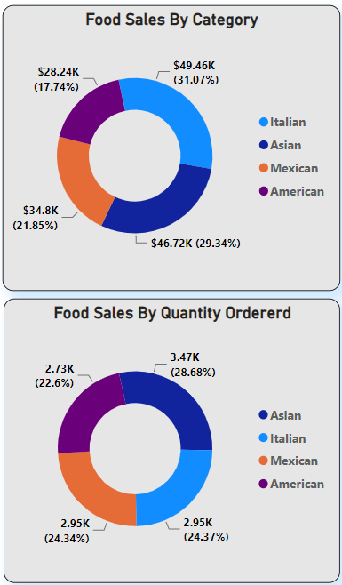
Analysis of Food Sales by Category and Quantity Ordered
The majority of sales revenue comes from Asian and Italian food categories, contributing 31.07% and 29.34% respectively. Mexican and American food categories make up the remaining 39.59%.
In terms of quantity, Asian food leads with 28.68% of total orders, followed by Italian and Mexican at 24.37% and 24.34% respectively. American food accounts for 22.61% of the total orders.
Recommendation:
Boost Underperforming Categories: American Food: As it has the lowest percentage in both revenue and quantity, consider revising the American menu to include more appealing options, or offer promotions to increase interest.

Slide 11
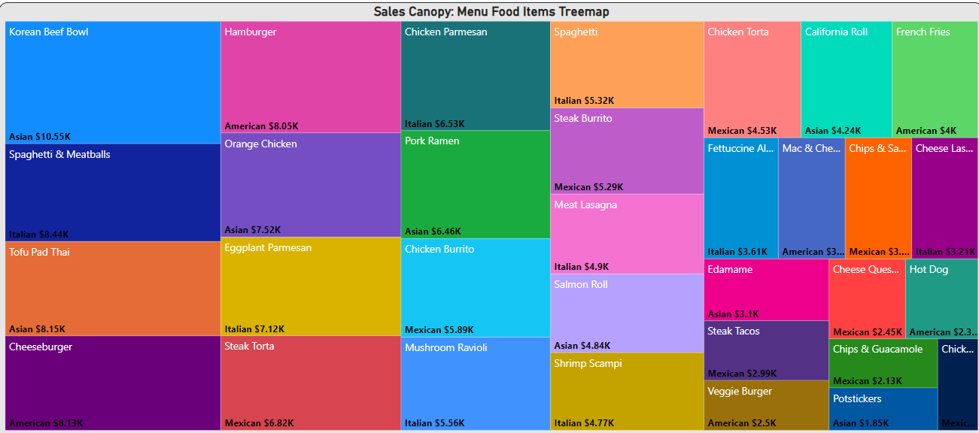
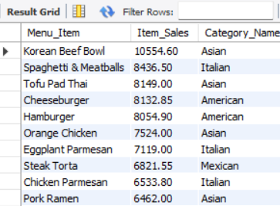
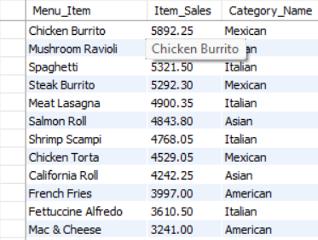
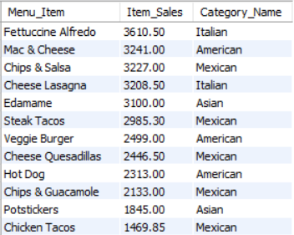
Analysis of Menu Food Items Tree map
SQL Query-
select mi.item_name as Menu_Item, sum(mi.price) as Item_Sales, mi.category as Category_Name from order_details od inner join menu_items mi on od.item_id = mi.menu_item_id group by mi.item_name, mi.category order by sum(mi.price) desc;

Slide 12
Analysis of Menu Food Items Tree map
Top Performers:
Korean Beef Bowl (Asian): $10.55K
Hamburger (American): $8.05K
Spaghetti & Meatballs (Italian): $8.44K
Tofu Pad Thai (Asian): $8.15K
Cheeseburger (American): $8.13K
Mid-Range Performers:
Orange Chicken (Asian): $7.52K
Eggplant Parmesan (Italian): $7.12K
Pork Ramen (Asian): $6.46K
Chicken Burrito (Mexican): $5.89K
Spaghetti (Italian): $5.32K
Lower Performers:
California Roll (Asian): $4.24K
French Fries (American): $4K
Mac & Cheese (American): $3.35K
Edamame (Asian): $3.1K
Veggie Burger (American): $2.5K
Recommendations for Improvement
Focus on Top Performers:
Expand Popular Items: Highlight and promote best-selling items like the Korean Beef Bowl and Spaghetti & Meatballs. Consider introducing variations or complementary dishes to increase sales.
Enhance Mid-Range Items:
Marketing and Promotions: Develop targeted marketing campaigns and promotions for mid-range items like Orange Chicken and Eggplant Parmesan to boost their sales.
Revise or Remove Low Performers:
Menu Optimization: Evaluate the performance of lower-selling items like the California Roll and Veggie Burger. Consider revising recipes, offering limited-time specials to gauge customer interest, or removing them from the menu if they consistently underperform.

Slide 13
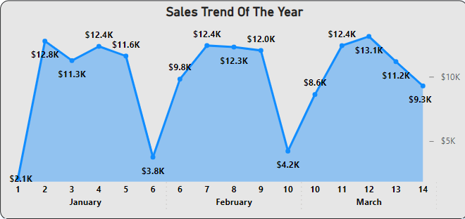
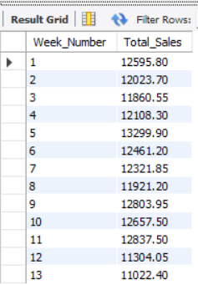
Sales Trend Analysis
This sales growth is characterized by significant fluctuations with peaks at the beginning and middle of each month, followed by dips towards the end.
Possible Reasons for End of Month Dips:
Financial Constraints: Customers might be facing financial constraints towards the end of the month, leading to reduced spending.
Seasonal Variations: Changes in weather, holidays, or local events could impact sales.
Operational Issues: Potential issues like stockouts, staffing problems, or reduced marketing efforts.
Recommendations:
Promotions and Discounts: Offer end-of-month promotions or discounts to incentivize purchases
Customer Engagement: Increase marketing efforts towards the end of the month such as targeted email campaigns or social media ads, to remind customers of special deals
High Sales Weeks: Leverage data from high-sales weeks to understand customer preferences and replicate successful strategies in other weeks.
SQL Query
select week(od.order_date) as Week_Number, sum(mi.price) as Total_Sales from order_details od inner join menu_items mi on od.item_id = mi.menu_item_id group by week(od.order_date);

Slide 14
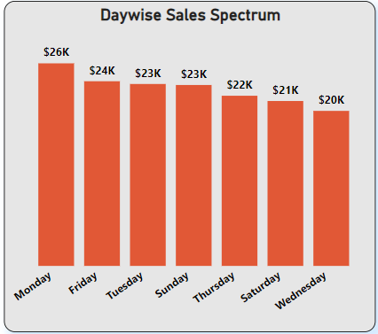
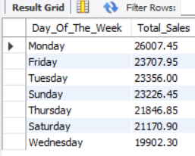
Analysis of Day wise Sales Spectrum
The bar graph illustrates the sales performance across different days of the week over a three-month period
Possible Reasons
High Sales on Monday:
Promotional Activities: Possible promotional offers or discounts on Mondays could drive higher sales.
Lower Sales on Saturday:
Competing Activities: Increased competition from other restaurants or events may divert potential customers.
Recommendations
Enhance Saturday Sales: Weekend Specials: Introduce special weekend promotions, themed nights, or exclusive menu items to attract customers.
Boost Mid-Week Sales: Corporate Partnerships: Partner with local businesses for corporate discounts or office catering options to increase weekday sales.
SQL Query:
select dayname(od.order_date) as Day_Of_The_Week, sum(mi.price) as Total_Sales from order_details od inner join menu_items mi on od.item_id = mi.menu_item_id group by dayname(od.order_date)order by Total_Sales desc;

Slide 15
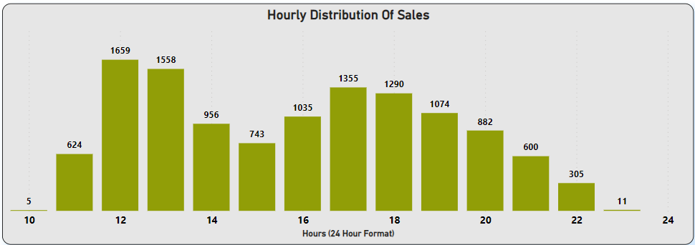
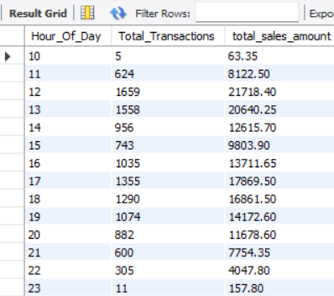
Analysis of Hourly Distribution of Sales
The bar graph illustrates the sales activity across different hours of the day. The X-axis represents the hours in a 24-hour format, and the Y-axis shows the number of sales during each hour. Key observations include
Possible Reasons
High Sales at Noon and 1 PM:
Lunch Rush: High customer turnout during lunch hours as people take breaks from work or daily activities.
Promotions: Potential lunch specials or deals attracting more customers.
2. Evening Sales (5 PM - 8 PM):
Dinner Time: Increase in sales due to dinner reservations and after-work dining.
3. Low Sales Late at Night (9 PM onwards):
Closing Hours: Reduced sales as the restaurant nears closing time.
Customer Habits: Fewer people dine out late at night.
SQL Query
select hour(od.order_time) as Hour_Of_Day, count(*) as Total_Transactions, sum(mi.price) as total_sales_amount from order_details od inner join menu_items mi on od.item_id = mi.menu_item_id group by hour(od.order_time) order by Hour_Of_Day;
Recommendations
Maximize Peak Hours: Efficient Staffing, Special Promotions
Increase Off-Peak Sales: Afternoon Deals, Happy Hour with discounts on drinks and appetizers

Slide 16
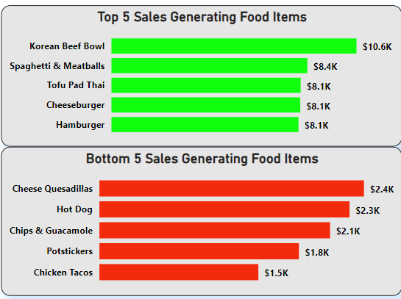
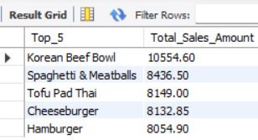
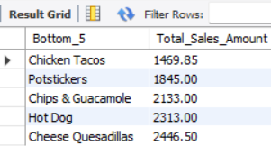
Analysis of Top 5 and Bottom 5 Sales Generating Food Items
SQL Queries
select mi.item_name as Top_5, sum(mi.price) as Total_Sales_Amountfrom order_details od inner join menu_items mi on od.item_id = mi.menu_item_id group by mi.item_name order by Total_Sales_Amount desc limit 5;
select mi.item_name as Bottom_5, sum(mi.price) as Total_Sales_Amount from order_details od inner join menu_items mi on od.item_id = mi.menu_item_id group by mi.item_name order by Total_Sales_Amount asc limit 5;
The horizontal bar charts represent the top 5 and bottom 5 food items based on sales generation. By focusing on maintaining the popularity of high-selling items and improving the appeal of low-selling items, the restaurant can enhance overall sales performance and customer satisfaction.
Recommendations:
Promotional Offers: Feature top selling items in promotions to further boost sales and attract new customers.
Menu Highlight: Make top selling items prominent on the menu and suggest them through servers.
Customer Feedback: Gather feedback to understand why these items are less popular and make necessary adjustments.

Slide 17
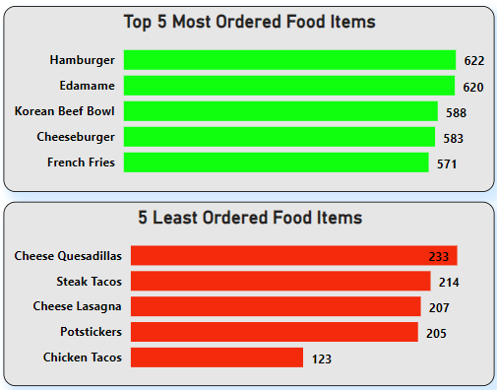
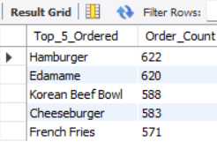
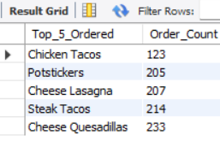
Analysis of Most and Least Ordered Food Items
SQL Queries:
select mi.item_name as Top_5_Ordered, count(od.order_id) as Order_Count from order_details od inner join menu_items mi on od.item_id = mi.menu_item_id group by mi.item_name order by Order_Count desc limit 5;
select mi.item_name as Top_5_Ordered, count(od.order_id) as Order_Count from order_details od inner join menu_items mi on od.item_id = mi.menu_item_id group by mi.item_name order by Order_Count asc limit 5;
The bar charts represent the top 5 most ordered and bottom 5 least ordered food items at the restaurant.
By leveraging the insights gained from analyzing the most and least ordered food items, the restaurant can optimize its menu, improve customer satisfaction, and enhance overall sales performance.

Slide 18
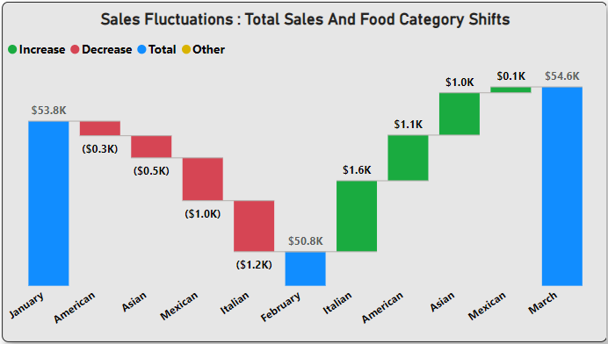
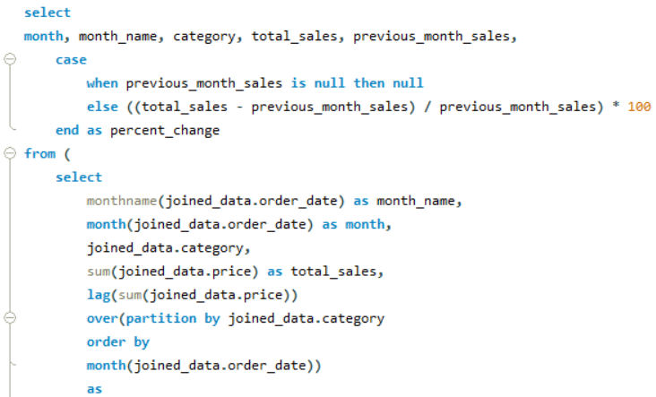
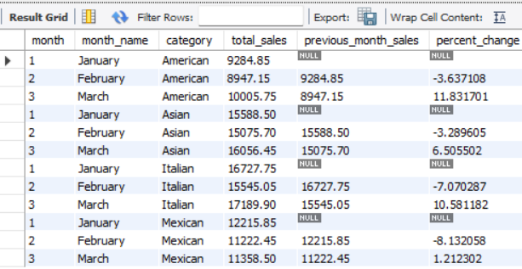
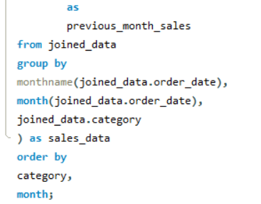
Sales Changes by Food Category: Monthly Waterfall Analysis
SQL Query:

Slide 19
Sales Changes by Food Category: Monthly Waterfall Analysis
The waterfall chart provides a visual representation of the changes in total sales across different food categories from January to March.
Blue Bars: Represent the total sales for each month.
Red Bars: Indicate a decrease in sales for specific food categories compared to the previous month.
Green Bars: Indicate an increase in sales for specific food categories compared to the previous month.
X-Axis: Displays the months and the names of food categories to show total sales and category-specific increases and decreases.
Observations:
January to February:
Overall sales decline across all food categories with Italian food experiencing the most
February to March:
Overall sales increase across all food categories.
Italian food sees the highest increase in sales.
Possible Reasons for Sales Fluctuations:
Fewer Days in February: February has fewer days compared to January and March, naturally leading to fewer sales opportunities.

Slide 20
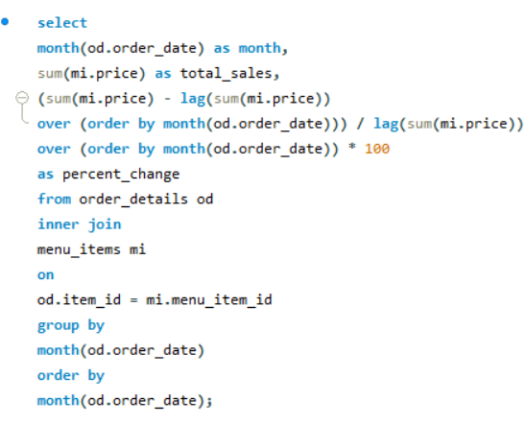
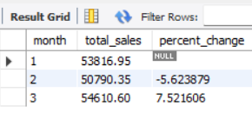
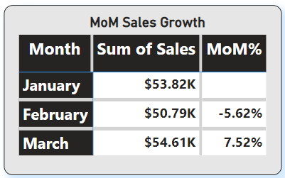
Month-on-Month Sales Percentage Change Analysis
SQL Query:
The table chart provides a clear view of the total sales and percentage change in sales on a month-on-month basis for January, February, and March.
Observations:
January to February: Sales decreased by 5.62%, indicating a decline from $53.82K to $50.79K.
February to March: Sales increased by 7.52%, rising from $50.79K to $54.61K.

Slide 21
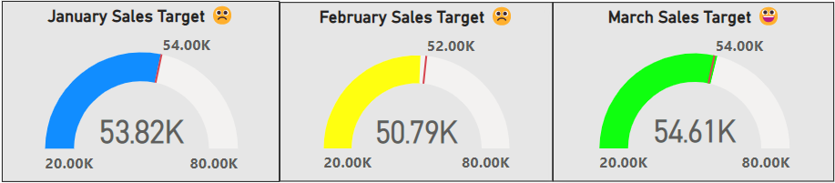
Monthly Sales Target Achievement Analysis Using Gauge Charts
The gauge charts were used to analyze whether the sales targets for January, February, and March were achieved.
Observations:
January: The target was narrowly missed by $180, indicating that the sales performance was very close to the goal.
February: The target was missed by a larger margin of $1,210, suggesting a more significant shortfall in sales.
March: The target was exceeded by $610, showing a successful achievement of the sales goal.
Recommendations:
1. Sales Incentives: Introduce incentives for staff to boost performance
2. Analyse Shortfalls
3. Set Realistic Targets: Regularly review and adjust targets based on performance and market conditions.

Slide 22
Conclusion
This project analyzed restaurant sales data, including order details, trends, and performance metrics, using Power BI for visualization. Key insights and recommendations were drawn to improve performance and customer satisfaction.
The restaurant processed 5,343 orders, generating total sales of $159,000, with an average per cheque (APC) of $29.80. Italian and Asian food were top contributors, while American food had significant revenue despite fewer orders. The most popular items were Korean Beef Bowl, Spaghetti & Meatballs, and Hamburger. Least-performing items, like Chips & Guacamole, suggest the need for reevaluation or promotion.
Sales trends showed end-of-month dips, likely due to lower customer engagement and fewer days in February. Mondays had the highest sales, with peak hours at noon and evening. January and February missed sales targets, while March exceeded them. Sales fell from January to February but rebounded in March, with significant variations in Italian food sales.
Recommendations include increasing promotions during slower periods, targeting less popular items, optimizing the menu, ensuring adequate staffing during peak times, and collecting customer feedback for continuous improvement.
Leveraging these insights and recommendations can enhance operational efficiency, boost sales, and achieve sustainable growth, ensuring the restaurant remains competitive and appealing to customers.

