Slide 1

Team Cult
problems
sources
Solutions and model
services
team
about
Value, Growth and Welfare

Slide 2



1
2
3
sources
Solutipns and model
UNPREPARED CIRCUMSTANCES
UNOPTIMIZED INDUSTRY
problems
services
team
HOTEL BOOKINGS AND GUIDES
about
Climate, topography and circumstances
Not so well optimized tourism industry can be a real bummer.
Difficult to find hotel and guides.

Slide 3

Solutions and model
sources
team
problems
services
about
SINCE 2022
TEAM CULT
A website and an app for the masses who often deal with these problems. We plan to connect all the aspects of tourism through our website and app so that they can easily access all the services which they would otherwise have to struggle for. We hire freelancers to receive and help our customers who are completely unaware or unsure of their surroundings. We aim to provide speedy, reliable and secure services which the mass can trust.

Slide 4
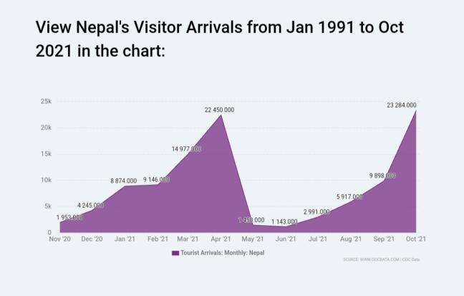
problems
Solutions and model
sources
team
services
about

Slide 5
sources
history
services
team
solutions
about
WEBSITE
APP
OWNED AND PARTNER CHANNELS

Slide 6
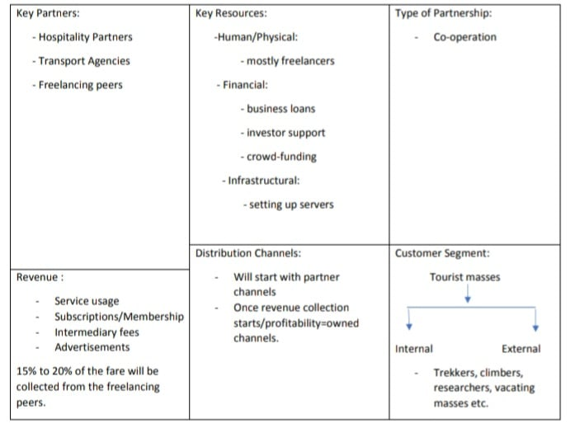
sources
history
services
team
model
about

Slide 7
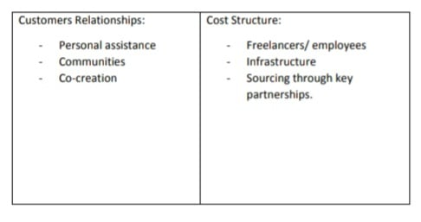
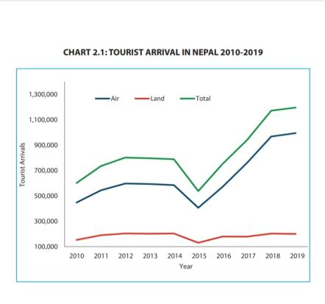
sources
history
services
team
model
about

Slide 8






Mediatory Services
Information
We mediate between our customers and professional service providers.
We provide whatever information our customer finds need of.
Hiring Freelancing Guides
Transportation
history
sources
services
Solutions and model
In a foreign surrounding, if need be freelancing peers can be hired.
We provide transportation services to our customers through existing, partners and freelancing peers.
team
about
Hospitality Services
Communication
We provide good lodging, hospitality, fooding and good privacy to the customers through partner and owned channels.
We help our customers better communicate and adapt to their destination surroundings..

Slide 9
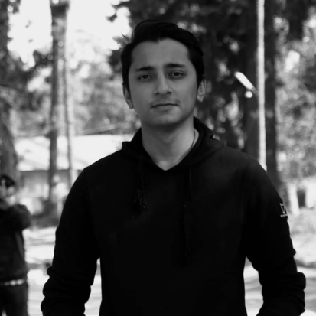
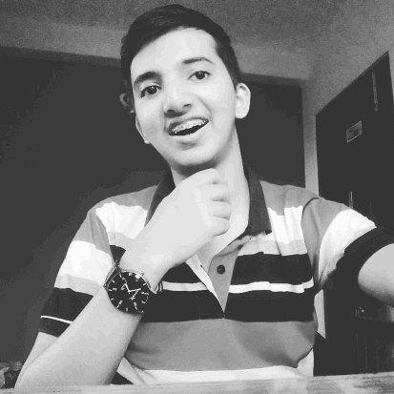
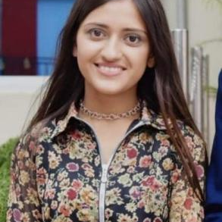
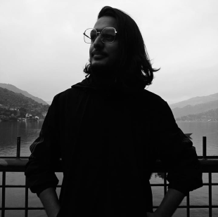
01
02
PRABIN JOSHI
SARTHAK GAUTAM
CEO
PRESENTER
follow
history
services
team
about
03
04
YASMINI GYAWALI
SUDIP TIMALSINA
VICE CEO
MANAGING DIRECTOR

Slide 10



history
sources
Solutions and model
services
team
about
FACEBOOK
GOOGLE
NEPAL TOURISM BOARD

