Slide 1
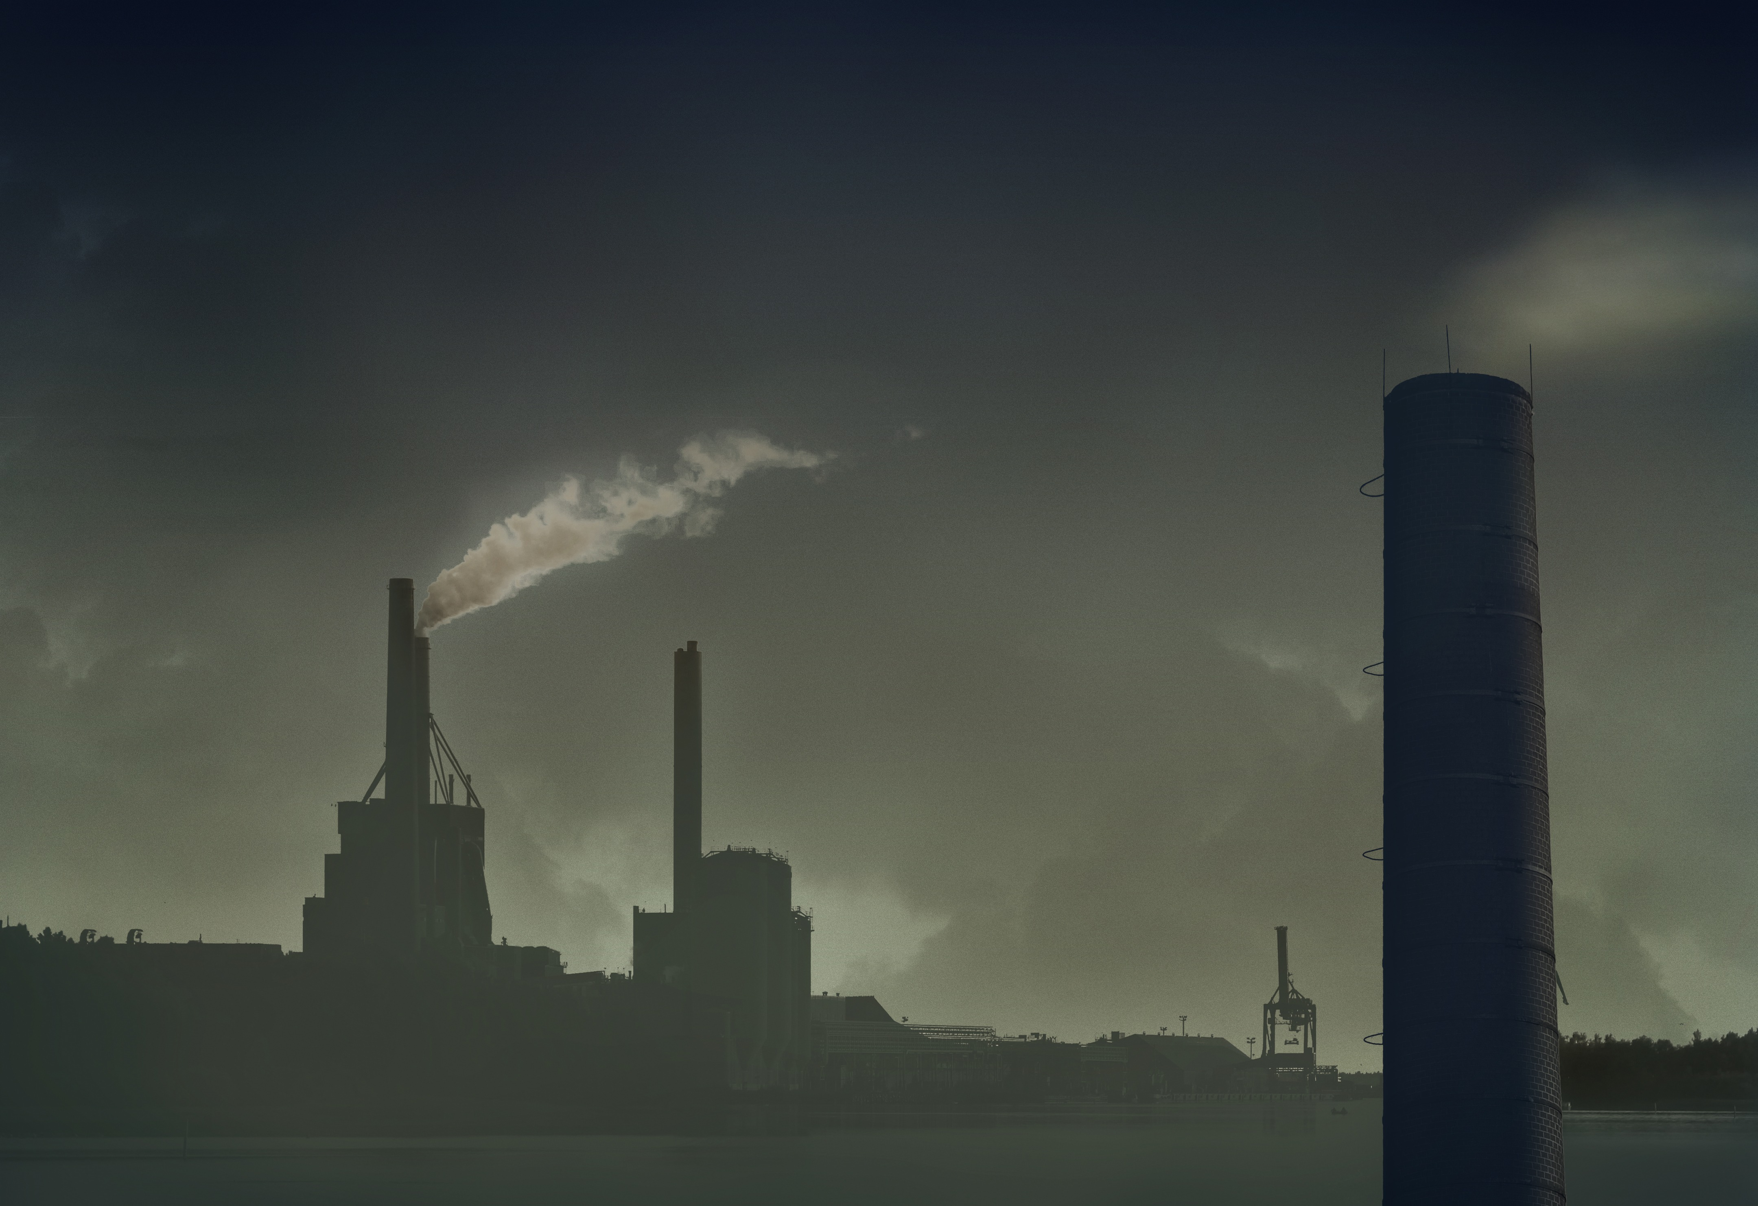
C R I S I S M I T I G A T I O N A N D M A N A G E M E N T : A N E N G I N E E R ‘ S P O I N T O F V I EW

Slide 2
TABLE OF CONTENTS
01
It’s Breathtaking.
02
Problems
03
Solutions
04
Conclusion.

Slide 3
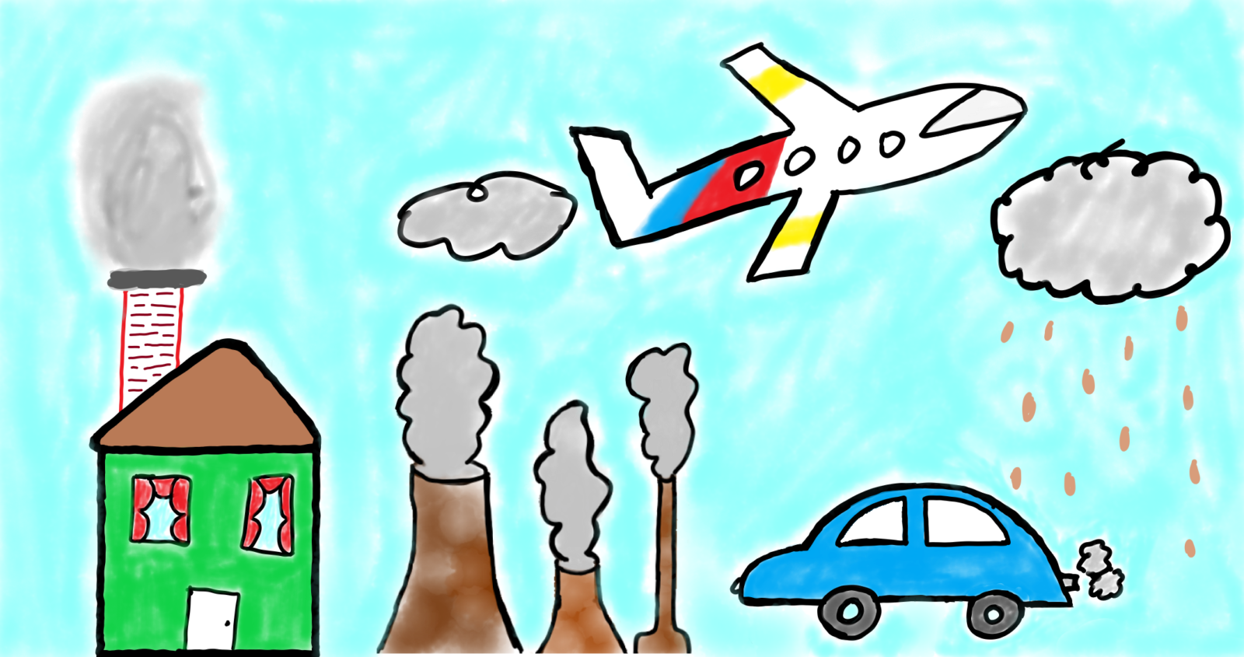
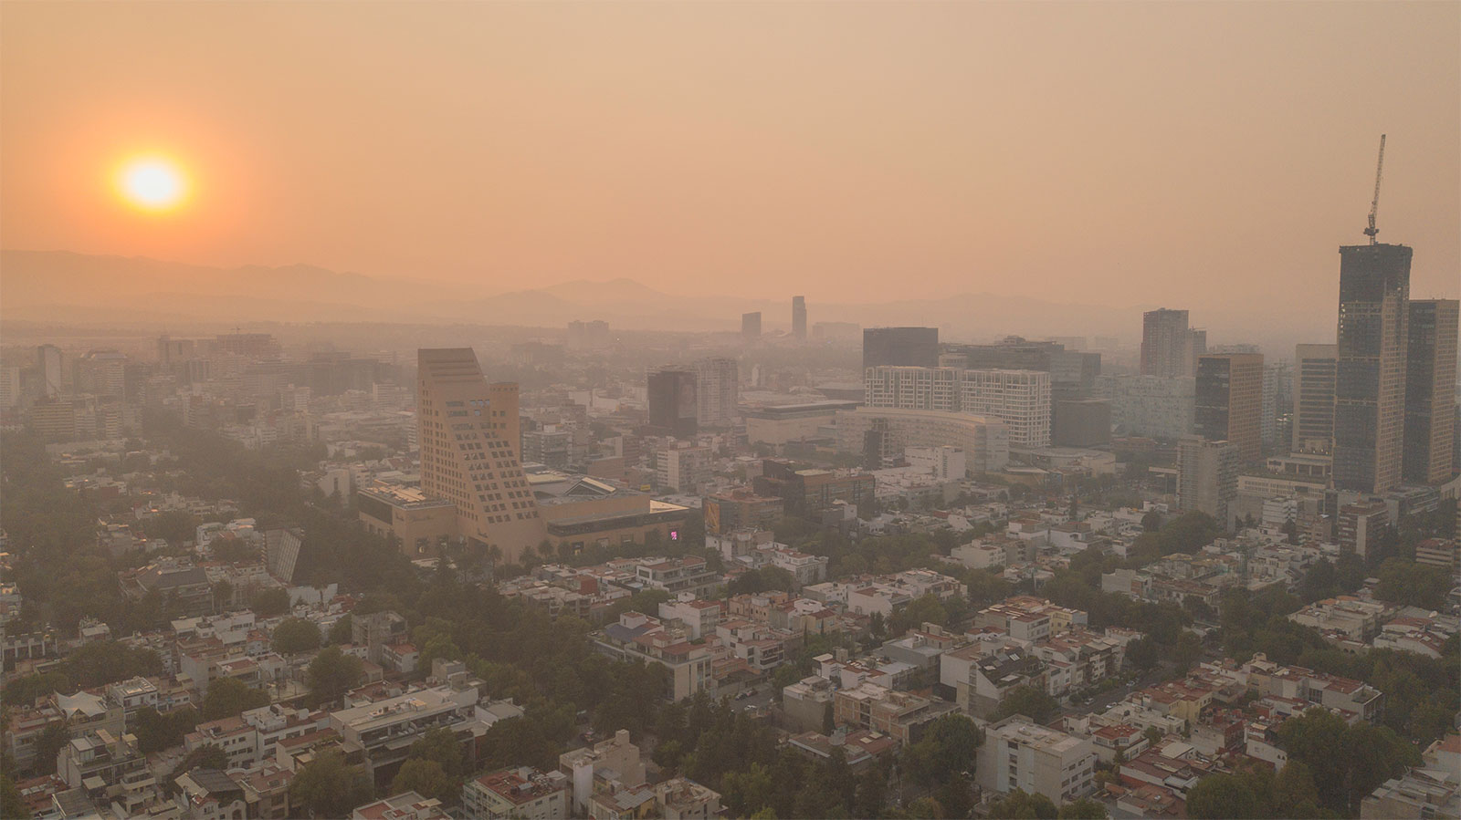
What is air pollution?
-> To put it simply, air pollution is the alteration of the natural properties of air. The air we breathe naturally contains gases like oxygen , nitrogen and carbon dioxide & other gases in small amounts. But recently the addition of various oxides of nitrogen(NOx) , sulfur dioxide(SO2) , formaldehyde etc have made the very air we breathe poisonous.
Today the biggest health hazard in the world is being born with a nose.
BREATHING KILLS!!

Slide 4
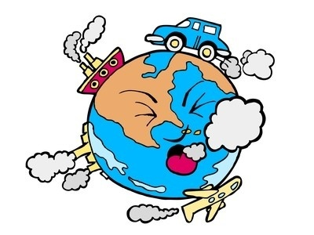
Why is it THE problem?
-> We drink 2 to 3 ltrs of water every and we breathe nearly 7 to 8 ltrs of air every minute, just to provide context. And every bit of air we breathe consists of these all kinds of nasty gases like NOx, CO2, formaldehyde etc. that cause various respiratory diseases throughout the world , cause strokes and various cardiovascular diseases.
To summarize, if you breathe you die. If you don’t you die.

Slide 5
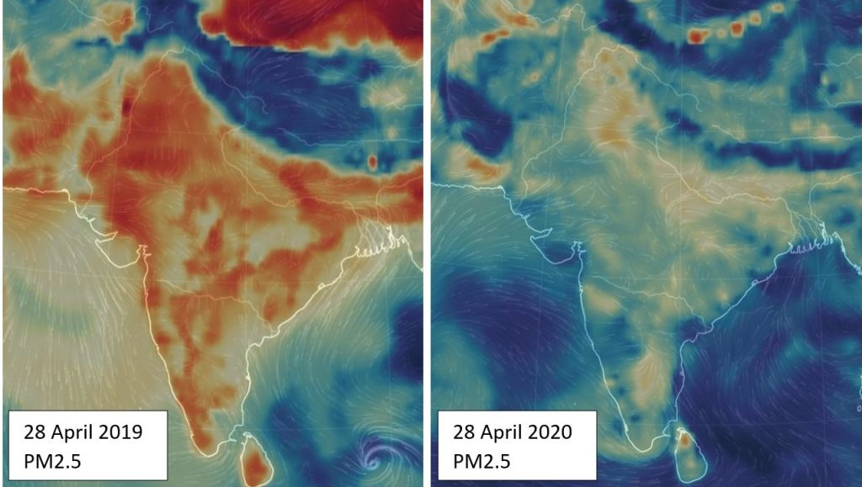
Who’s to blame?
-> Pollution is caused by both natural and man made aspects. But the obvious culprits to the rapid increase in pollution in recent times are human activities. Most of the human processes that we do every day involves burning stuff. We burn coal for energy and it is the main contributor to air pollution. Other activities like transportation also contribute majorly to air pollution.
The above picture is a clear indication. It shows the pollution before lockdown and after lockdown in the sub-Indian continent. The sudden halt in human activities shows sudden and rapid improvement in the air quality.
Still there’s a cloud of pollution over Asia visible from outer space.

Slide 6
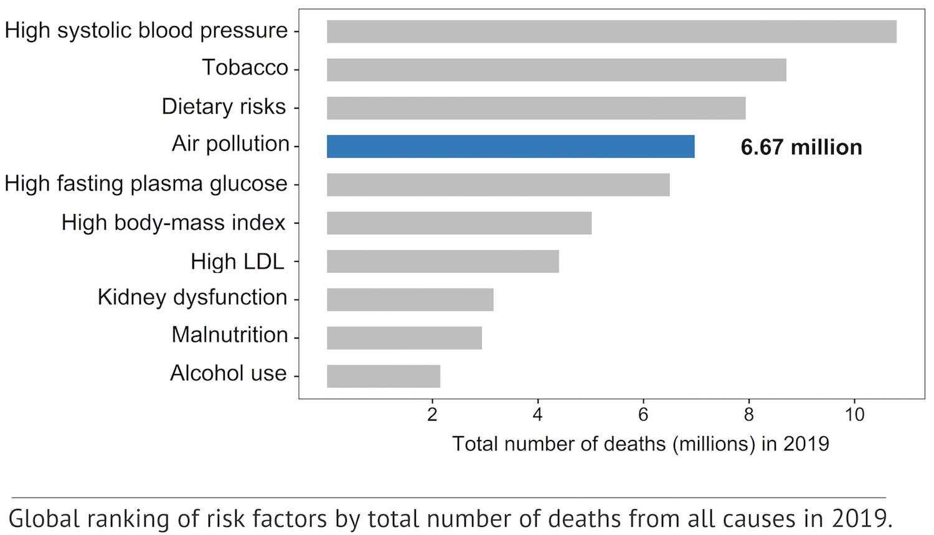
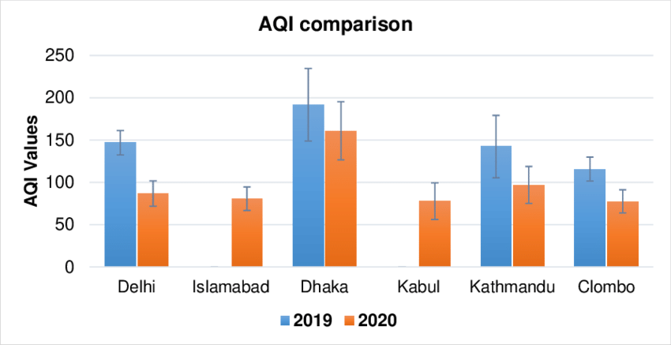
A major study conducted by air labs in 2019 shows that more than 6.5 million people die annually due to problems caused by air pollution. The number of deaths is higher than the number of deaths caused by aids and a few varieties of cancer combined. In two years , the number of deaths is now obviously higher.
The second chart shows the pollution levels of different capitals of some south Asian countries. And Kathmandu is definitely among the ones having the highest pollution levels only behind Dhaka and Dehli.

